Slide 1
24th November 2022
90 mn to Close the Loop :
O-I and touristic zone

Slide 2
Quality
A challenge on quality ?
In general :
No challenge regarding quality collection except those one who are connected to quantities : crushed cullet
- A potential risk on color variation for the glassmaker in winter :
Summer → Rosé Wine consumption → More Flint
More qty in summer → consumption of the summer cullet is in winter when color distribution is different : coordination with Batch and furnace manager

Slide 3
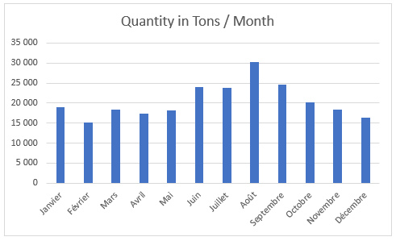
Quantity
This is the challenge! Quantity multiplied by two during summer in south-east region

Slide 4
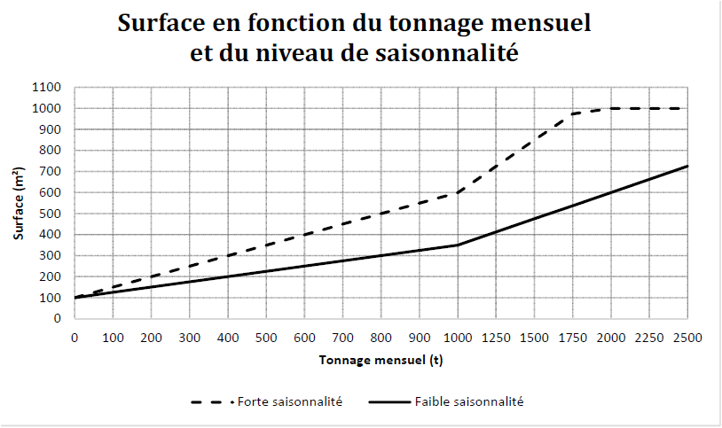
Actions put in place with actors
With Municipalities
Recommendation on the size of the platforms in the contract with the communities depending on seasonality.
Validation process for each new platform
With Carriers
Empowerment of the carriers: 1 carrier/platform
Long-term contracts (3 years) with carriers to take into account seasonal peaks
In difficult situation : Setting up of a 2nd carrier if agreed and coordination with platform by OI
In crisis situation : Payment of trucks in “shuttle” (empty return): we trust the carrier.
When he said to us that he put X trucks in shuttle, we grant him an over cost (increase of approx. 40% to 60% of the going price ; depending on distance)
Minimum dimension of a platform
Depending on monthly collection

