Slide 1
HERRCO
GLASS RECYCLING

Slide 2
Glass quantity
Put on market quantity (Only affiliated member companies - FRC 2022): 74.000 tn
Glass recycling quantity (FRC 2022): 30.400 tn
Goal Achieved: 41%
Glass recycling Target: 60%

Slide 3
Streams glass collection
Blue Bell
Blue Bin
HORECA
Separate glass collection
23.000 Businesses
10.500 blue bells
3 sorting plants in 3 cities:
Athens, Larisa, Thessaloniki
60% from the total
recycling quantity
Households
Household commingled collection
160.000 bins
32 sorting centers all over the country
40% from the total
recycling quantity

Slide 4
Blue bell vs Blue bin
% Recycling quantity
Blue Bell | 60%
Blue Bin | 40%

Slide 5
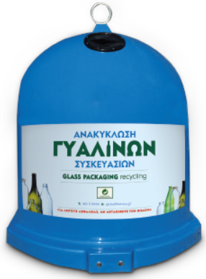
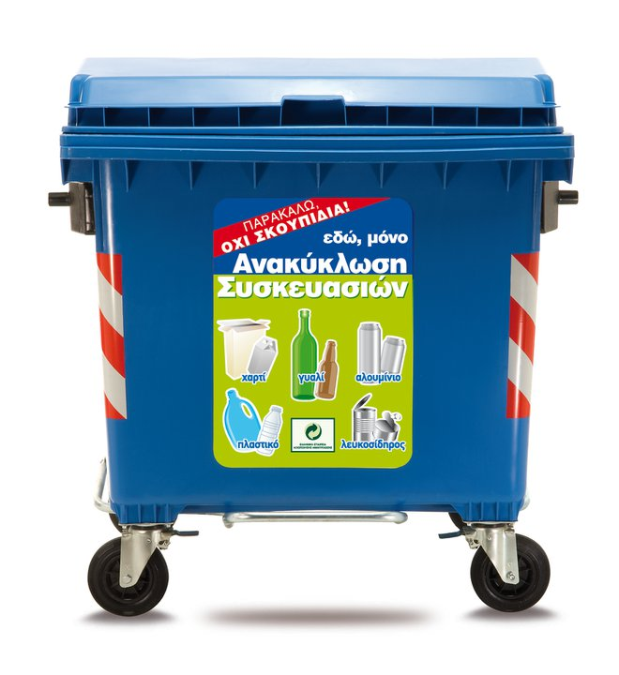
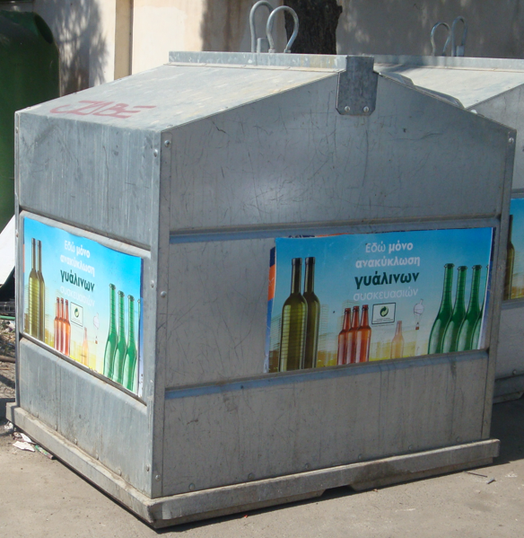
Equipment
HORECA
Blue Plastic bell 1,3 m3
Blue Plastic bell 2,5 m3
HOUSEHOLD
Blue Plastic bin 1.100 lt
Metallic bell 2,5 m3

Slide 6
Extra Equipment for HORECA (Internal use only)
Blue bin wheeled 120lt
Glass recycling bags 60lt

Slide 7
Goal Achievement

Slide 8
Glass recycling - Peak Season

Slide 9
Touristic destinations
13.000 businesses (57% of the total amount)
6.000 Βlue bells (57% of the total amount)
Business categories:
15% Ηotels
20% Restaurants
65% Café-bar, Clubs

Slide 10
Glass recycling - Touristic destinations

Slide 11
Difficulties in achieving goals
Absence of legal obligation for involvement.
The overcrowding in many islands make it difficult for the employees to separate glass
The lack of free spaces forces the local authorities to place bells only in central parts consequently the employees have trouble with the distance.
Except for hotels(organized businesses), bars-restaurants-clubs are not so environmentally friendly.
Door to door collection is a very expensive project for 6 months in places with too many people.
There is no glass market. The collected glass is transferred for sorting for zero income and after sorting the price sold is minimum. HERRCO covers the total collection expenses.

Slide 12
DRS
The new law is going to be implemented in July 2023.
We estimate that 40% of the affiliated quantities of glass will be responsibility of the new DRS system.
We anticipate the new set up of the market (put on the market, % of the participation on DRS, possible changes in packaging in order to reduce cost ect).

Slide 13
HERRCO

