Slide 1

STRATEGY FOR THE PRESENT AND FUTURE OF CIRCULAR HORECA IN SPAIN
WITH THE SUPPORT OF

Slide 2


01.
A land of bars
In Spain, there are…
311,990
^{over} 200,000
HORECA ESTABLISHMENTS
SINGLE-USE GLASS PACKAGING GENERATORS
Quite important cultural element
HORECA holds strategic weight in tourism and the Spanish economy
JOB GENERATION
CONTRIBUTION TO GDP
TURNOVER
2021
1^{.5}
4^{.4%}
87.816
MILLION EMPLOYED WORKERS
BILLION EUROS
2
SOURCE: Annual Report on HORECA in Spain 2022 (Anuario de Hostelería de España 2022).

Slide 3

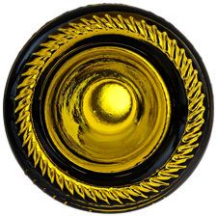

02.
Responsible HORECA, a key lever
THE HOSPITALITY INDUSTRY
HORECA
ESTABLISHMENTS
66^{.2%}
1
GENERATES ALMOST
ESTABLISHMENT
SEPARATE AND RECYCLE
GENERATES ON AVERAGE
50%
23
PIECES OF GLASS PACKAGING A DAY
The HORECA sector is key
for a real transition towards a circular economy and fairer and more sustainable development
2^{.82}
OF THE WASTE FROM SINGLE-USE GLASS PACKAGING on the market.
TONNES A YEAR
3

Slide 4
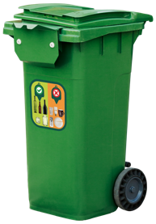
03.
Historic commitment to a
sustainable HORECA
INVESTMENT
UP TO 2022
2017
2018
2019
2020*
2021*
2022
18,014,157
20,031,381
21,971,249
12,894,155
17,048,799
23,340,741
*Consequence of closures and restrictions affecting the HORECA industry.
WE HAVE
IMPACTED
300
141,464
ON AVERAGE EVERY DAY
70%
EQUIVALENT TO
BARS RECEIVE
AN IMPACT
ESTABLISHMENTS
IN THE COUNTRY
RECYCLING
OUT OF EVERY 2
ESTABLISHMENTS
OF ESTABLISHMENTS IN THE LAST 5 YEARS
1
EVERY DAY
WE ANSWER
WE HAVE
OVER
25
&
30
80
QUERIES BY
HAS AN
ECOVIDRIO RESOURCE to assist in selective separation
related to separation at source
PEOPLE ON THE GROUND dedicated to informing, performing studies and providing training
4

Slide 5
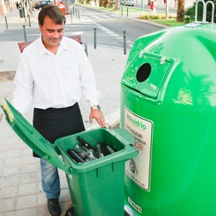
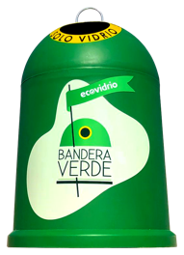
03.
Historic commitment to a
sustainable HORECA
SPECIAL INFRASTRUCTURES
DOOR-TO-DOOR SYSTEMS
54
⁺50,000
⁺156,000
ADAPTED CONTAINERS
ADAPTED BINS
CITIES
MOBILISATION AND AWARENESS-RAISING CAMPAIGNS
high HORECA concentration and areas with access difficulties
5

Slide 6
04.
Strategy for the present and future of circular HORECA in Spain
OBJECTIVES FOR
2023-2025
GOAL
2025
76%
RECYCLING ESTABLISHMENTS
EVOLUTION OF RECYCLING ESTABLISHMENTS
Ecovidrio's integrated programme targeting the HORECA industry, which aims to increase the percentage of glass recycling establishments in this channel
2024
2022
2023
75^{.2%}
66^{.2%}
72^{.5%}
1,389,000
FROM THE HORECA CHANNEL FORECAST FOR
2023-2025
SELECTIVE WASTE COLLECTION
6
TONNES OF WASTE FROM SINGLE-USE GLASS PACKAGING

Slide 7





04.
Strategy for the present and future of circular HORECA in Spain
ENVIRONMENTAL IMPACT
2023-2025
ENVIRONMENTAL BENEFITS
AVOID EXTRACTION OF
SAVINGS IN CONSUMPTION OF
1,666,800
992,023
AVOID EMISSION OF
805,620
TONNES OF RAW MATERIALS
MEGAWATT-HOURS OF ENERGY
TONNES OF CO₂ INTO THE ATMOSPHERE
7

Slide 8


04.
Strategy for the present and future of circular HORECA in Spain
INVESTMENT
2023-2025
2023
26,601,853
MILLION EUROS
⁺80
2024
26,640,714
MILLION EUROS
MILLION EUROS
2025
27,448,764
MILLION EUROS
8

Slide 9
04.
Strategy for the present and future of circular HORECA in Spain
STRATEGIC PLANS
ECOVARES PLAN
IMPACT
61%
01.
Increased reach and penetration
To reach 10,200 premises in municipalities with less than 12,500 inhabitants and 117,746 premises in municipalities with more than 12,500 inhabitants.
EXISTING
PREMISES
IMPACTED
117,746
ESTABLISHMENTS
INCREASE
10,200
THOSE JOINING
^{by}15%
RECYCLING
ESTABLISHMENTS
MUNICIPALITIES WITH MORE THAN 12,500 INHABITANTS
ESTABLISHMENTS MUNICIPALITIES WITH LESS THAN 12,500 INHABITANTS
ESTABLISHMENTS
9

Slide 10
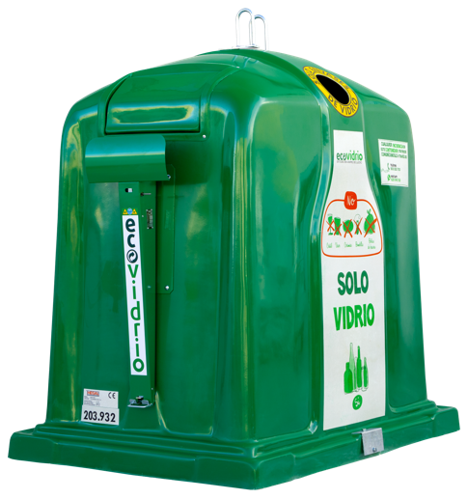
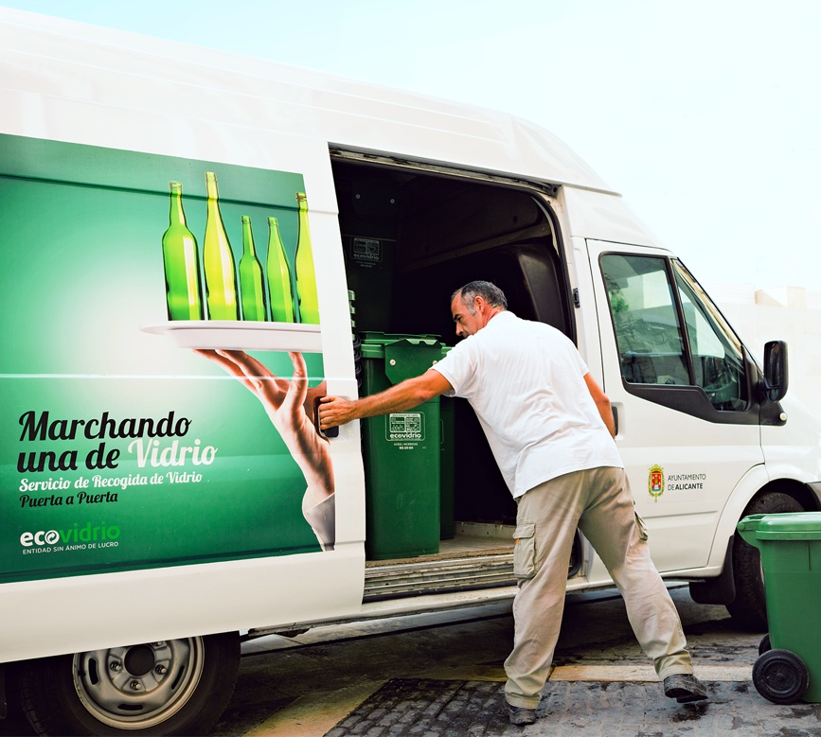
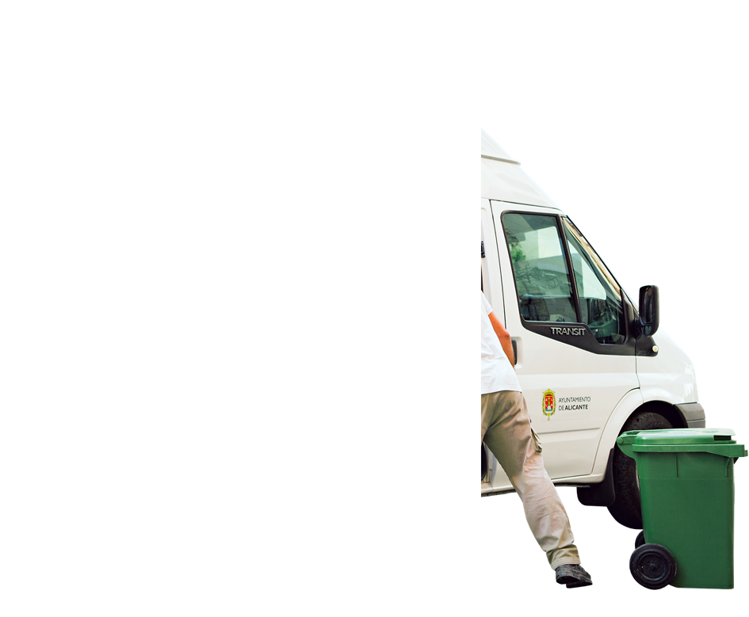
04.
Strategy for the present and future of circular HORECA in Spain
STRATEGIC PLANS
2023-2025
INCREASE
^{of}19%
54
IN ADAPTED CONTAINERS
CITIES HAVE DOOR-TO-DOOR SYSTEMS
10,000
NEW
ADAPTED CONTAINERS FOR HORECA
10

Slide 11
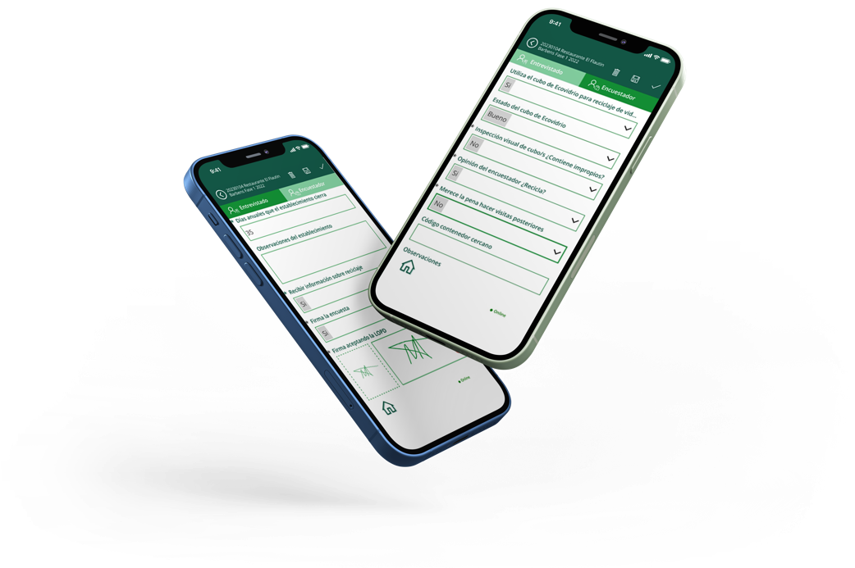
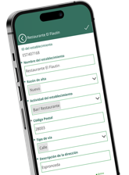
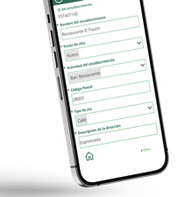
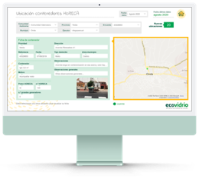
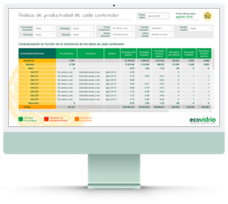
04.
Strategy for the present and future of circular HORECA in Spain
STRATEGIC PLANS
ECOVARES PLAN
02.
Data analysis techniques and digitisation
To improve efficiency and optimise Ecovidrio's management.
We perform a daily data intake through:
THIS ALLOWS
US TO
Expand data on collection times and days according to needs.
Respond faster to detected problems.
Improve traceability in the collection data.
Analyse the quality of the service offered.
ECOVARES APP
PROBLEMS REPORTED
MARKET DATA MANAGEMENT SOFTWARE
DATA FROM DAILY COLLECTION
11

Slide 12
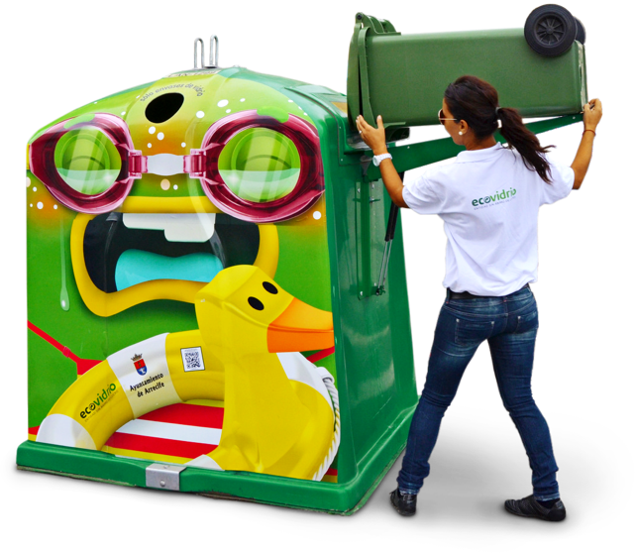
04.
Strategy for the present and future of circular HORECA in Spain
STRATEGIC PLANS
ECOVARES PLAN
03.
Alliances with major stakeholders
Due to volume of waste generation and influence such as hotel chains, restaurant groups and their franchises.
12

Slide 13
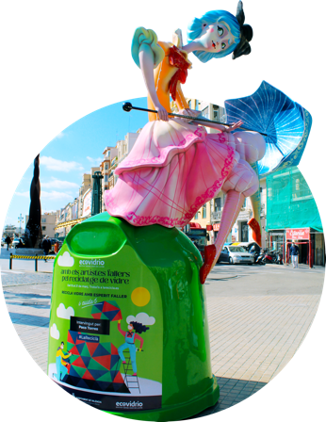
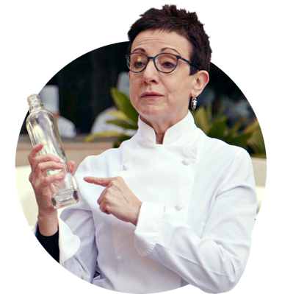
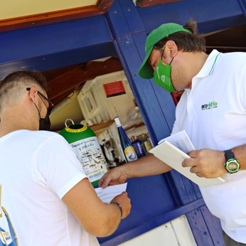
04.
Strategy for the present and future
circular HORECA in Spain
STRATEGIC PLANS
ECOVARES PLAN
04.
Environmental information and training
Waste management and environmental sustainability campaigns to mobilise and engage HORECA professionals.
Visits.
Guidance services.
Seasonal awareness-raising campaigns.
Network of ambassadors.
Environmental training through different channels.
13

Slide 14

THANK YOU

