Slide 1
Close the Glass Loop
Ambition and perspective

Slide 2
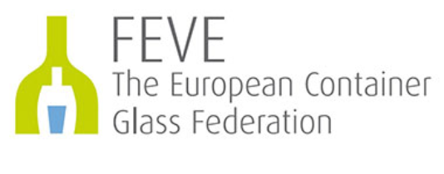
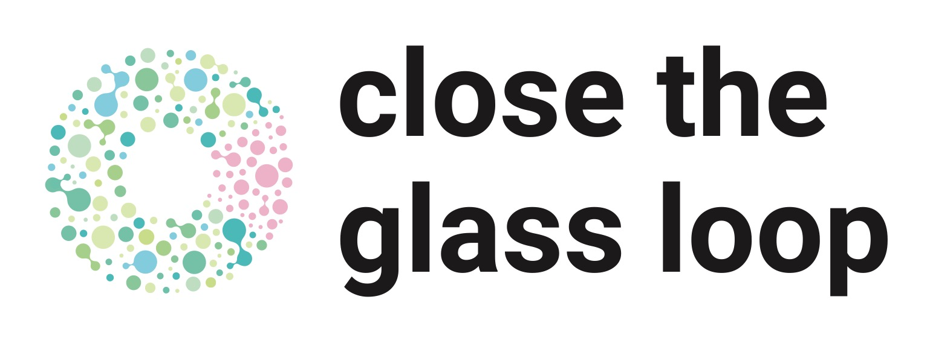
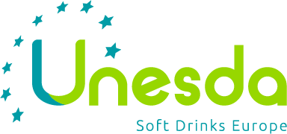
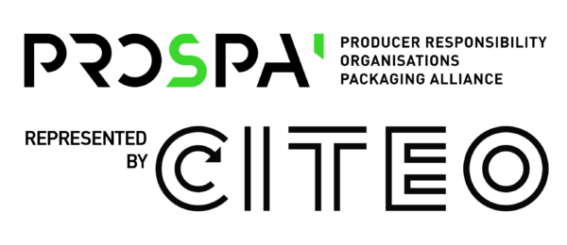
A strong European partnership

Slide 3
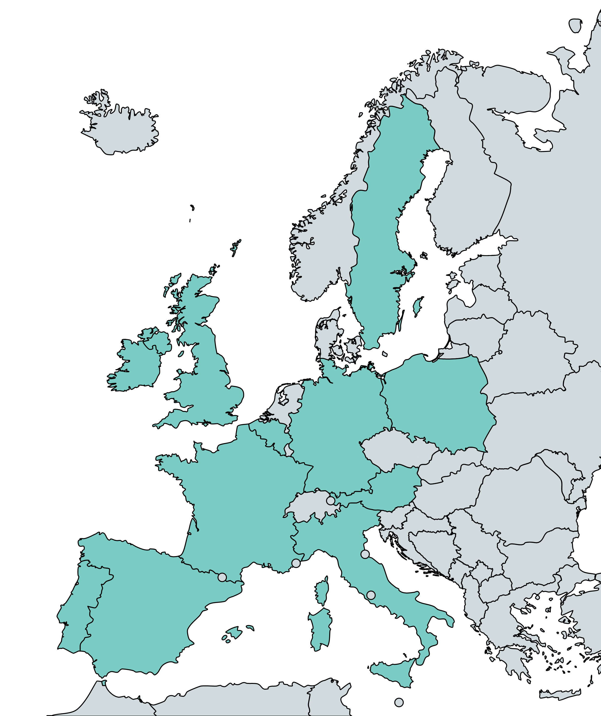
A partnership of National platforms

Slide 4
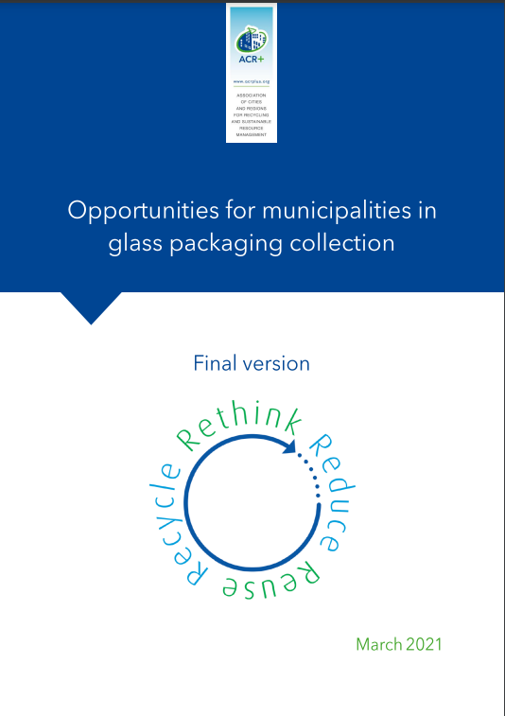
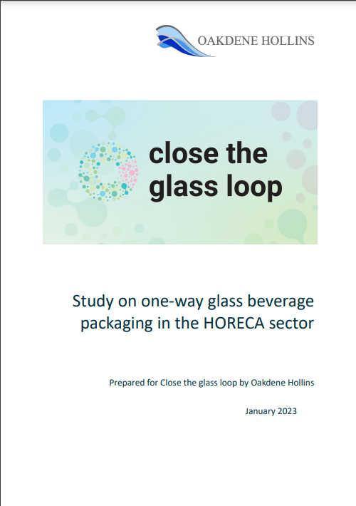
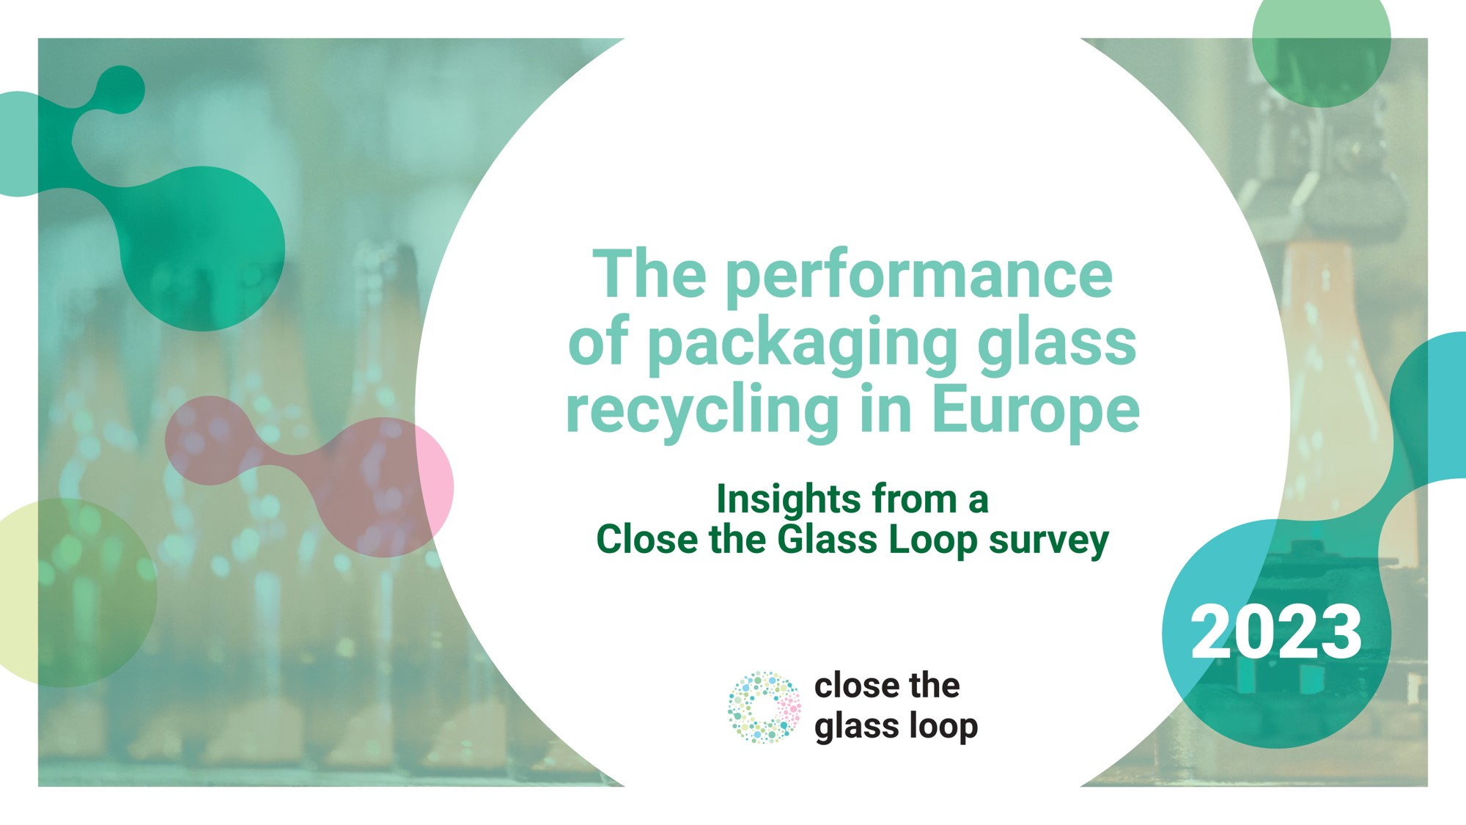
Close the Glass Loop: a knowledge center
New!
New!

Slide 5
Notes:
First time that there is such a study on glass collection in the HORECA sector
Lucky to have HOTREC as a partner

Slide 6
Notes:
Products in glass bottles and jars are usually consumed and discarded in two major points of consumption: households and hotels, cafés and restaurants (HORECA).
The collection of empty one-way glass containers is therefore heavily reliant on municipal waste infrastructure and on disposal from HORECA operators.
Because Hotels, Cafés and Restaurants are important markets for glass-packed products, a key challenge to meeting the Close the Glass Loop target is to increase the glass collection rate in the HORECA channel.
This channel is renowned for being fragmented with limited data readily available.
Therefore, the purpose of this study was to gain a greater understanding of glass use in the HORECA channel to:
Identify the potential for closing the glass loop within the HORECA channel
Enable informed decisions to be made on how best to increase glass collection for recycling rates in this channel.

Slide 8
Notes:
The study was carried out by Oakdene Hollins and is based on an analysis of two GlobalData datasets:
Placing on the Market (POM) of one-way glass-packed beverages in 2019 in the EU27 + UK.
By ‘beverages’, we mean four product categories – non-alcoholic beverages, mineral water, beer & cider, wines and spirits – which we assumed represent the vast majority of products consumed in the HORECA channel (we could also find sauces, olive oil, jam, etc.)
Number of HORECA establishments by country and by type of establishment. We found out that there are 2 million establishments that fall under 3 main categories: pubs, clubs and bars (56%), restaurants (25%) and accommodation (19%)
Overall finding #1: In unit terms, we found out that 1 in every 10 glass bottle for beverages placed on the EU 27 + UK market is a one-way glass bottle consumed in the HORECA channel.

Slide 9
Notes:
In terms of tonnage, this means that one-way glass-packed beverages in the HORECA channel amount to 3 million tonnes or 17% of the 17.5 million tonnes of glass packaging placed on the EU 27+UK market.
The study looked at 3 ways of characterising glass packaging waste in the HORECA channel:
In absolute tonnage
In kg per capita
In tonnes per HORECA outlets
The study provide country-specific data

Slide 10
Notes:
For instance if we look at the absolute tonnage generated in the HORECA channel, 6 countries stand out: UK, Italy, Spain, France, Germany and Portugal.
They individually produce more than 100,000 tonnes per year and represent more than three quarters of the total one-way HORECA tonnage.

Slide 14
Notes:
Moving forward, Close the Glass Loop will work on Crossing the 3 dimensions we looked at, we can identify 3 levels of priorities:
Tier 1 countries (above thresholds for the 3 dimensions): the UK, Spain and Portugal
Tier 2 countries (above thresholds for 2 dimensions): Italy, Latvia, France
Tier 3 countries (above thresholds for 1 dimension): Germany, Romania, Greece, Austria, and Czech Republic
The study helps us identify the ‘significant few’ countries we need to focus us to close the loop in the HORECA channel and contribute to our overall 90% collection for recycling rate and we will be working on a HORECA Roadmap

Slide 15
Notes:
Interviews with national experts give us some insights on the main barriers to increase collection & recycling of glass in the HORECA channel:
Data quality: it is a challenge to disaggregate the performance of the HORECA and household channels, in terms of collection for recycling, and therefore to tailor solutions to the individual needs of HORECA operators.
Poor quality glass: high levels of ceramic, stone and porcelain (CSP) contamination. FERVER (the European Federation of Glass recyclers) suggests that contamination levels can be as high as 12kg/tonne of glass in the HORECA channel.
Collection methods and logistics: many countries cited the lack of tailor-made collection methods as a major barrier. It is commonplace for the same collection systems, using the same vehicles or bring banks, to be used to collect both household and HORECA waste. Since the quantity of glass from households is much higher, the collection systems are typically tailored to this channel.
I invite you to have a look at the study, which is a first attempt for Close the Glass Loop at identifying how to best close the loop in the HORECA channel.

Slide 17
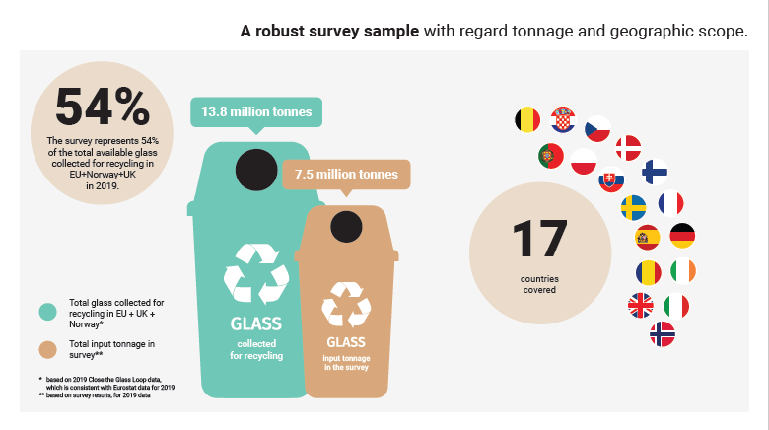
Notes:
Throughout December 2021 to October 2022, Close the Glass Loop conducted an online survey to get insights on the recycling of glass and evaluate the performance of glass packaging recycling in Europe.
The survey compiles data received from glass recycling facilities. It is a robust sample:
17 countries covered
The survey represent 54% of the amount of glass collected for recycling in 2019 in the EU+Norway+the UK

Slide 18
Notes:
Municipal waste - National municipal waste collectors 77%
Municipal waste - Material Recovery Facilities (or pre-sorting plants) 9%
Municipal waste - Imported material from municipal waste collectors 6%
Post-consumer non-municipal waste – Direct acquisition from consumers 3%
Post-consumer non-municipal waste – End of life refillable glass 2%
Pre-consumer – Direct acquisition from bottlers 2%
Post-consumer non-municipal waste – One-way glass from Deposit Refund Systems 1%
Pre-consumer – Direct acquisition from the glass container industry (e.g. bottle breakage) <1%
Post-consumer non-municipal waste – Direct acquisition from HORECA (Hotels, Cafés, Restaurants) <1%

Slide 20
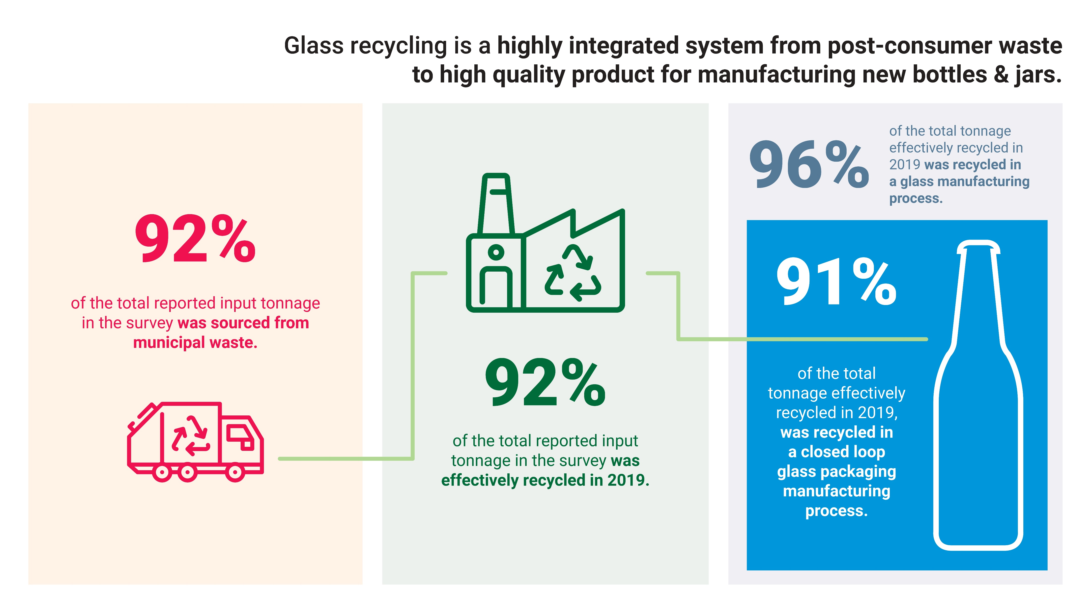
Notes:
It is the first time that Close the Glass Loop carried out this exercise and the conclusions of the study are quite striking:
From input of the glass recycling facilities to output, the glass collection & recycling value chain has a high degree of traceability
Glass packaging collection is heavily reliant on municipal waste infrastructure: 92% of the waste materials entering Glass Recycling Facilities are from municipal waste sources. This reflects the fact that products packed in glass are typically consumed in households or in similar settings (i.e. HORECA).
Glass packaging is highly recycled: 92% of the input tonnage was recycled in 2019
Closed loop recycling of glass packaging is a reality: as much as 91% of the recycled tonnage was recycled back into glass bottles & jars
We would like this survey to become an annual exercise that will support the publication of the glass collection for recycling statistics. We will aim to improve the scope and representativeness of the survey year on year, to give insights on the work of the glass collection & recycling value chain.
Thanks to FEVE and FERVER members who contributed to the survey

Slide 21
Notes:
To explore the role of municipalities in closing the glass loop, we regularly release episodes of our glass and the city dialogues
Düsseldorf: focus on the city's underground glass containers
Sicily: a local glass recycling ecosystem on an island
Vienna: R&D projects to make use of glass after incineration
Algarve: the specificities of glass collection in a tourist area

Slide 22
Lots of materials are available on the Close the Glass Loop website
Visit us!
www.closetheglassloop.eu

Slide 23
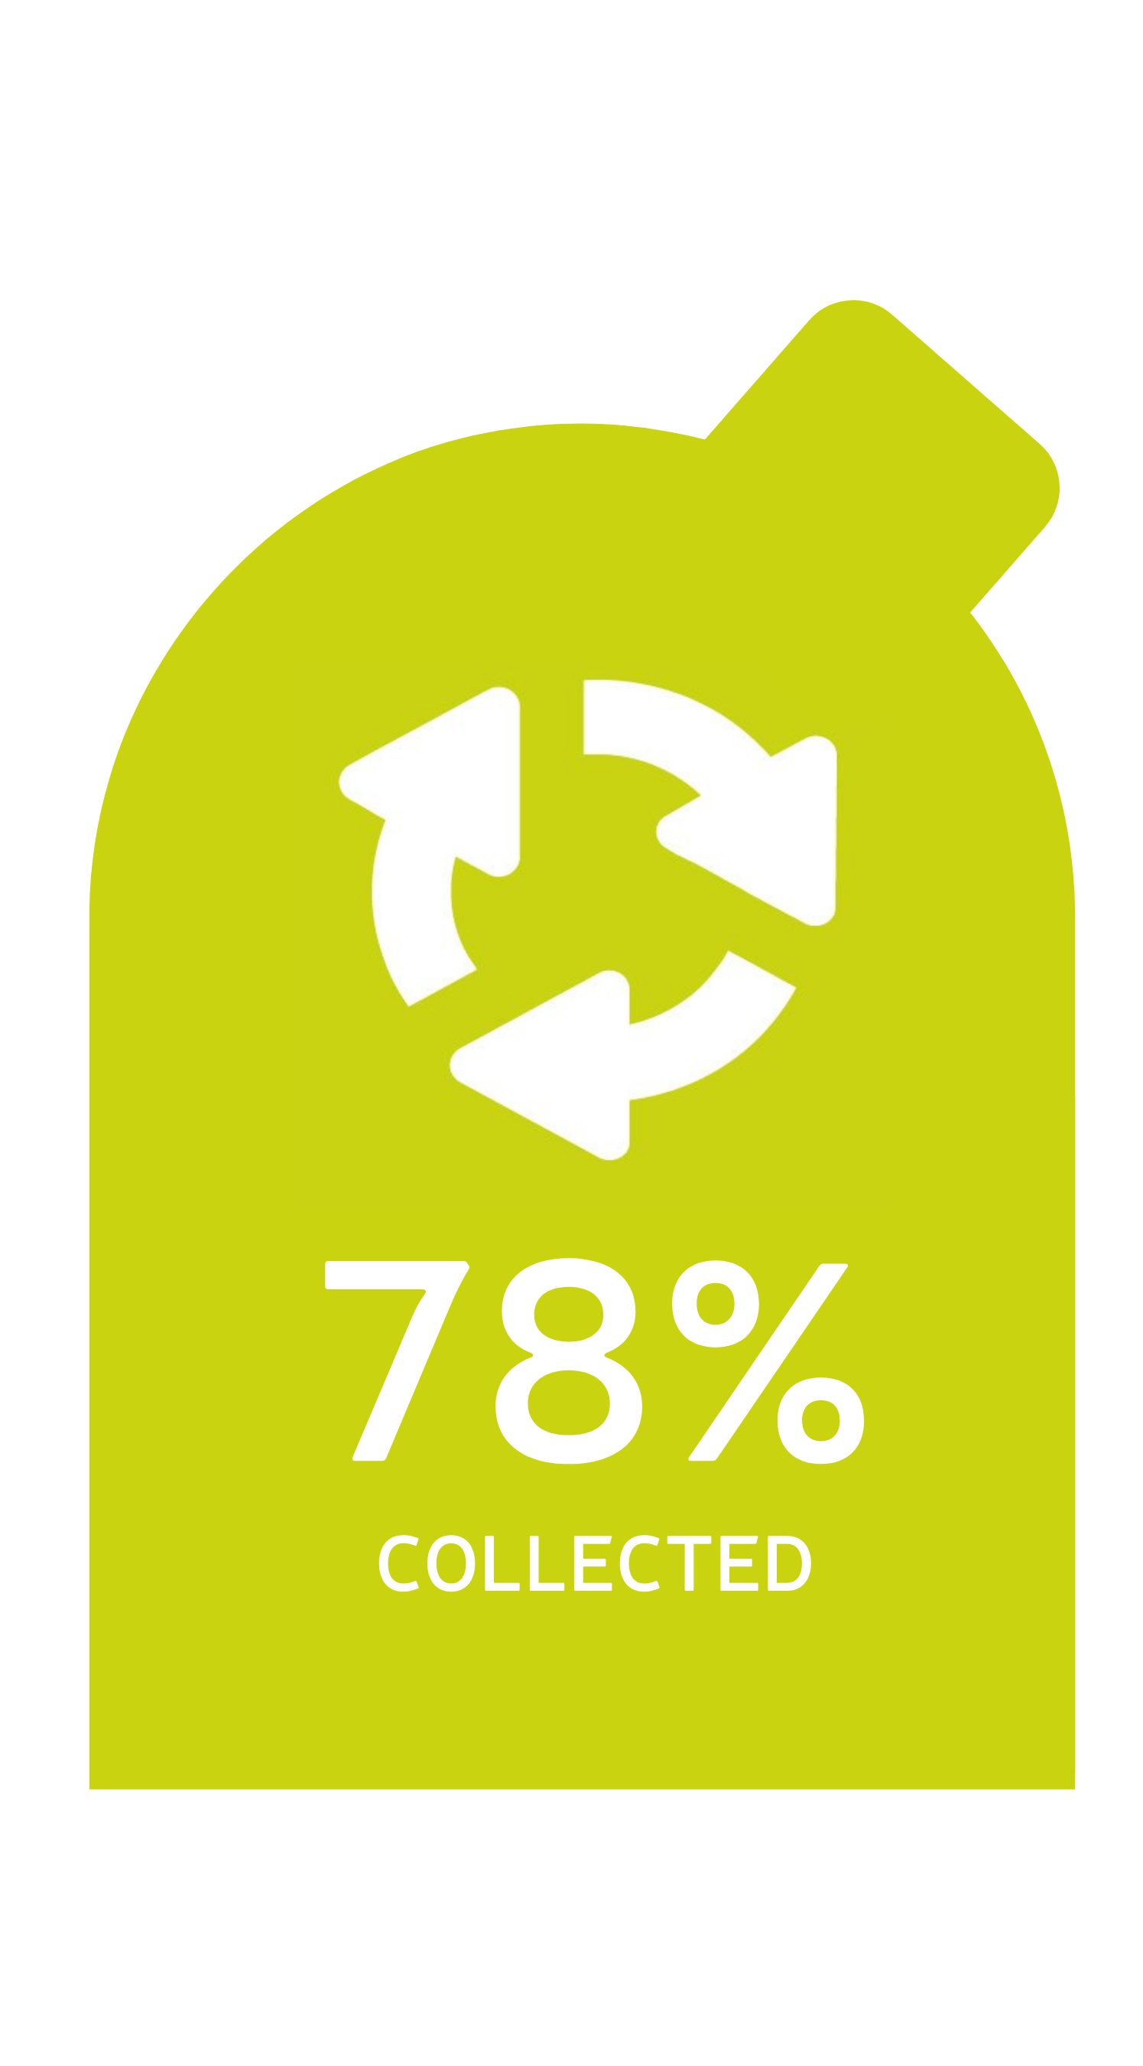
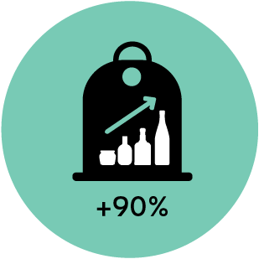
Latest glass collection for recycling statistics revealed…
?
2021
2030
Notes:
In the past months, Close the Glass Loop has gathered the latest collection for recycling rates in European countries (reference year 2020).
Burning question: are we on track to reach our 90% collection for recycling rate by 2030?

Slide 24
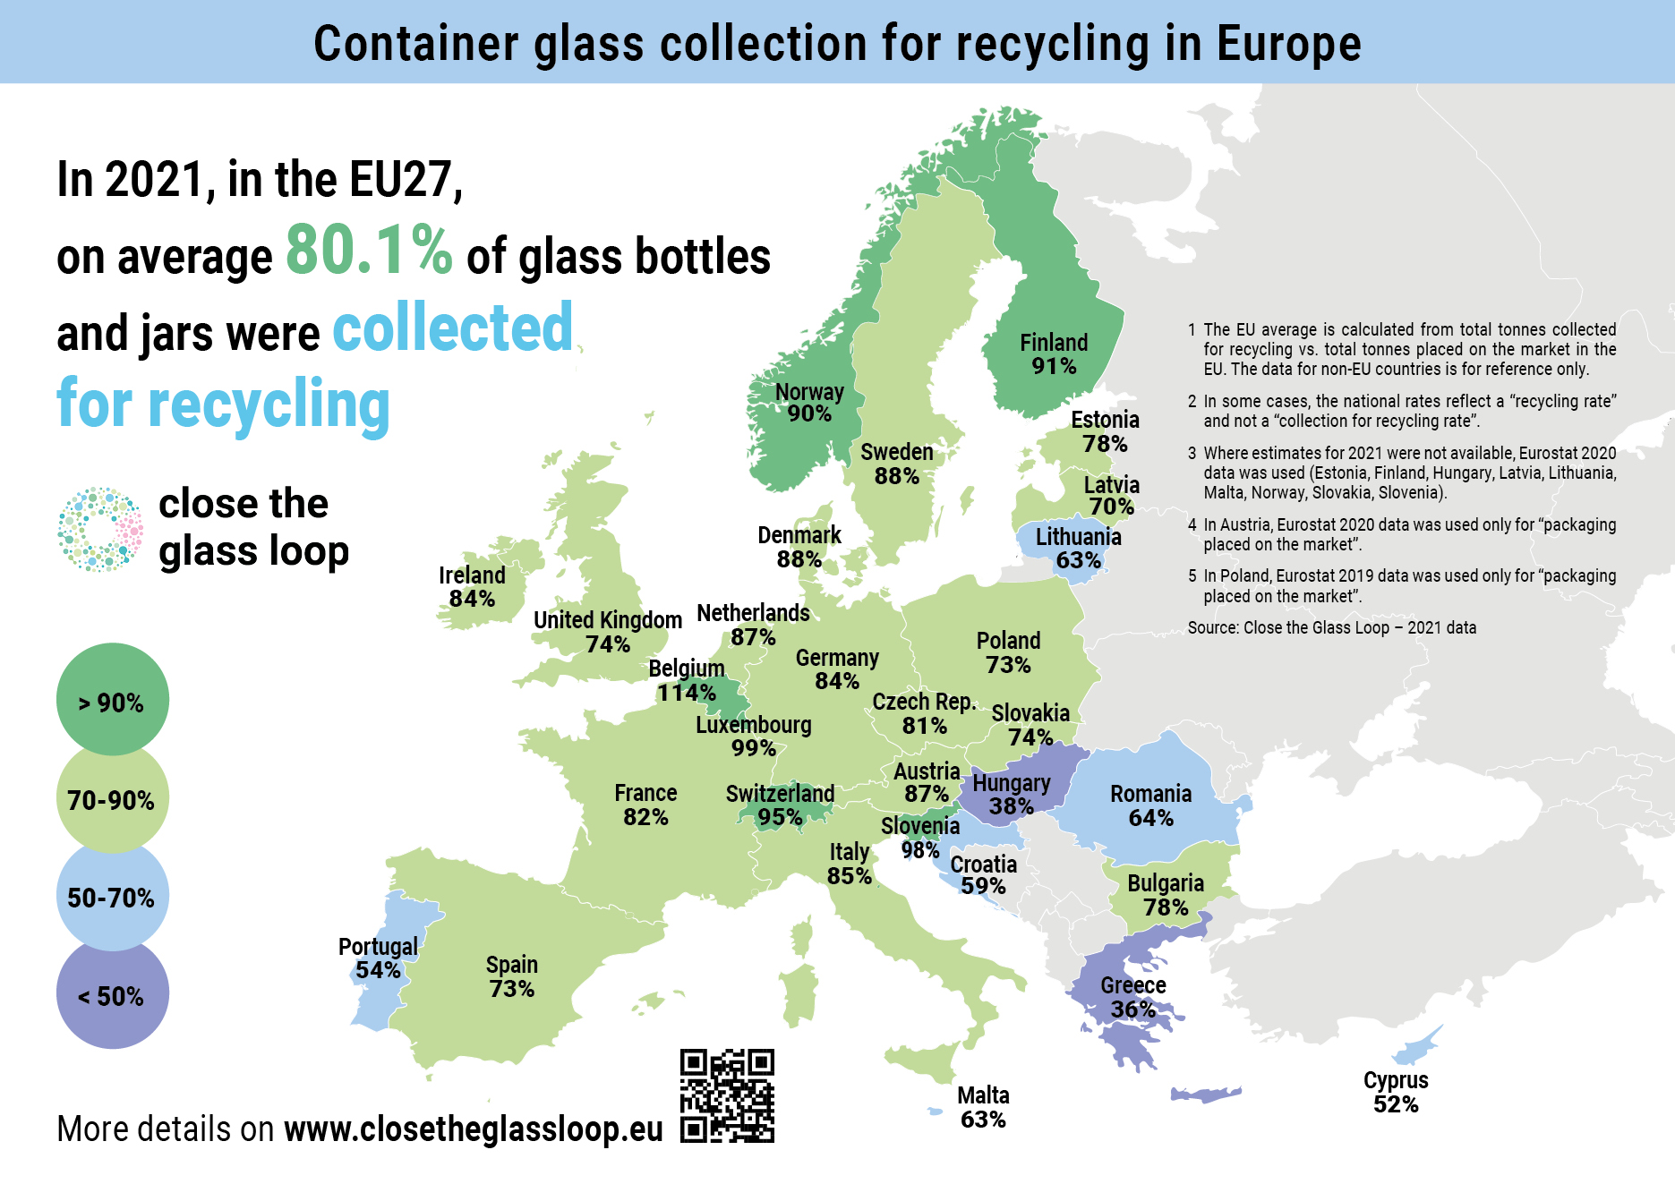
80.1%
2021
Notes:
Our new figures show that the EU average collection for recycling rate for glass packaging was 80.1% in 2021, a slight increase compared to 2020 (we were at 79.6%). The average now focuses on the EU27 – it does not cover the UK anymore.
The data for non-EU countries are available but they are for reference only.
CLICK - A few remarks on these data:
In terms of methodology
First of all, it is important to note that it is increasingly difficult to get real “collection for recycling” figures as the official data require Member States to report “real recycling” figures. In some instances, the national rate reflects a recycling rate and not a collection for recycling rate.
In some countries, the drop may not reflect a drop in performance but rather a change in methodology or reporting.
Eurostat should publish the ‘real’ recycling rate’ at the end of the year and we should be able to identify those countries that no only track the recycling rate
In terms of trends:
Overall, the top 10 collectors remain the same, except for Estonia exiting the Top 10 and Denmark entering the Top 10 with a significant increase of +17.2%. However, most of the 10 top performers have remained stabled or experience a rate decrease.
On the other end, there have been interesting developments with the poorest performers:
Unlike in 2020, there is not a single country below 35% collection for recycling
There has also been a considerable increase for countries that have historically had a low collection rate: Romania (2.5%), Lithuania (+6.1%), Malta (+18.6%), Portugal (+5.8%), Cyprus (+17,6), Hungary (+9.1%) or Greece (+3.2%).
According to the European Commission, these Member States are at risk of not meeting their 2025 recycling target of 70% but at least there has been some progress.
Worth noting as well, the increase in Poland and Slovakia, two countries which are now above 70%.
In you want to dig into the statistics you can find all the figures country by country and their evolution year on year on Close the Glass Loop website.

Slide 25
Paving the way to 90%
Notes:
Scope: EU27+UK until 2020; EU27 in 2021
Notes:
With this EU collection rate of 80.1%, we have achieved a new record high glass collection for recycling rate.
However, there is still a lot to be done to ensure that 90% of glass packaging is collected to be recycled by 2030 all across Europe.
We can make it but the clock is ticking. We still need investments. The mobilisation of National Platforms and National Action Plans will be essential to trigger the necessary actions to increase glass collection and recycling in each EU Member State.
Call out to increase glass collection in big municipalities (municipal waste critical), touristic areas, hospitality sector (collect glass that is now collected today) – we want to work much more closely more with municipalities, EPR schemes, HORECA operators
Glass recycling facilities and manufacturers working to increase recycled content across factories all over Europe to ensure that what is collected is recycled.
The Close the Glass Loop platform is eager to help strengthen existing national platforms or create new ones in key countries, especially in Eastern & Southern Europe.

Slide 26
Thank you for your time to Close The Glass Loop!
Notes:
On this note, I would like to thank you for your attention and our EU and national partners for their support and engagement to close the glass loop!
I am happy to answer any questions you may have

