Slide 1
Close the Glass Loop
The Action Plan for Portugal
May 2022
Plataforma para a Circularidade
das Embalagens de Vidro em Portugal

Slide 2
Facts & Figures (2019*)
10.3 Million
Inhabitants
€24.6K
GDP PER CAPITA
92 212
km²
219 000 t
GLASS RECYCLED
56%
GLASS RECYCLING
RATE
21.3
KG OF GLASS RECYCLED PER INHABITANT
240
Inhabitants PER
BOTTLE BANK
* Source: Eurostat

Slide 3
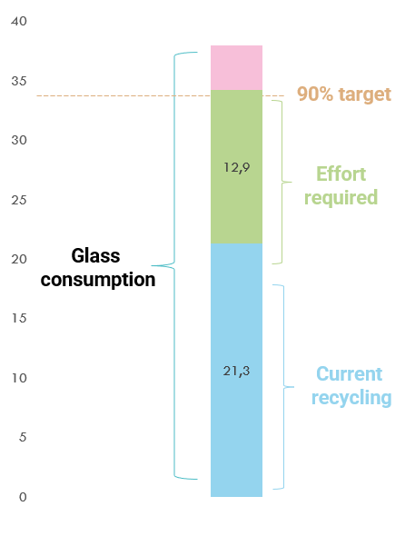
Challenges
Glass Packaging 2019 Kgs/inhabitant/year*
Prevent or reduce the impact of glass packaging and its waste on the environment; Ensure the functioning of the internal market, with an economic and environmental balance;
Give special focus on the glass collections of the HORECA; Capture the potential of Glass packaging, associated with consumers’ houses; Bet heavily on improving our EPR system performance; Promote awareness-raising and education activities, both for HORECA channel and retailers, as well as consumers, to increase the recycling quality of this packaging material; Maximize the use of recycled glass in the production of new glass packaging.
* Source: Eurostat

Slide 4
Vision
“Make Portugal a reference country in the collection and recycling of glass packaging, as well as in the use of recycled glass in the production of new glass packaging".

Slide 5
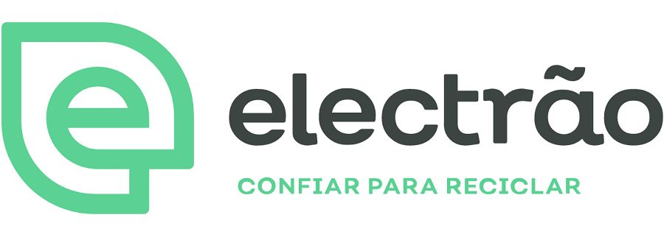
Founding Members
24.05.2022

Slide 6
Forseen Working Groups
Roadmap 2030
HORECA Channel
Municipalities / Municipal Waste Management Systems
Consumer Awareness
Innovation and Recycling Process Development

