Slide 1




BA GLASS | Close the Glass Loop
14th March 2024

Slide 2


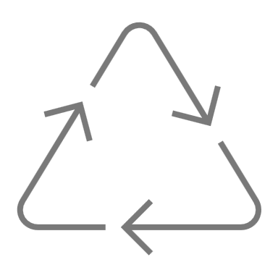




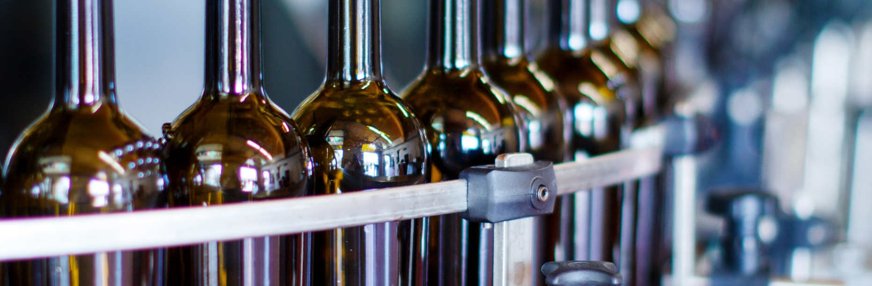
+110 Years
+1.5 Billion €
Cullet
+60 countries
of history.
in sales.
4 treatment facilities.
Sales in different countries.
WHO IS BA?
KEY FIGURES
Sustainability in BA
14th March 2024
11 Billion
14 plants
4 decoration
+5000
Bottles and jars/year
Manufacturing in 8 countries with
14 plants.
Integrated solutions with 4 decoration techniques.
Full time
employees.

Slide 3
OUR PLANTS?
5
4
Plants in Iberia
Plants in Southeast Europe
Avintes, Marinha Grande,
Venda Nova, Villa Franca
de los Barros and Léon
Bucharest, Sofia,
Plovdiv and Athens
4
2
Plants in Central Europe
Plant in Central America
Sieraków, Jedlice, Gardelegen
and Orzesze
Lerma

Slide 4
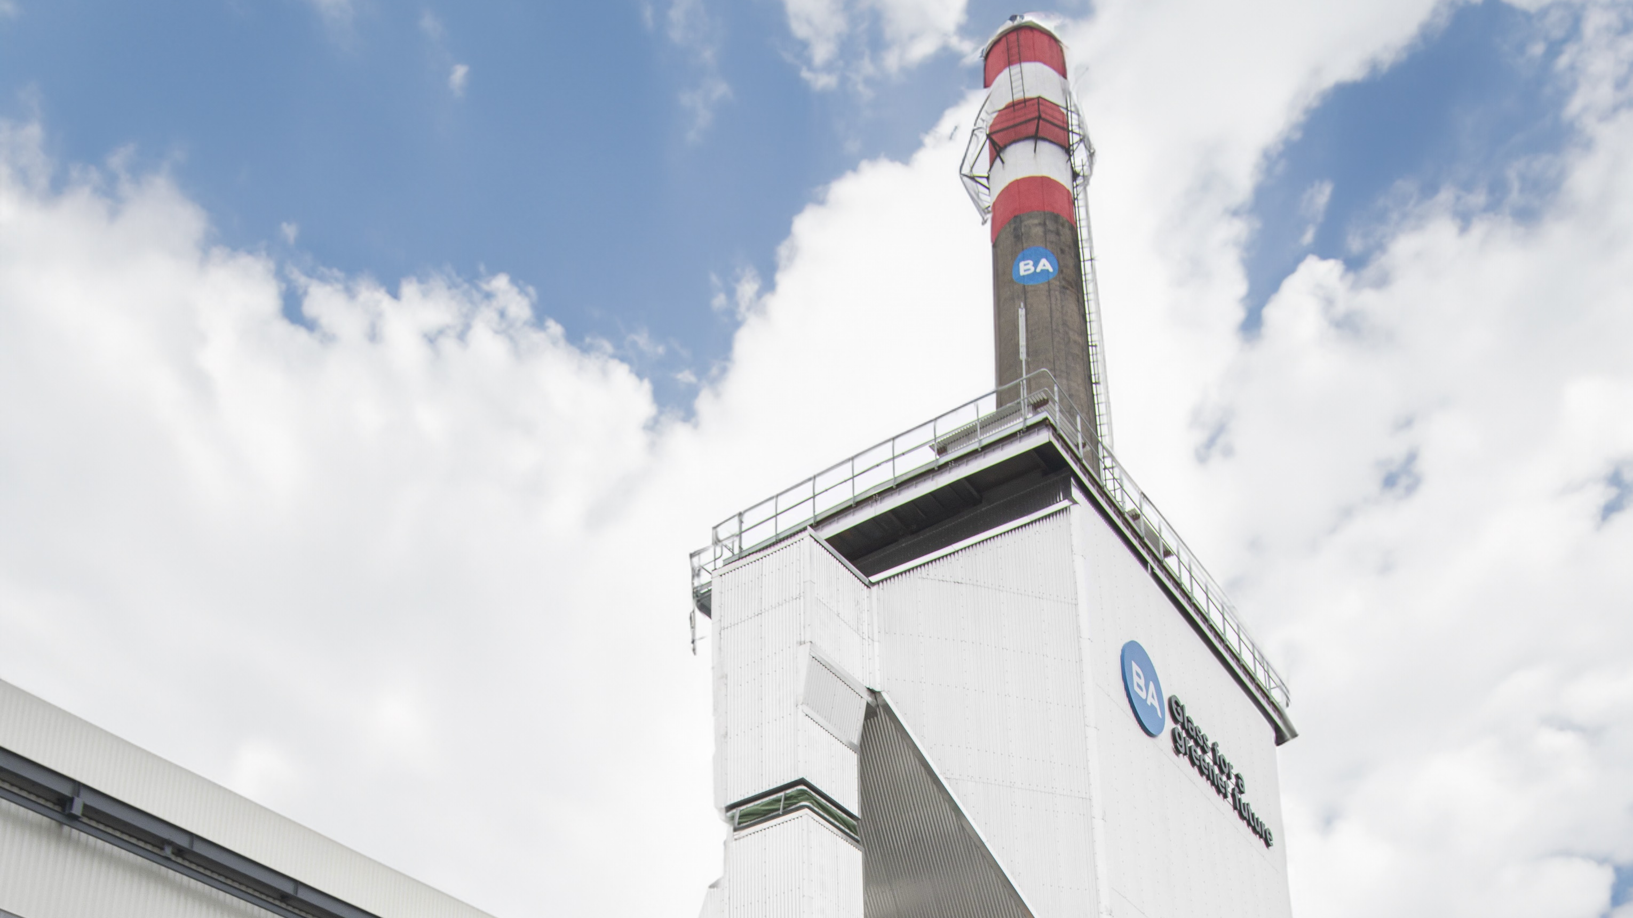
BUCHAREST PLANT
3
37%
150
650
Colors
Cullet Incorporation
Different designs/year
Daily pull
(tons)
KEY FIGURES
310
90M€
1.9M
2
Full time
Employees
Total
investments
~in 2023
Bottles
and jars
per day
Furnaces

Slide 5
SUSTAINABILITY IN BA
14th March 2024

Slide 6

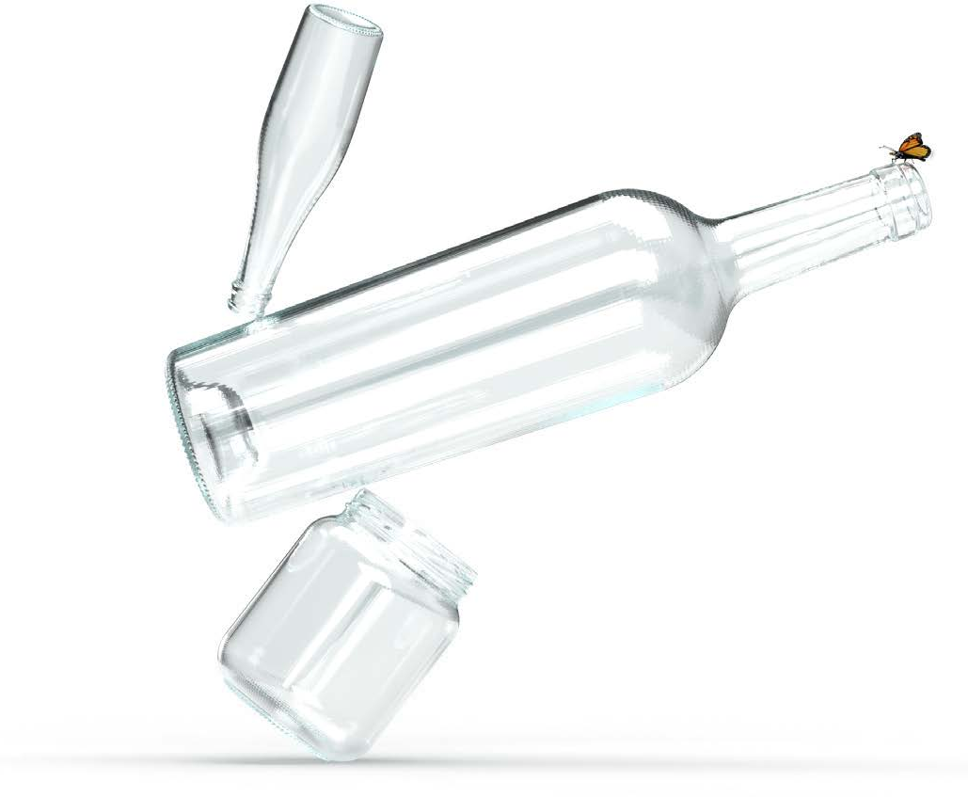

BA GLASS
Is committed to
OUR COMMITMENTS
CARBON NEUTRALITY BY
2050

Slide 7





BA GLASS
Commitment with Sustainability

Slide 8



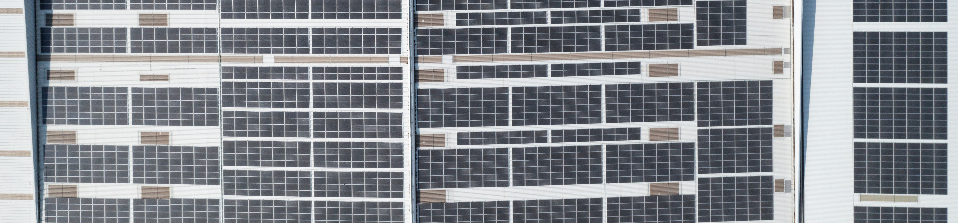
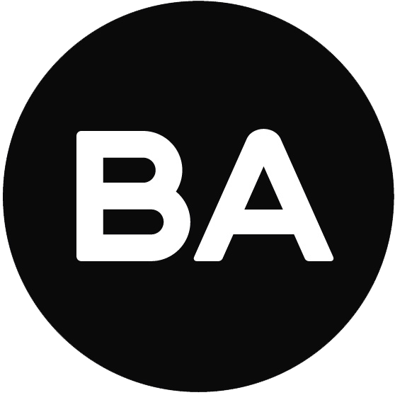
BA GLASS
Decarbonization Strategy
OUR COMMITMENTS
1
2
4
5
6
Energy
Efficiency
Raw
Materials
Renewable Electricity
Furnace
Technology

Slide 9
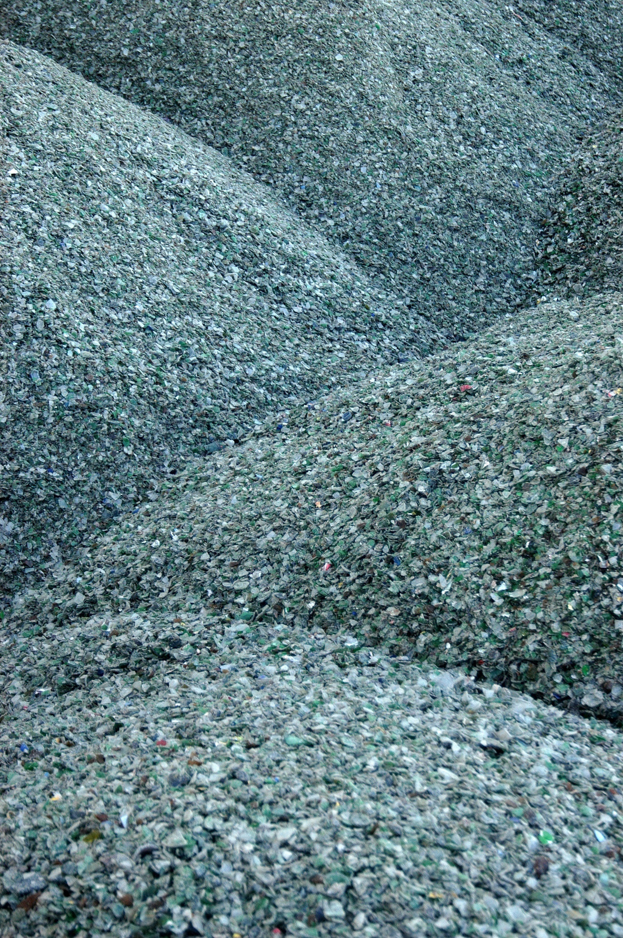
We can use up to
70% of recycled glass
1 TON OF RECYCLED GLASS:
-1 ton waste in nature
-2,5% energy consumption
-1,2 tons virgin raw materials
-5% CO2 emissions

Slide 10


Sustainability in BA
What are we doing to increase cullet availability?
FEVE initiative
Close the glass loop
Challenge our
customers to get
to the consumers
Work closely with
local Authorities / Stakeholders

Slide 11

Sustainability in BA
“Plataforma Vidro+”
OUR COMMITMENTS
BA is member of “PLATAFORMA VIDRO+”
PLATFORM FOR THE CIRCULARITY OF GLASS PACKAGING
  VISION: "To convert Portugal into a reference country in the collection and recycling of glass packaging, as well as in the incorporation of recycled glass in the production of new packaging”;
  OBJECTIVE: "Collection of 90% of the glass packaging placed on the market, for recycling, by 2030”.
>
>

Slide 12
The key priorities for a CLOSE THE GLASS LOOP action plan in ROMANIA
Change the culture
  Communication is massively important, must reach everyone
  Reaching the younger generation, is a leverage
Evolve all stakeholders - We are ready
Recycled glass is part of a value supply chain, that must be preserved
Recycled glass must stay in Romania close loop - We can use much more!
1
2
3
4

Slide 13
THANK YOU
14th March 2024

