Slide 1
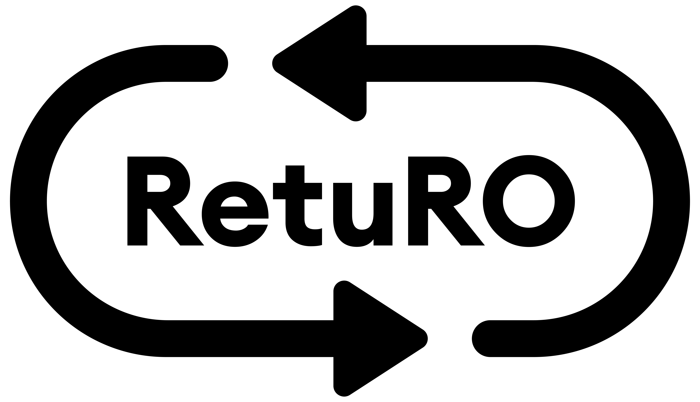
The Deposit-Return System in Romania

Slide 2
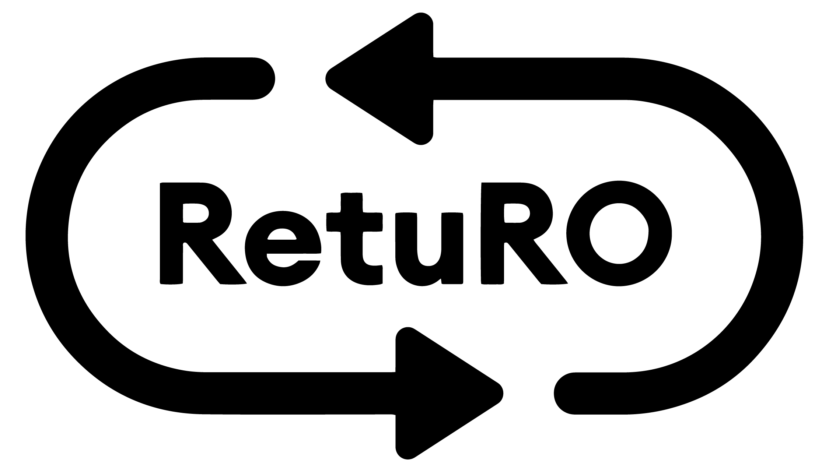
DRS in numbers
RetuRO is the largest circular economy project in Romania, managing the Deposit-Return System in Romania.
Expectations for the first year of DRS: return rate of 65%
Involvement of 19 million Romanians.
By June 2024, only products compliant with DRS will be on shelves.
Approximately 7 billion packages collected annually.

Slide 3
DRS in numbers
Over 220 million beverage packaging units with the DRS logo have been placed on the market in Romania since the launch of the system (45 million in Dec. & 180 million in Jan.).
In December 2023, the number of returned DRS packages was 31,000, while in January, over 2.2 million packages were returned. In February, we are likely to surpass 20 million packages collected through DRS
Almost 70.000 businesses have engaged with the DRS

Slide 4
DRS in numbers
We have opened the first 2 regional centers - in Cluj and Timiș Counties.
We have the capacity to process 1 billion packages per year at this moment.
In the next 3 months we plan to open RetuRO centers in Bacău County, Ilfov County and Brașov County; Prahova County and Dolj County.
We reached 120 employees, and our goal is to create 600 green jobs, out of which 500 will be dedicated to operating our regional centers

Slide 5
Together we are making our country cleaner

