Slide 1

Bucharest
Towards a Close Glass Loop Action Plan Conference
Bucharest, 14th of March 2023

Slide 2
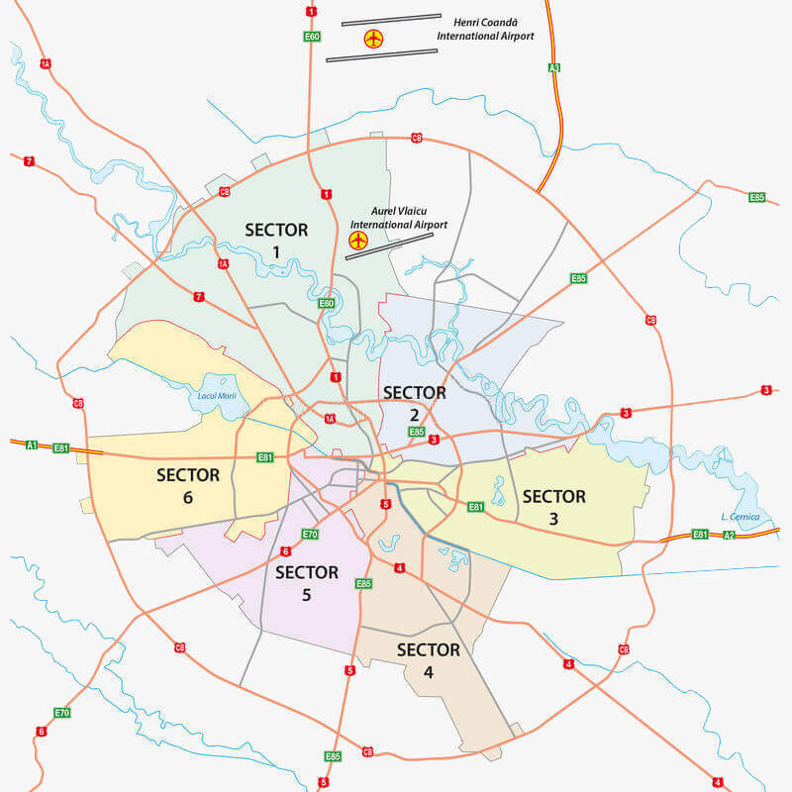
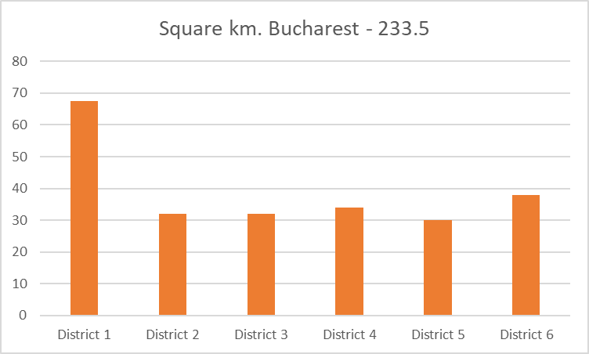
City of Bucharest – 6 districts
& 7 mayors

Slide 3
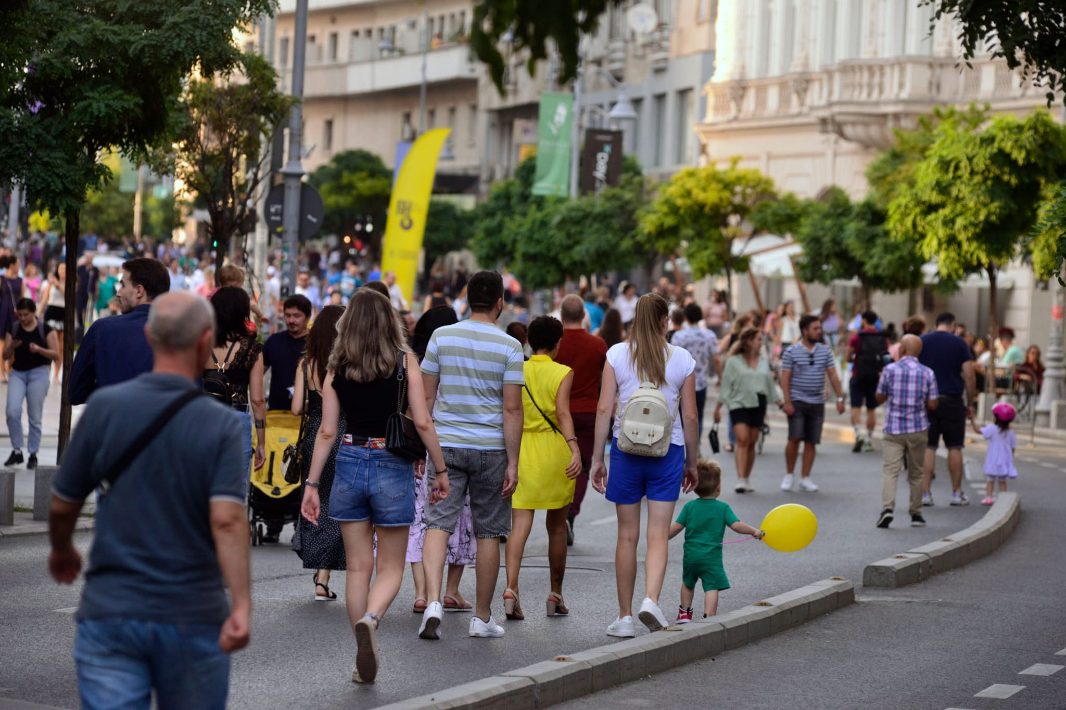
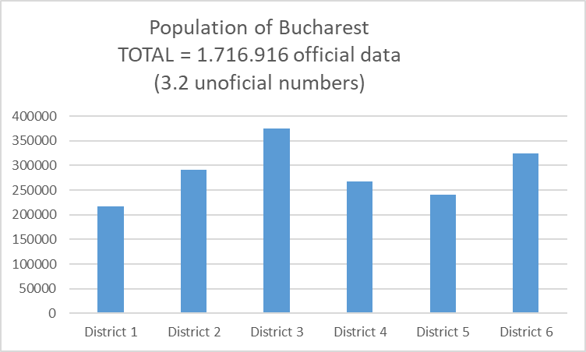
City of Bucharest
- the largest urban density in Romania
* Source: hotnews.ro

Slide 4
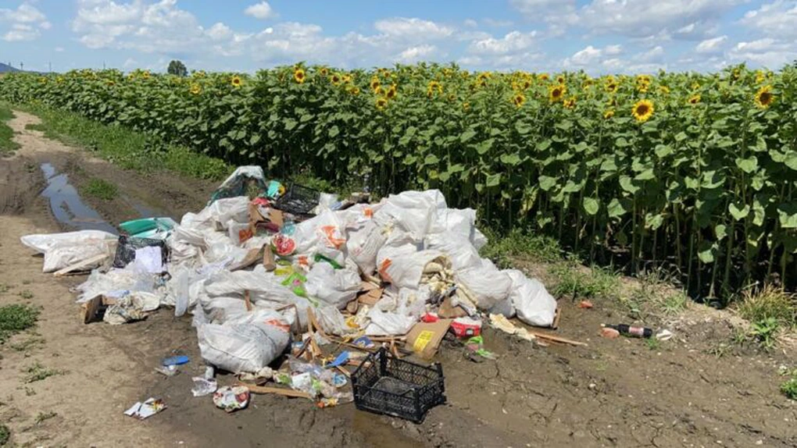
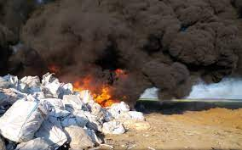
Waste – collection & data streams
Municipal Waste
Municipal Waste – collected by sanitation companies
Separately collected fractions by others than sanitation companies (EPR)

Slide 5
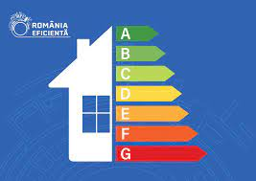
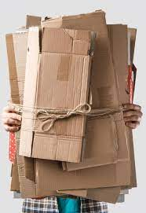
Separately collected fractions by others than sanitation companies
Fueled by the private sector
EPR schemes targets & funding
RetuRO SGR

Slide 6
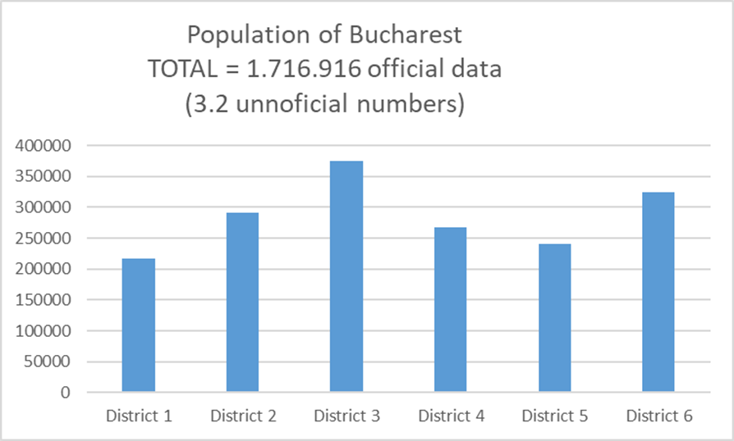
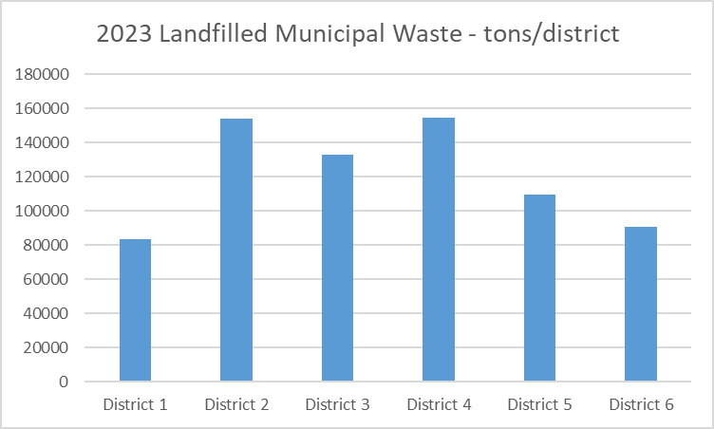
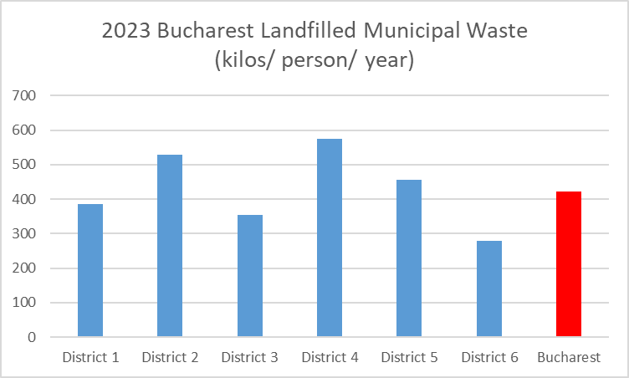
2023 Municipal Waste - Data

Slide 7
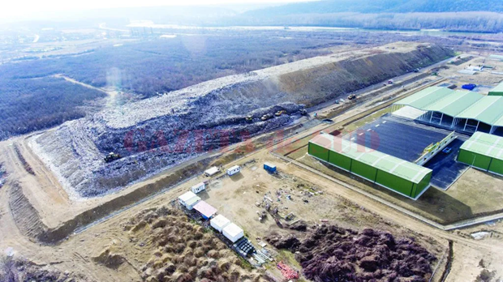
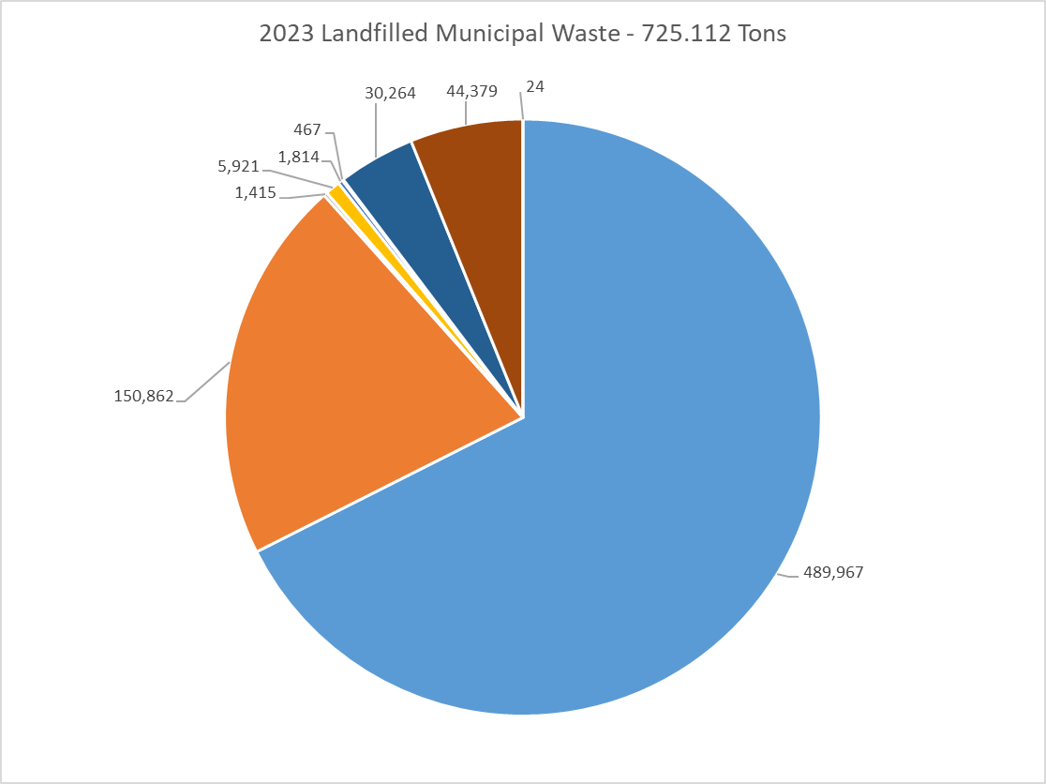
2023 Municipal Waste – Data (2)
Category | Tons
Mixed municipal waste - 20 03 01 | 489,967
Street cleaning residues (stradale) - 20 03 03 | 150,862
Bulky waste (voluminoase) - 20 03 07 | 1,415
Biodegradabil green - 20 02 01 | 5,921
Soil and stones (parks) - 20 02 02 | 1,814
Soil and stones (excavations) - 17 05 04 | 467
Mixed construction and demolation - 17 09 04 | 30,264
Other wastes from mechanical treatment of waste (rezidual tratare) - 19 12 12 | 44,379
Mixtures of concrete, bricks, tiles and ceramics - 17 01 07 | 24
TOTAL | 725,112
Average landfill/ month | 60,425

Slide 8
2023 glass packaging collection for recycling
- data at the level of municipality (?)
District | Collected Packaging Glass - Tons
A | 647.12
B | 470.56
C | 0
D | 162.72
E | 1476.22
F | 0.73
TOTAL | 2757.35
Sorting process | Packaging Glass - Tons
A | 232.39
B | 1270.83
C | 1.5
TOTAL | 1504.72
Category | Data & Assumptions
POM – OIREP (2022) | 410.924 tons – packaging glass
65% recycled by OIREPs | 267.100 tons – packaging glass
30% of POM is in Bucharest | 123.277 tons – packaging glass
65% recycled from Bucharest by OIREPs | 80.130 tons – packaging glass
vs. TOTAL Municipal waste | 4262.07 tons – packaging waste

Slide 9
Thank you!
Roxana Șunică
Executive Director
Municipality of Bucharest
Public Utilities Department
Phone no.: + 40 721 369 779
roxana.sunica@pmb.ro

