Slide 1
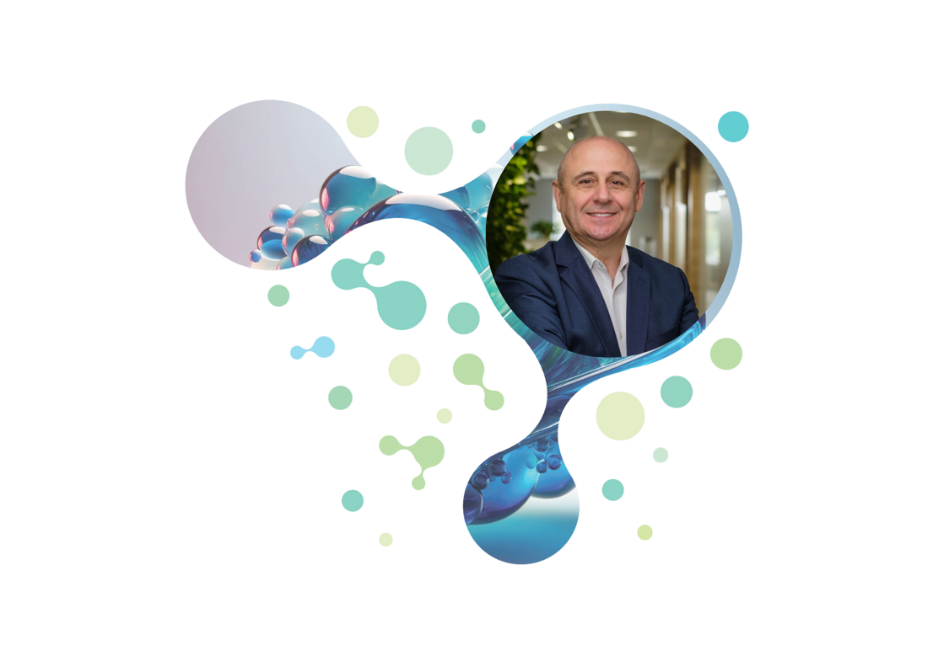
Green Group 2023– All rights reserved
Making or Breaking the Glass Loop in Romania
Constantin Damov
GreenGroup Chairman

Slide 2
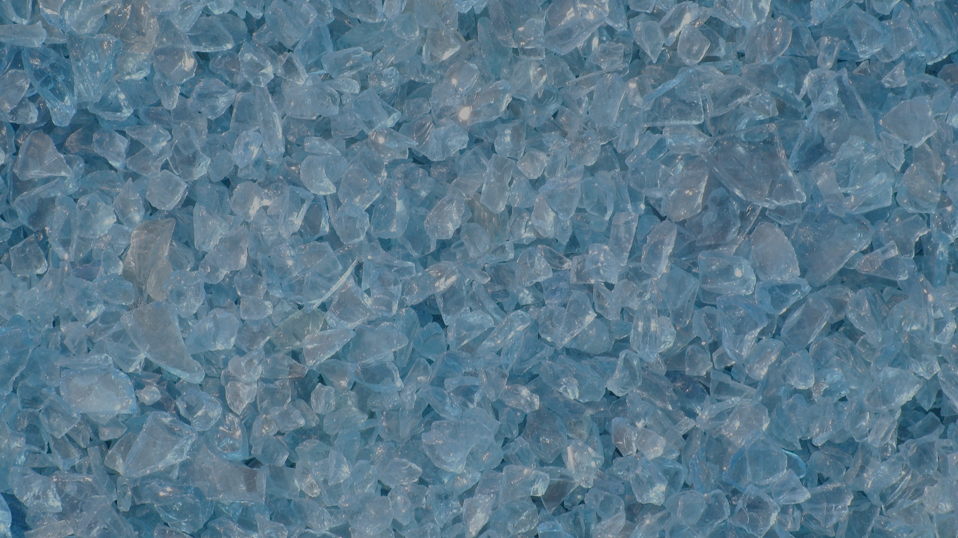
Glass recycling
Business division within GreenGroup

Slide 3
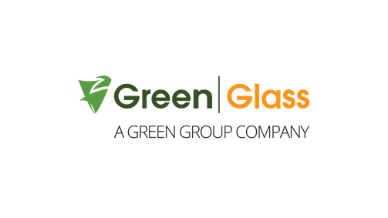
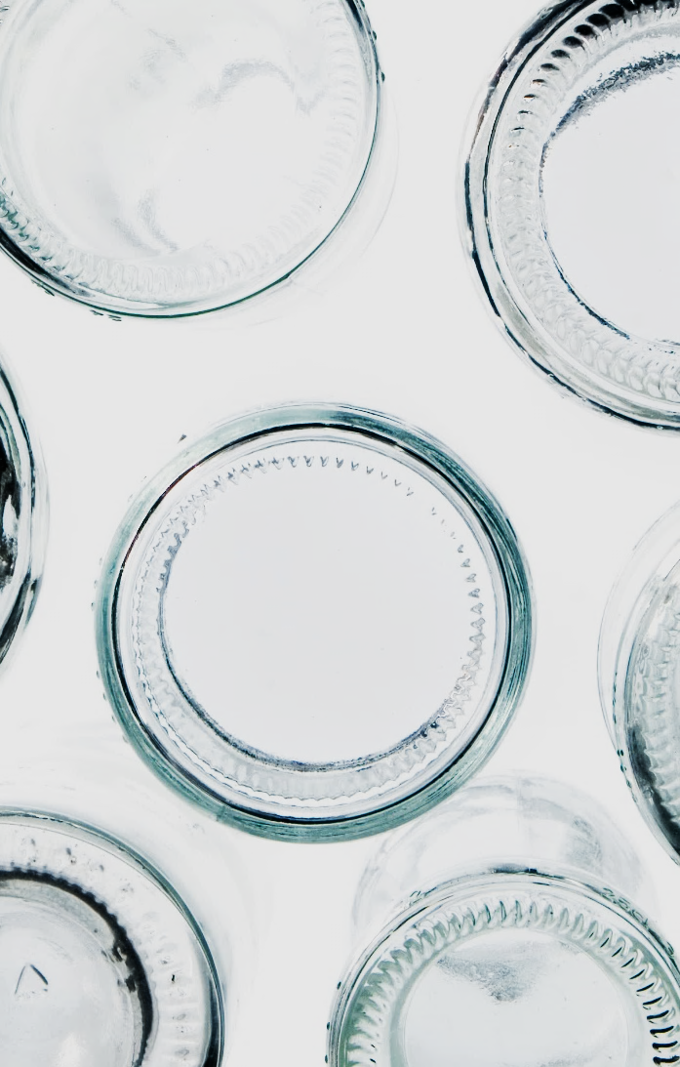
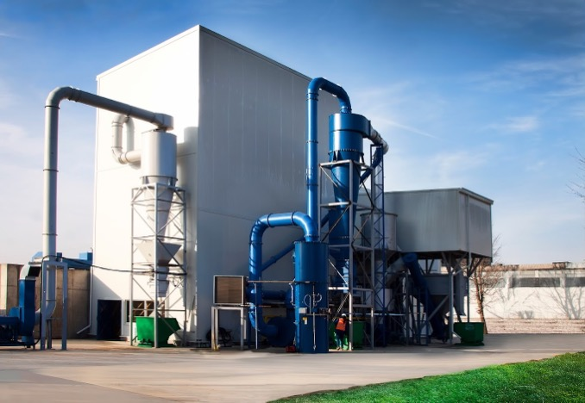
Glass recycling in Romania
GreenGlass Recycling overview
Established in 2013
Part of GreenGroup
End of waste recycling facility
Total capacity of 110,000 tons/glass per year
Notes:
Inlocuim poza, punem ceva mai luminos.
Si punem buline in loc de linii.

Slide 4
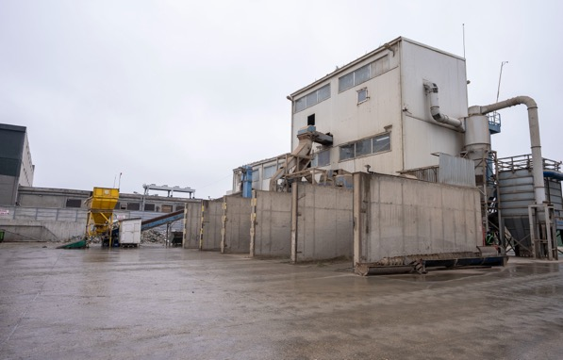
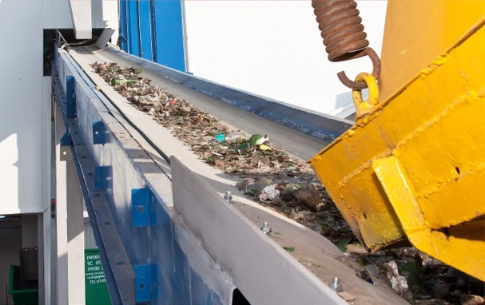
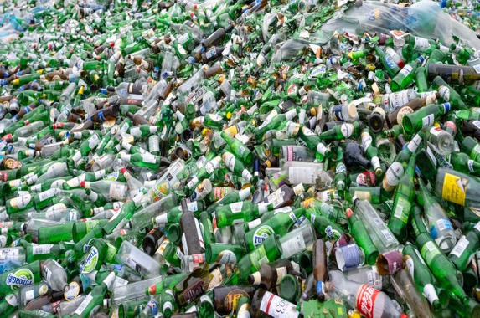
Glass recycling in Romania
End of waste recycling facility

Slide 5
GreenGlass Recycling
Potential for closing the loop
Collection
DRS Projected Collection Up to 300,000 Tons
Recycling
GreenGlass Capacity Target:
260,000 Tons
Production
Local Cullet Demand: aiming for 170-200,000 Tons.

Slide 6
Closed loop means circularity
Filling the Gap: The absence of a closed loop in Romania
68%
13%
1.3%
40%
Less than
in the closed loop.
Recycling rate for municipal solid waste
Circularity rate
Glass circularity -
Glass collection in 2023

Slide 7
Call to Action:
Urgent need to implement a Plan for Closing the Glass Loop!

Slide 8
Thank you all for your commitment to closing the glass loop!
Constantin Damov
Chairman
constantin.damov@green-group.ro

