Slide 1


Ecodesign in the
perfume and cosmetics sector
November 2024

Slide 2
Contents
Glass in the perfume and cosmetics sector
Ecodesign guide for the perfume and cosmetics sector
Modulated fee for glass
Valencia Pilot Test

Slide 3
01
Glass in the perfume and cosmetics sector

Slide 4
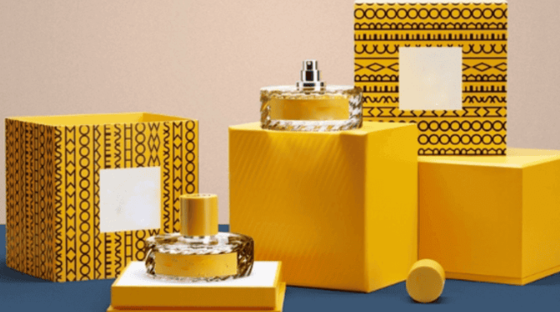
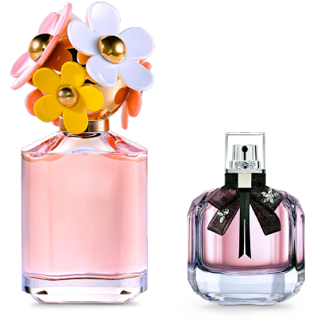
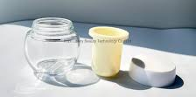
Glass in the perfume and cosmetics sector
This sector accounts for less than 2% of the total weight of domestic glass packaging
Opportunities
Points for improvement
Market interest in improving the sustainability of packaging.
The sector is looking for quality in its packaging.
Glass is a high added-value material, whose recyclability, safety and reusability make it ideal.
Overwrapping: the sector habitually gives a high-quality image to the contents.
There is still an opportunity to improve the waste to product ratio: it is possible.
It is a sector that uses certain products that could impair the recyclability of glass: opal and borosilicates.

Slide 5
02
Ecodesign guide for the perfume and cosmetics sector

Slide 6
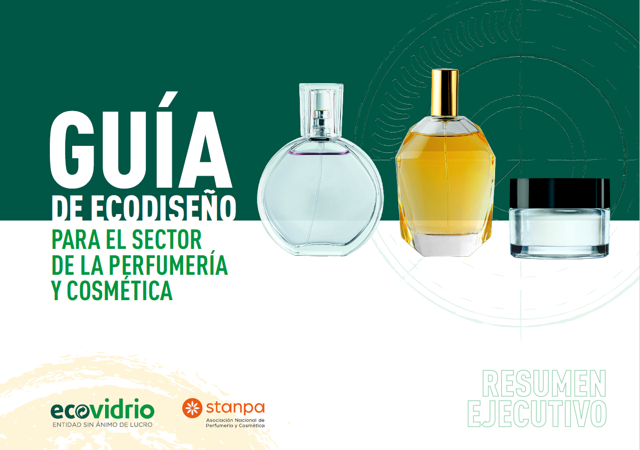
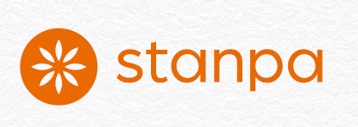
Ecodesign guide for perfume and cosmetics
2023

Slide 7

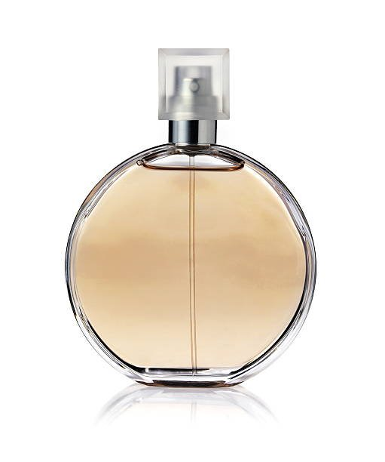
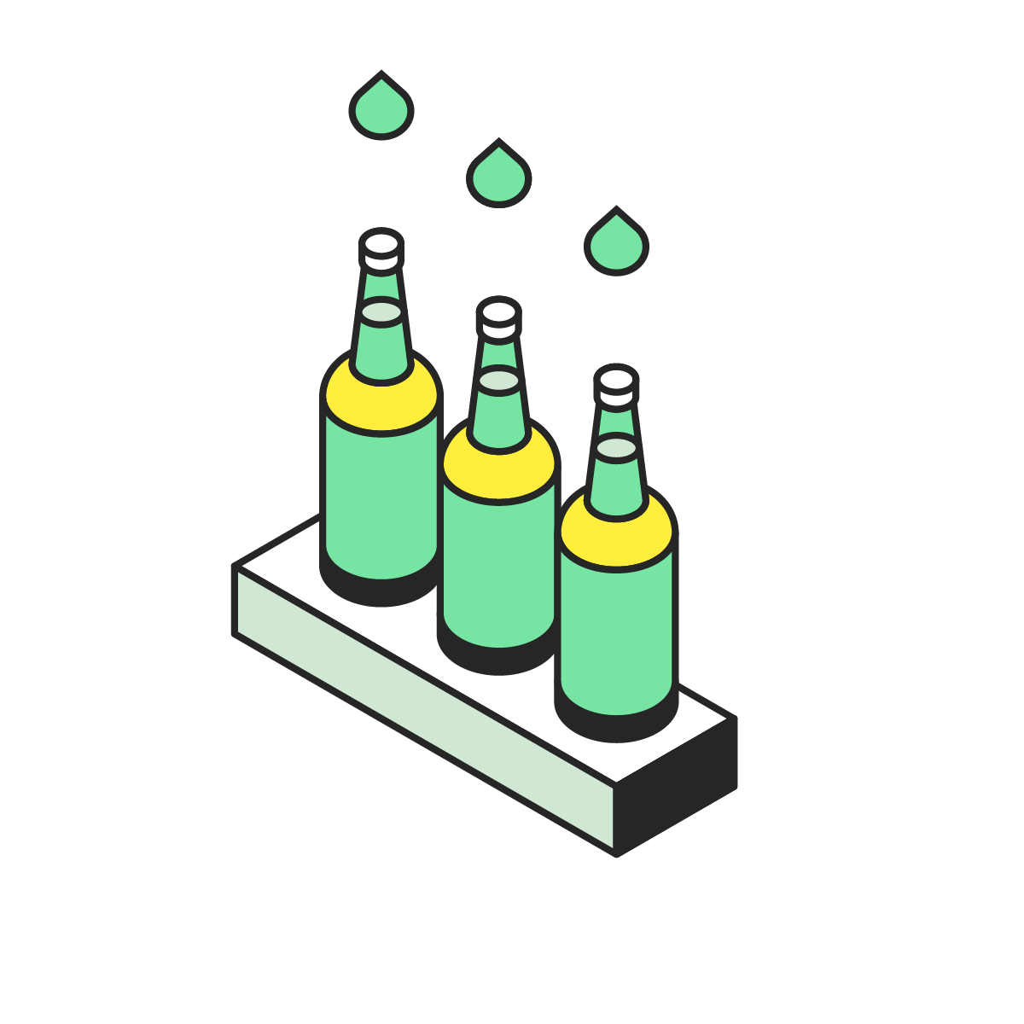
Ecodesign guide for perfume and cosmetics
General objectives:
Reduce the weight of the container.
Eliminate non-functional elements as far as possible.
Avoid the use of glasses other than soda-lime: opal and borosilicate.
Avoid the use of ceramic substances in caps and other additional elements.
Improve the separability of elements attached to the container.

Slide 8







Ecodesign guide for perfume and cosmetics
Types of measures to implement:
Measures for the disposal of packaging elements.
Measures to reduce the unit weight.
Measures to optimise formats.
Measures to accompany all actors to facilitate their involvement in the packaging value chain.
Measures to reduce the environmental footprint.
Measures to promote reuse.
Measures to improve recyclability.

Slide 9
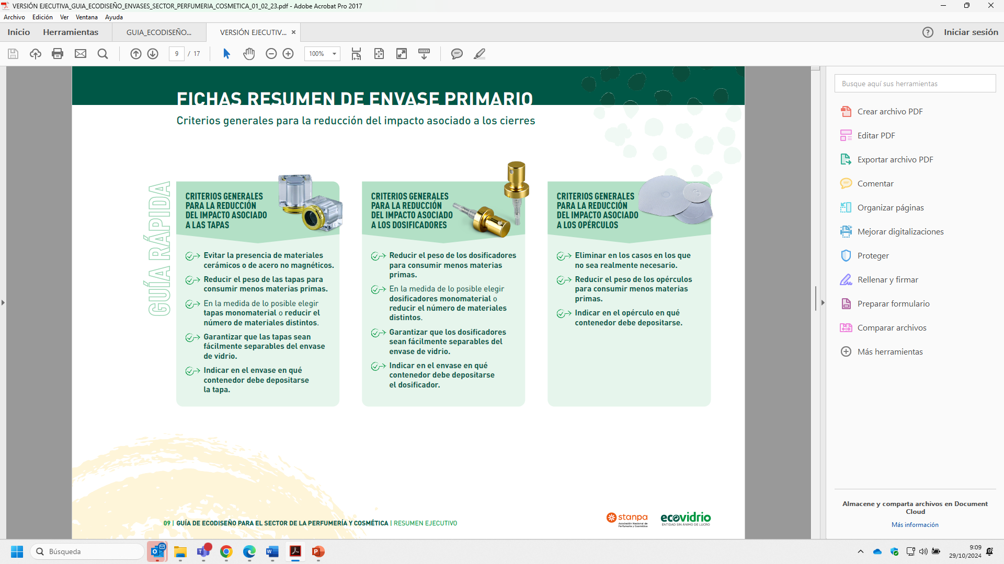

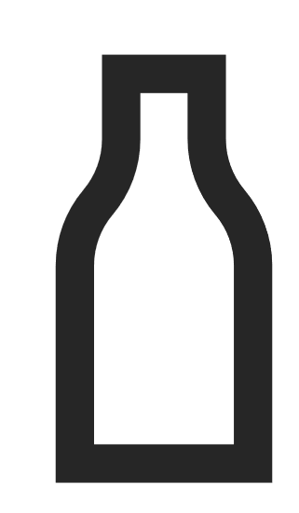





Ecodesign guide for perfume and cosmetics
Improve the impact of caps
Improve the impact of atomisers
Avoid ceramics or non-magnetic steel
Reduce the weight
Avoid multimaterial caps
Ensure caps can be separated from the glass container
Reduce weight
Choose single-material atomisers
Ensure they can be separated from glass packaging

Slide 10
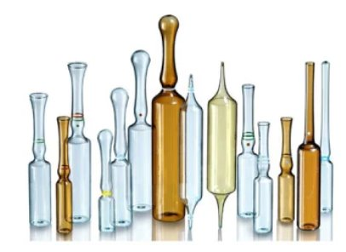
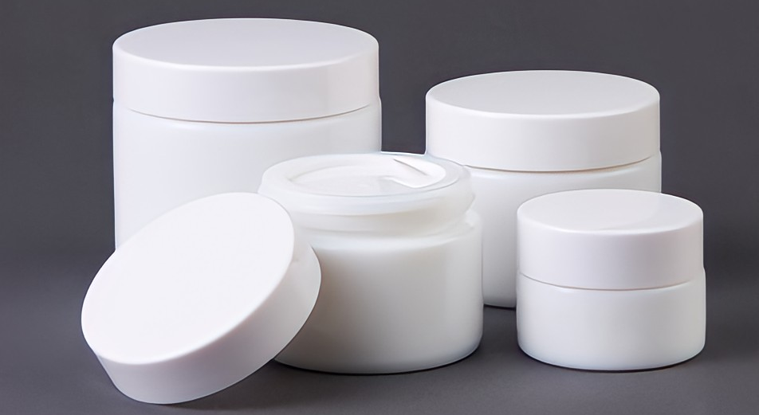
Borosilicate
Opal glass
Borosilicate glass: characterised by the presence of boric oxide in its composition.
It behaves as a disruptor: different from soda-lime glass and with a higher melting point, which impairs recyclability. ​
There is no alternative for ampoules?
  Opal glass: opaque glass whose composition includes fluorinated compounds and/or. It has a higher melting point than soda-lime glass.
  It behaves as a disruptor: different from soda-lime glass and with a higher melting point, which impairs recyclability. ​
As an alternative to borosilicate glass, and opal, amber-colored soda-lime glass and/or pre-cut sleeves can be used to minimize product photodegradation wen needed.

Slide 11
03
Modulated fee
for glass

Slide 12

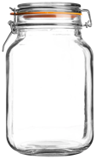
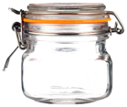
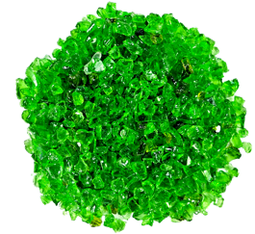
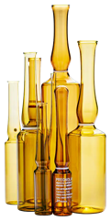
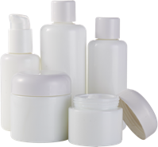

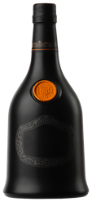
Eco-modulation of glass fees
APPLICABLE
AS OF
APPLICABLE
AS OF
50% over the base fee
2024
2025
JANUARY
JANUARY
PENALTY
REWARD
01.
Ceramic
closure
Packaging sustainability studies: reversing the cost of penalties.*
02.
Manufacture with
glass other than
soda-lime:
opal glass
borosilicate glass
e.g. ampoules
* The aim is to work on the recyclability of packaging: carrying out studies to improve the sustainability of packaging subject to eco-modulation.
03.
Associated infusion element (porcelain, ceramic, stoneware, etc.)

Slide 13
04
Pilot Tests
Valencia Stanpa

Slide 14
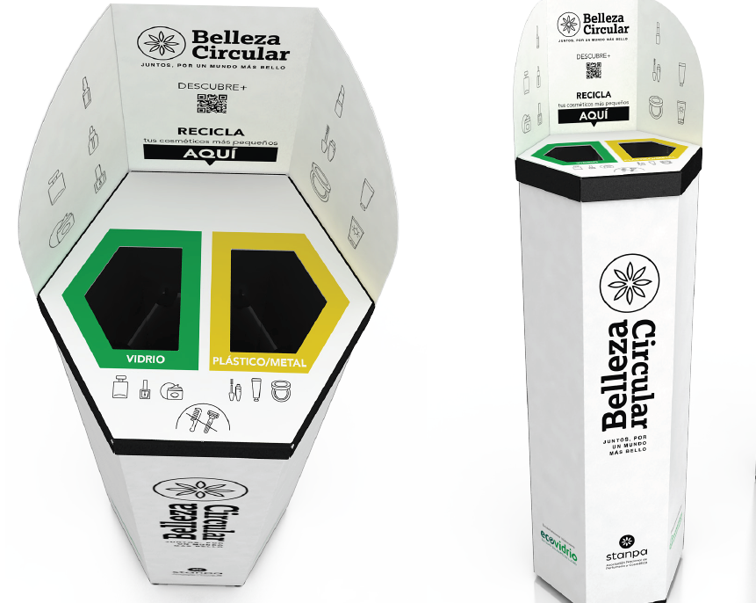
Pilot tests in the city of Valencia
The first pilot test is retailers: this involves placing bins to collect glass and light packaging from the perfume sector (small packaging).
70 bins: in shopping centres, OTC chemists', retailers, perfume and cosmetic centres.
Perfume and cosmetics containers with recyclability problems: opal and borosilicate (ampoules) may have an outlet for recycling in uses other than the glass furnace.
We will measure how much glass is collected and judge the feasibility of the project.

Slide 15
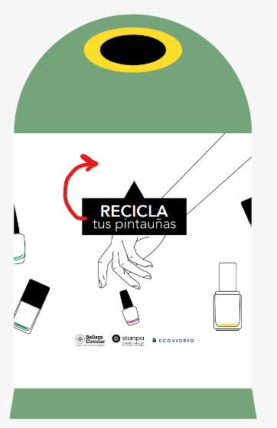
Pilot tests in the city of Valencia
Second pilot test: specific containers in nail salons.
Nail polish contains hazardous substances, so is considered hazardous waste. This pilot test would analyse the costs and efficiency of specific separate glass collection in nail salons.
Specific “mini igloo”, training and collection in 20 nail salons in Valencia.
Both tests include a specific project logo, website and communication to the public and centres.
The glass would be tested to be recycled for furnaces or construction uses.
Duration of pilot tests: January to June 2025.

Slide 16
Any questions?

Slide 17

THANK YOU
ecovidrio.es
@ecovidrio

