Slide 1
Webinaire Bathroom glass: a forgotten asset for the closed loop?
Citeo x 90 minutes to Close the Loop – Novembre 2024
Notes:
Matinale
Ce matin on va vous parler d’amour… mais surtout de tri
Et on va essayer d’apporter des éléments de réponse à cette question : les Français et le tri : une histoire d’amour stable ?
Ce partage s’inscrit dans le cadre des 10 ans de l’Observatoire du geste de tri, je vais y revenir
D’abord, nous présenter
Je vais passer la main à Stéphanie pour nous en dire + sur : pourquoi un tel observatoire ?

Slide 2
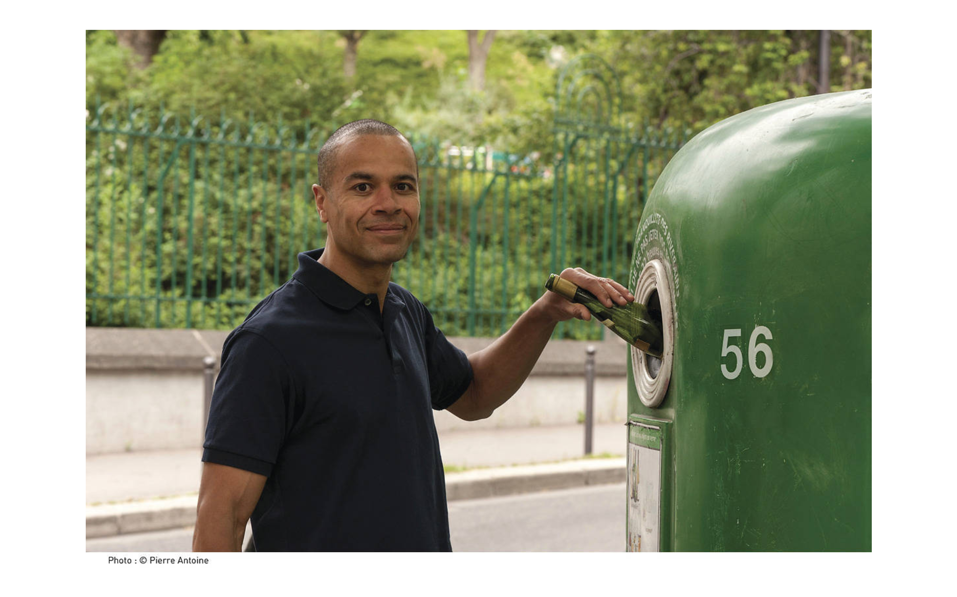
Insights from our Barometer on practices and attitudes towards recycling in France : 10-year evolution (exclusive info)
The number of people self-reporting recycling is stable over 10 years > about 4 out of 5 people for glass
People recycle a little bit more regularly, and more different types of packaging
Self-reported practices in France are equal for glass bottles and jars (no deposit return system in France)
If recycling is still a strong norm, the trust towards recycling is progressively weakening
Author : Manon Désert, Citeo for the Webinaire « Bathroom glass: a forgotten asset for the closed loop? » - Novembre 2024

Slide 3
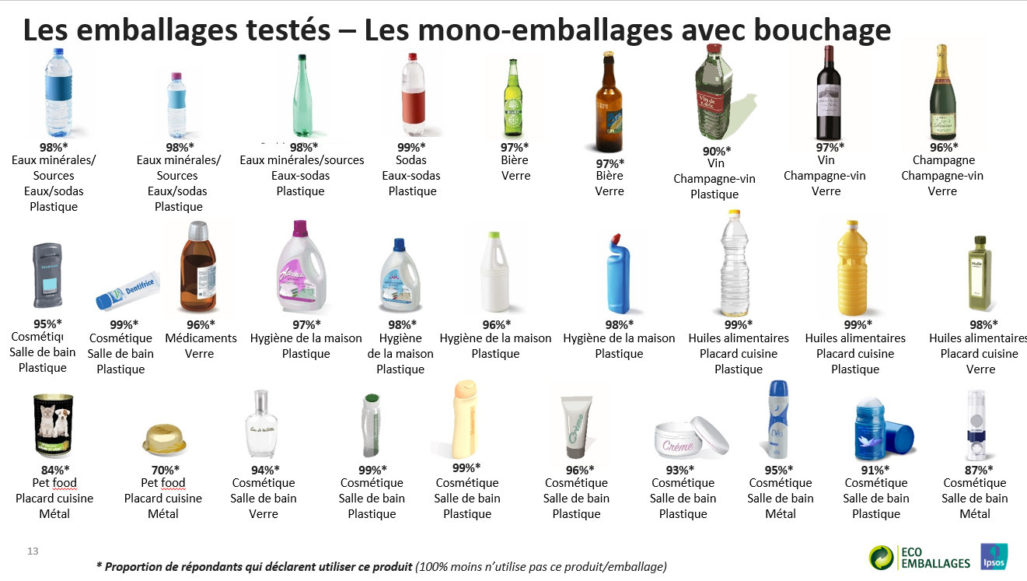
Bathroom glass : relatively less recycled packaging in France
2017 study on 100 types of packaging
Bathroom products were less well recycled by consumers
Nail polish was among the 10% least recycled packaging type studied
Author : Manon Désert, Citeo for the Webinaire « Bathroom glass: a forgotten asset for the closed loop? » - Novembre 2024

Slide 4
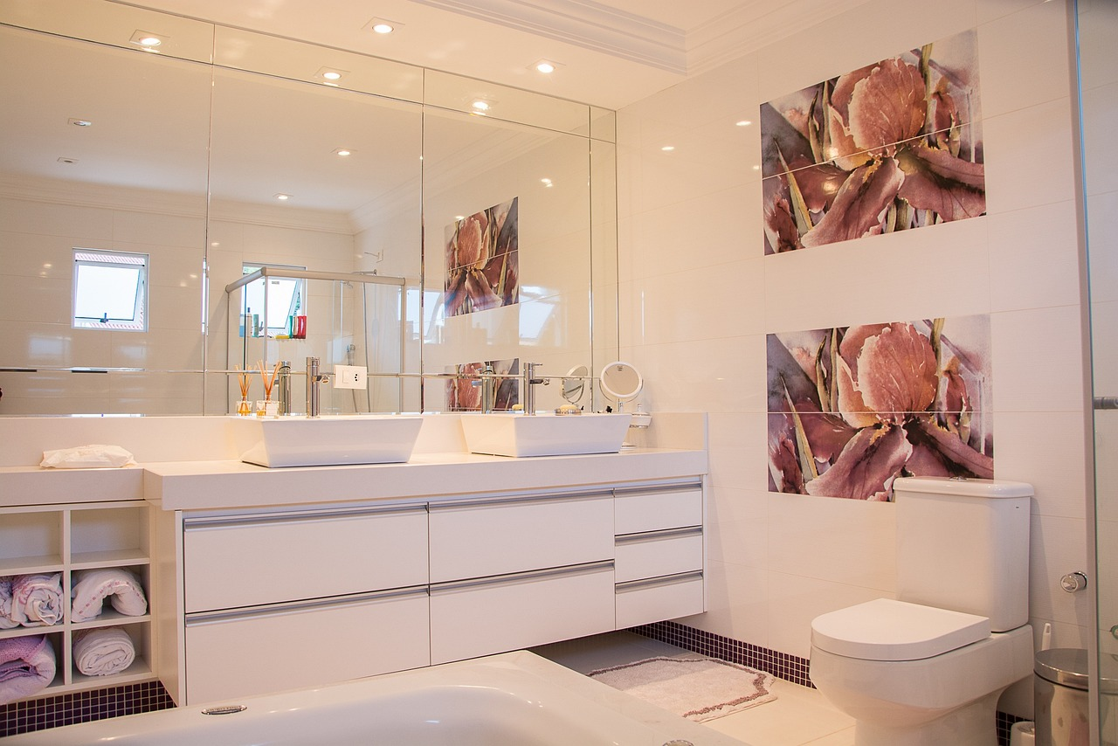
Why consumers less likely to recycle bathroom glass ?
The bathroom : not a room highly compatible with waste management
Longer consumption period, and therefore less frequent disposal of packaging
Luxury products seen as « valuable » and not « waste »
Complex packaging
Hard to empty: example of nail polish
Author : Manon Désert, Citeo for the Webinaire « Bathroom glass: a forgotten asset for the closed loop? » - Novembre 2024

Slide 5
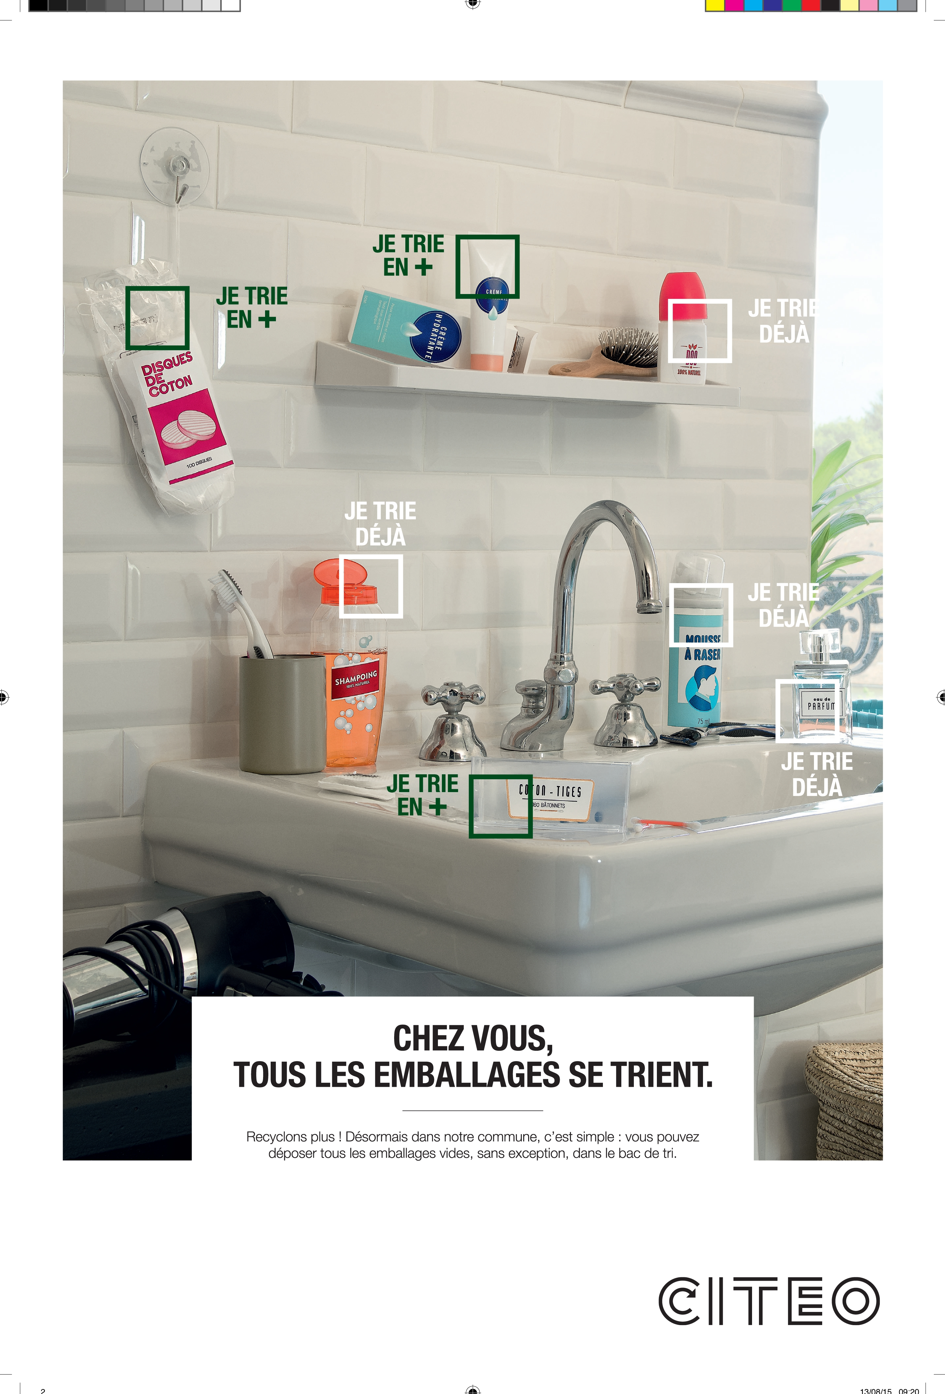
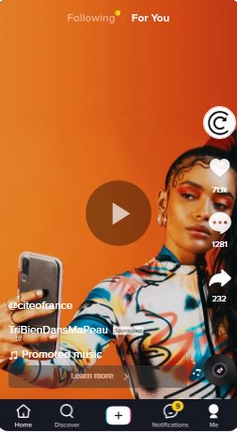
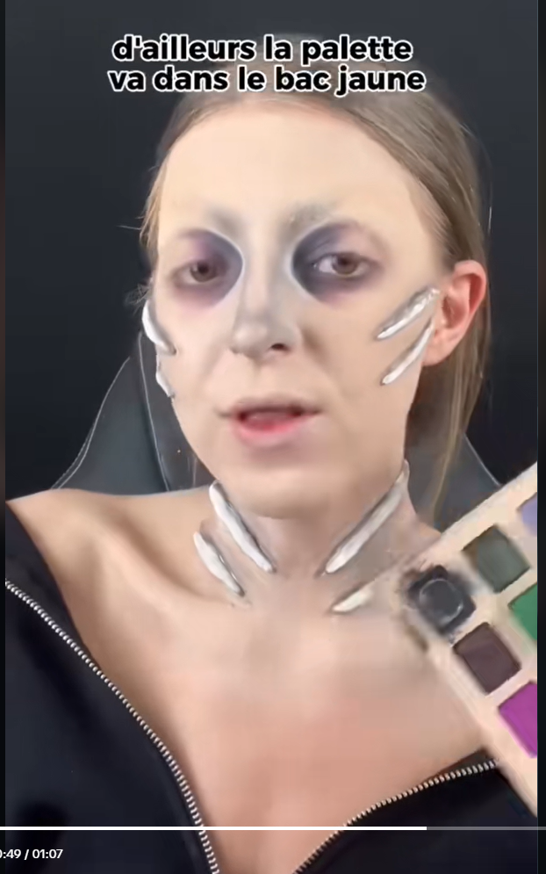
Citeo initiatives to engage consumers on bathroom packaging : a few examples
Posters on recycling instructions for bathroom products
Collaboration with influencers – example for Halloween
Digital campaign focusing on hygiene/beauty products, 2022
#TriBienDansMaPeau
Collaboration Citeo x Angiee Make Up
For Halloween 2024
Author : Manon Désert, Citeo for the Webinaire « Bathroom glass: a forgotten asset for the closed loop? » - Novembre 2024

Slide 6
Manon DESERT
Lead of Practices and Behaviour Change at Citeo
manon.desert@citeo.com

