Slide 1
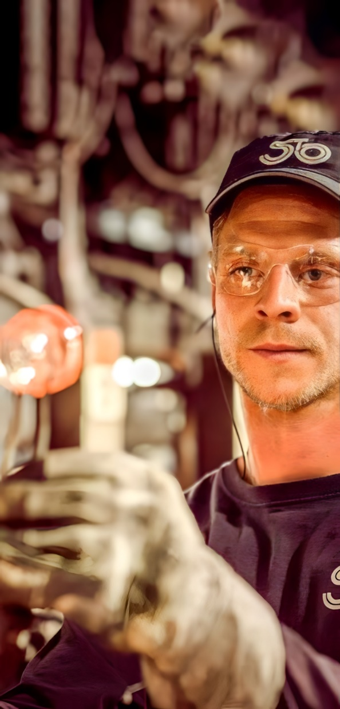
THE ART OF
Making Glass & More

Slide 2
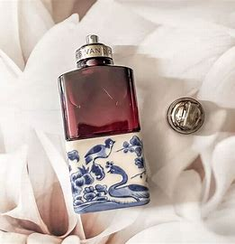
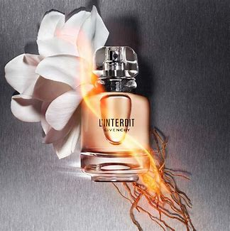
Stoelzle Perfumery
& Cosmetics
Part of the Stoelzle Glass Group, a family-owned company with a long tradition in glass-making.
The Group produces approx. 2.7 billion glass bottles per year for Perfumery & Cosmetics, Spirits, Pharma and Food & Beverages.
Perfumery & Cosmetics
140.8 mio Perfumery flacons and beauty jars per year.
Two production sites in France and Poland.
2 Decoration sites which develop sustainable techniques to enable 100% recyclability.
Usage 15% PCR (Post-consumer recycled glass).

Slide 3
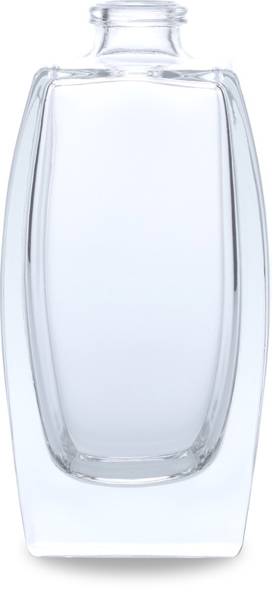
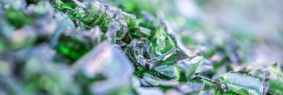
About Glass
AS A PACKAGING MATERIAL GLASS IS UNDOUBTEDLY IN A LEAGUE OF ITS OWN.
It consists of 100% naturally occuring raw materials:
Glass is infinitely recyclable, without quality loss. This saves energy and raw materials, and lowers emissions when added to our batch.
5%
FELDSPARS
5%
DOLOMITE
12%
LIMESTONE
SODIUM CARBONATE
18%
recyclable
59%
SAND
natural
100%
inert
tasteless
3

Slide 4
Why recycling beauty glass packaging matters
DESIGNING BOTTLES FOR A GREENER FUTURE
The beauty and wellness industries generate over 120 billion packages every year.
Today, glass is 30% lighter, 70% less energy-intensive and emits 50% less CO2 than fifty years ago.
In Europe 80% of glass is recycled, but 20% still is not.
Losses during glass recycling are still too high 17%.
Extra-white glass is preferred in Beauty. How can the industry maintain its purity with increased cullet use?
Use PCR with low iron content (<300 ppm); improve sorting for higher quality PCR; collaborate with recycling companies and sector for dedicated chains
Further develop technologies and work on raw material to increase PCR usage while preserving the extra-flint color
4

Slide 5
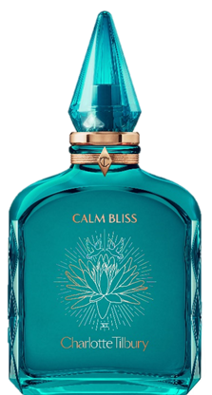
What is recycling beauty glass packaging about ?
DESIGNING BOTTLES FOR A GREENER FUTURE
Today there are limited material (almost none) that are not really recyclable.
Recycling is not really about Materials but Sorting !
Losses during glass recycling are still too high 17%.
We need to close the loop.
100%.
17%.
The recycling process may incorrectly identify the glass as a ceramic, stone or porcelain
5

Slide 6
What makes a product difficult to recycle ?
DESIGNING BOTTLES FOR A GREENER FUTURE
Materials
A lot of beauty packaging is not correctly identified by the Customers, making difficult for them to know what needs to be recycled and where.
Material Mix
Most of packaging is made of more than one type of material and must be separated apart (pumps, squeezable tubes, compacts, lids, caps & other Closures, etc.). In most cases broken manually.
Product Configuration
Decoration Techniques (Frosted or Etched Glass, Metallized Inks & Coatings, Powder Coat & UV-Based inks & coatings, Silk Screen Printing, etc.)
6

Slide 7
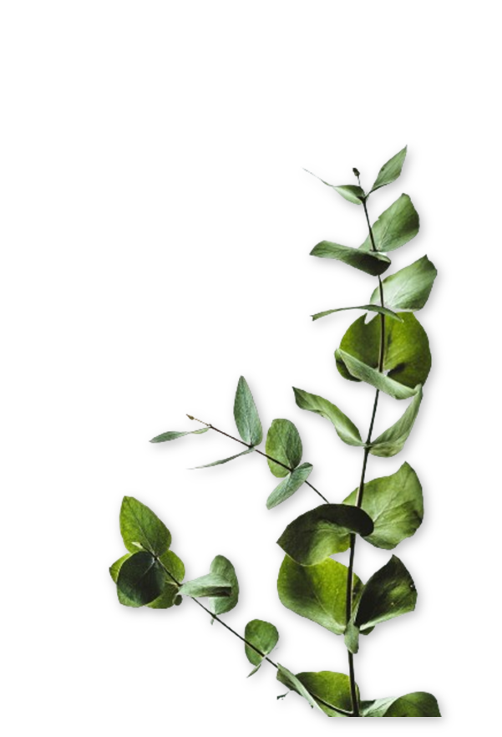
Stoelzle: Our Role as a Glass Producer
DESIGNING BOTTLES FOR A GREENER FUTURE
Designing glass products where other parts can be easily removed to ensure proper recycling is convenient for the end consumer.
Sustainable Decoration (e.g. organic inks) to enable 100% recyclability.
Lightweight glass for reduced carbon emissions from manufacturing transport.
Using PCR & PIR glass: Increase of recycled content to 20% until 2030.
7

Slide 8
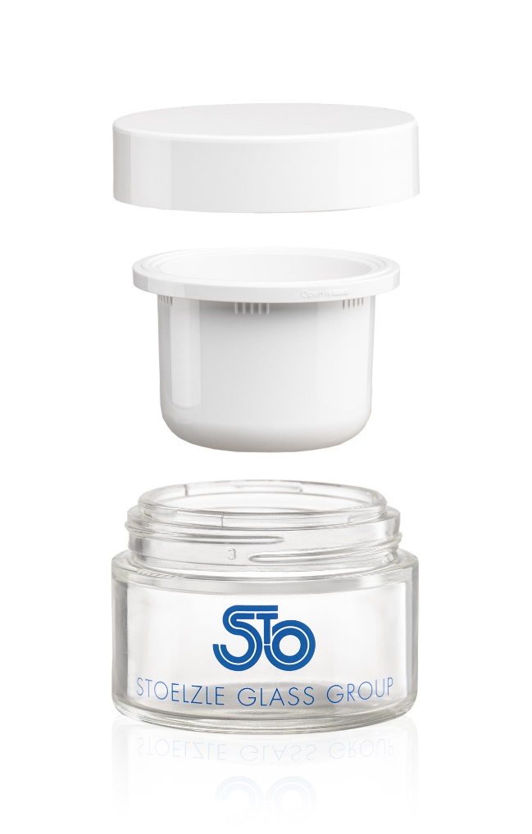
Designing Easy to Recycle Products
A PLASTIC CUP IN A GLASS JAR, EASY TO USE AND RE-USE
THE CAP
Refillable jar:
Features components that are easy to separate and 100% recyclable.
Aligns with the growing trend of refillable packaging
100% PET or PP,
100% recyclable
THE CUP
100% PP, 100% recyclable
THE JAR
100% glass, 100% recyclable
11,6% PCR glass
Lightweight : 125g
8

Slide 9
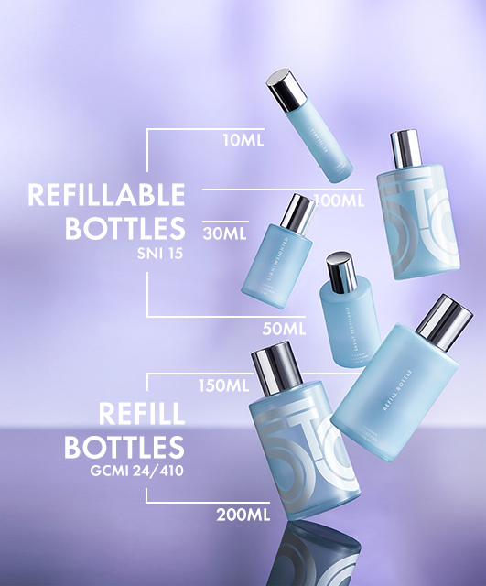
Designing Easy to Recycle Products
REFILLABLE PERFUME BOTTLES
Bottles for perfumery designed to improve recycling rate.
Pumps and other components can be easily removed, simplifying proper recycling for the end user.
Due to their neck design and larger capacities, bottles are ideal for fragrance refills, as well as cosmetic use, such as body care in combination with proper removable accessory (ie. dispenser).
15 % PCR content and significant reduction of CO2 in their manufacturing due to lightweight design.
9

Slide 10
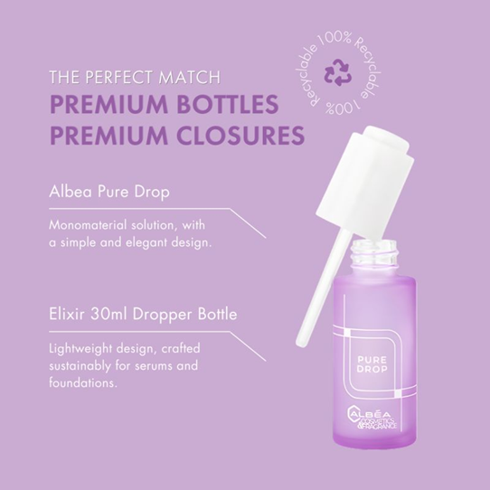
Designing Easy to Recycle Products
RECYCLABE SERUM BOTTLES
Bottles designed to improve recycling rate.
Pumps and other components in mono material solution
Pumps can be easily removed, simplifying proper recycling for the end consumer.
2 waste bins (Glass and Plastic)*
* After proper cleaning of residual
10

Slide 11
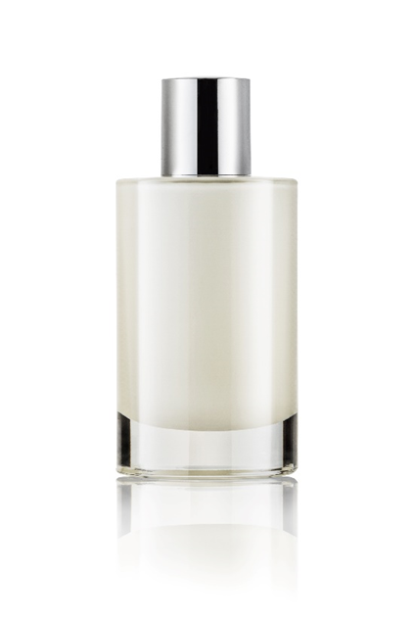
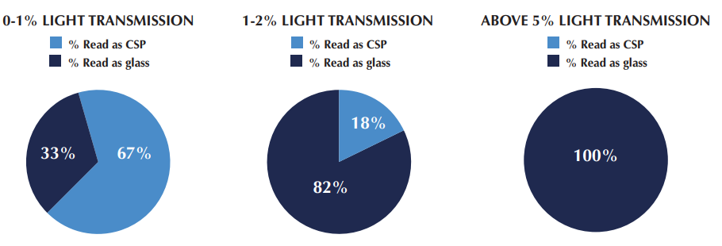
Designing Easy to Recycle Products
DECORATION TO ALLOW 100% RECYCLABILITY
Light Transmission. Guarantee minimum light transmission to ensure 100 % recyclability. According to a recent study by Estée Lauder* [see below], LT above 5% guarantee 100% recycling. Standard methods in definition.
Coatings. Solvent free ecofriendly technology of powder coatings and decorative transfer. Crushed bottles are melted, organic materials (e.g. paint) burn off.
UV Barrier Coatings. Maintain 100% glass light transmission but filter UV to preserve fragrances. Alternative to opaque and not recyclable containers.
* Driving Sustainability Study
11

Slide 12
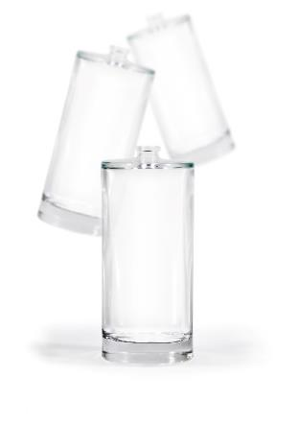
Thank
You !

