Slide 1
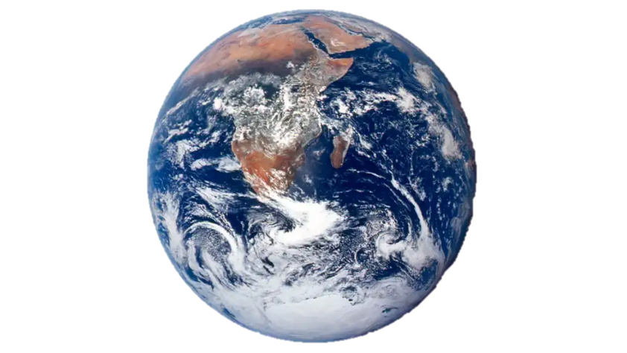

From sound to insight- recycling the future
Jordi Berguinzo Martinez
jordib@candam.eu
candam.eu

Slide 2


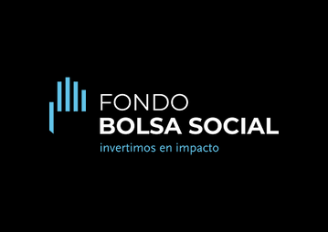




5.5M
2.8M
+700
invertidos (€)
ingresos (€)
dispositivos instalados
12K
9K
11
usuarios
paises
sensores de llenado
Notes:
"No es una idea: ya estamos en marcha. Hemos recaudado más de 5 millones de euros, generado casi 3 millones en ingresos acumulados, y desplegado 700 dispositivos y 9.000 sensores de llenado. Contamos con la patente concedida y el respaldo de inversores líderes en sostenibilidad, innovación tecnológica y economía circular, combinando capital público, privado e impacto"

Slide 3
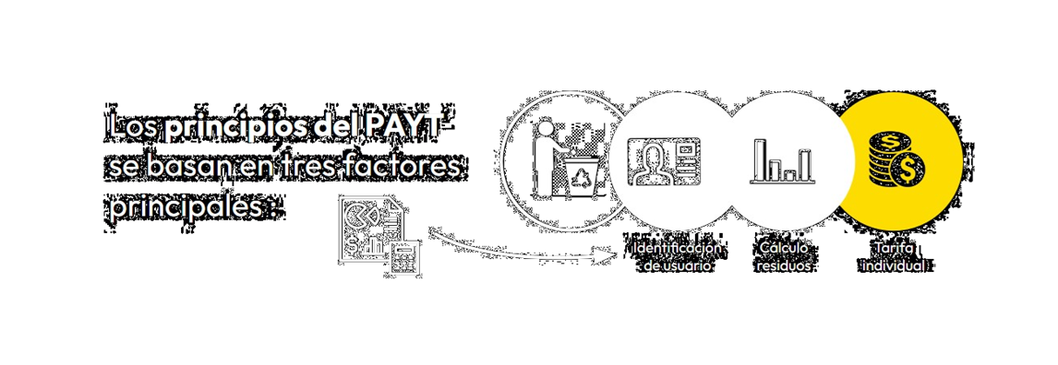
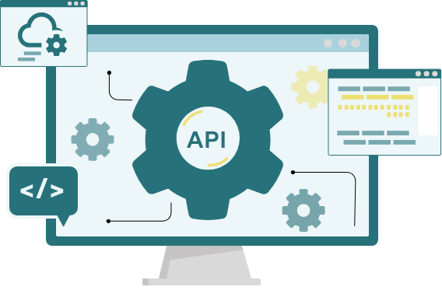
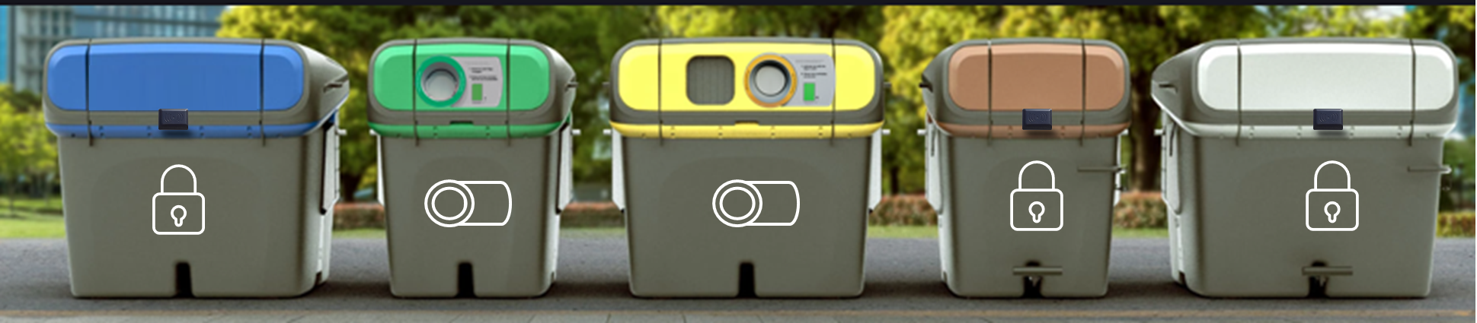
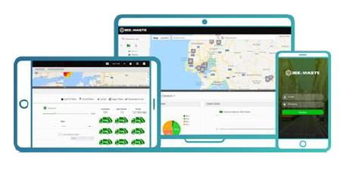
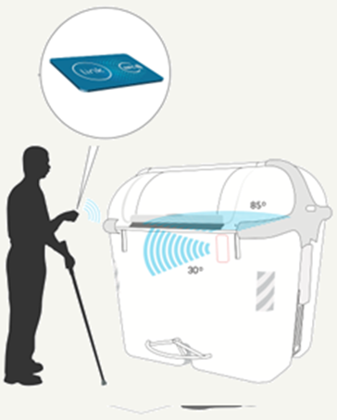
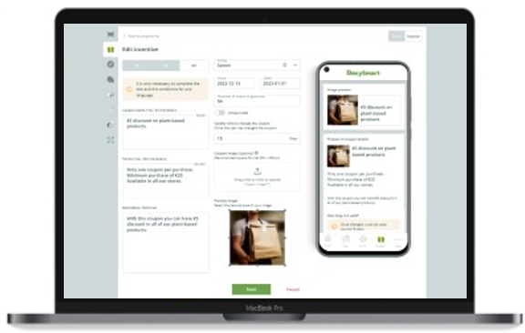
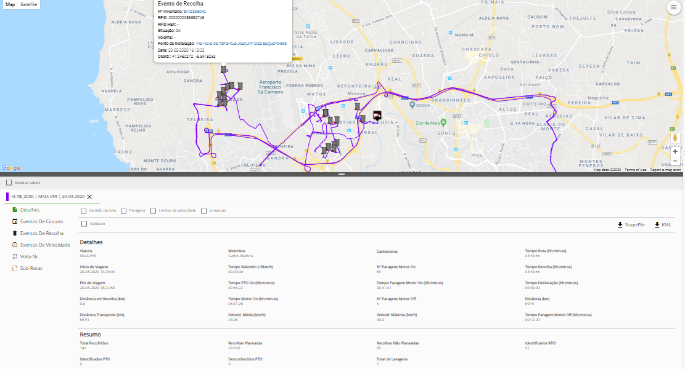
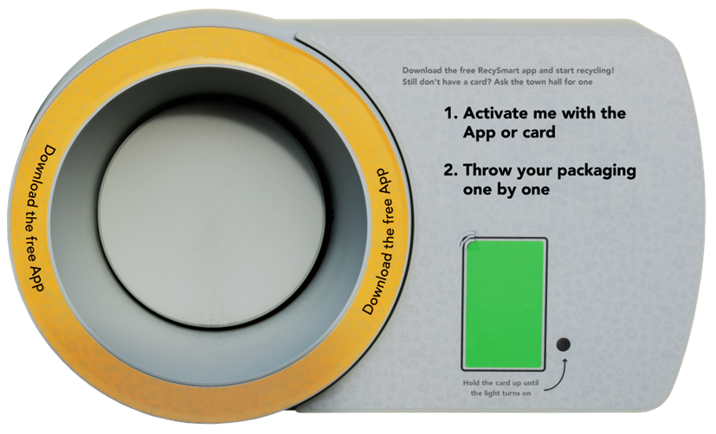
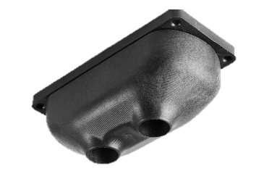
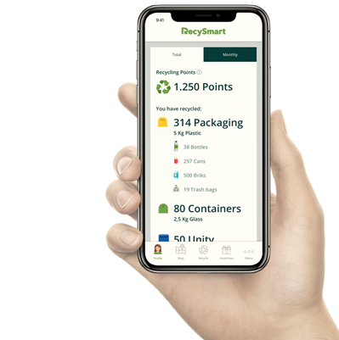
Tech ecosystem
MODULES
PAYT i RAYT incentives
Maintenance
Route Optimization
Business Intelligences
Digital assets (RFID tags)
Smart log
Weighting scales
App citizens and partner
Power BI
Tax fee
PAYT Module
Marketplace (Incentives)
Opt. Routes
RecySmart
Fill level sensors
Smart Log
App
Notes:
European Environment Agency: https://www.eea.europa.eu/ims/waste-recycling-in-europe

Slide 4
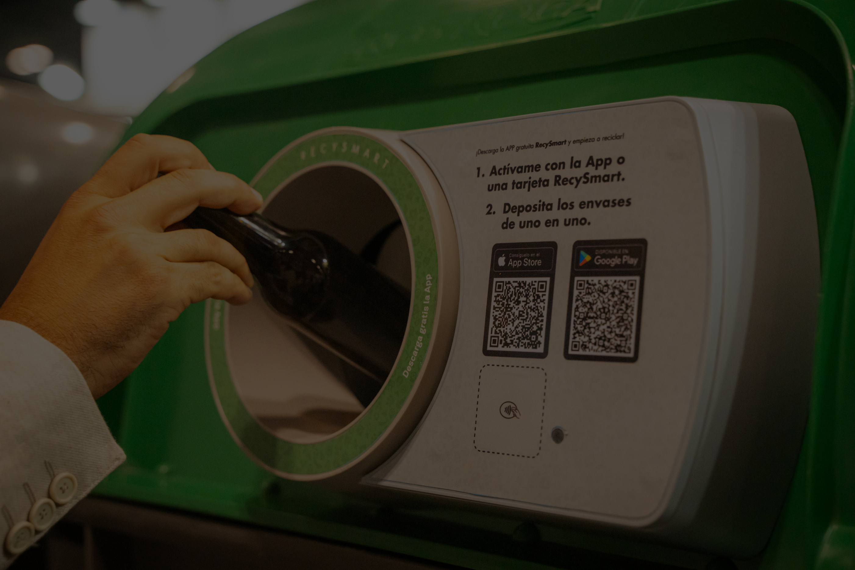

Increasing Glass Recovery Rates Through Smart Incentive-Based Systems: Lessons from Meliana
Jordi Berguinzo
jordib@candam.eu
+34 654 869 903
candam.eu

Slide 5

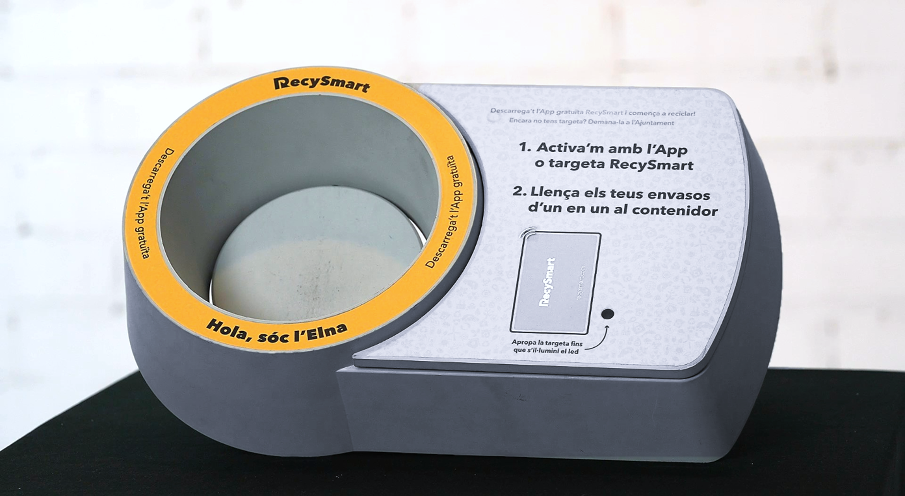

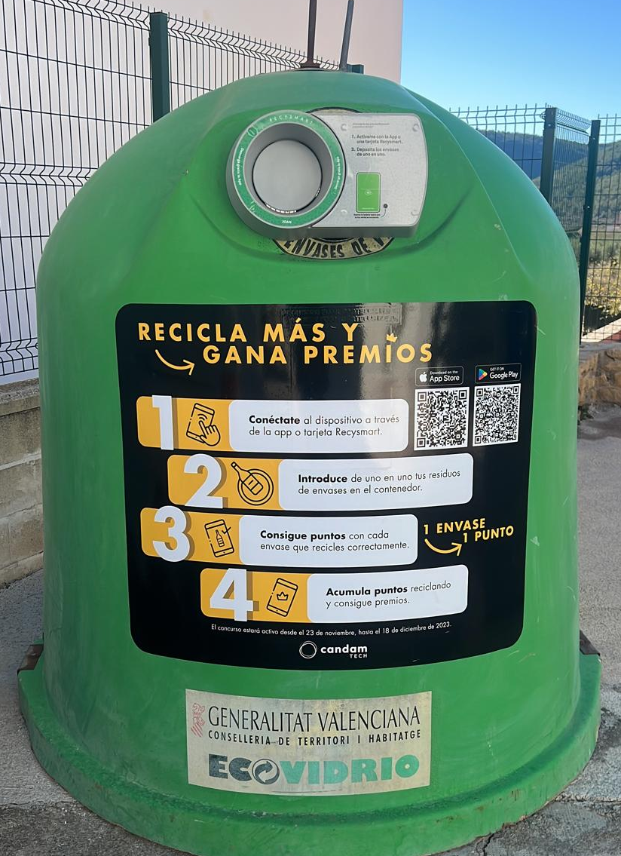
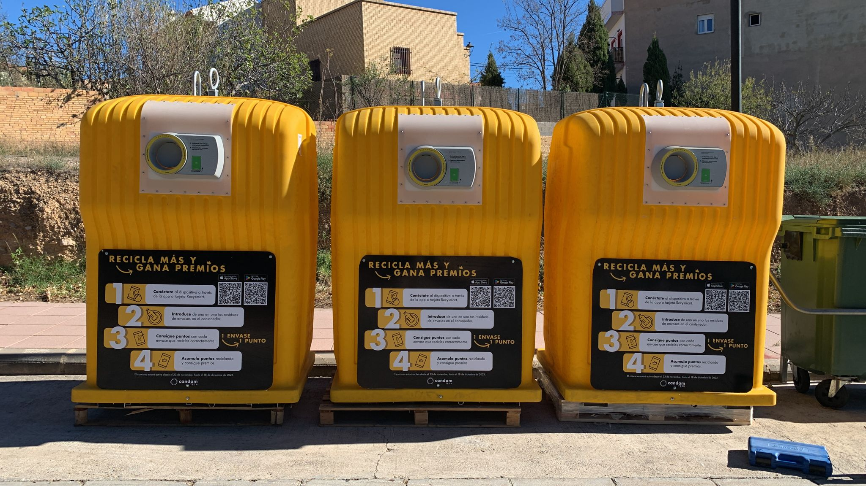
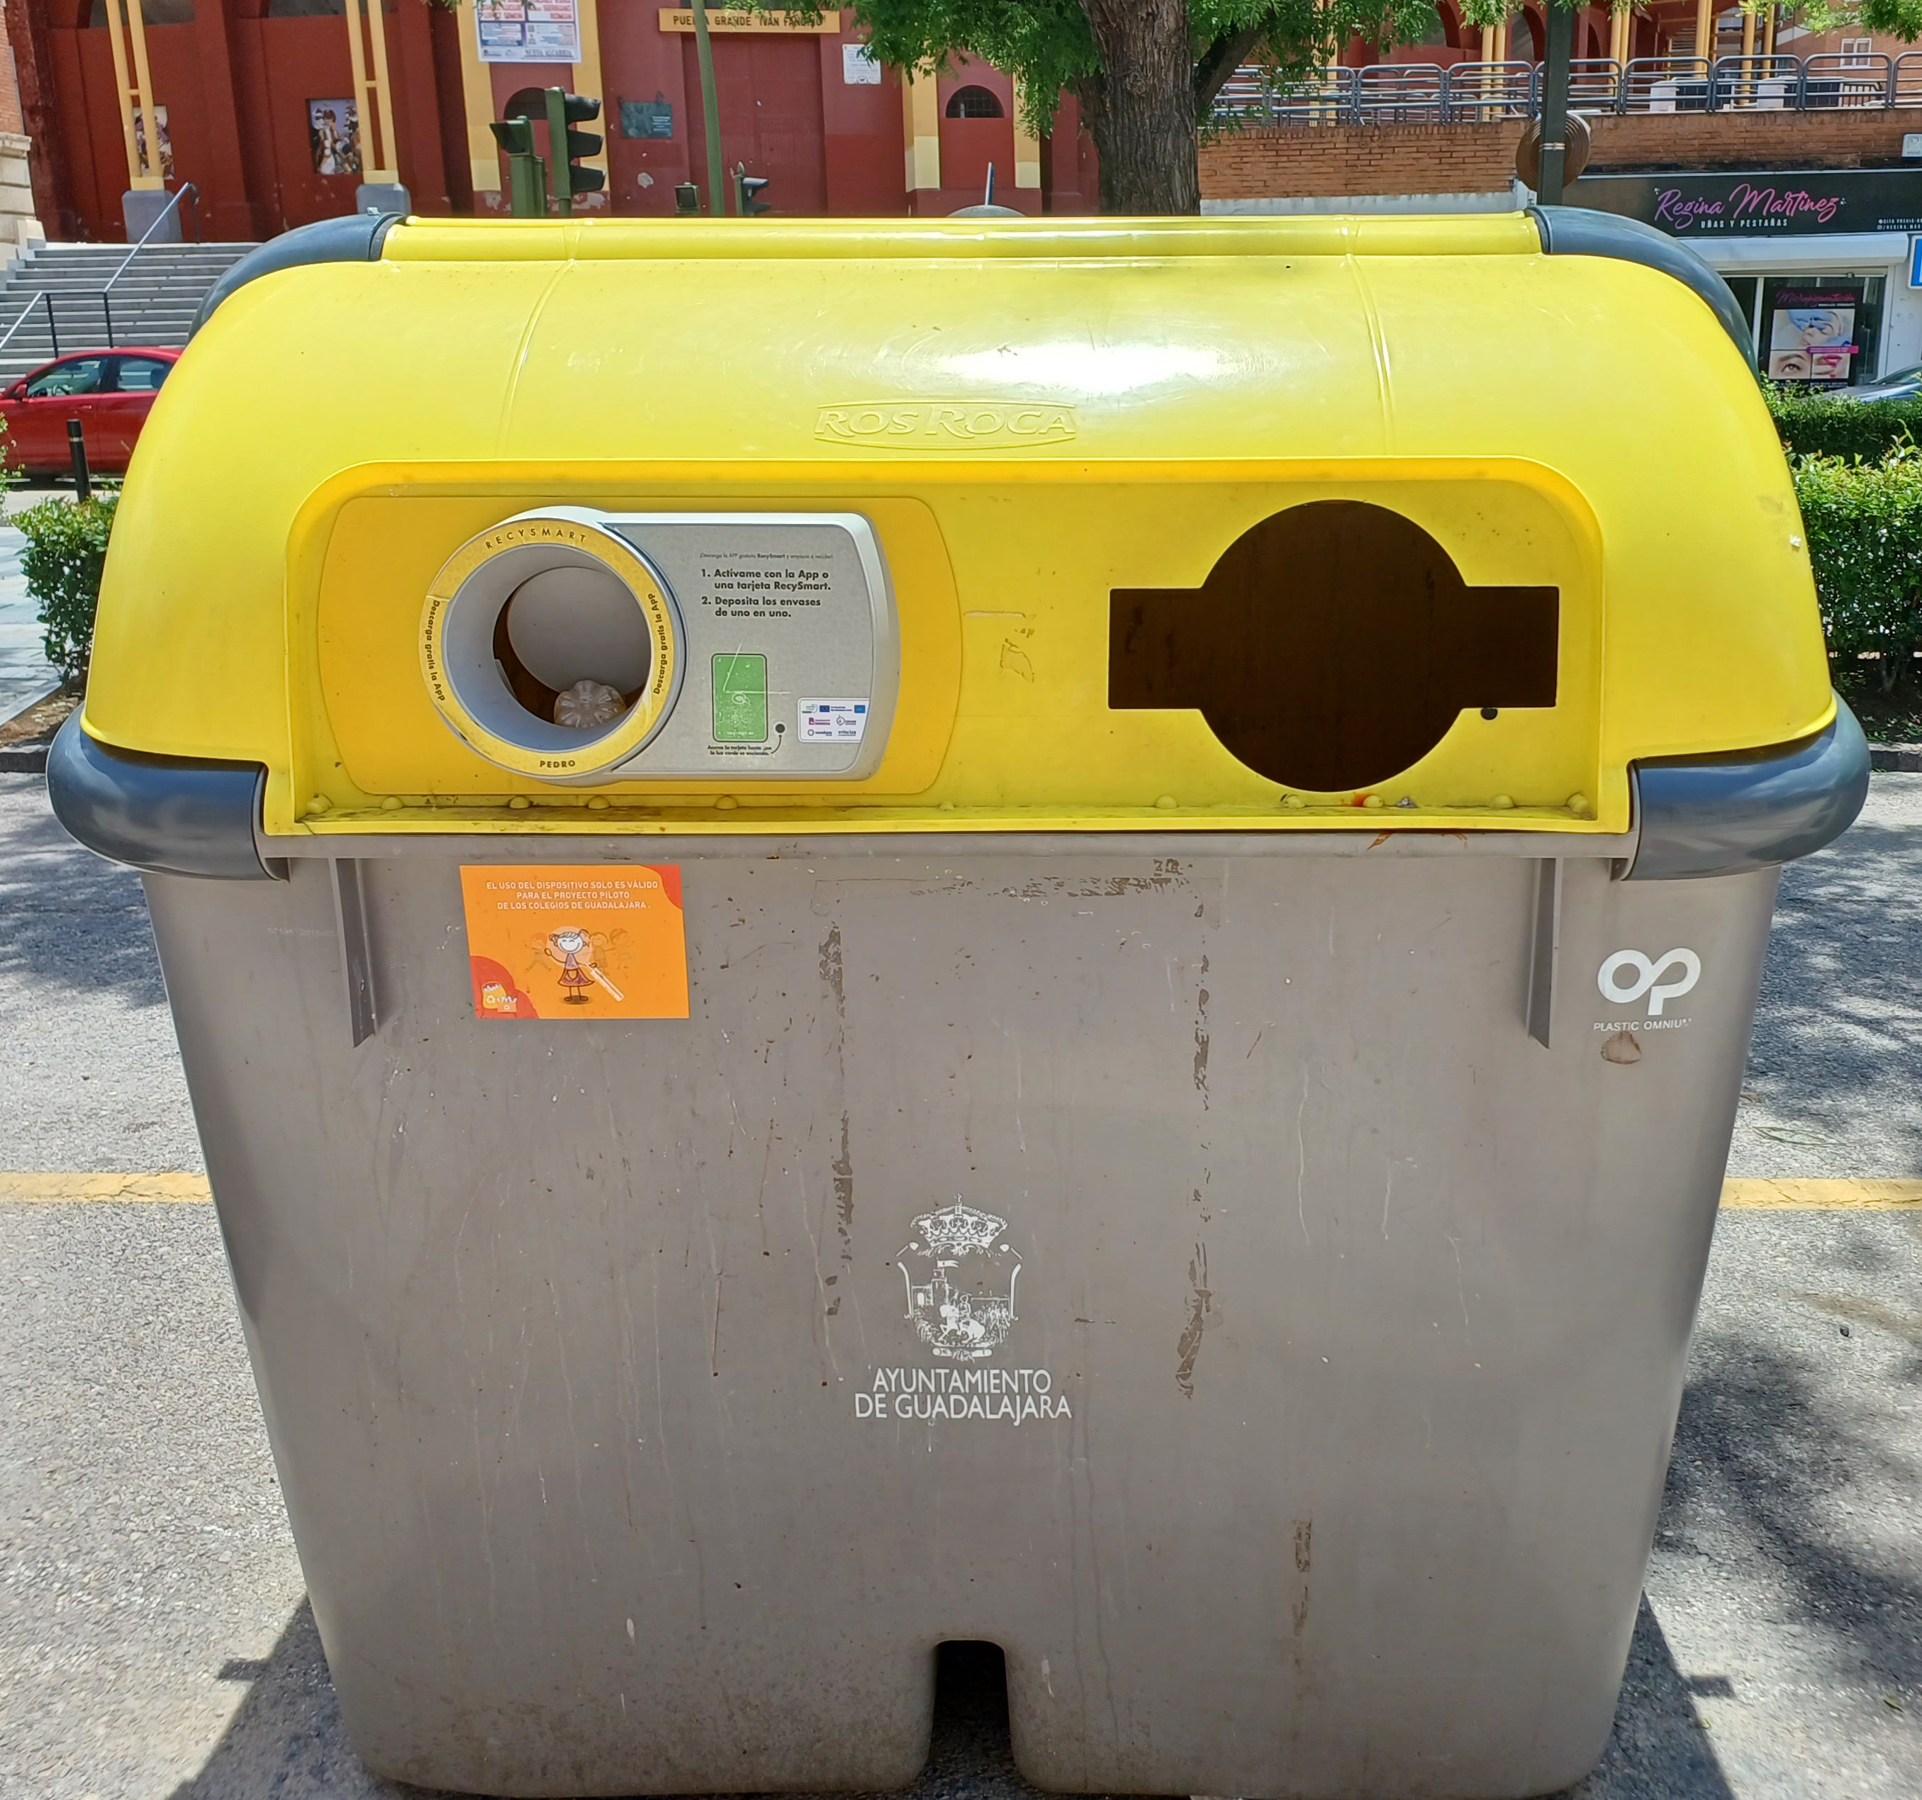
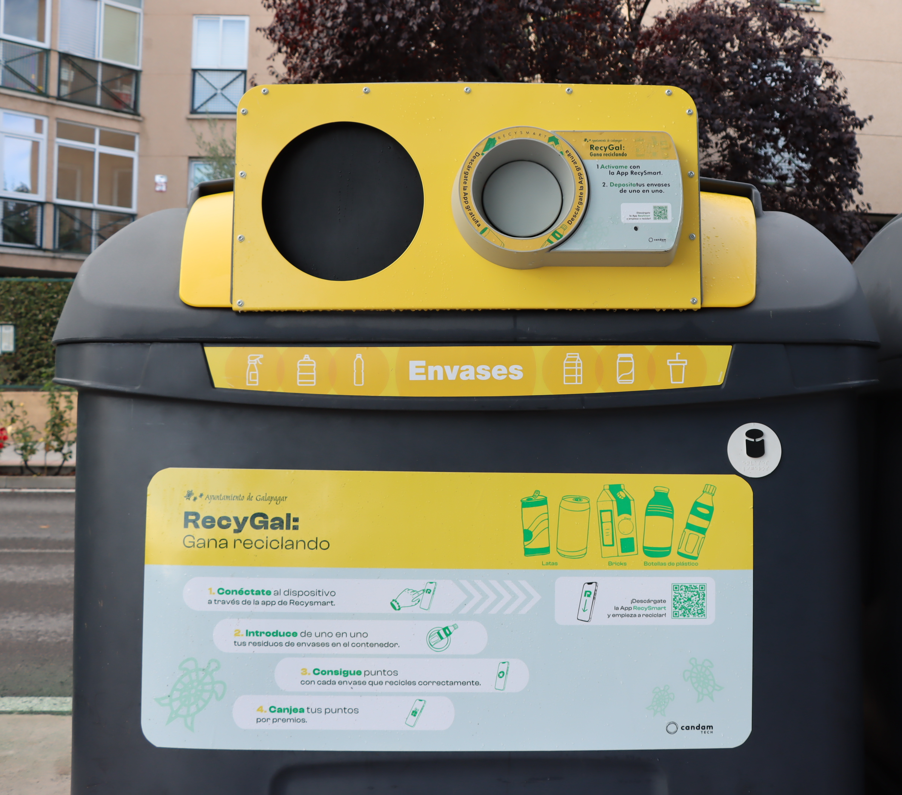
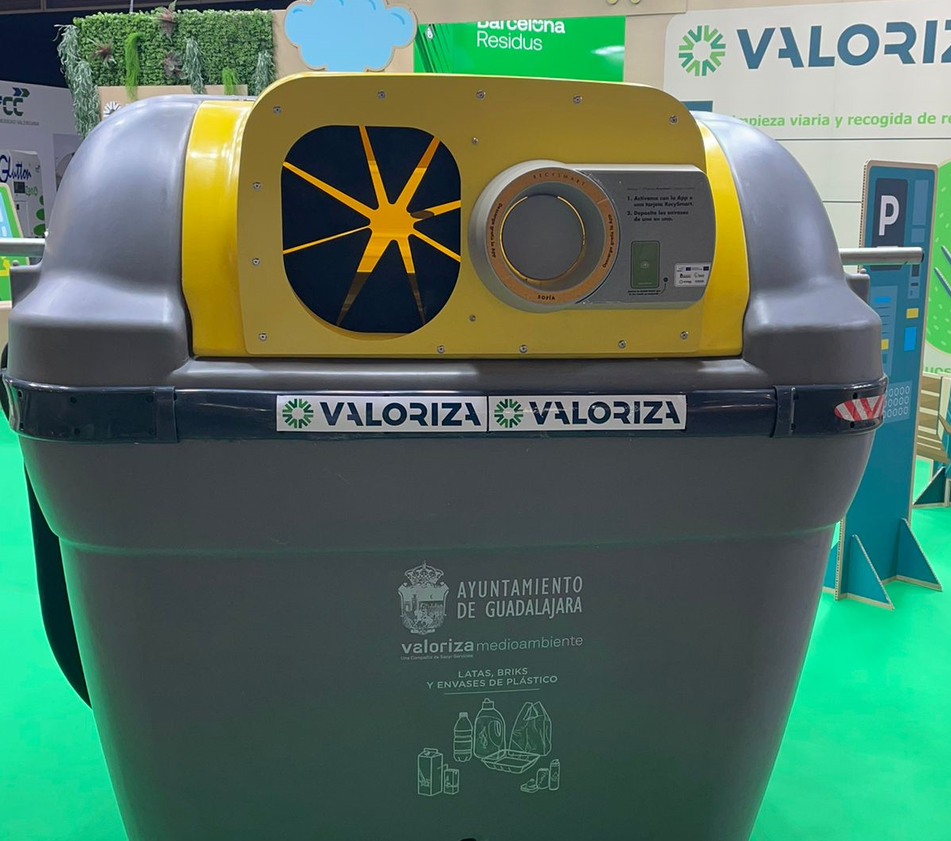
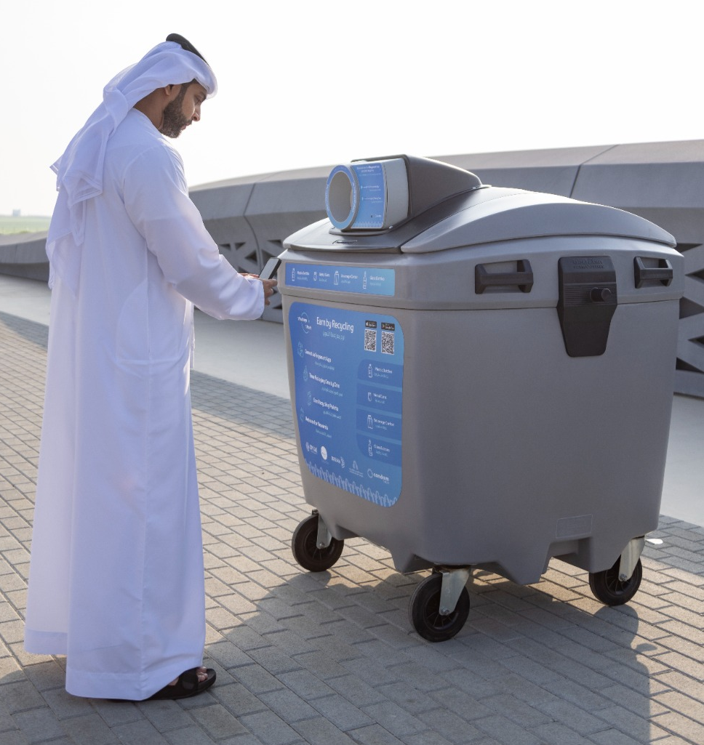
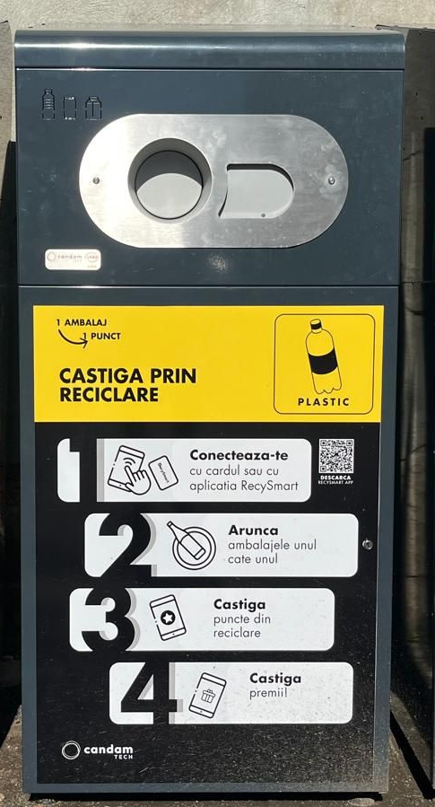
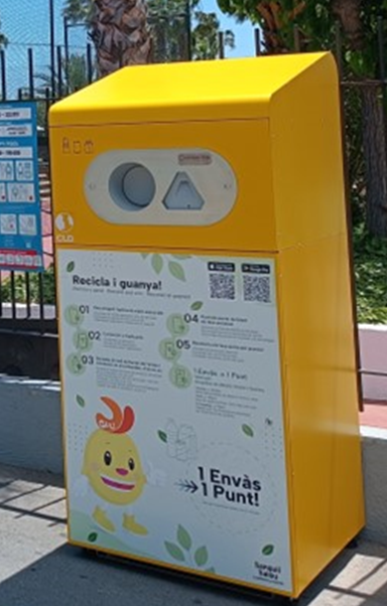

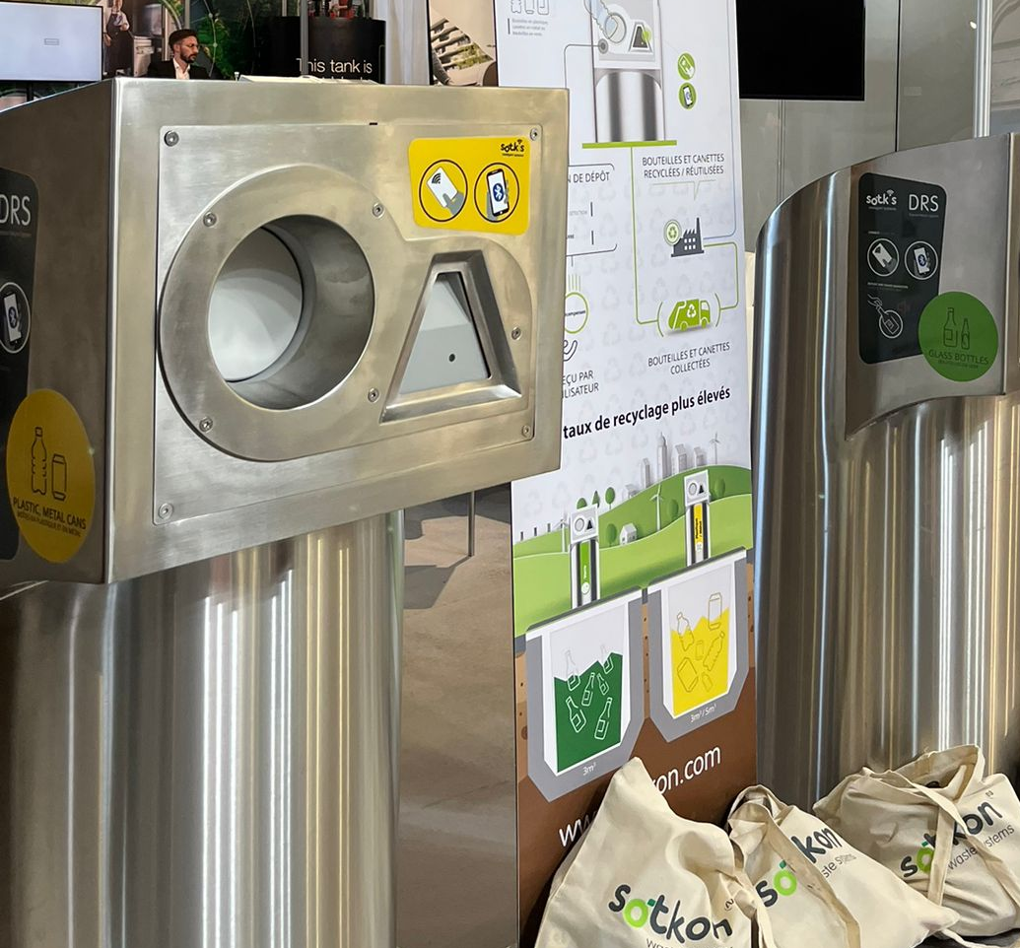
Turn any bin on the street into a smart.
The only effective, low-cost technology capable of increasing packaging recycling rates.

Slide 6
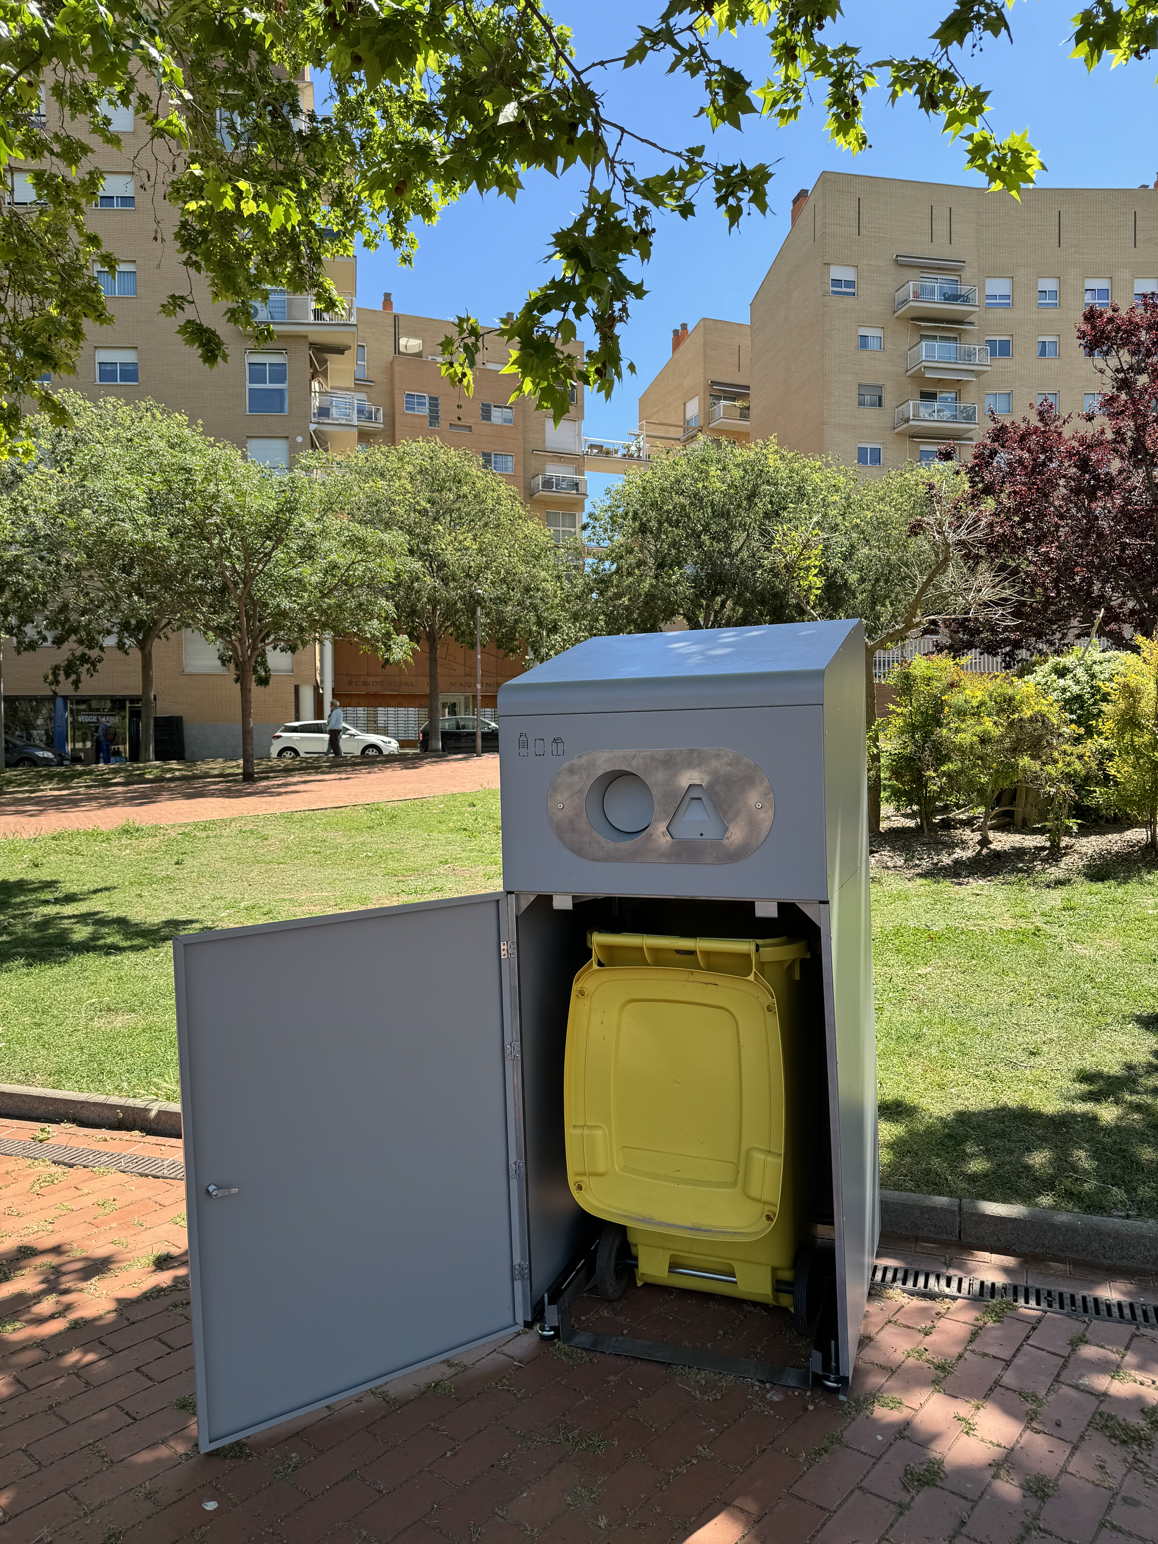
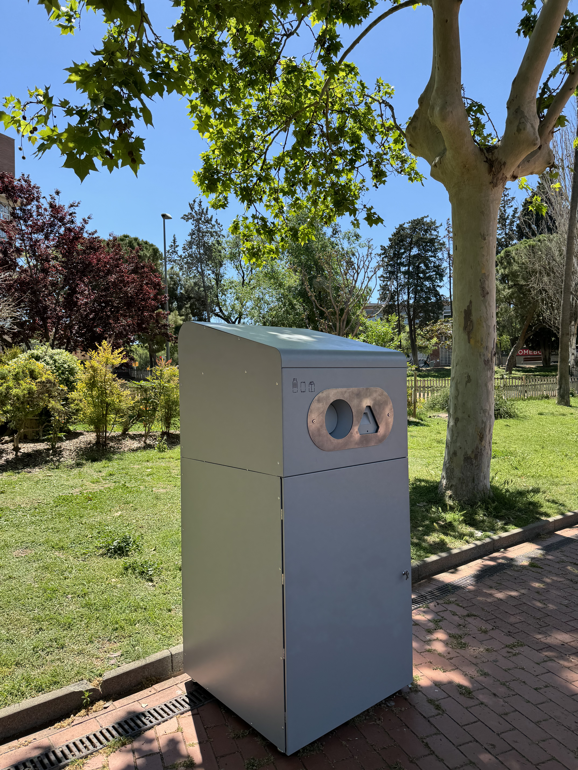
RecySmart Bin
A smart, accessible container for:
Events
Beaches
Pedestrian areas
Bus/train stations
Shops
Gas stations
Airports
Sports clubs
Private companies
Notes:
Different sizes to suit needs, not accessible to the public but for retailer returns only.

Slide 7
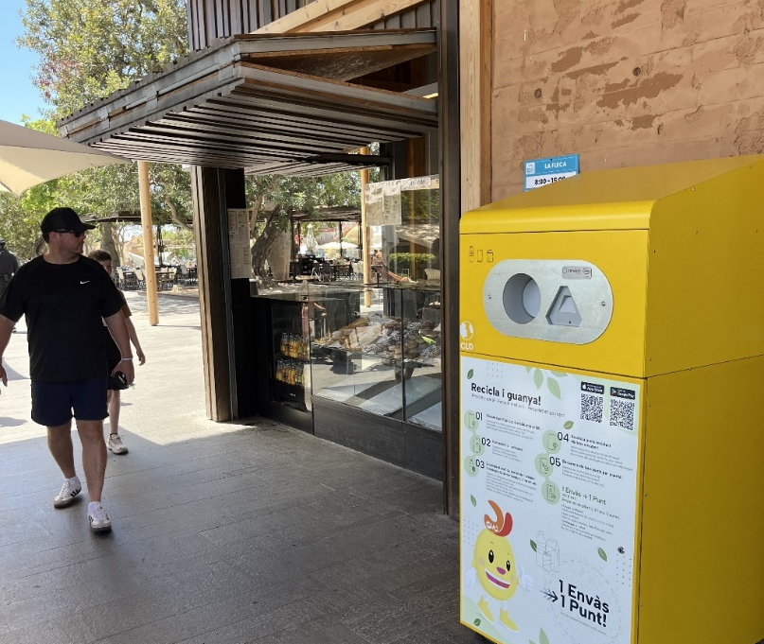
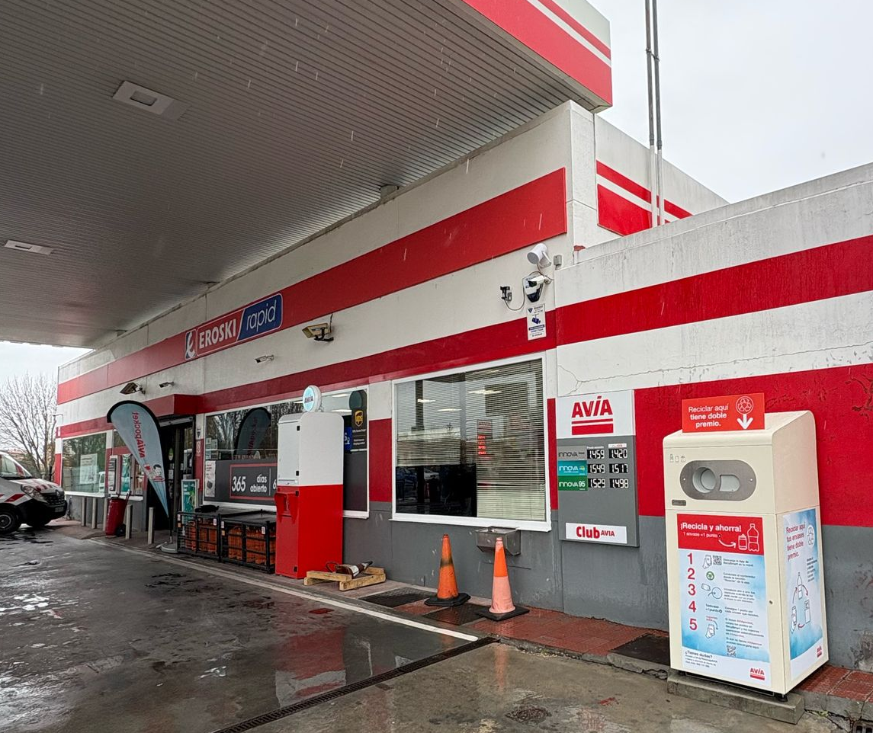
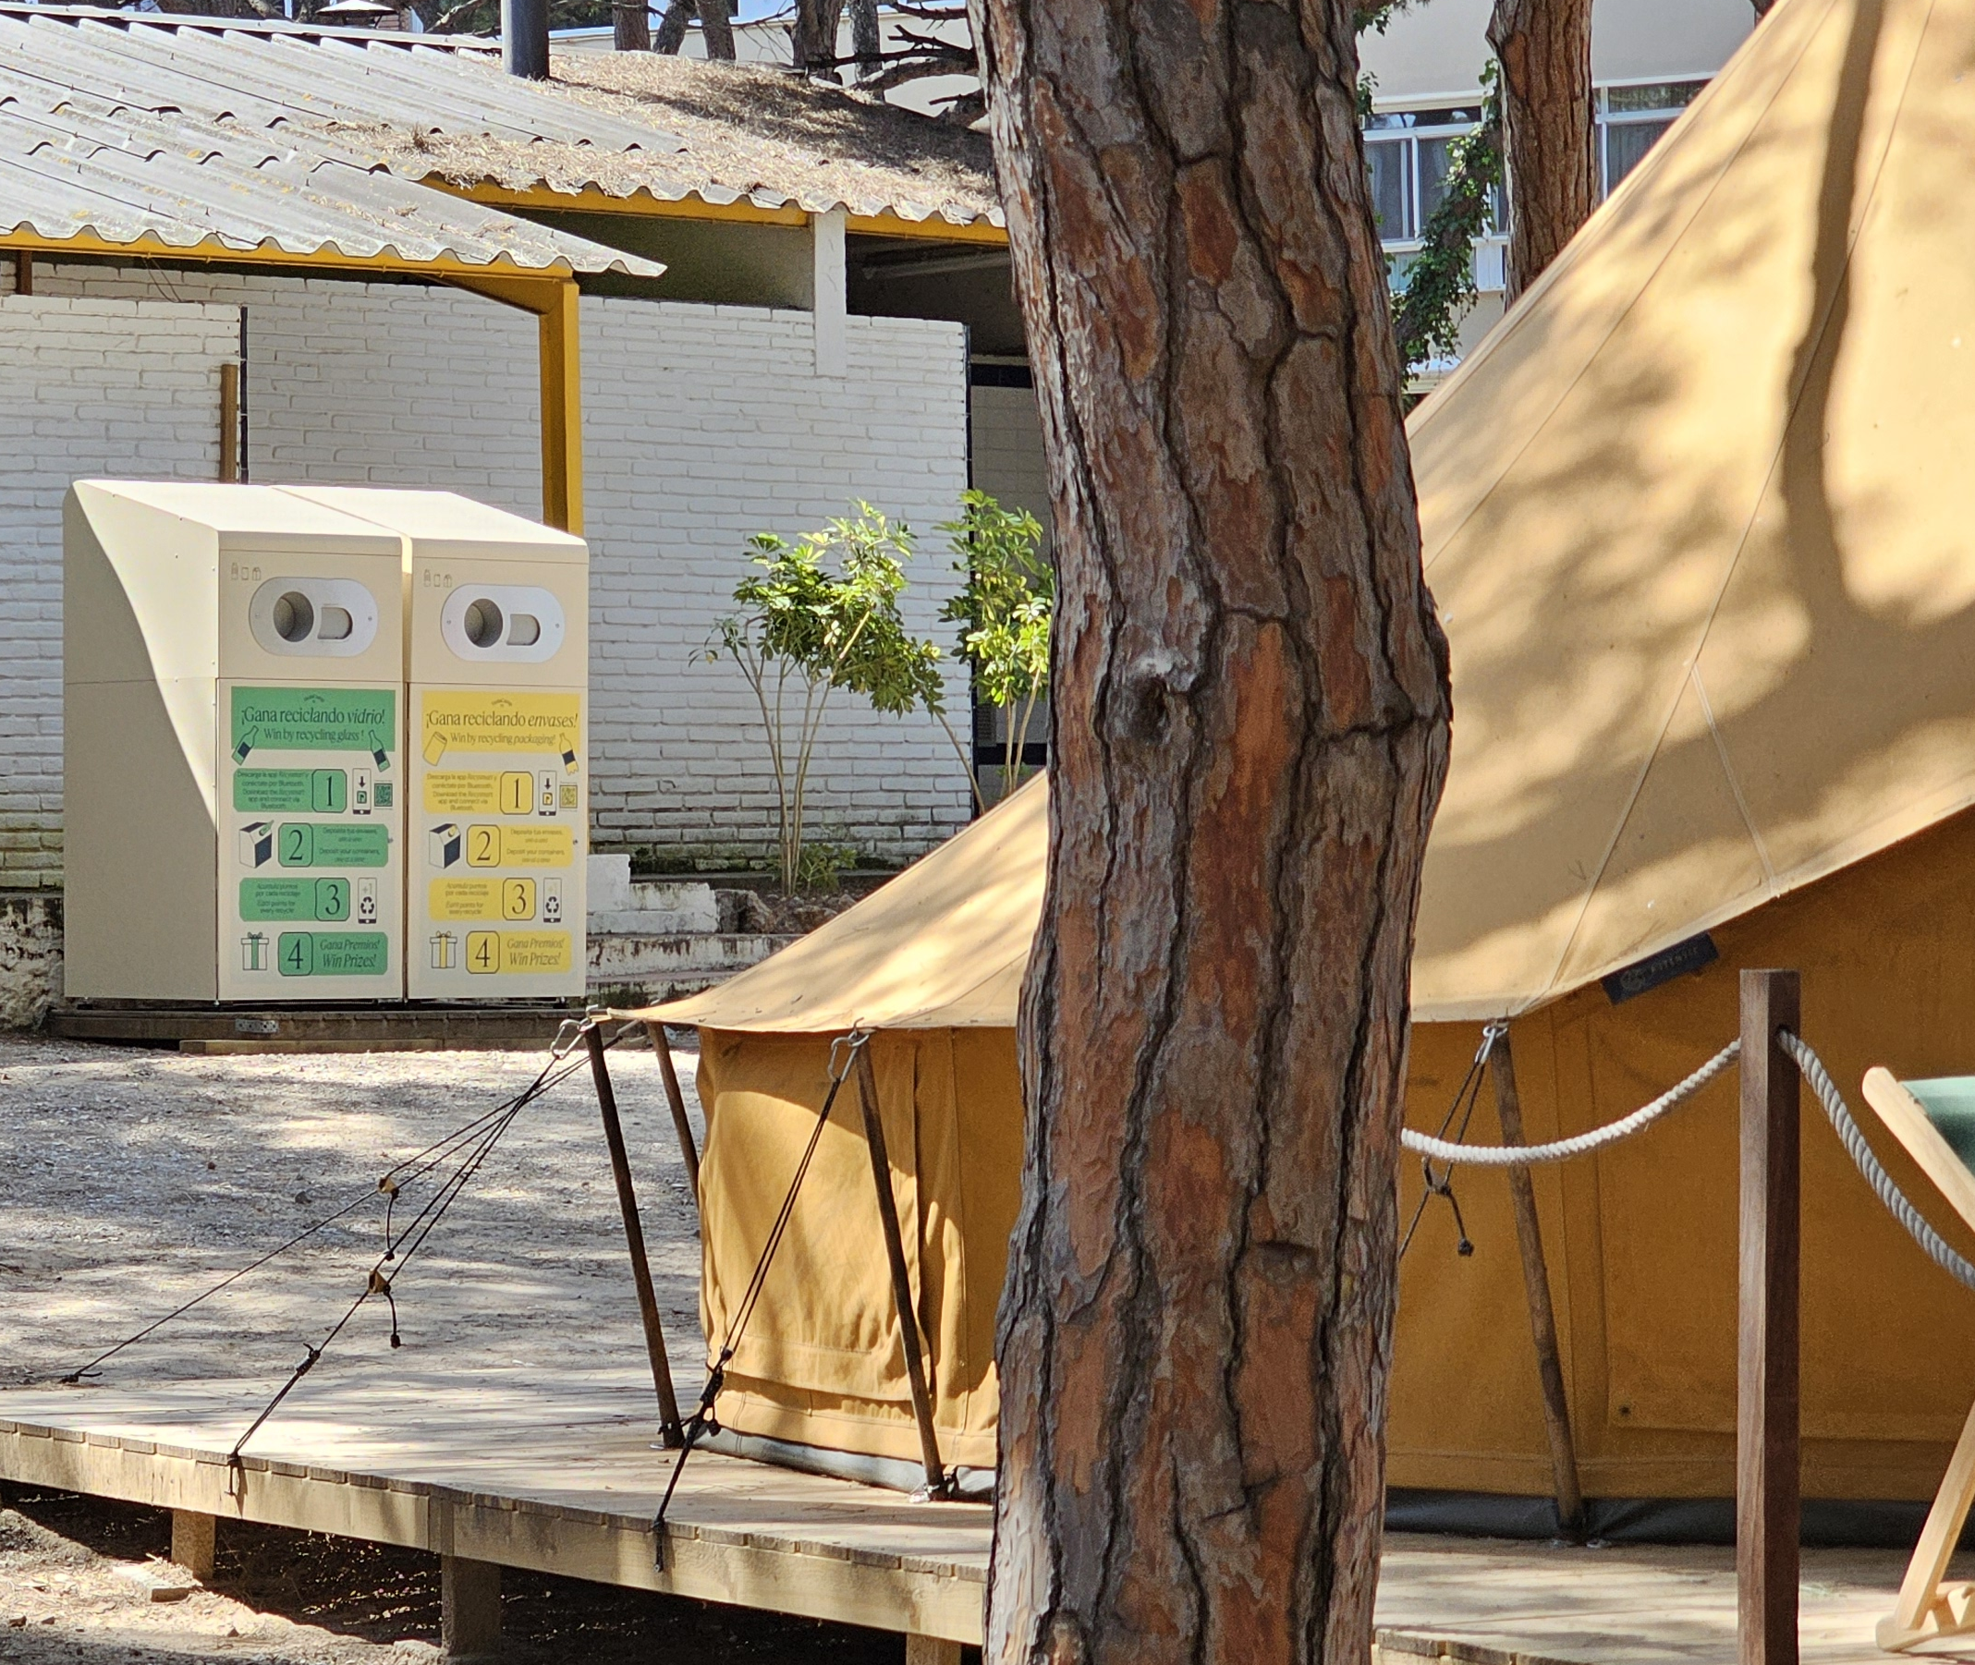
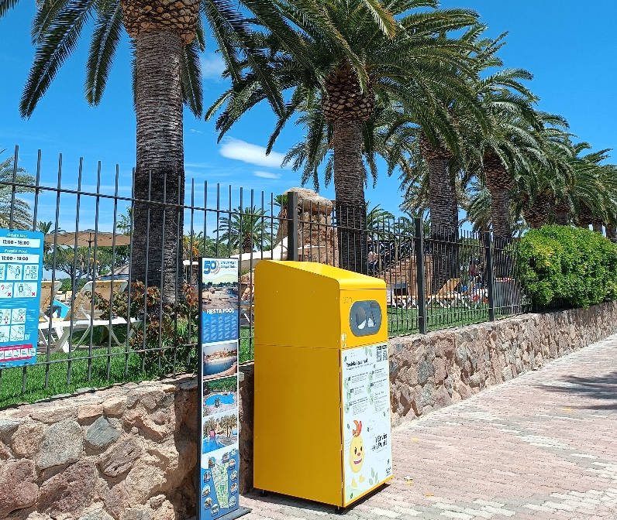
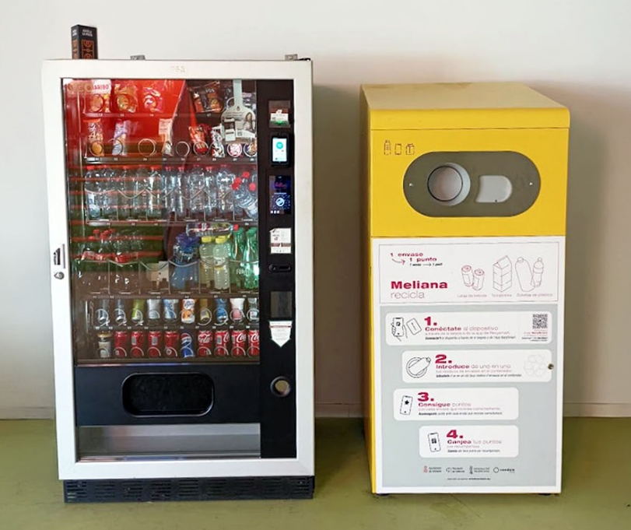
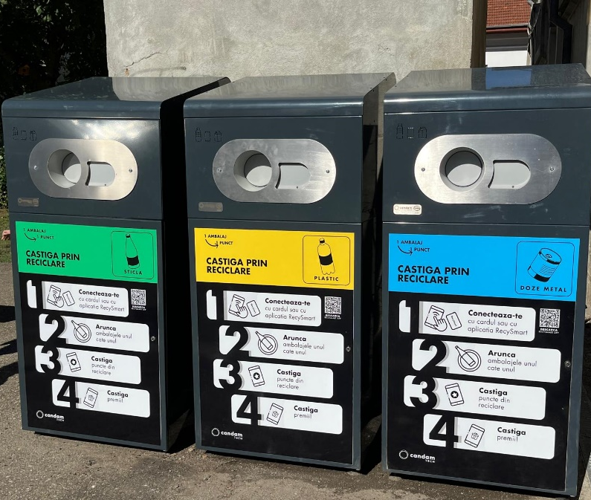

Slide 8
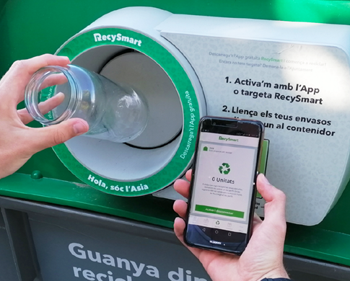
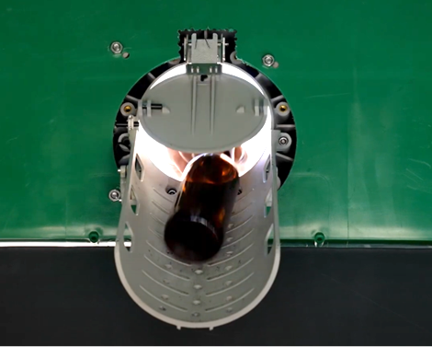
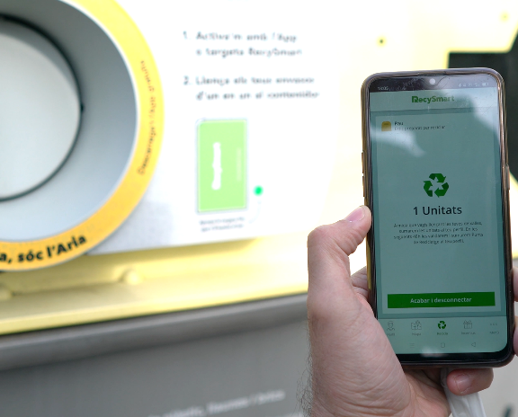
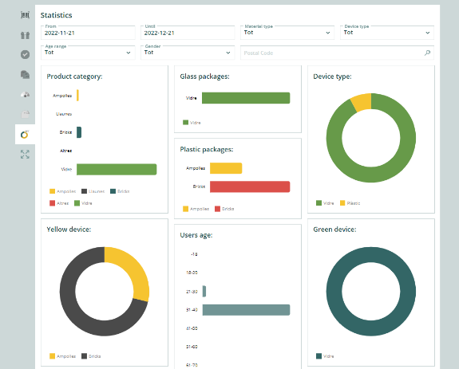

How does it work?
User ID
Citizens log in with the App or RFID card to identify themselves and start the recycling process.
Characterization
They feed their containers one by one into the correct container and RecySmart characterizes the material in real time.
Reward/Cashback
The citizen will receive the corresponding recycling points to exchange for rewards or the economic return of the deposit.
Sending Data
All data (user ID + recycled packaging) is sent to our platform for processing and analysis.
Unique patented technology capable of characterizing 4 types of packaging waste: Plastic bottles, cans, cartons and glass.

Slide 9
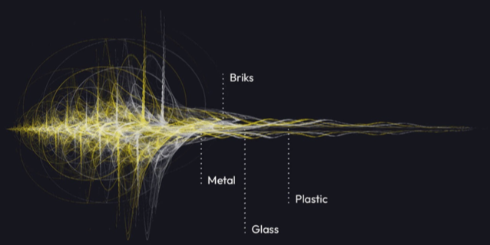

Acoustic patented technology
95%+ material clasification
Proof of disposal:
WHO, WHAT, WHERE, WHEN

Slide 10
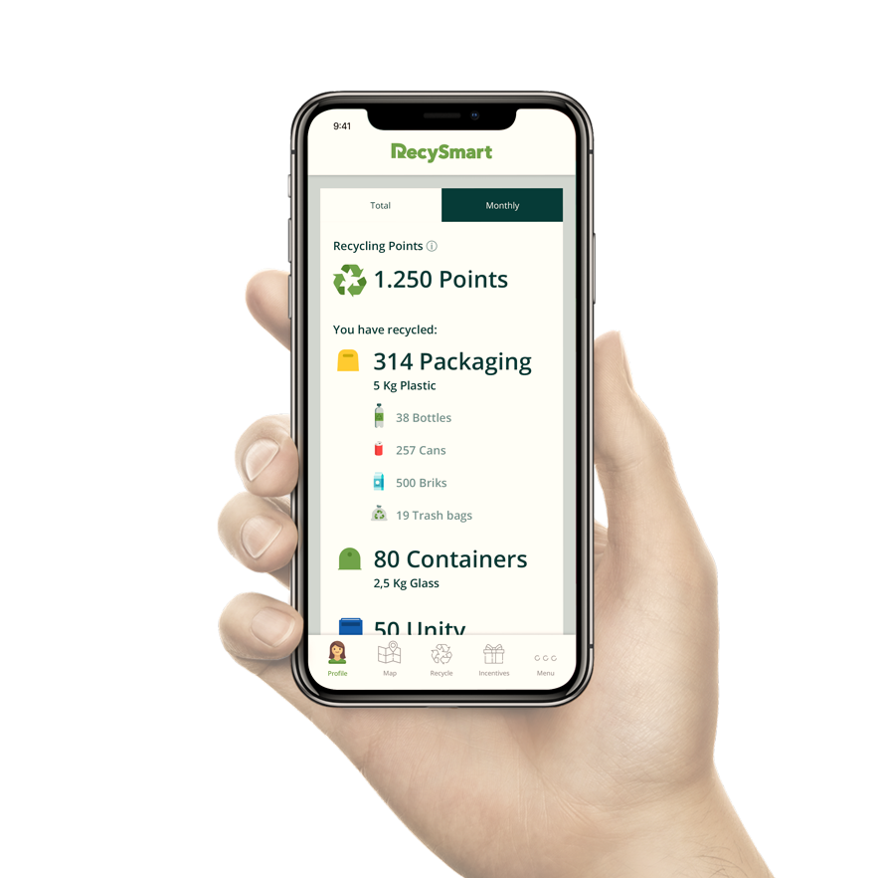
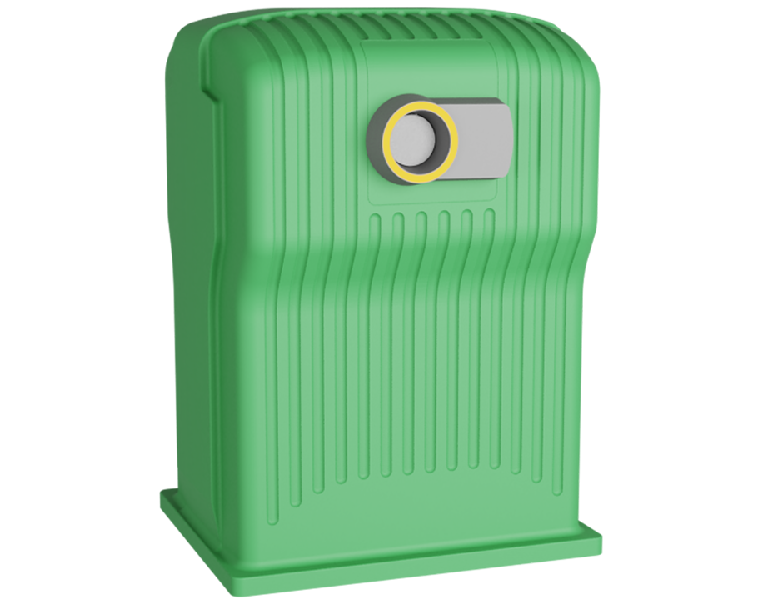
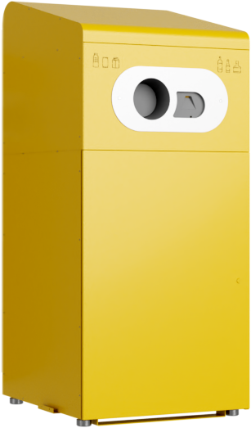
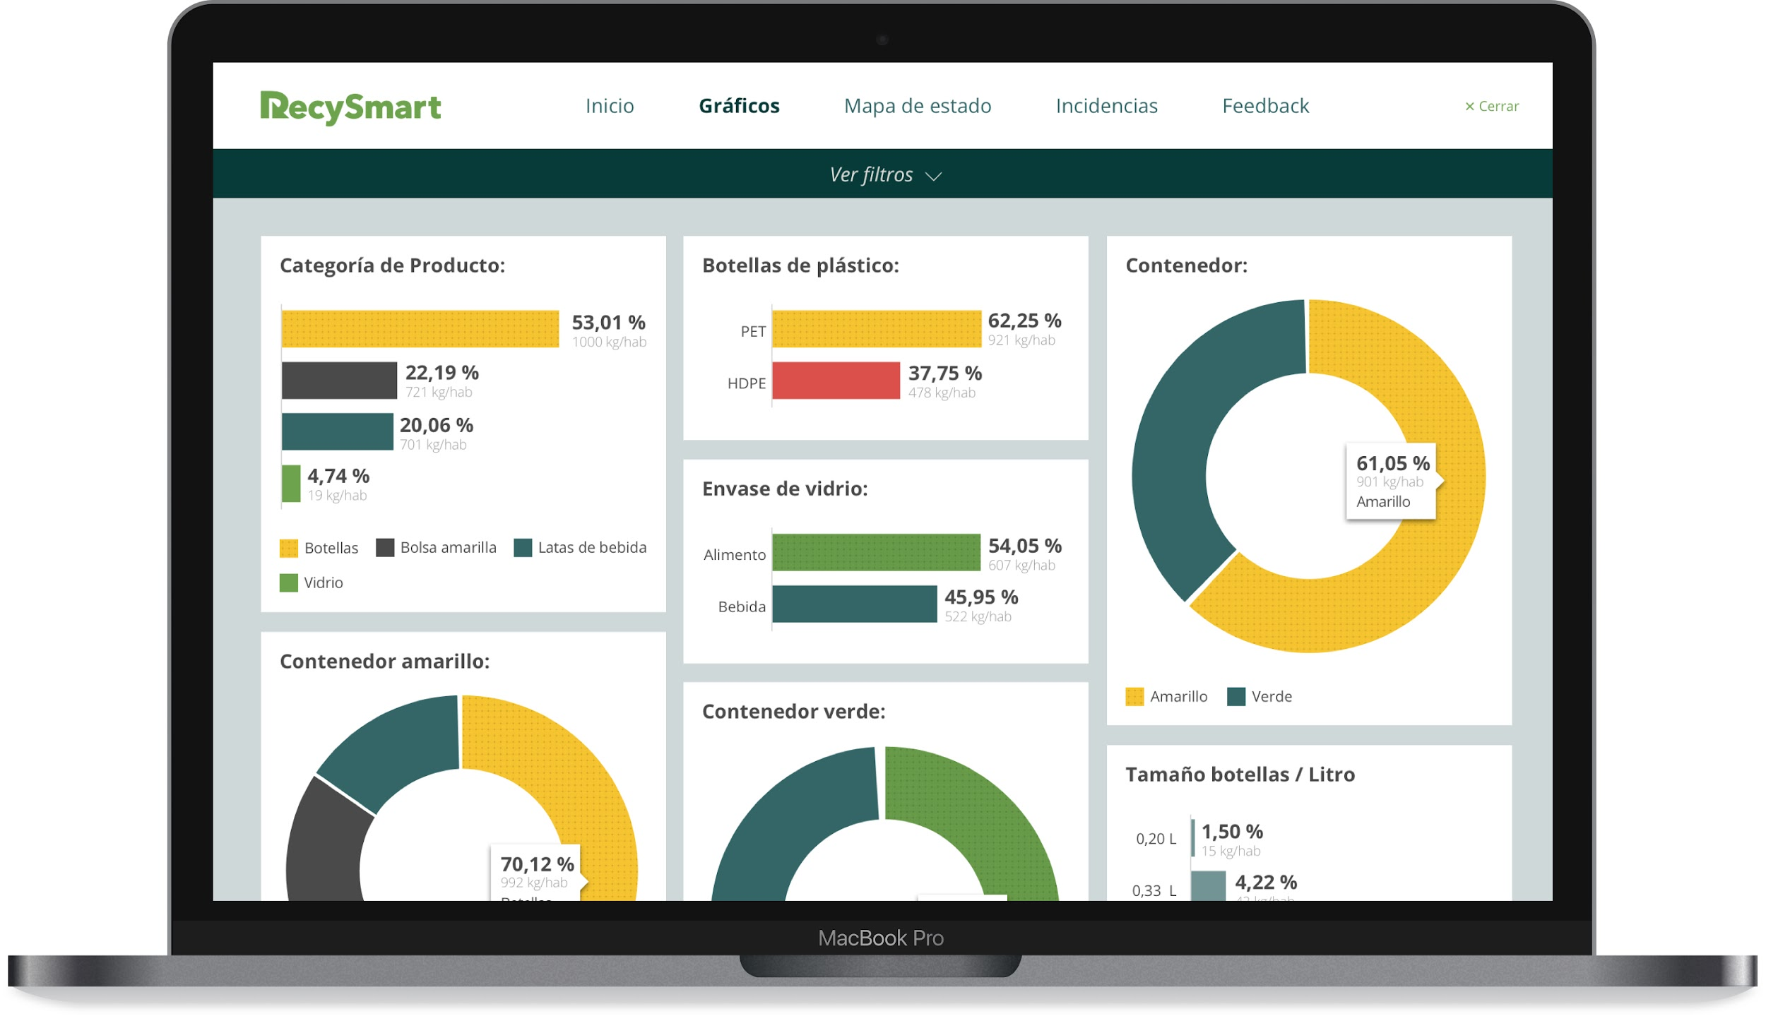
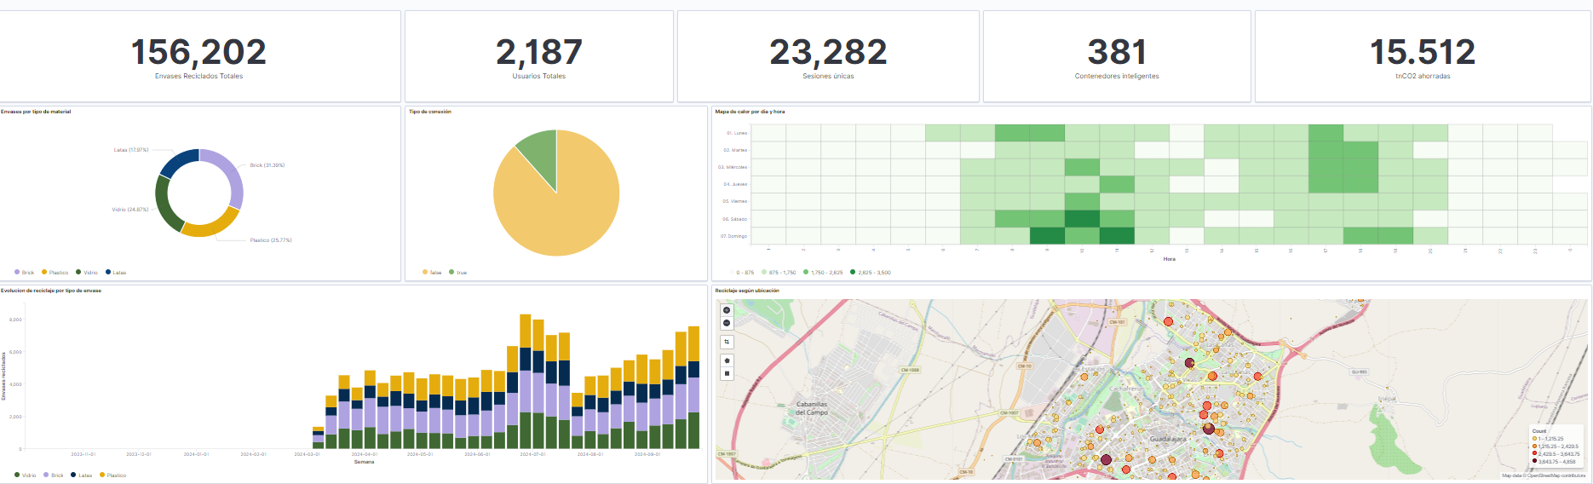
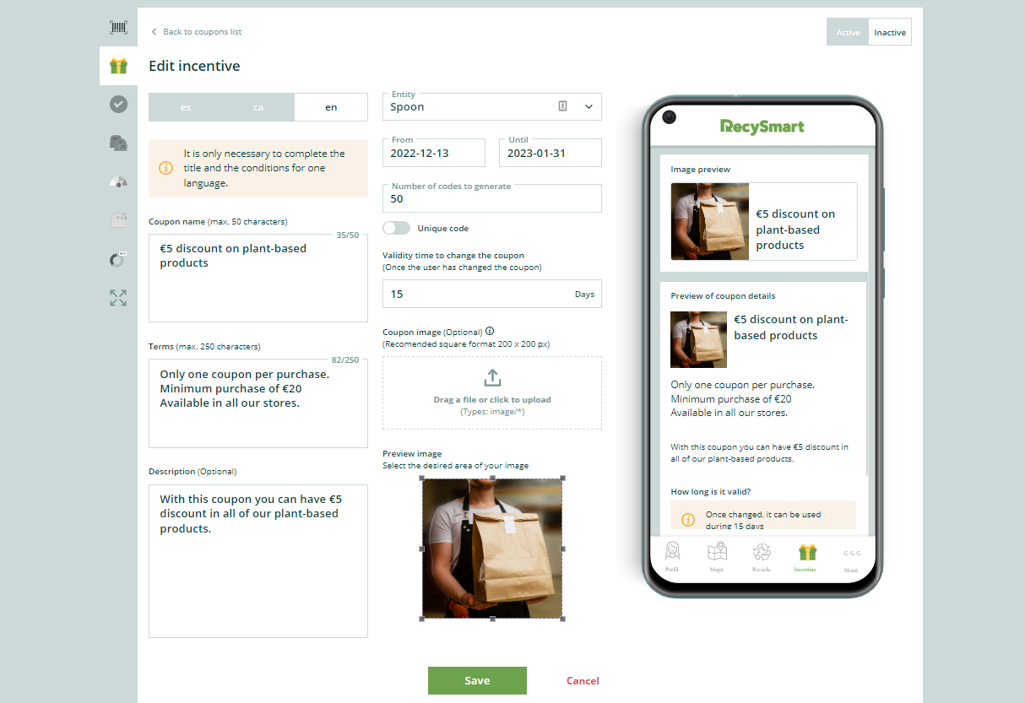
Technology ecosystem: Recysmart Ring
INTERCONNECTION:
CITIZENRY
LOCAL ENTITIES
WASTE MANAGERS
SHOPS
LOCAL
RecySmart
Device
Citizen App
PAYT Sense
Market place

Slide 11
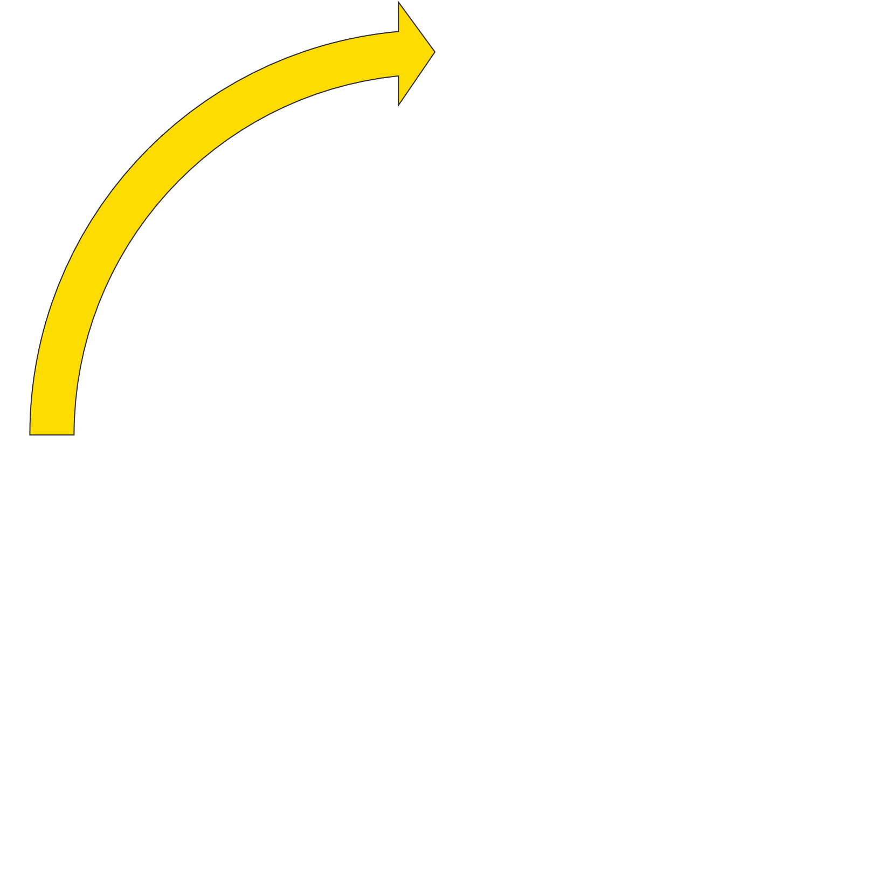
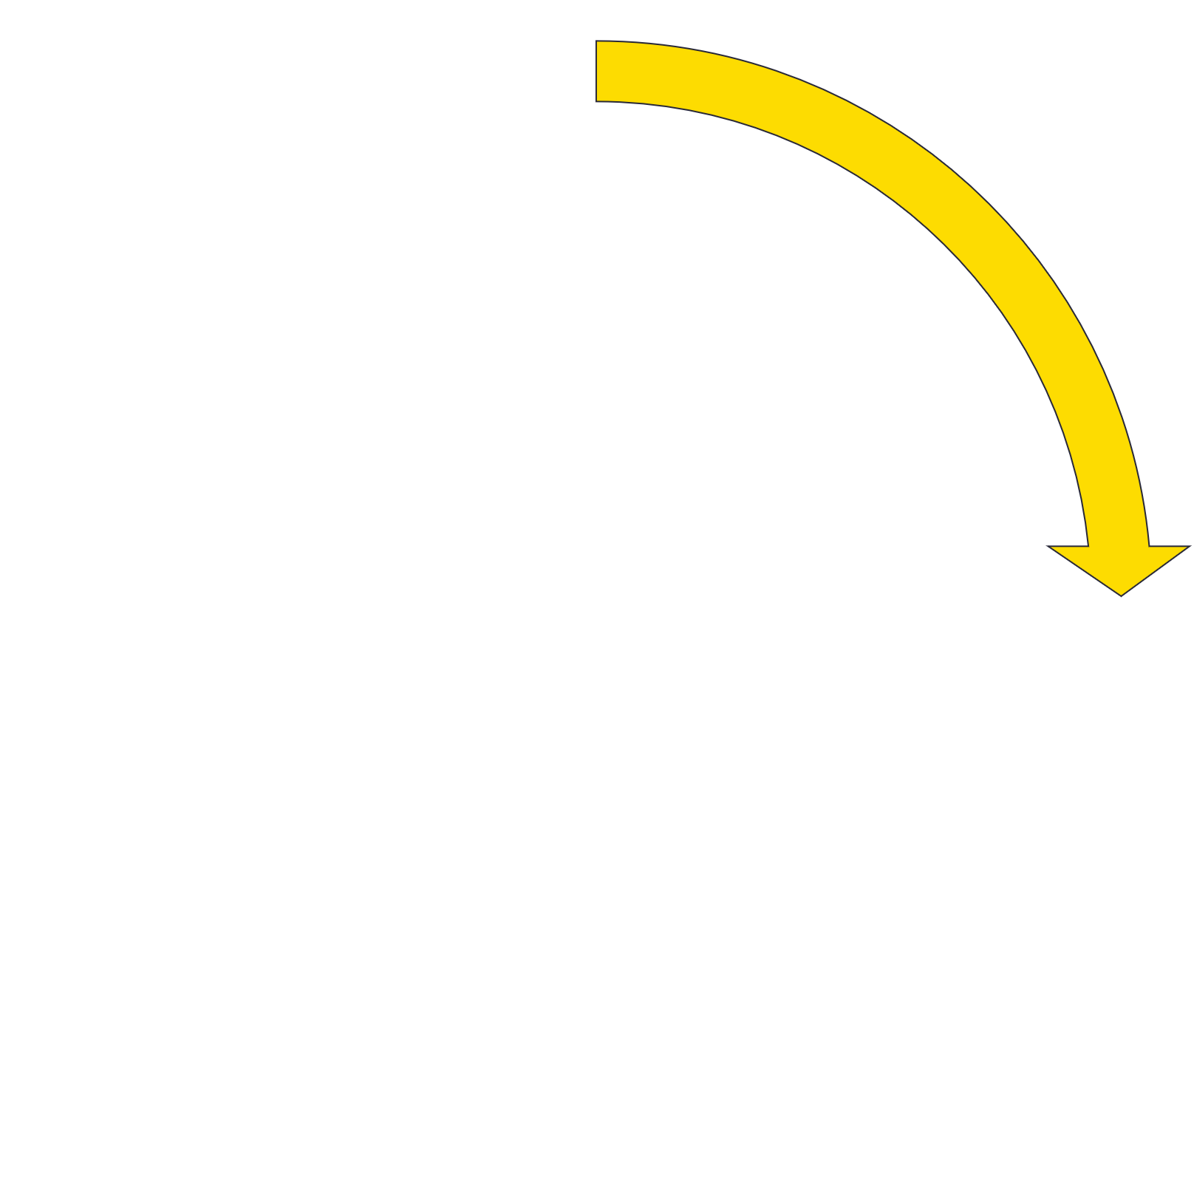
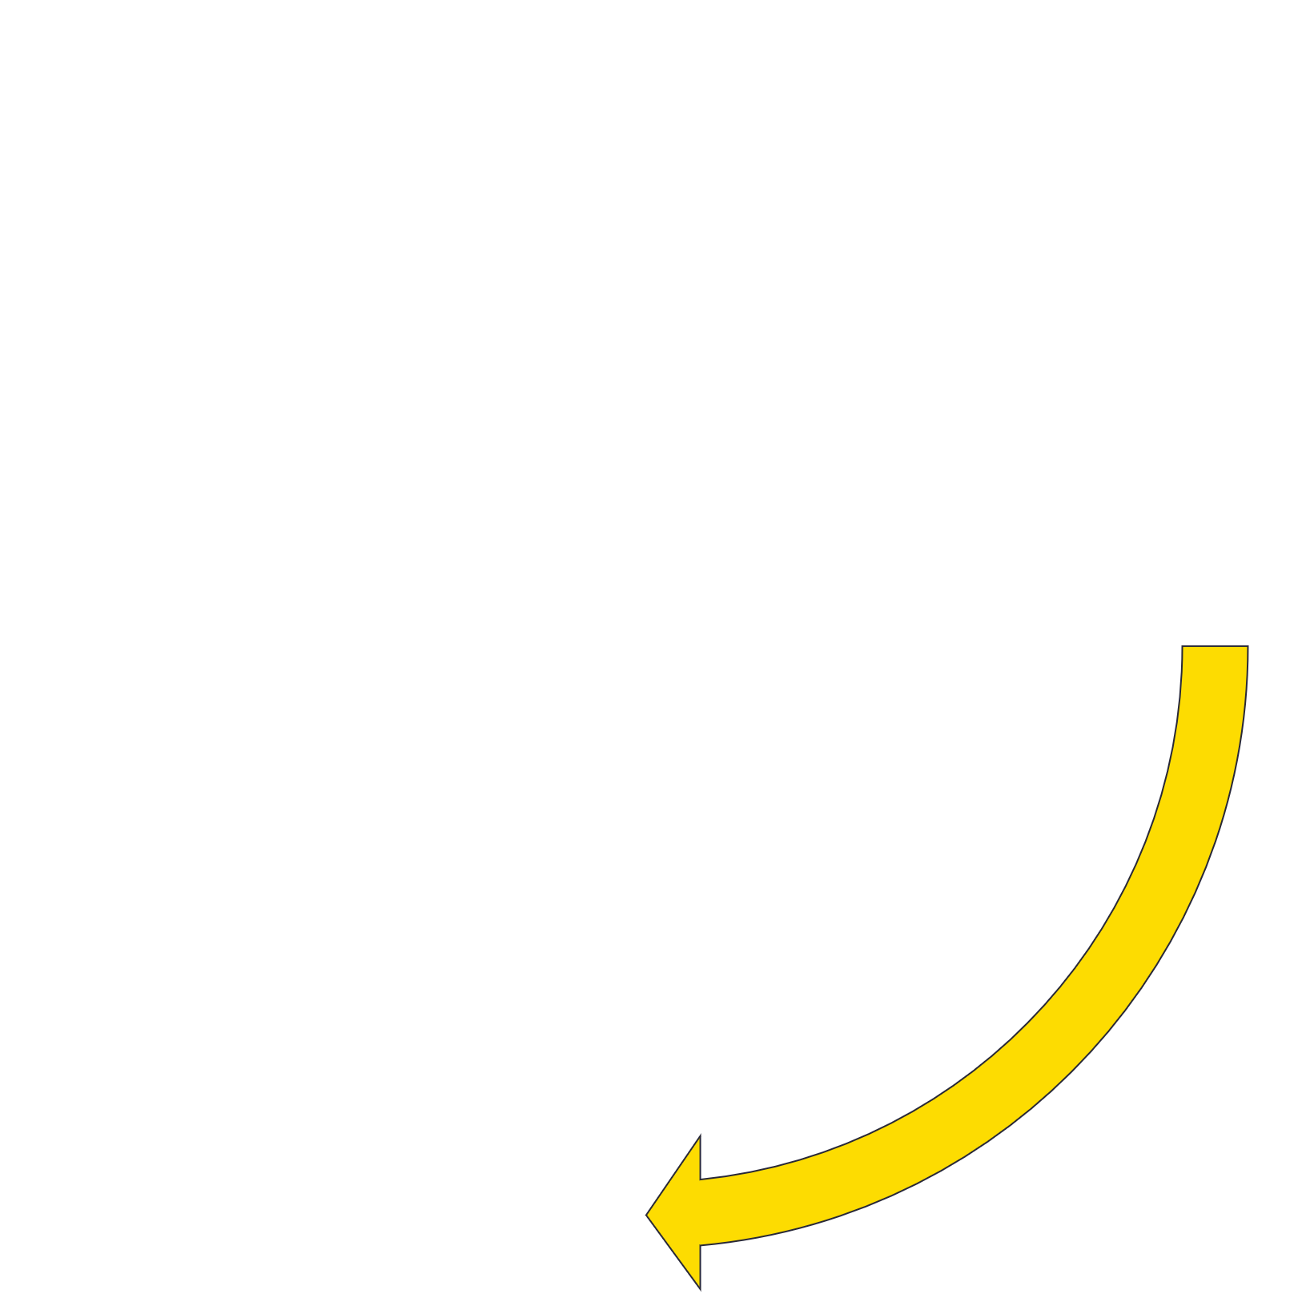
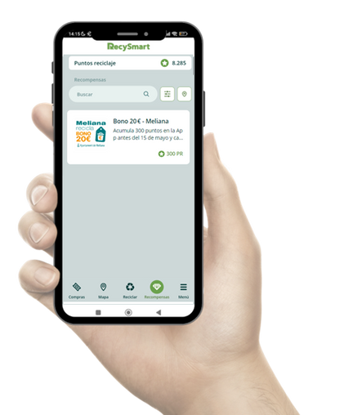
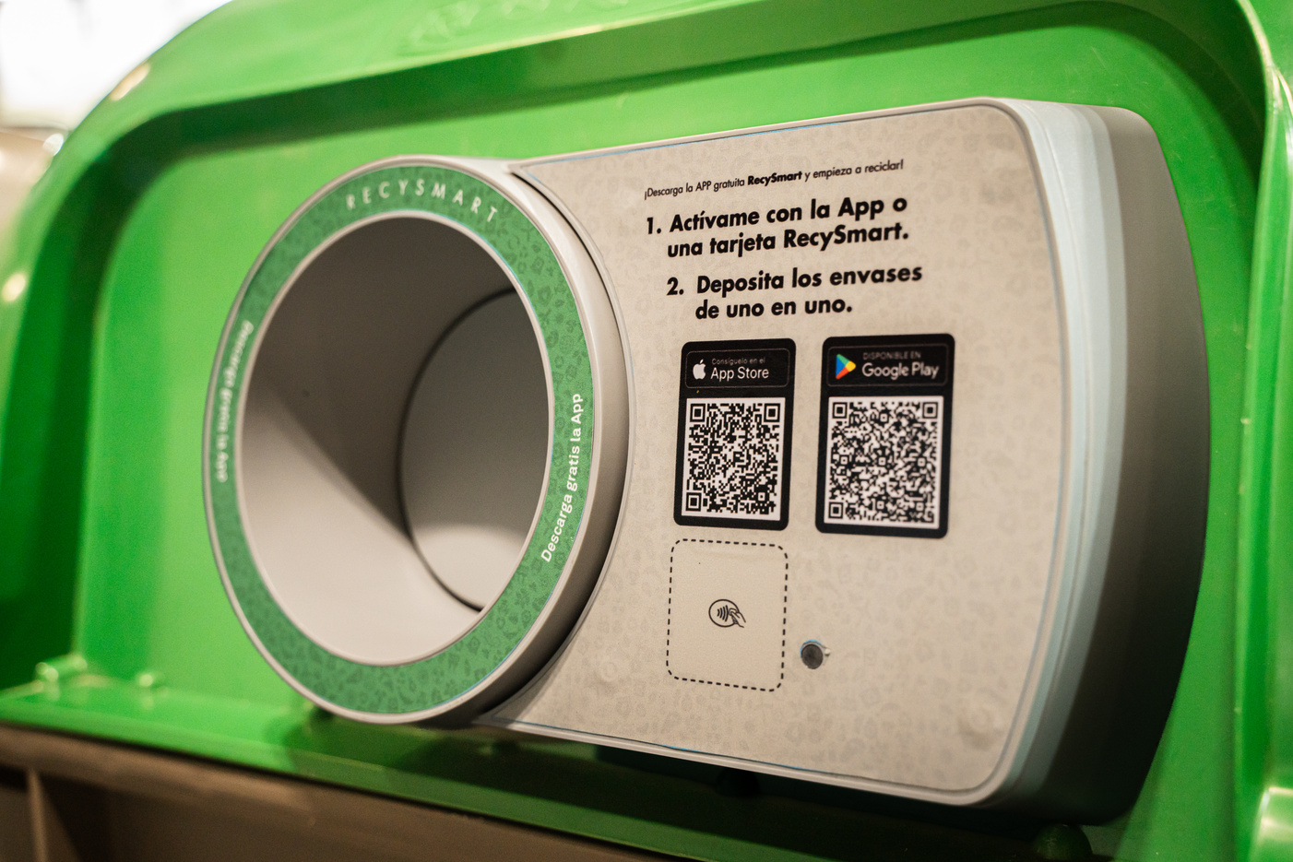
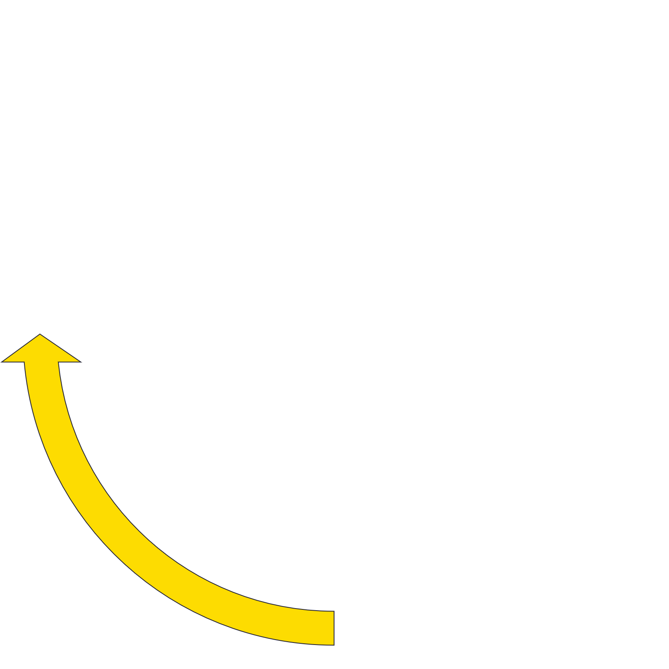

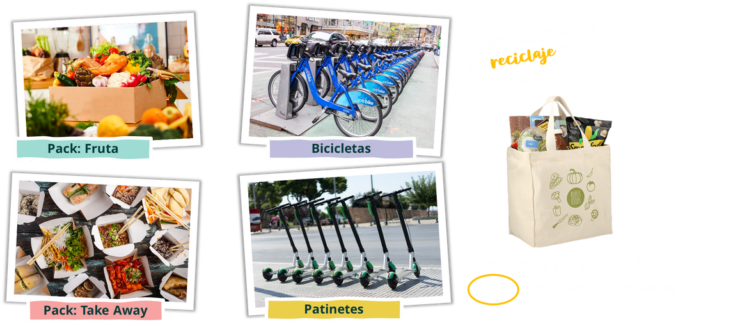
Meliana Project
Solución habilitada para todos los ciudadanos de Meliana.
~ 10k citizens
Smart Rings Deployed in Meliana
35 RecySmart
Recycling
Citezens
Recycling
City Council
Local Commerce
Custom vinyls and app for the visual identity of Meliana
Rewards: Vouchers redeemable at local businesses
Notes:
Recycling :
Pedestrian zones, Beaches, Parks, Bus stations, Schools, etc...
Citizens
Local Commerce & Community Shops, Public transport, Restaurants, etc...

Slide 12
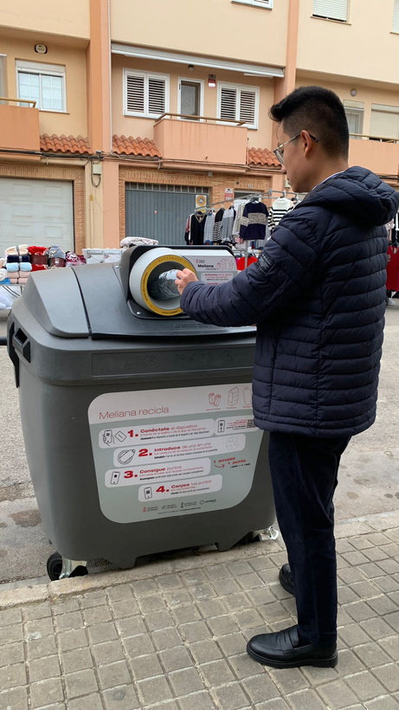








1 st Phase- 2025
35 RecySmart deployed
  20 glass
  15 light packaging

Slide 13










Results
Diciembre 2024 - Octubre 2025
Users
Rewards exchanged
Glass containers
tn CO₂ avoided
+1.600
+ 1.000
+110 k
+26
Evolución acumulada de reciclaje
Tipo de conexión
Tarjeta
App RecySmart

Slide 14






Recycling Analysis
Recycling by age group
Average nº packages per household
Household participation
12
Glass containers per month
Heat Recycling per day and hour
Heat map by location

Slide 15




Packaging collection
Data from January to July
TN collected
2025
Glass collection rates
152
vs same period 2024
With a territorial coverage of 45% by RecySmart

Slide 16



Quality of material collected

Slide 17



Quality of material collected
¡ Also in light packaging !

Slide 18




2n Phase – Project Expansion
+40
RecySmart
100%
Glass bins equipped
+70
Filling level sensors
Increase the packaging recovery covering the full territory
Collection optimization and overflow prevention
Aggregating data from all municipal councils to set up the basis for the PAYT tax system

Slide 19


Design of the Fair Waste Rate Model
User identification: In order to measure the contribution of each citizen, the first step is to identify the generator of the waste.
Waste calculation: number of contributions made with smart rings and closures.
Individual rate: Individualised collection based on the waste generated and the selective separation carried out at source.
7
countries
€ x M
public funding

Slide 20

3 rd Phase - Design of the Fair Rate Model
PAYT Sense™
Leveraging RecySmart data and AI to predict waste generation, identify behavioral patterns and enable fair, accurate and transparent PAYT systems while improving collection operations across municipalities.
CLUSTER A
CLUSTER B
DOMESTIC RATE (Smart Bins)
Fixed Fee (x%)
Fixed amount depending on the number of residents, water consumption, m², etc.
Variable fee (x%)
7
countries
Data generated by citizen
Data generated by horecca
Total population
Verticality of the city
Density of inhabits / Km2
Number and type of horreca
Socioeconomic profile
Contributions
PAYT Sense™
CLUSTER C
CLUSTER D
AI
Collection growth
Optimization collectoin
€ x M
public funding

Slide 21



























From sound to insight- recycling the future.
Notes:
We invite you to take an active role in a transformation that’s already underway. This isn’t just about improving recycling — it’s about reinventing it across cities, businesses, and shared spaces. Leading organizations have already placed their trust in Recysmart. The window of opportunity is open. Change is possible. And the time is now. Shall we lead it together?

Slide 22

Jordi Berguinzo
jordib@candam.eu
candam.eu

