Slide 1


1
Recycling pilot Croatia
FEVE & Vetropack Group

Slide 2
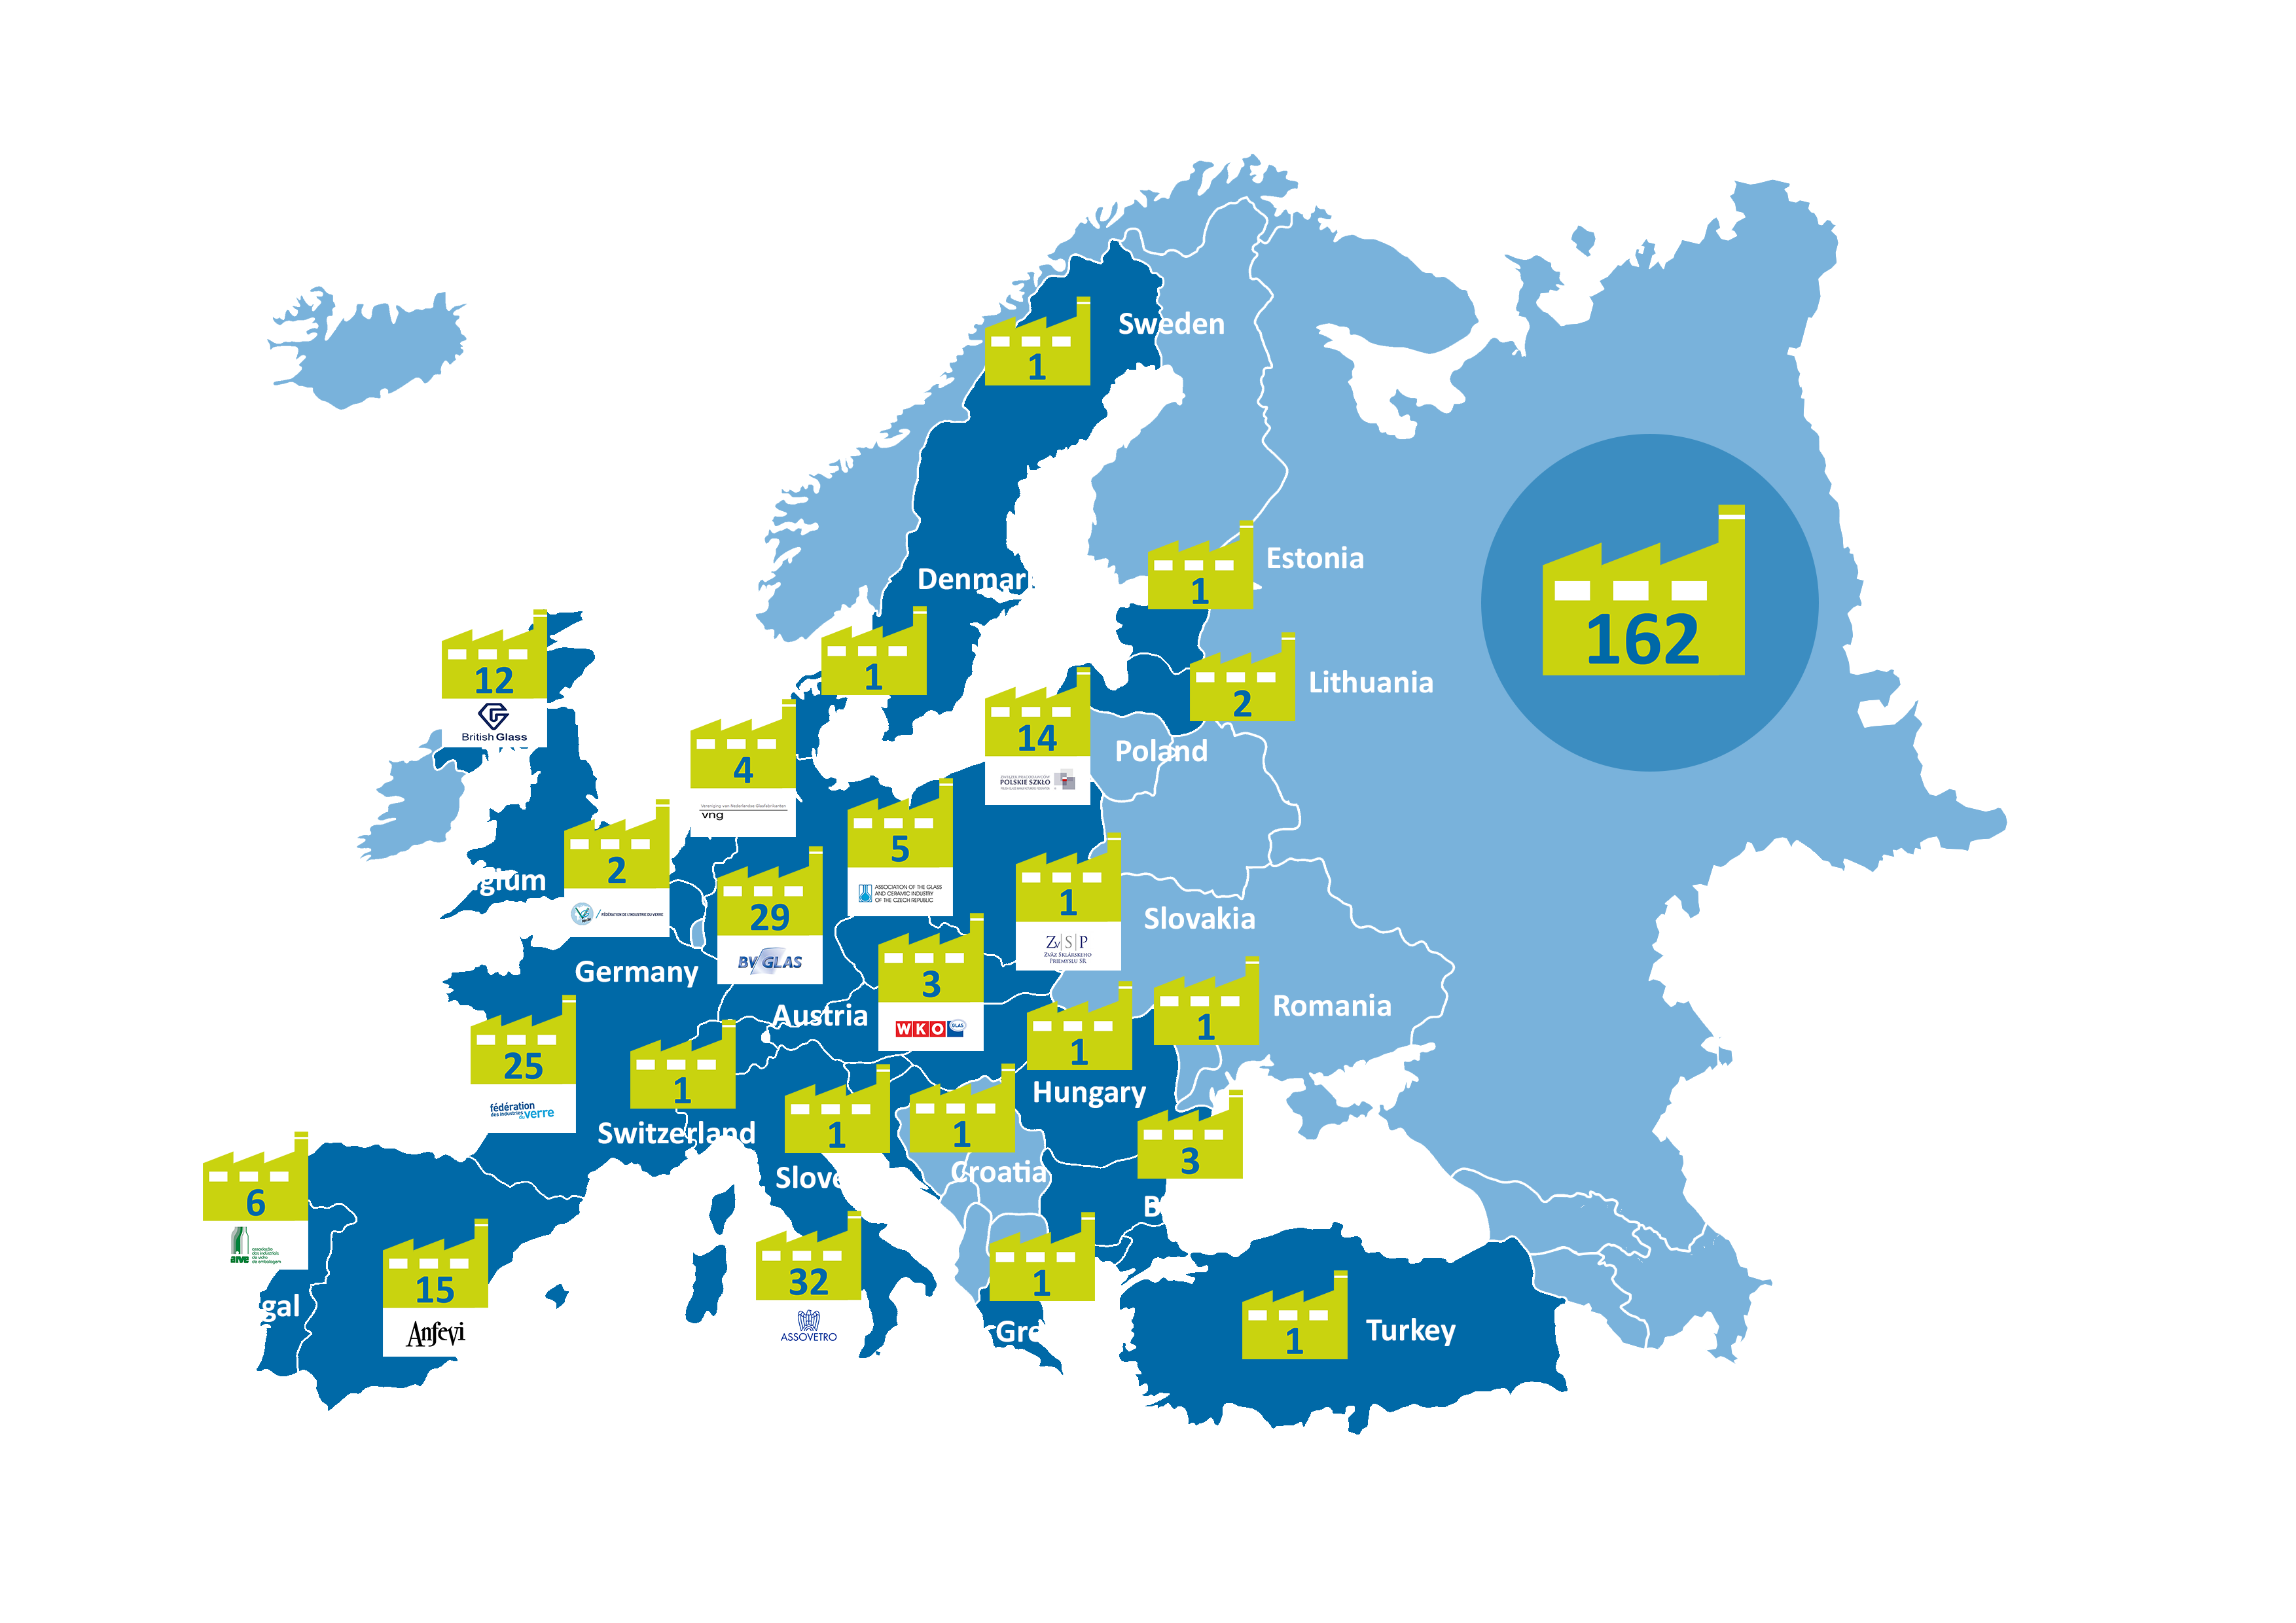
WHO WE ARE
OUR INDUSTRY IN NUMBERS
162 plants in 23 countries
125,000 jobs (40,000 direct)
~ 90 billion glass containers yearly
98% of the 45.000 EU companies selling products in glass are SMEs
€140 billion: EU exports packaged in glass
> €600 million invested annually in energy efficiency, decarbonisation and upgrades
75.6% recycling rate (2022)
Source: FEVE – Year 2021
Notes:
The glass packaging industry generates 125 000 direct and indirect jobs thanks to more 160 Container glass production sites in Europe
We estimate that products packed in glass contribute to around €140 billion in EU exports in 2023. All in all, our footprint, along with the sectors we serve, accounts for an added value to the economy of almost 1% of EU GDP.
With an estimated 45,000 European manufacturing firms selling their products in glass (more than 98% of being SMEs), it has long been an essential packaging material that strategic sectors have relied on.
Sustainable glass packaging will remain essential to deliver on economic competitiveness and build brand value, as well as to protect products from the external environment and transport them safely.

Slide 3




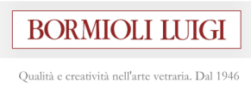







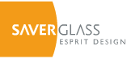

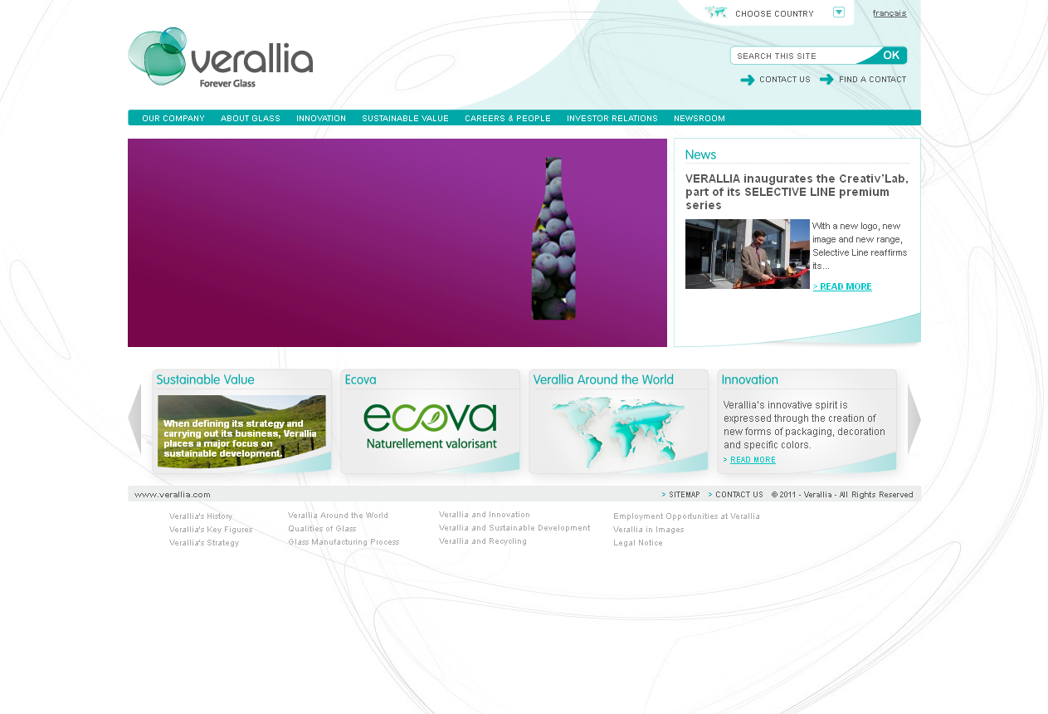


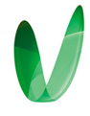



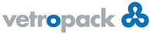

FEVE Members supplying food, beverage, cosmetics, perfumery and Pharma
Ardagh Group
BA Glass Group
Beatson Clark
Bormioli Luigi
Bormioli Pharma
More than 90% of the European glass container manufacturing industry
Ciner Glass
Gerresheimer Group
Gürok Turizm ve Madencilik A.Ş. (GCA)
Heinz Glas
Ramon Clemente
Saverglass Group
O-I Europe Group
Pochet Group
SGD Pharma Group
Steklarna Hrastnik d.o.o
Stölzle Glass Group
Verallia Group
Verescence
Vetreria Cooperativa Piegarese
Vetreria Etrusca
Vetropack Group
Vidrala Group
Wiegand Group
Zignago Vetro Group
Notes:
Add piegarese, delete sisecam

Slide 4
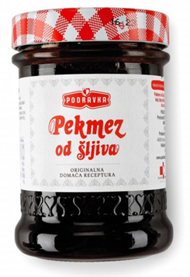


WHO WE ARE
Project scope
OBJECTIVES
Test building blocks of a methodology that can be adapted and replicated to increase quantity and quality of glass collected.
Variable 1: Implement a digital campaign of Friends of Glass channels aimed at increasing quality and quantity of glass collected
TIMEFRAME
FOCUS
6 months
Jars, <200 ml bottles
MARKET
Croatia, Koprivnica, 30.854 inhabitants
Benchmark: Čakovec
METHODOLOGY & PROCESS:
0
1
2
3
Activity: establish partnership with local glass producer, EPR scheme and potentially local brand
Objective: gain local and European credibility, insights and measurement opportunities
Activity: survey towards target audience with questions on current recycling attitudes (note – this project has no objective or ability to change the existing infrastructure)
Objective: survey existing barriers that prevent people from recycling to gain insights for campaign
Measurement: survey results
Activity: develop a digital campaign that incentivizes people to recycle targeting the roadblocks identified through the survey
Objective: influence recycling attitudes by tackling the biggest belief roadblocks to recycling
Measurement: campaign engagement and social performance
Activity: conduct follow-up survey with similar questions and source collection data
Objective: assess changes in attitudes or beliefs among target audience as well as trends in volume of glass collected
Measurement: survey results variance; volume of glass collected
PARTNERSHIP
INSIGHTS
CAMPAIGN
COLLECTION

Slide 5
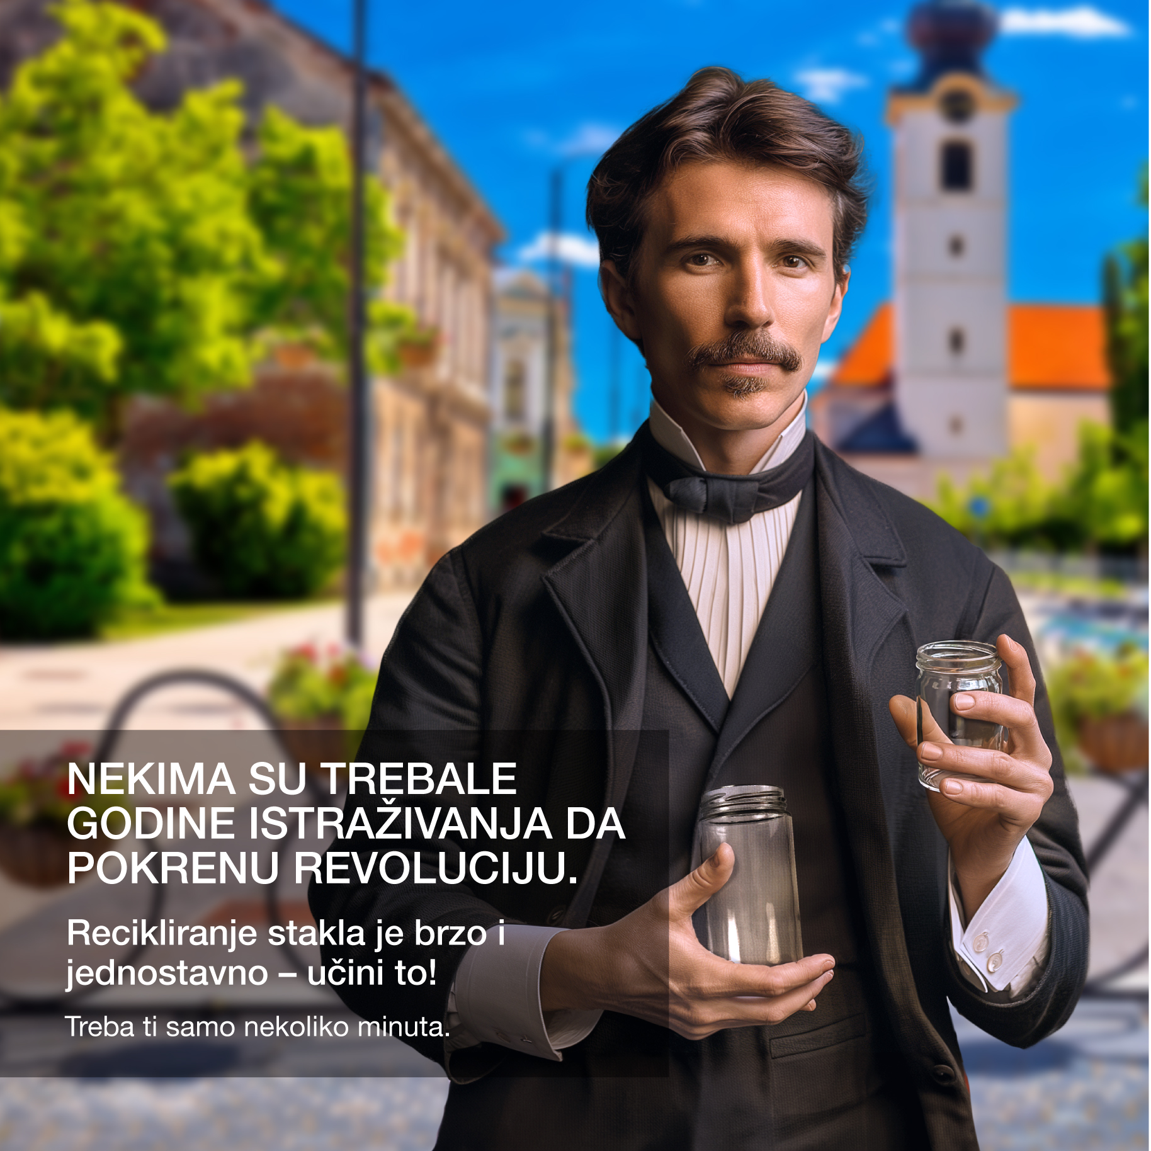
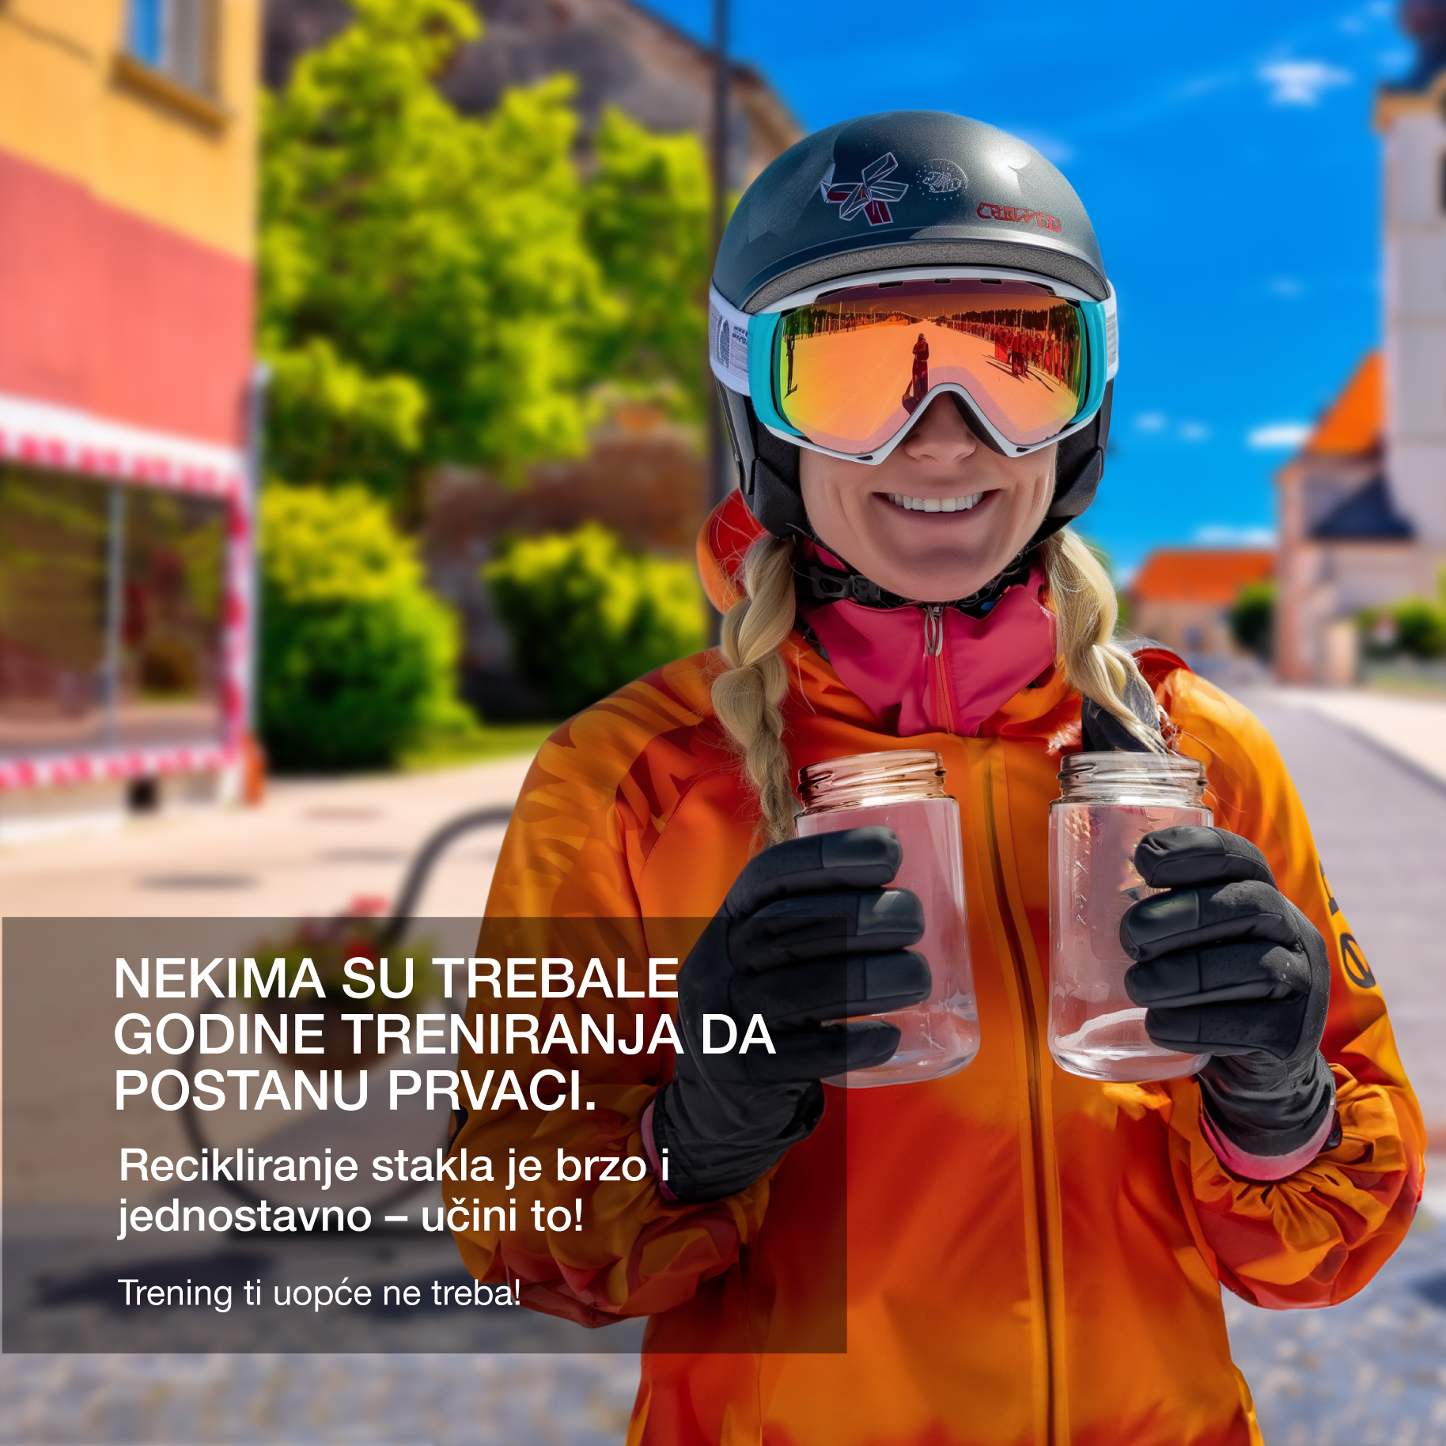

WHO WE ARE
Acting through Digital Campaign
Our digital campaign leveraged generative AI to develop locally relevant creatives addressing the key roadblock identified by the first survey: glass recycling is perceived as effortful. Bottle bank accessibility was also flagged as a key issues, yet it is not something this project could tackle.
As a result, the digital campaign focused on the contrast between perceived ‘feats’ and glass recycling, with the ultimate message being “you don’t need to be a hero to make a difference”.
The campaign gathered a considerable number of comments and interactions from our target audience, showing that this is an important conversation in Koprivnica.
4.2M Total Impressions | 54.3k Total Engagements | 1.5% AVG Engagement Rate (Benchmark 2%)
37.3K Clicks | 0.94% AVG Click-through rate (Benchmark 0.9%)*
Nikola Tesla Janica Kostelic Superwoman

Slide 6

Final survey shows that the pilot “moved the middle” by shifting perceptions and self-reported behaviour among people who were neutral or pro-recycling.
WHO WE ARE
Measuring and Learning
Our follow-up survey highlighted:
positive shift in self-reported recycling.
positive shift in perceived value of individual contribution to glass recycling.
positive shift in glass’ environmental impact.
Compared to the survey conducted at the beginning of the process. This points to:
Knowledge and awareness on glass recycling has increased
Respondent are more attentive to sorting glass correctly
People are less worried of environmental impact of glass
Additional learnings include:
The survey also highlighted an increase in the perceived time and effort needed to recycle. This is in line with multiple comments we received – hinting at a more structural issue.
“Bad sorters”, meaning users that self-reported not to recycle glass, while representing a minority in the sample, did not show an improvement in perception.

Slide 7
Collection data shows improvements, but direct attribution requires further tests
WHO WE ARE
Impact on Glass Collection
MAIN FINDINGS
Glass collection in Koprivnica increased at a rate of +1.3 ton/month (+9%) during campaign period.
Cakovec and Bjelovar on the other hand saw a decreased volume.
While this trend could be observed even before the pilot project, therefore no direct causation link can be drawn, is it in contrast with a downward trend seen in other geographies, hinting at a possible role of the pilot in maintaining momentum.
Collection Data

Slide 8

WHO WE ARE
Key Conclusions
1. Digital communication works. 2. AI unlocked fast, hyper-local creativity. 3. Collaboration turned communication into measurable impact. 4. Structural gaps became visible. 5. The pilot offers a scalable blueprint.

Slide 9
1
Thank you.
FEVE & Vetropack Group

