Slide 1
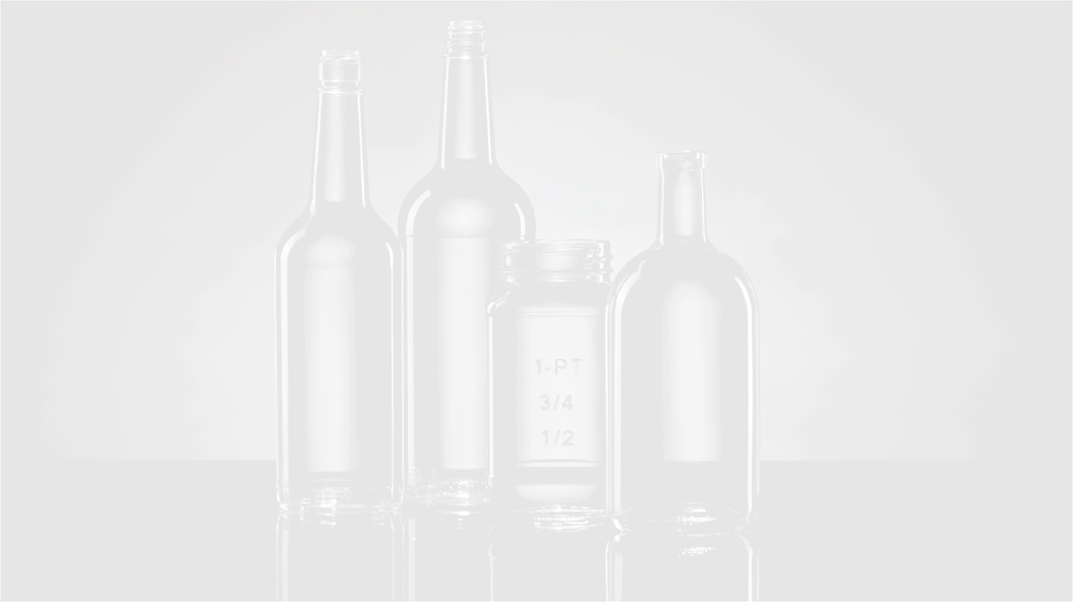
Quality impact
Ceramic Stones Porcelain pollution
in Cullet
Hans Hilkes
Senior Quality Manager Glass Raw Materials - AGP
January 2026

Slide 2
Introduction
Appearance
Container Glass Plant
Possible consequences of what slips through

Slide 3
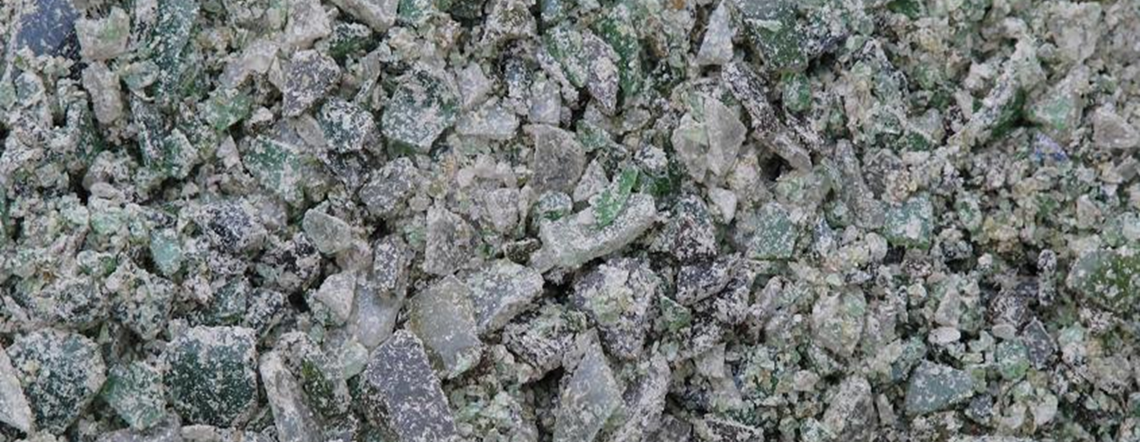
Introduction
Cullet (or “recycled glass”) is the main raw material used in the production of container glass.
It is also the most polluted.

Slide 4
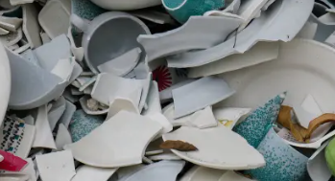
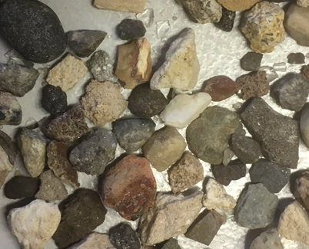
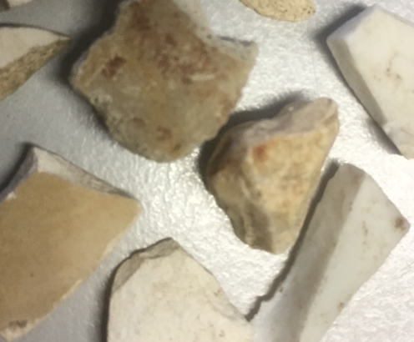
Introduction
An example of contamination is the presence of stones, ceramics or porcelain.
Incoming glass materials at Glass recycling companies contain this to a greater or lesser extent as contamination next to the glass.
Possible causes,
Consumers who dispose of these materials incorrectly
Pollution of industrial glass streams like,
Filler companies
Horeca establishments

Slide 5
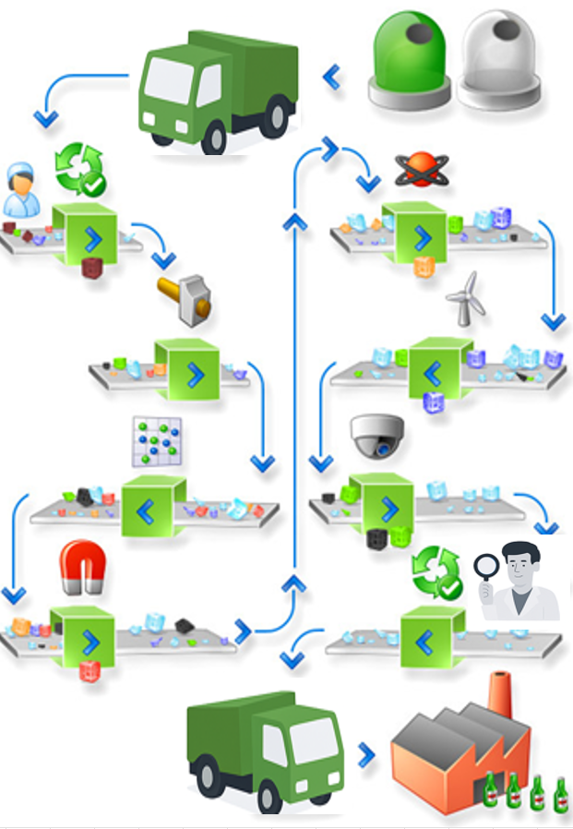
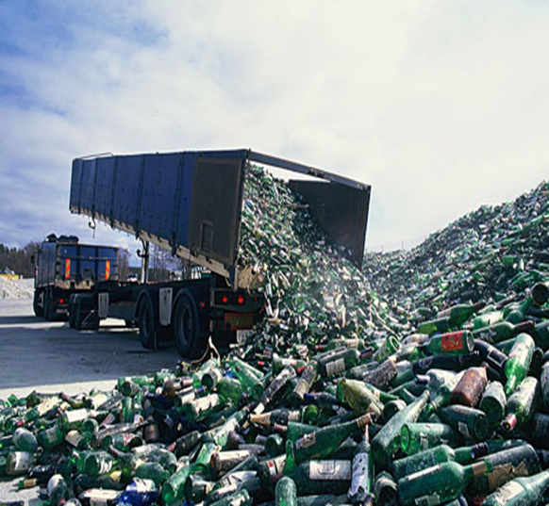
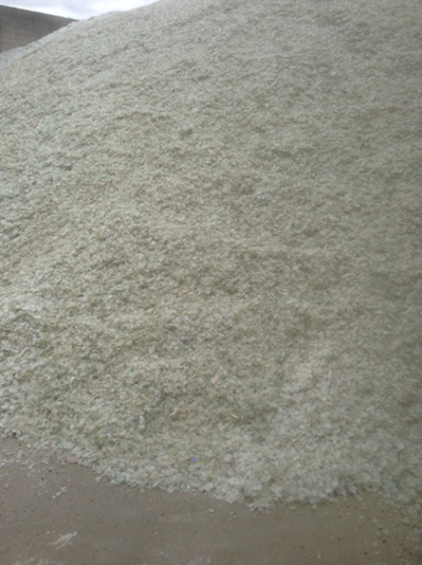
Introduction
Glass recycling companies have advanced equipment to remove these and other contaminants.

Slide 6
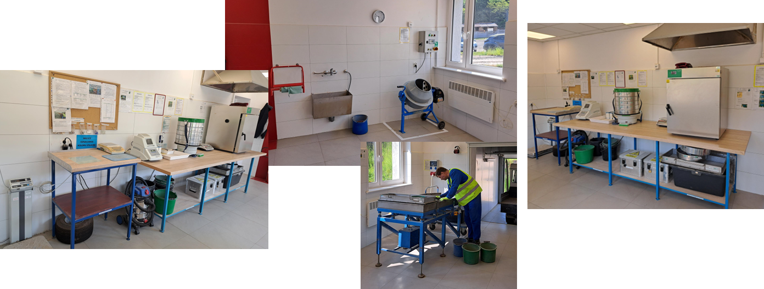
Introduction
To check if the Furnace Ready Cullet, delivered by the Glass recycling companies, is according specification requirements, Glass producers perform quality checks on incoming deliveries.

Slide 7
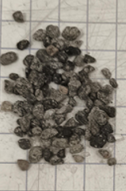

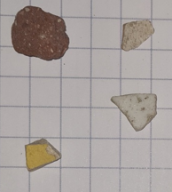
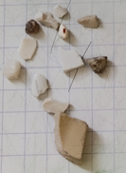
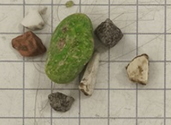
Introduction
Cullet that isn’t according specification is rejected and returned to supplier
Examples shown are findings out of a 50 kg sample taken from an incoming delivery

Slide 8
Introduction
Appearance
Container Glass Plant
Possible consequences of what slips through

Slide 9
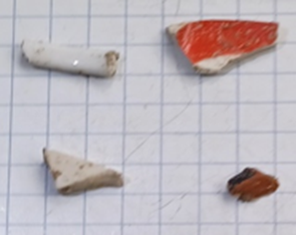
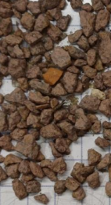
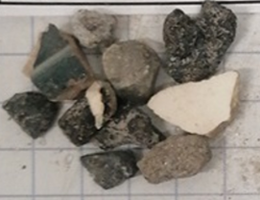
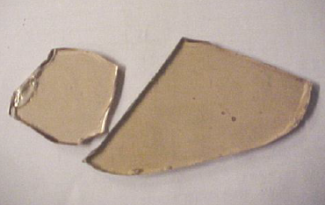

C.S.P. (Ceramic, Stones, Porcelain)
Pieces of Ceramic, Stones, Porcelain found in deliveries of Furnace Ready Cullet

Slide 10
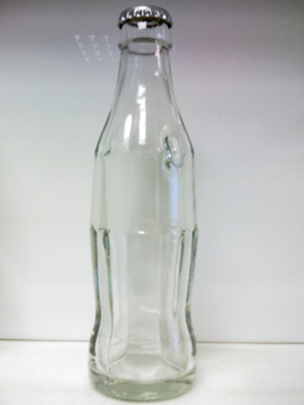
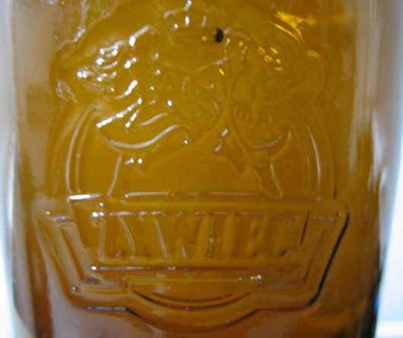
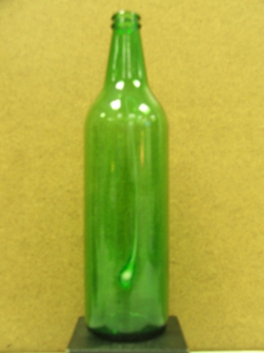
C.S.P. (Ceramic, Stones, Porcelain)
Ceramic, Stones, Porcelain inclusions found in produced containers

Slide 11
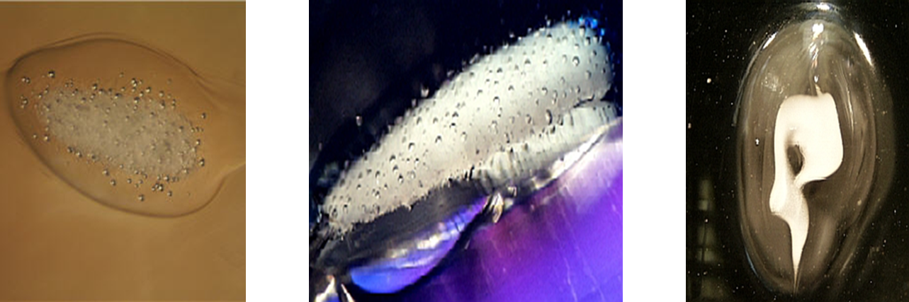
C.S.P. (Ceramic, Stones, Porcelain)
Ceramic, Stones, Porcelain inclusions found in produced containers under microscope

Slide 12
Introduction
Appearance
Container Glass Plant
Possible consequences of what slips through

Slide 13
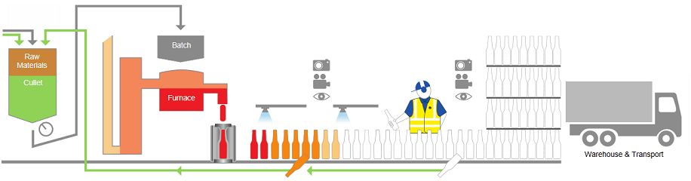
Container Glass Plant
Process Overview
Because Recycling Cullet always has a certain level of pollution present, also in Container Glass Plants a lot of effort is put in sorting out products with defects (Inclusions, Cracks, etc)

Slide 14
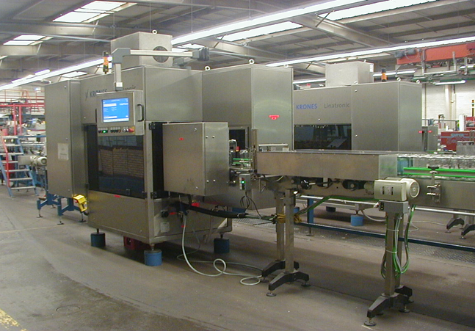
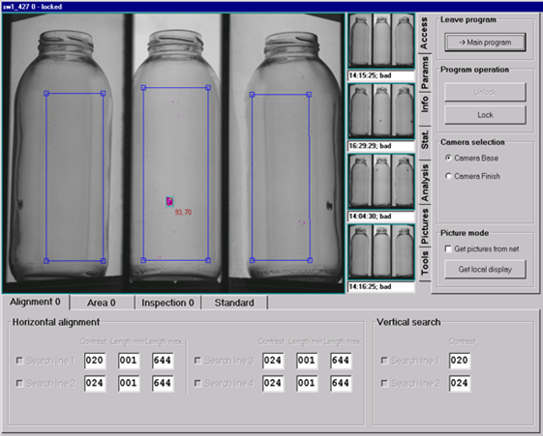
Container Glass Plant
Equipment in use: Camera Inspection Equipment
Removal of Products with inclusions, blisters and other visual defects

Slide 15
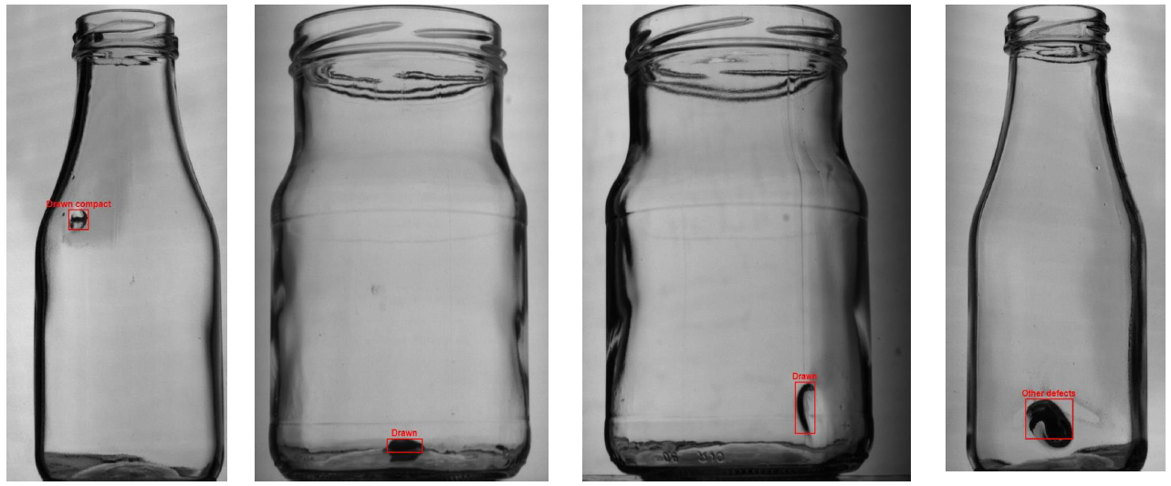
Container Glass Plant
Equipment in use: Camera Inspection Equipment
Removal of Products with inclusions, blisters and other visual defects

Slide 16
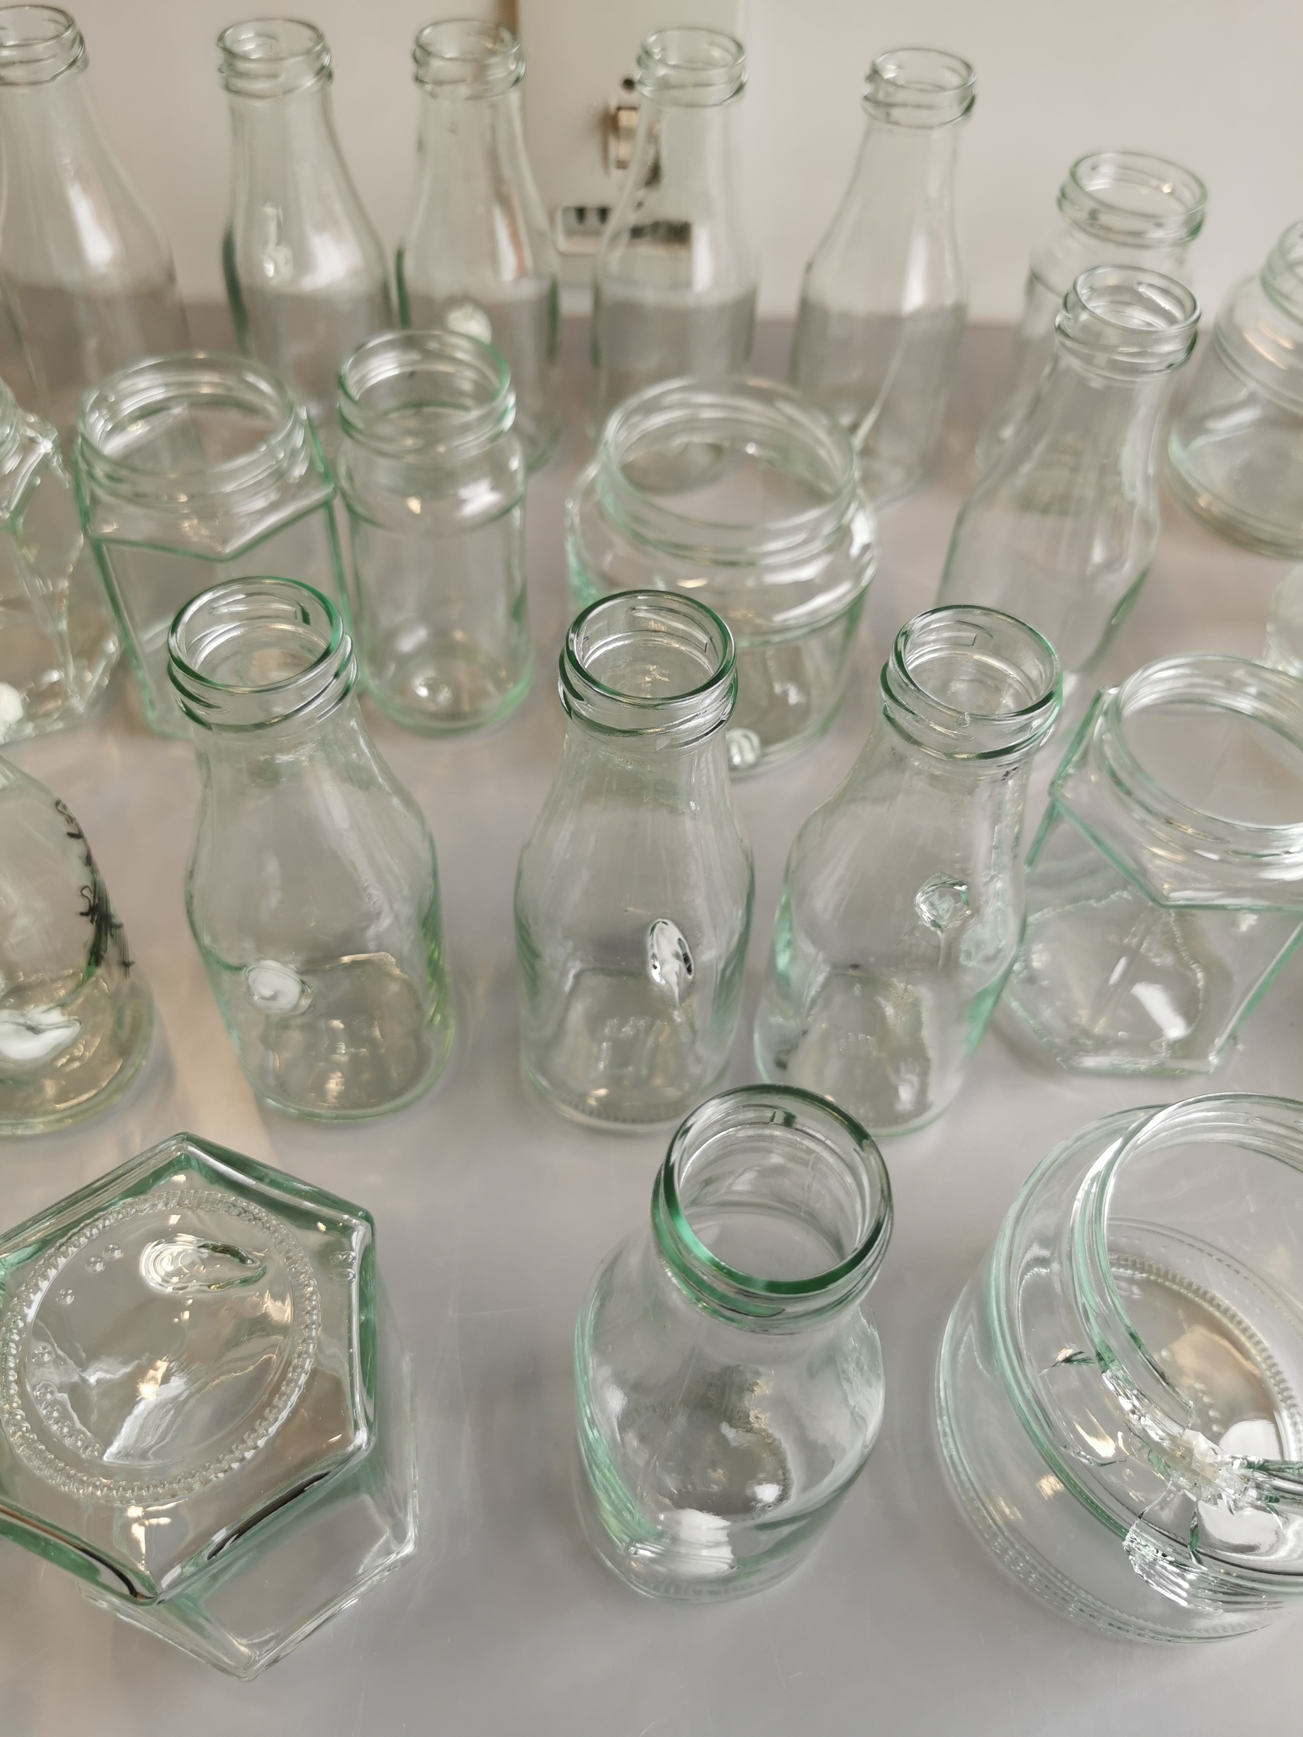
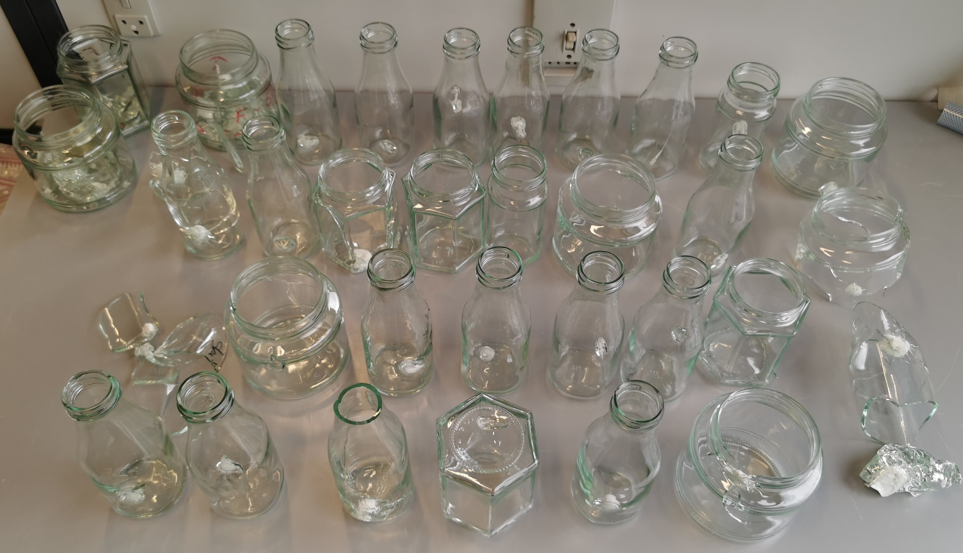
Container Glass Plant
Equipment in use: Camera Inspection Equipment
Removed Products with inclusions

Slide 17
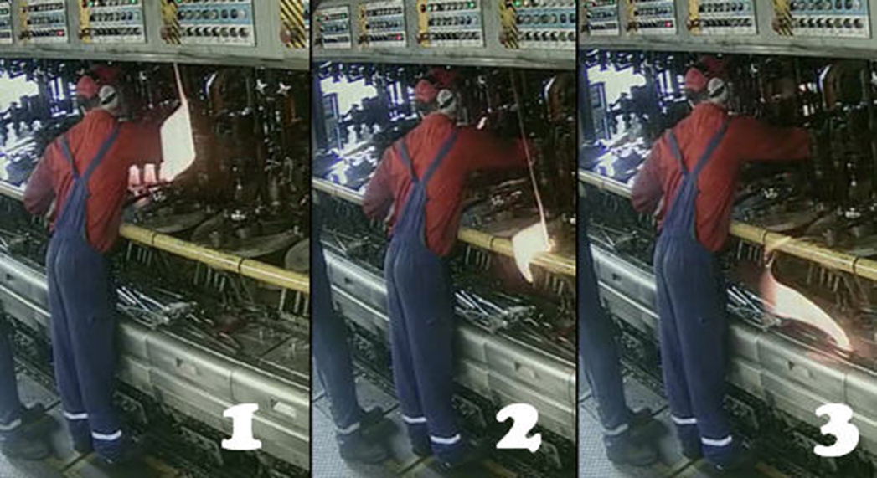
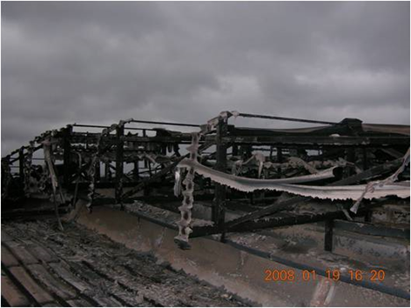
C.S.P. (Ceramic, Stones, Porcelain)
C.S.P. (Ceramic, Stones, Porcelain)
Big pieces of (glass) ceramic can cause blockage in IS machines, and start a fire

Slide 18
Introduction
Appearance
Container Glass Plant
Possible consequences of what slips through

Slide 19
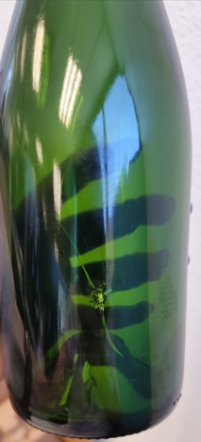
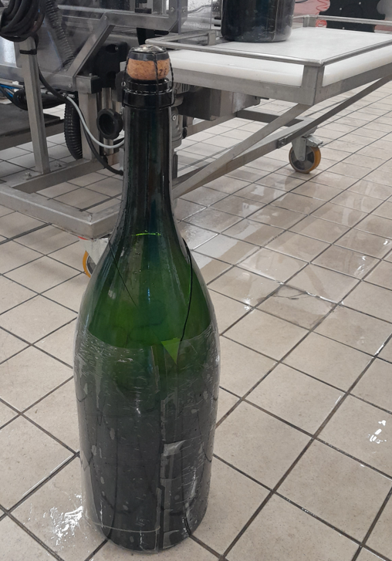
Filler plants (at customers)
Breakage during filling process
What if these products reach end-consumers

Slide 20
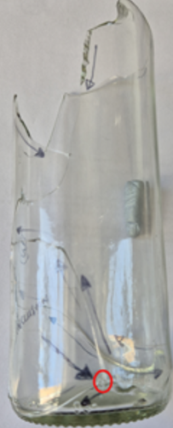
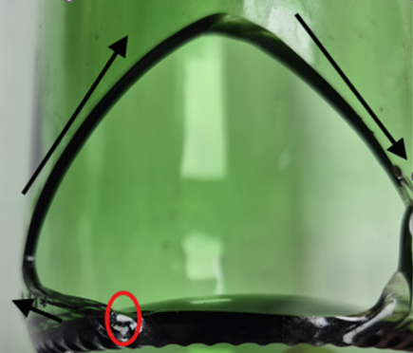
Filler plants (at customers)
Breakage after filling process, during transport
Red circle is point of origin of breakage, fortunately, did not reach the end-consumer

Slide 21
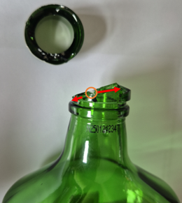
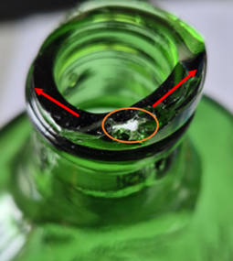
Filler plants (at customers)
Not found at Glass plant / Filler
Product returned by end-consumer, caused injury to end-consumer when removing the closure

Slide 22
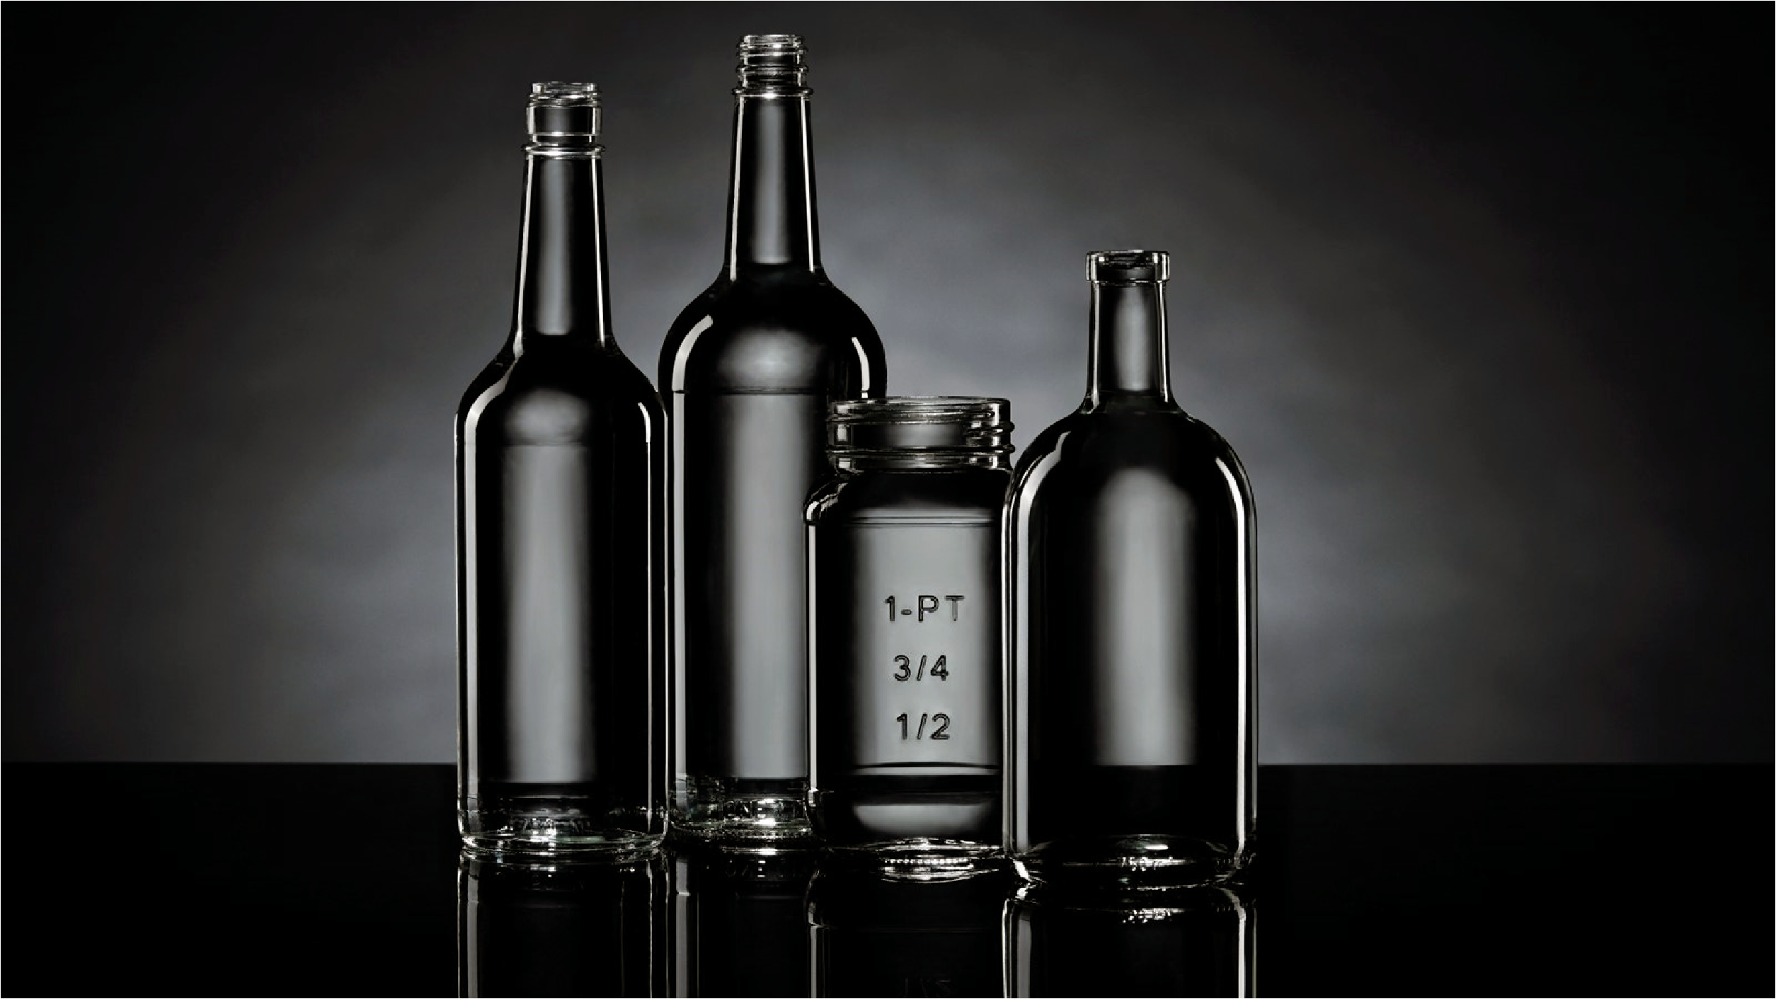
Thanks for your attention

