Slide 1


THE BEVERAGE CONTAINER REFUND SCHEME
BCRS Introduction Thursday 19th March 2026
Alexander Galea - CEO
BCRS Malta Ltd - The licenced not-for-profit operator of the Maltese Beverage Container Refund Scheme

Slide 2
ORGANISATION INTRODUCTION
BCRS Structure
Raphael Aloisio Chairman
Malta Beverage Producers Association
Malta Beverage Importers Association
Malta Beverage Retailers Association
CEO
DRS and BS Manager
DRS Ops Manager
Head of Finance

Slide 3

STATISTICS – 2025
COLLECTION
737 million bottles & cans
242million collected IN 2025 (2024: 236m)
CHARITY DONATION
€378k
> €80k this year
MATERIAL RECYCLED
> 32K tonnes
10,965 tonnes DURING 2025
COLLECTION RATE IN QUANTITY
2025 86%
2024 84% (FULL YEAR)
2023 80% (FULL YEAR)

Slide 4

REGISTRATIONS
CATEGORY
POPULATION
REGISTERED
Producers
11
11
100%
Importers
196
196
100%
Distributors
84
84
100%
Retailers
1728
1715
99%
Catering
2851
3001
95%
5020
4,857
97%
TOTAL
CONFIDENTIAL

Slide 5
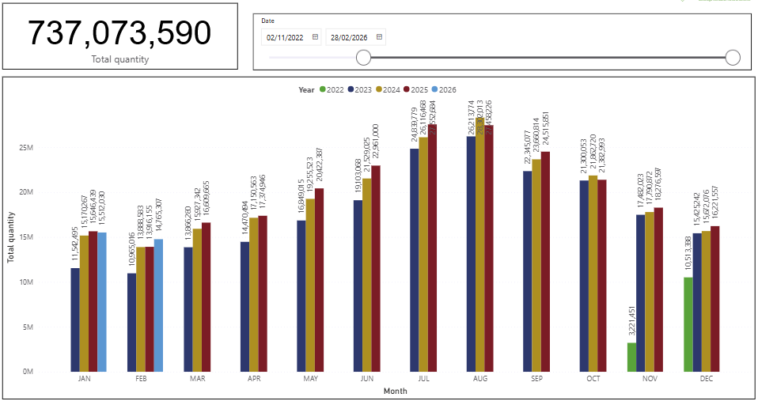
TOTAL COLLECTION STATISTICS – PROGRESS YEAR ON YEAR
CONFIDENTIAL

Slide 6
COLLECTION BY MATERIAL STREAM

