Slide 1

Glass packaging in Latvia’s DRS
Close the Loop, 19.03.2026.
Miks Stūrītis
CEO
SIA Depozīta Iepakojuma Operators

Slide 2
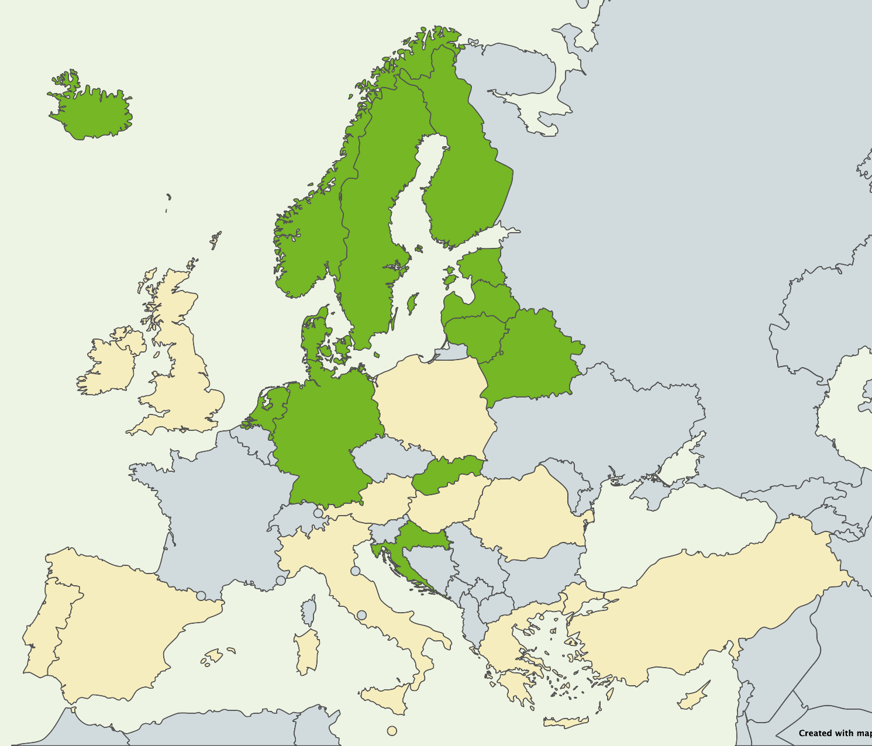
Facts about Latvia
Population:
~1 880 000
Area:
64 594 km²
Annual deposit packaging volume:
520 millions

Slide 3
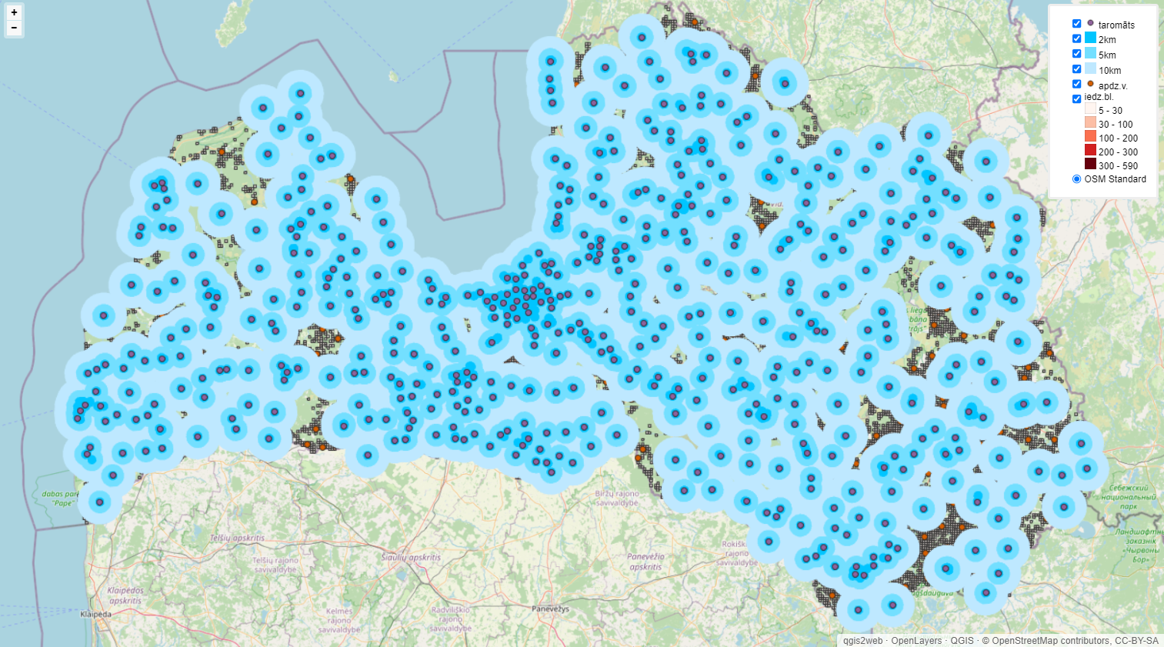
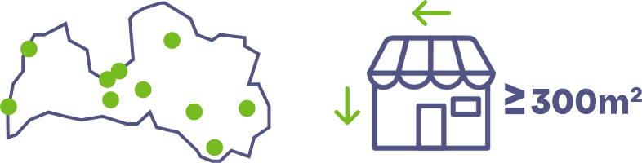
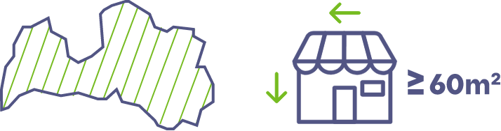
Return network
1400 collection points
Population | 1 880 000
Live further than 2km from DP | 264 200 | 14%
Live further than 5km from DP | 106 900 | 6%
Live further than 10km no DP | 15 300 | 1%

Slide 4
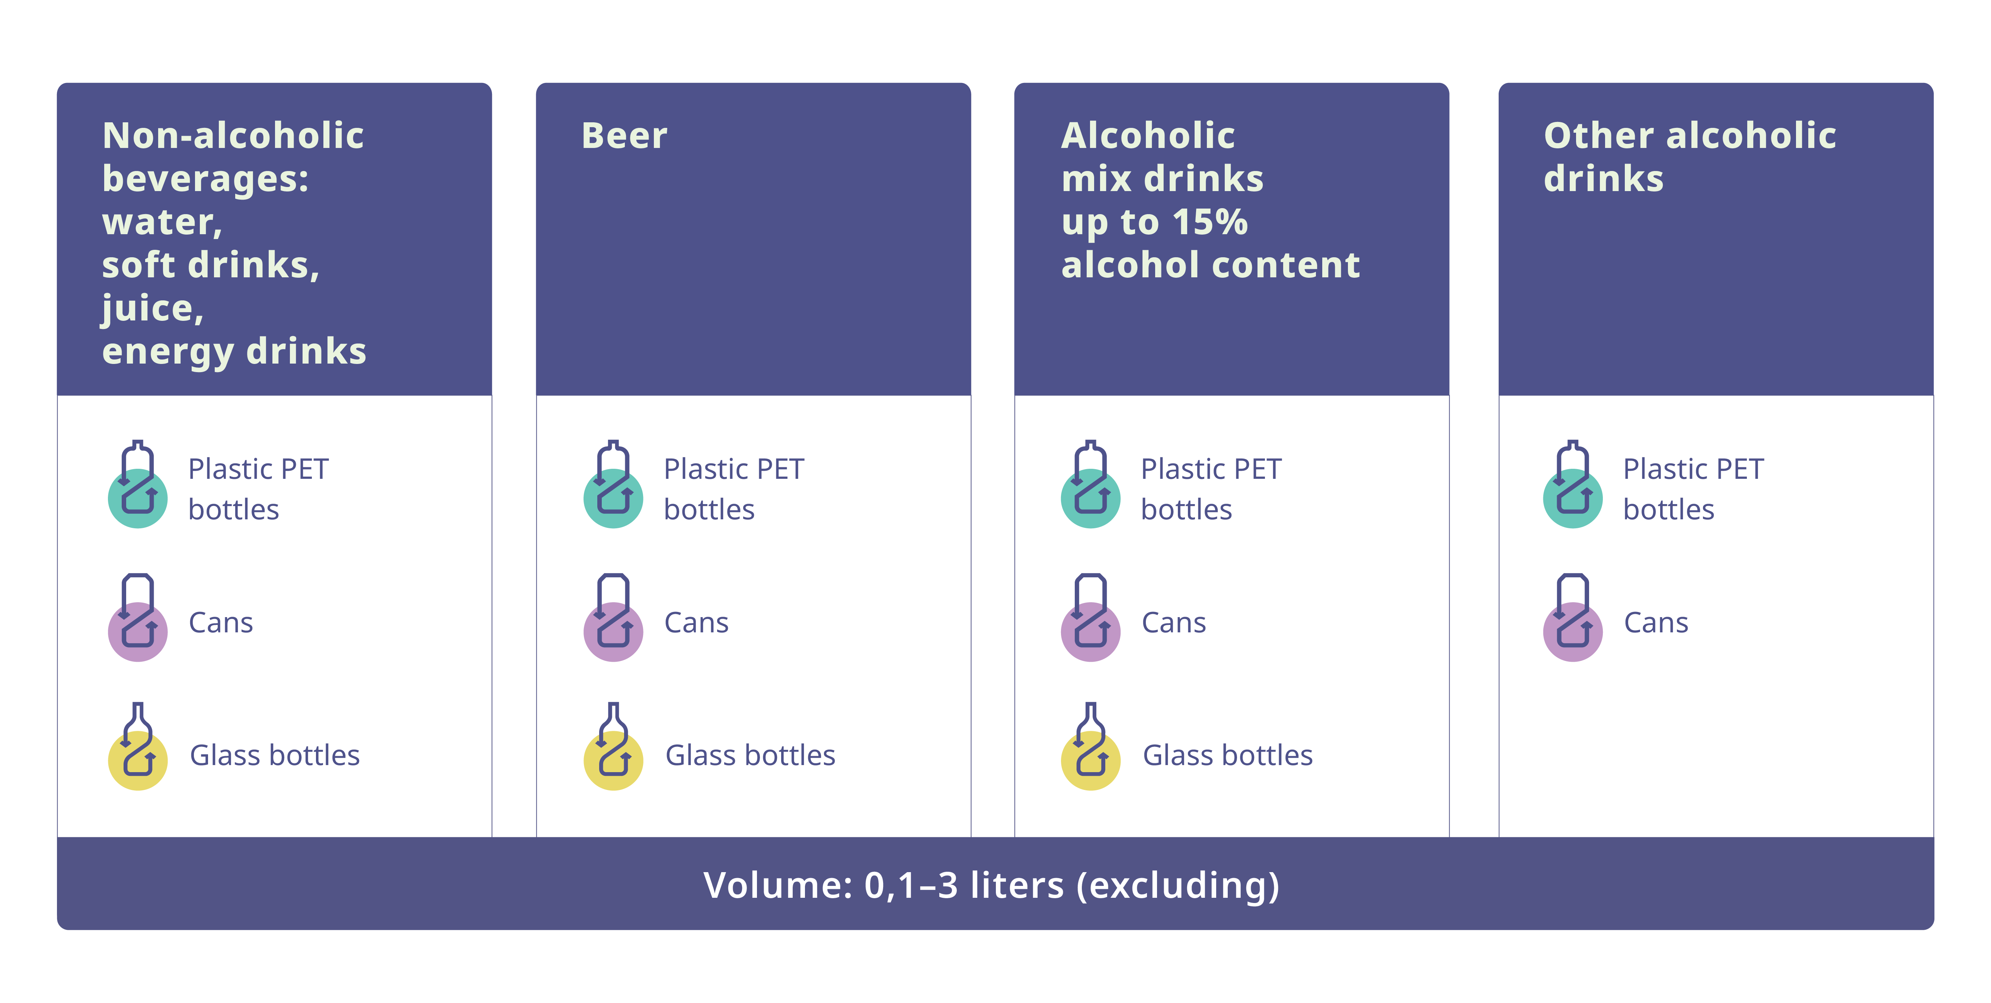
DRS scope and material split
Includes recyclable and reusable packaging
Excluded: dairy products, wine and liquors in glass

Slide 5
Latvia DRS performance
DRS covers 66% of all glass packaging by weight

Slide 6
Pros
Cons
          Littering reduction
          Contribution to fixed cost sharing
          Sinergies with refillables
          Higher quality, sorted material for recycling
          Weight, bulkiness and low material value increases handling complexity and drives up costs
          Rather high collection in alternative collection models
          Lower return rates on larger (> 0.5 l) packaging formats

Slide 7
DRS material split

Slide 8
Glass collection cost effectiveness
DRS cost per unit, EUR | DRS cost EUR/1 kg | PRO cost EUR/1 kg | PRO cost per unit, EUR
0,0491 | 0,19 | 0,109 | 0,0277

Slide 9
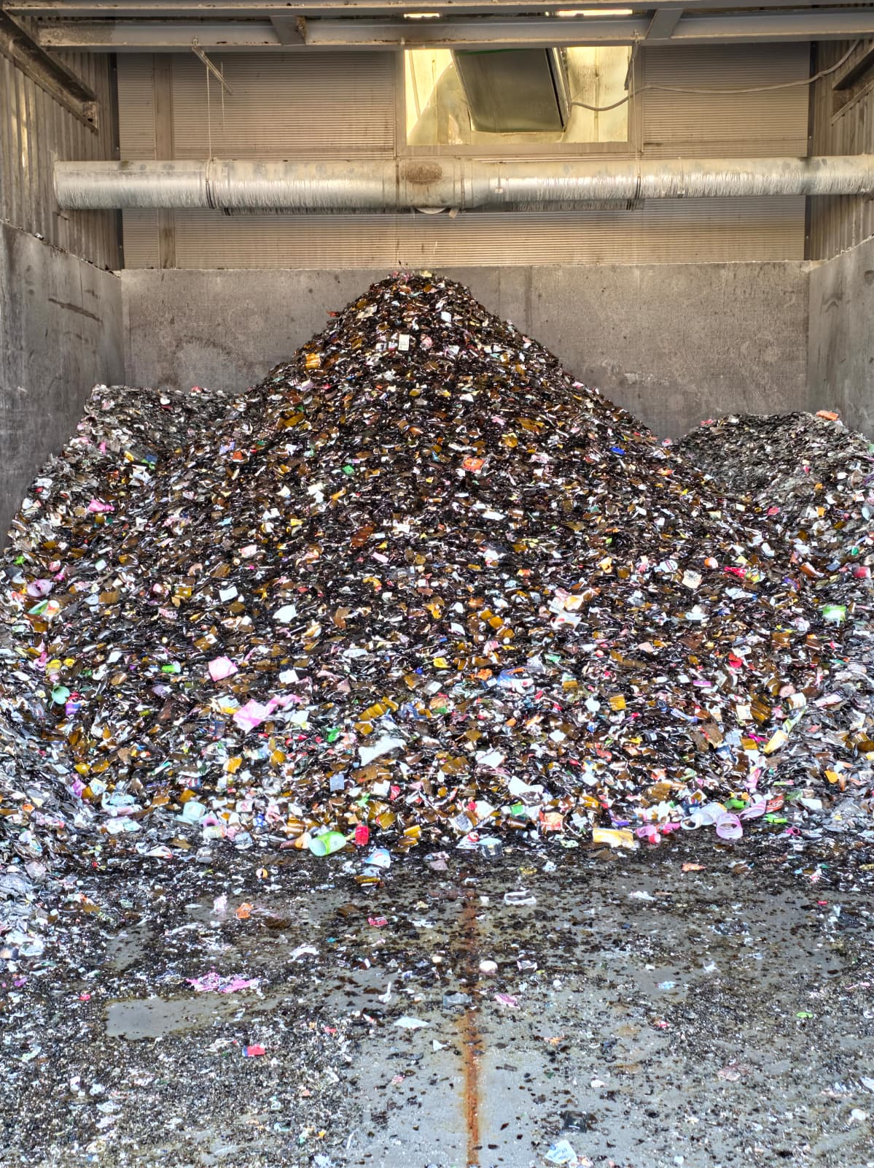
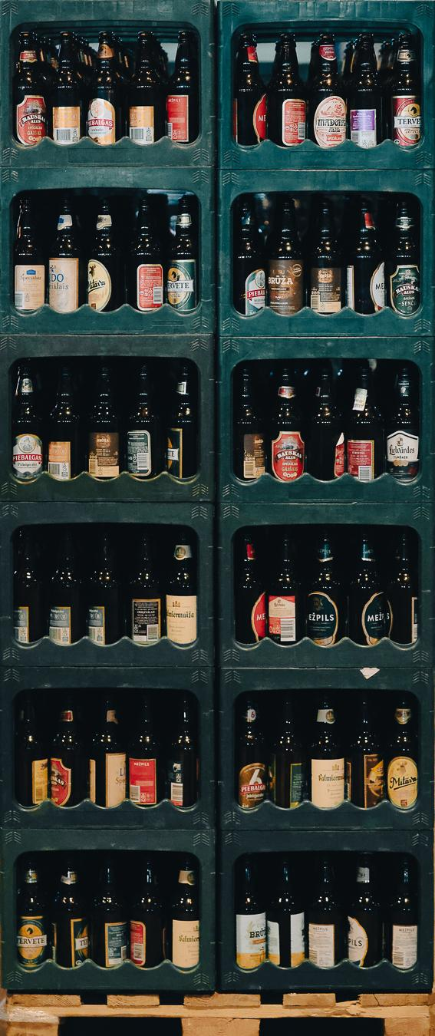
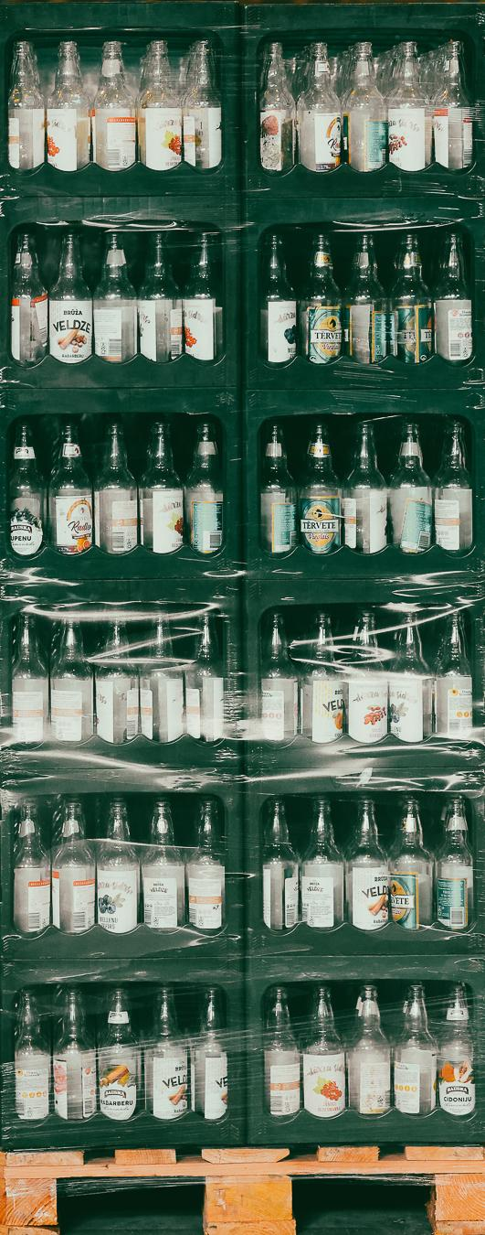
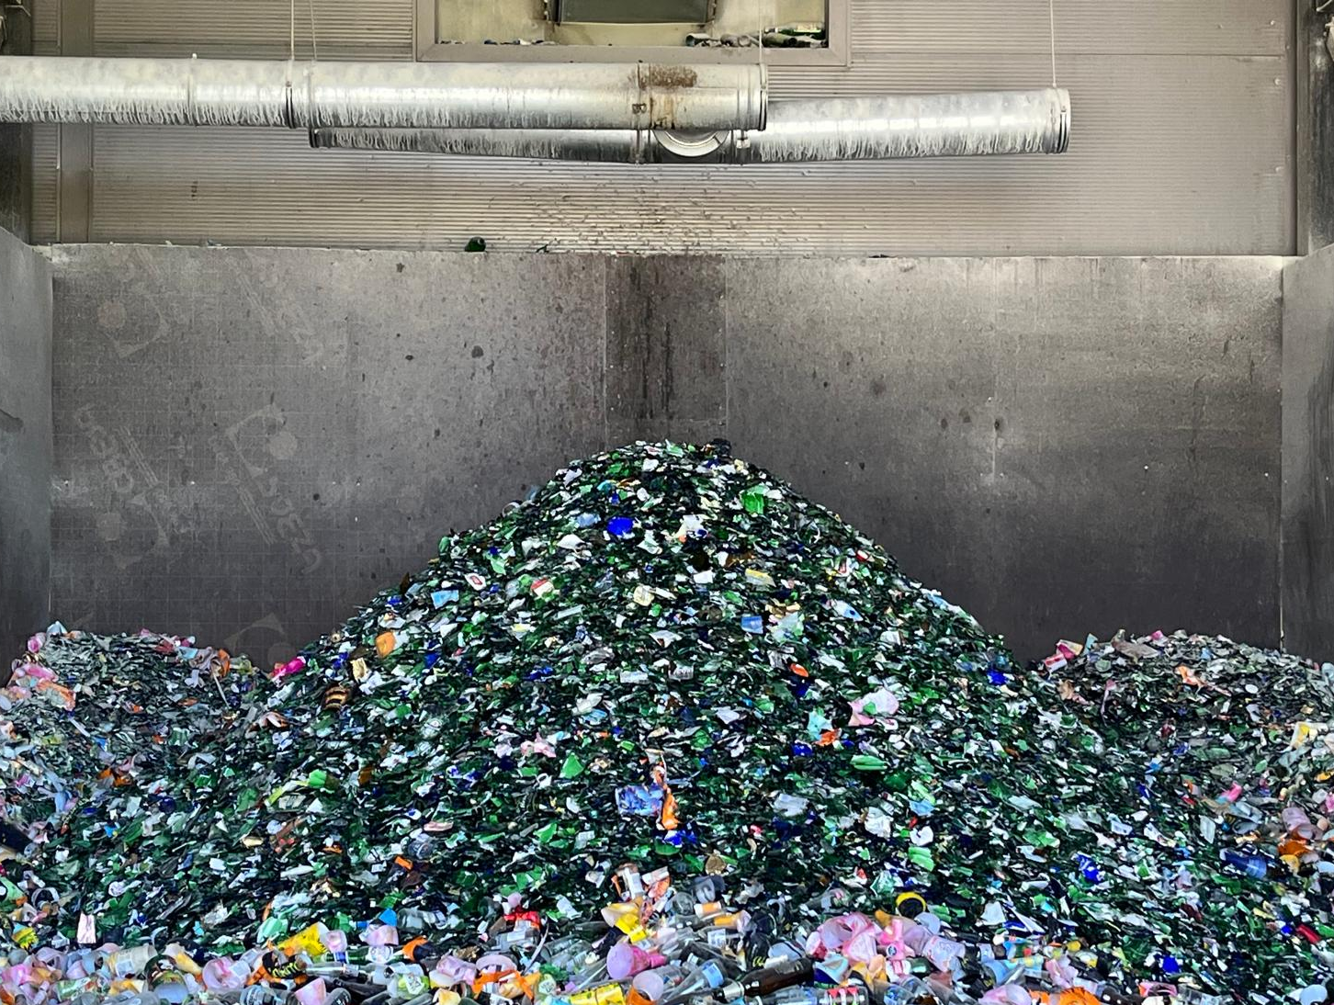
Thank you!

