Slide 1
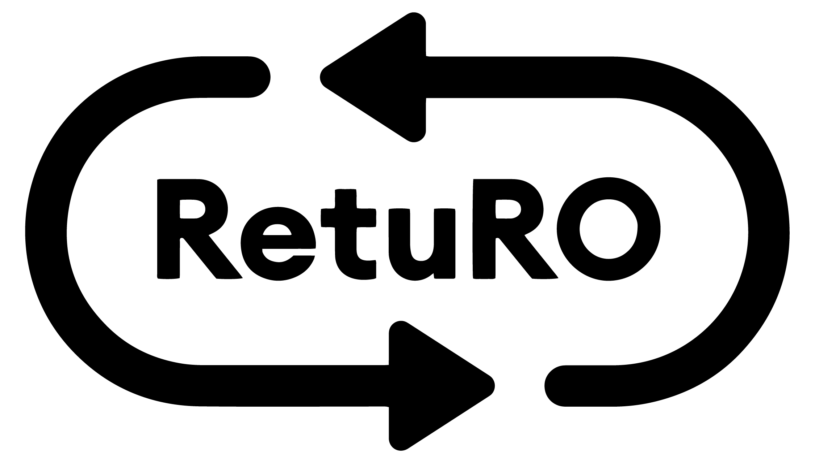
The Romanian DRS
Proprietary. For informational purposes only.

Slide 2




RetuRO’s Mission
Packaging Return Rates**
DRS
Return Rates
RetuRO is the sole administrator of the Deposit Return System in Romania.
Scope – to implement Romania’s largest circular economy project while making a cultural shift towards sustainability.
2022* |  | 2024 | 2025 | 2026
 |  |  |  | Targets
30% |  | 53% (Target - 65%) | 86% (Target - 75%) | 85%
37.5% |  | 55% (Target - 65%) | 82% (Target - 80%) | 90%
42.2% |  | 55% (Target - 65%) | 83% (Target - 80%) | 90%
Glass
Plastic
Metal
Proprietary. For informational purposes only.
*the 2022 Eurostat figures represent the total amount of glass, **metal (aluminium) and plastic packaging recovered, not only for beverage packaging.

Slide 3

The Romanian Deposit-Return System
Deposit System
Packaging Scope
System Principles
System Infrastructure
Deposit paid @purchase and refunded upon return
Developed following several years of research into various European DRS models
Single-Use Beverage Plastic, Glass & Metal
0.1 – 3 liters Packaging
- Environmental Benefit & Closed Loop
Bottle2bottle, Can2Can recycling
Return to retail
- Cost control & revenue management
- Solid legal framework
- Alignment with Beverages industry
- Counting & sorting centers
- Nationwide Logistics Network
- IT platform enabling transparency & traceability
2018
Oct. 2021
Feb. 2022
Aug. 2022
July 2023
Nov. 30th 2023
Now
ING Bank grants RetuRO a EUR 85 million green loan
9 SORTING & COUNTING CENTRES
~83% average RETURN RATE
in the last 12 rolling months
Producers’ first discussions with government on DRS
Legislative framework into force
Incorporation of RetuRO SGR
RetuRO designated
as DRS administrator
DRS goes live
Proprietary. For informational purposes only.

Slide 4

DRS Scale & Complexity
The Deposit-Return System in Romania
largest fully integrated system globally
Government
Beverage Producers / Importers
Local Authorities
(Counties, Towns, Communes, Villages)
Scale
Consumers involved in the system 19 Mln.
(Romania’s population)
Beverage producers & importers ~4,000
Retailers ~ 80,000
Registered SKUs ~ 88,000
Containers put on the market annually ~ 7 Bln.
Retailers & HoReCa
Multiple stakeholders
Suppliers
Consumers
Banks/Auditors
Recyclers
Proprietary. For informational purposes only.

Slide 5

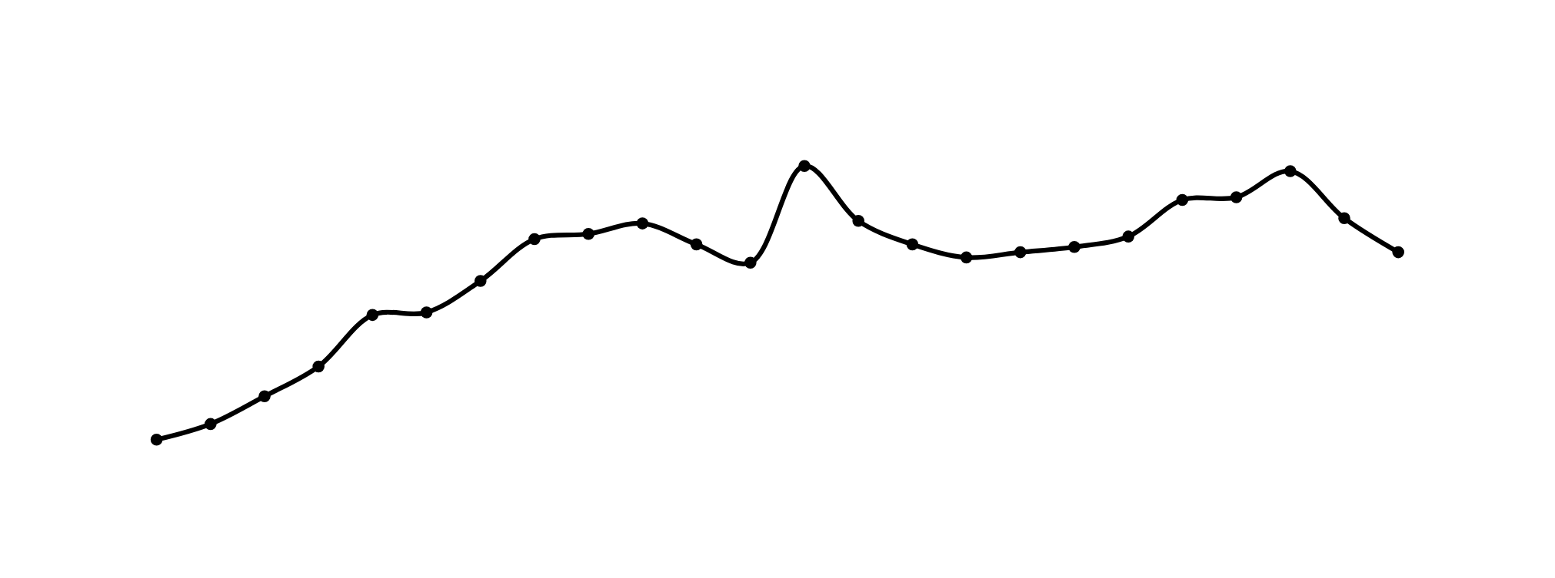
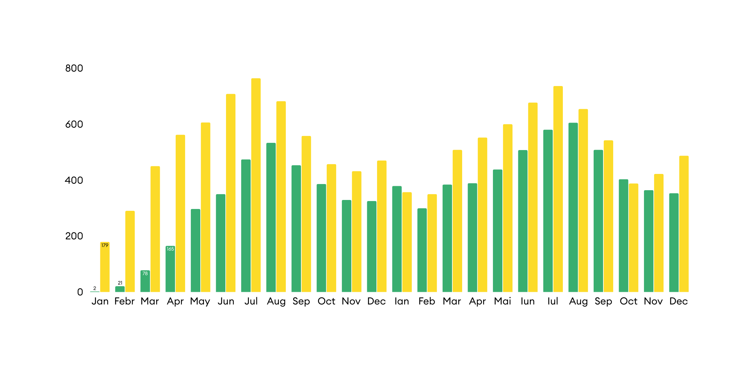
Collection Rate Evolution 2024-2025
Returned packaging (mln)
Packaging placed on the market (mln)
Return rate %
106%
104%
93%
94%
84%
85%
86%
78%
80%
76%
76%
75%
79%
73%
71%
73%
62%
49%
50%
69%
29.3%
17.5%
7.3%
1.3%
Proprietary. For informational purposes only.
In 2025, the collection rate average reached 83%.

Slide 6
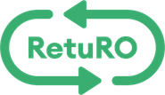
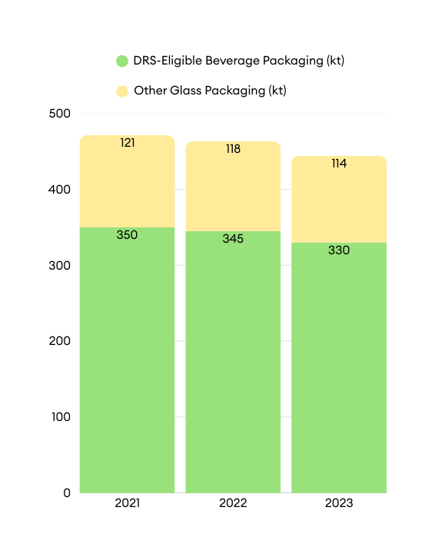
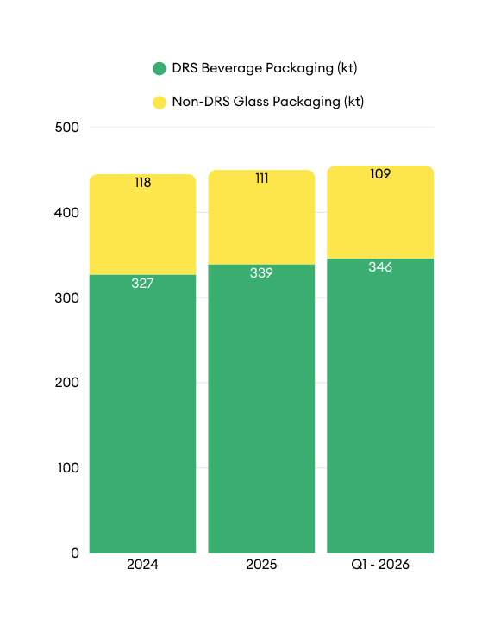
Market Context
Out of the total glass packaging placed on the market, ≈75% is represented by beverage packaging subject to DRS.
Glass placed on the Market Before 2024
DRS Adoption - Glass placed on Market
Annual specificities:
  2021: strong rebound after Covid
  2022: energy crisis peak
  2023: demand correction / destocking, preparation for DRS go live
  2024–today: gradual recovery, still fragile
  2026–2031: estimated moderate growth, big questions on consumer demand, energy cost
Proprietary. For informational purposes only.

Slide 7
Market Context
50% of glass collected is recycled in Romania
Reduced glass container Production capacity: ~50–60 overall glass manufacturers, but only one major glass bottles manufacturer in Romania – BA Glass
Capacity gap: Romanian recyclers absorb ~50% of DRS glass
Best nearby container-glass offtake options: Chişinău, Sofia, Plovdiv, Orosháza, Kaposvár
Pricing highly dependent on logistics & geography
Unbalanced recycler locations vs. RetuRO facilities
Source: RetuRO internal
Proprietary. For informational purposes only.

Slide 8
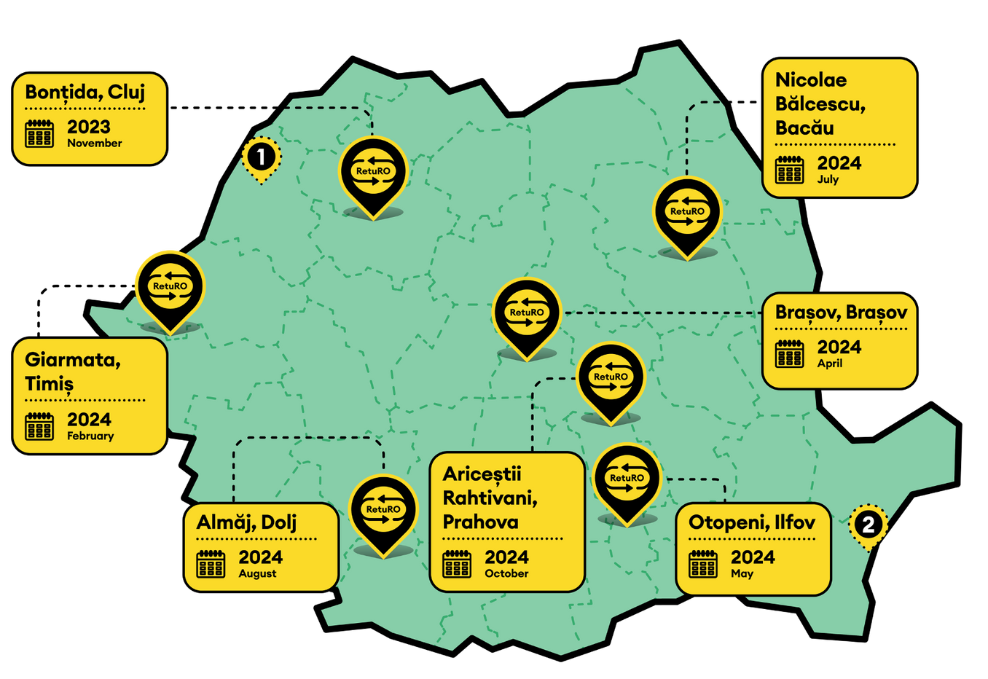



We have built the infrastructure to support the system :
7 regional counting and sorting centres opened by the end of the the first full year of operation
9 total regional counting and sorting centres in the RetuRO ecosystem
800 green jobs created with the 7 centers & HQ, from only 4 employees in January 2023
~90 mln €
RetuRO’s total investment in the
first year
Proprietary. For informational purposes only.

Slide 9
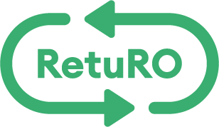
We have built a system designed to deliver both high collection rates and high material quality
Key Advantages of Including Glass in DRS
Much Higher Quality Cullet (Critical for Bottle-to-Bottle)
Lower Carbon Footprint for Glass Packaging
Stronger Circular Economy for Glass
Greater Supply Stability for Recyclers
Key Challenges of Including Glass in DRS
Operational Complexity and Costs
Reverse Vending Machine (RVM) Challenges / Retailers resistance
Significant impact on Existing Glass Collection Systems as the largest part of glass beverage packaging is currently collected through DRS
Increased Cost for Producers
🧩 A well-designed DRS does not replace collection systems — it complements them.
♻️💎 It is about the quality of materials to be recycled and the economics of circular packaging. Deposit systems can significantly improve cullet quality and enable true bottle-to-bottle recycling.
Proprietary. For informational purposes only.

Slide 10
THANK YOU!
Proprietary. For informational purposes only.

