Slide 1
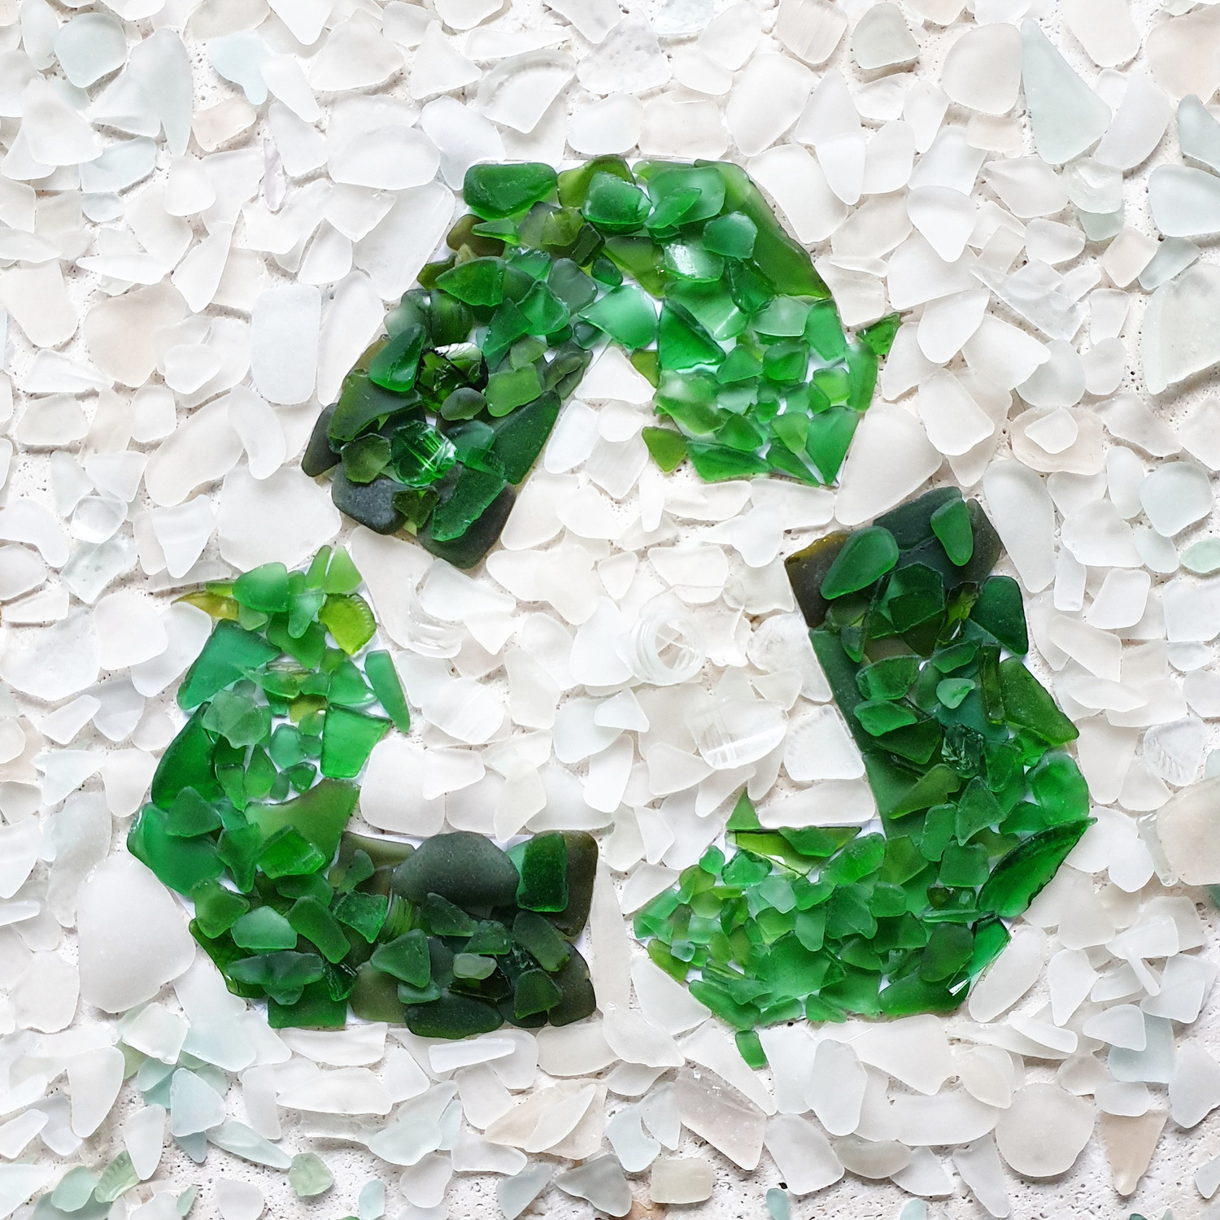

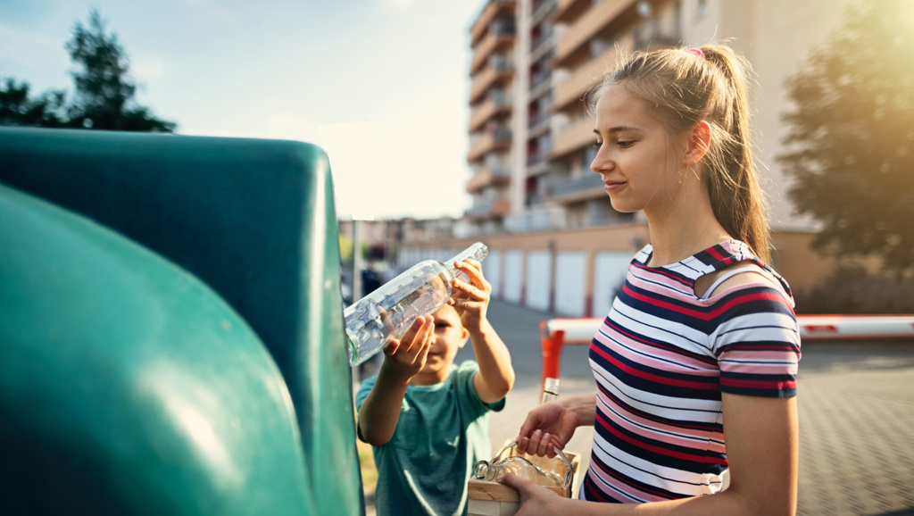
2026 ANNUAL EVENT
Advancing the Circular Economy for Glass Packaging
4th JUNE 2026
8:30 AM > 16:00 PM (CET)
TownHall Europe
Sq. de Meeûs 5,
1000 Bruxelles, Belgium

Slide 2
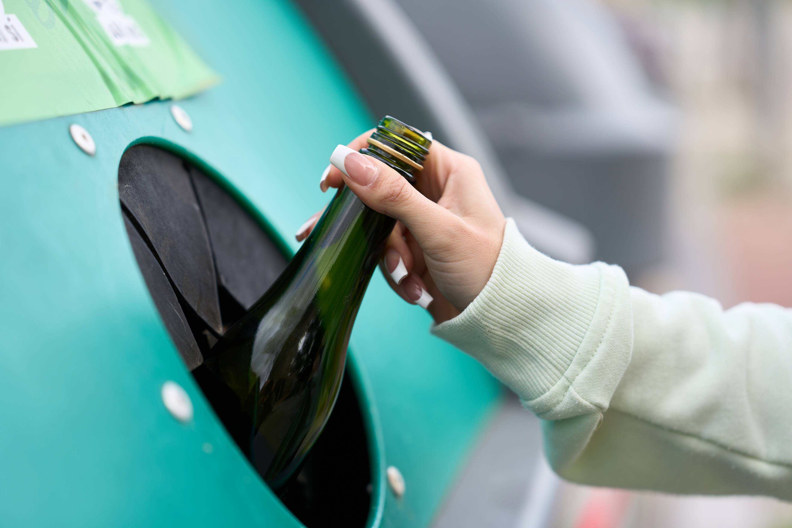
AGENDA
09:00 – 10:30
10:30 – 11:00
11:00 – 12:30
12:30 – 13:30
13:30 – 14:30
14:30 – 16:00
How can Europe sustain circularity at an industrial scale?
Welcome & Introduction
Opening Remarks
Panel Debate
Coffee Break
Towards a glass packaging value chain position on the Circular Economy Act
Panel Debate
Lunch Break
Focus on the national platforms of Close the Glass Loop
Project updates from National Platforms
Building Close the Glass Loop projects
TownHall Europe
Sq. de Meeûs 5,
1000 Bruxelles, Belgium
2026 ANNUAL EVENT

Slide 3
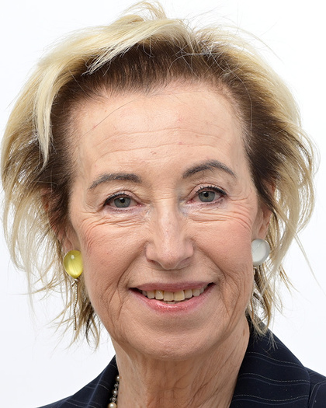
2026 ANNUAL EVENT
Advancing the Circular Economy for Glass Packaging
Letizia Moratti
Member of the European Parliament (EPP/IT)
OPENING REMARKS
4th JUNE 2026
8:30 AM > 16:00 PM (CET)
TownHall Europe
Sq. de Meeûs 5,
1000 Bruxelles, Belgium

Slide 4
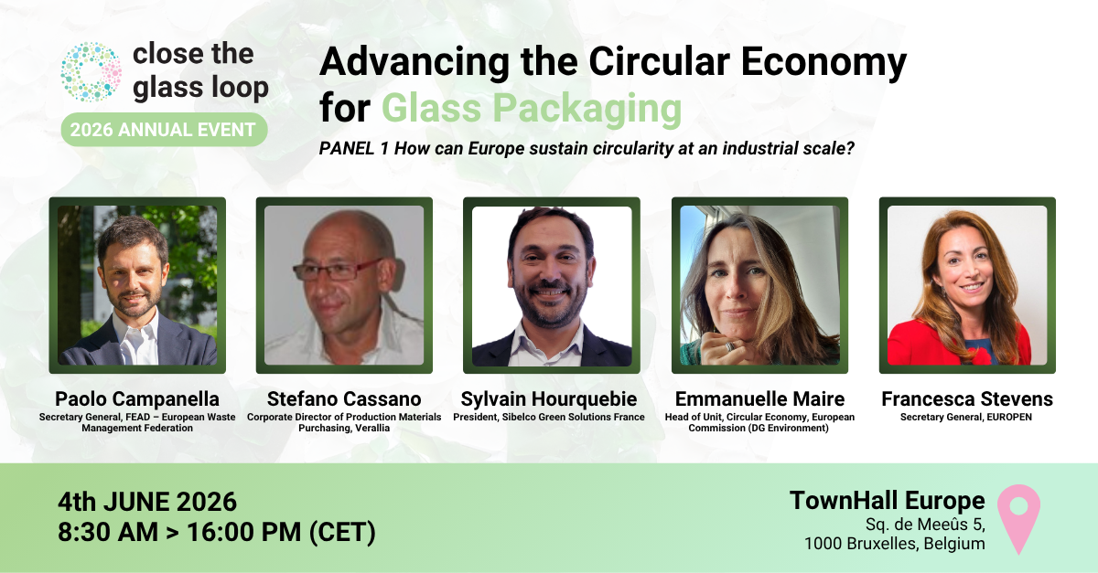

Slide 5
2026 ANNUAL EVENT
COFFEE BREAK
4th JUNE 2026
8:30 AM > 16:00 PM (CET)
TownHall Europe
Sq. de Meeûs 5,
1000 Bruxelles, Belgium

Slide 6
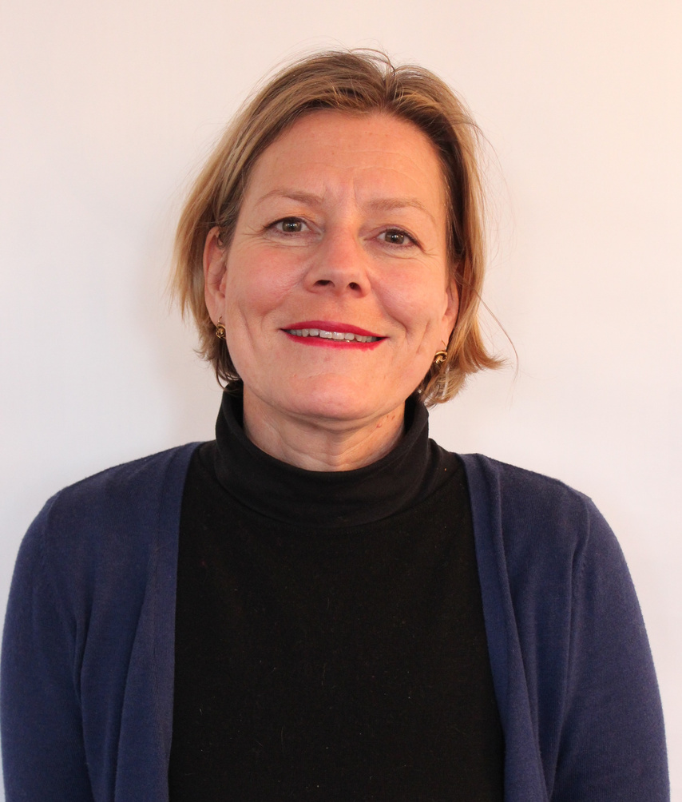
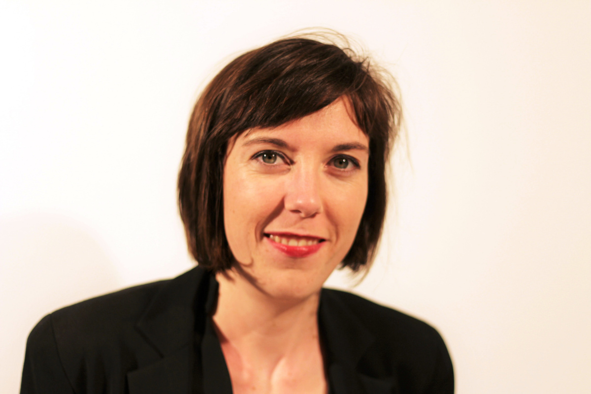
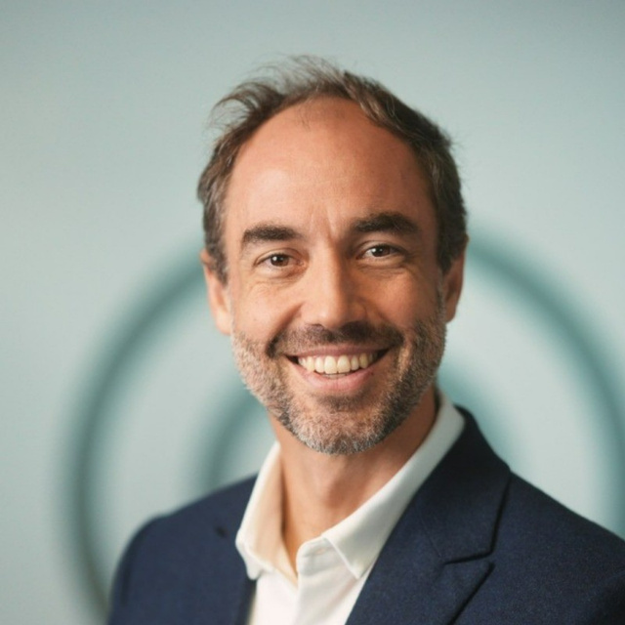
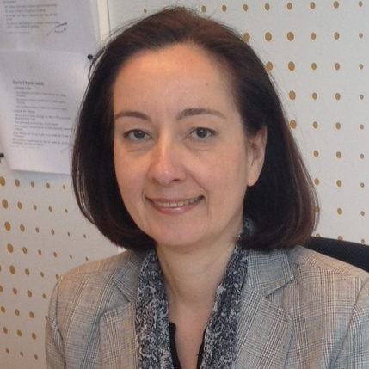
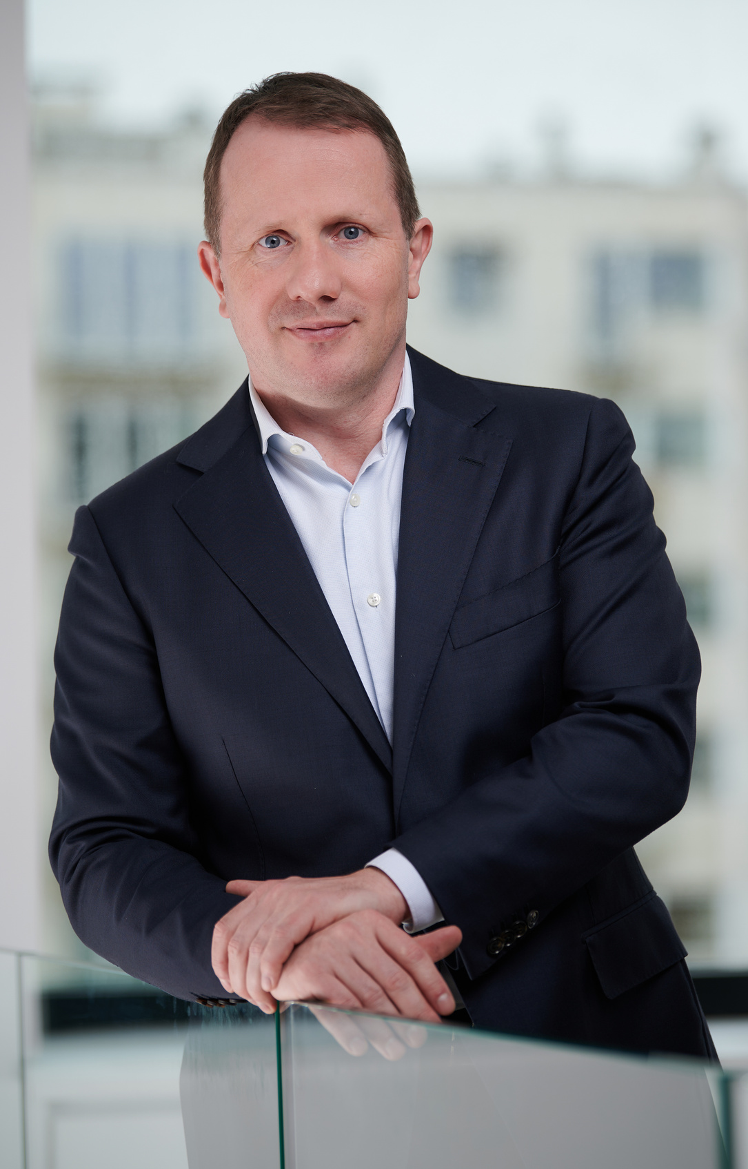
Advancing the Circular Economy for Glass Packaging
2026 ANNUAL EVENT
PANEL 2 Towards a glass packaging value chain position on the Circular Economy Act
Françoise Bonnet
Secretary General,
ACR+
Vanessa Chesnot
Head of Public Affairs & Product Policy,
FEVE – European Container Glass Federation
Valentin Fournel
Director of Ecodesign & Reuse,
CITEO
Monika Romenska
Regulatory & Public Affairs Manager,
EXPRA
René Schroeder
Secretary General,
FERVER – European Glass Recyclers' Federation
4th JUNE 2026
8:30 AM > 16:00 PM (CET)
TownHall Europe
Sq. de Meeûs 5,
1000 Bruxelles, Belgium

Slide 7
2026 ANNUAL EVENT
LUNCH BREAK
4th JUNE 2026
8:30 AM > 16:00 PM (CET)
TownHall Europe
Sq. de Meeûs 5,
1000 Bruxelles, Belgium

Slide 8
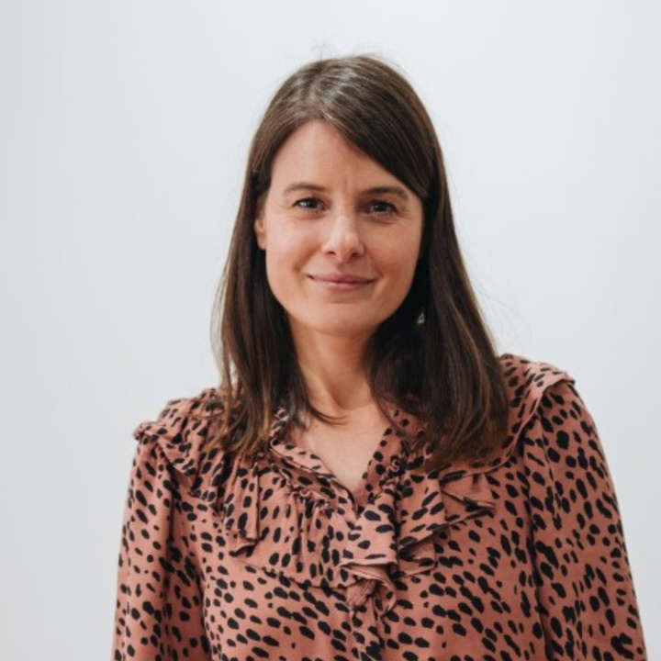
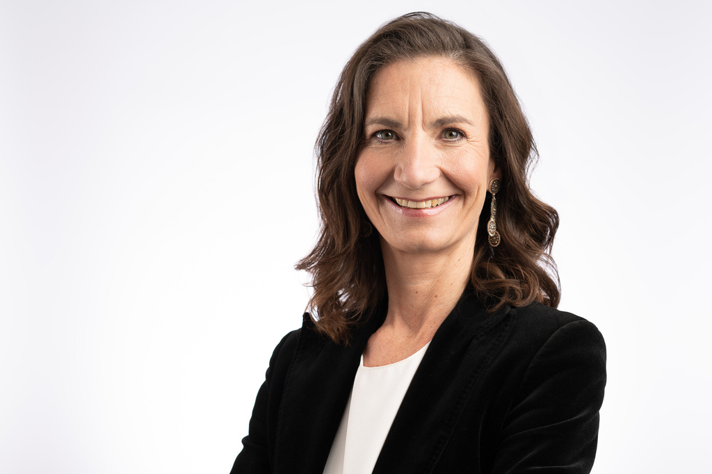
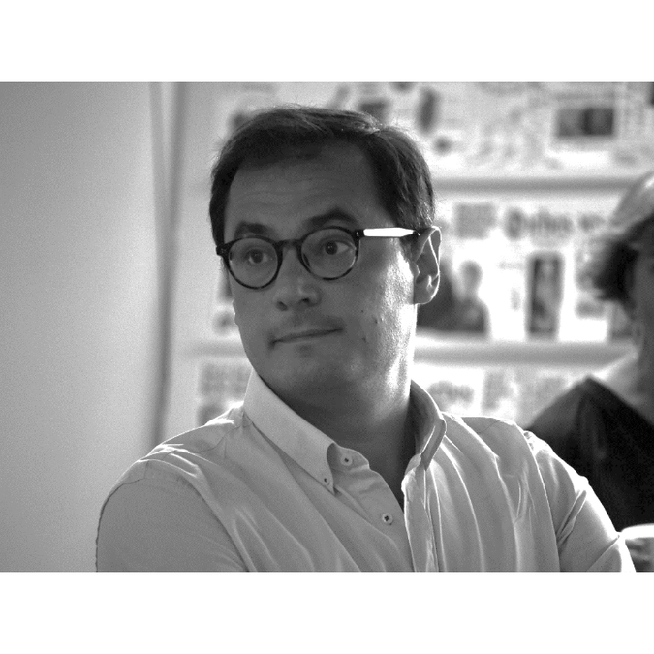
Advancing the Circular Economy for Glass Packaging
2026 ANNUAL EVENT
Session 3 Focus on the National Platforms of Close the Glass Loop
Sandra Anguiano
Public Affairs Director,
Ecovidrio
Eva Koller
Managing Director,
Austria Glas Recycling
Nuno Vieira
Coordinator,
Plataforma Vidro+
4th JUNE 2026
8:30 AM > 16:00 PM (CET)
TownHall Europe
Sq. de Meeûs 5,
1000 Bruxelles, Belgium

Slide 9
2026 ANNUAL EVENT
Advancing the Circular Economy for Glass Packaging
Eva Koller
Managing Director,
Austria Glas Recycling
PANEL 3 Focus on the national platforms of Close the Glass Loop
TownHall Europe
Sq. de Meeûs 5,
1000 Bruxelles, Belgium
4th JUNE 2026
8:30 AM > 16:00 PM (CET)

Slide 10
Projects for Cost efficiency in Austria
Eva Koller
Close the Glass Loop Brussels, 04.06.2026

Slide 11
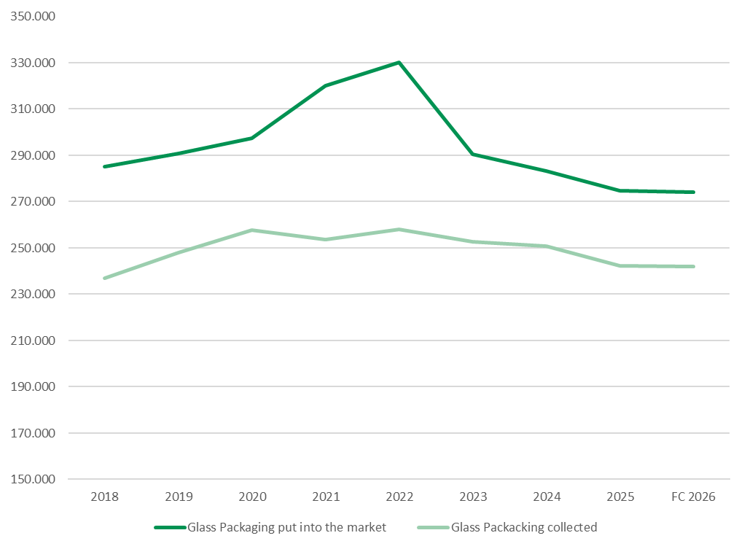
Glass packaging Austria
In tons/a
Reasons for declining amounts:
Switch from single use to reusable packaging
Less alcohol consumption
Weak economic situation
Packaging is becoming lighter

Slide 12
Challenges 2026
Quantities put into the market are decreasing significantly
Collection quantities are more or less stagnant
Operational partners are demanding higher prices mainly due to labor costs, fuel price
Recycling of coloured glass unstable

Slide 13



Cost efficiency projects through the entire value chain
collection infrastructure
collection
transfer
transportation
(optional)
storage
(optional)
transportation
recycling
Shared use
Collected material
to co-using household systems
Bin collection from
public collection
points
Regional
transfer center
%
Mechanical
Recycling
Household packaging
Bin collection
from small
businesses
Recycling
yards (MRF)

Slide 14
Cost efficiency projects through the entire value chain
collection infrastructure
collection
transfer
transportation
(optional)
storage
(optional)
transportation
recycling
Shared use
Collected material
to co-using household systems
Bin collection from
public collection
points
Regional
transfer center
%
Mechanical
Recycling
Household packaging
Bin collection
from small
businesses
Recycling
yards (MRF)

Slide 15
Cost efficiency projects through the entire value chain
collection infrastructure
collection
transfer
transportation
(optional)
storage
(optional)
transportation
recycling
INFRASTRUCTURE
Optimization of the filling level
Low-utilized Containers are being removed and repaired
Containers are moved to other locations or used as replacements for old containers
Less investment but the same quality
Shared use
Collected material
to co-using household systems
Bin collection from
public collection
points
Regional
transfer center
%
Mechanical
Recycling
Household packaging
Bin collection
from small
businesses
Recycling
yards (MRF)

Slide 16
Cost efficiency projects through the entire value chain
collection infrastructure
collection
transfer
transportation
(optional)
storage
(optional)
transportation
recycling
Shared use
Collected material
to co-using household systems
Bin collection from
public collection
points
Regional
transfer center
%
Mechanical
Recycling
Household packaging
Bin collection
from small
businesses
Recycling
yards (MRF)

Slide 17
Cost efficiency projects through the entire value chain
collection infrastructure
collection
transfer
transportation
(optional)
storage
(optional)
transportation
Collection
Optimization of the collection from small businesses
Cost cutting in operational field
New Tender 2028 with the aim of clear performance indicators
Projects involving digitalisation and tour optimization
  Sensor based measuring of the filling level of bins
  Projects, that use long term data concerning the actual collection
Currently no benefits in this case visible, therefore projects on hold
recycling
Shared use
Collected material
to co-using household systems
Bin collection from
public collection
points
Regional
transfer center
%
Mechanical
Recycling
Household packaging
Bin collection
from small
businesses
Recycling
yards (MRF)

Slide 18
Cost efficiency projects through the entire value chain
collection infrastructure
collection
transfer
transportation
(optional)
storage
(optional)
transportation
recycling
Shared use
Collected material
to co-using household systems
Bin collection from
public collection
points
Regional
transfer center
%
Mechanical
Recycling
Household packaging
Bin collection
from small
businesses
Recycling
yards (MRF)

Slide 19
Cost efficiency projects through the entire value chain
TRANSPORT AND STORAGE
Optimization of truck transport routes to the recyclers
16% less transport kilometers in 2025 versus 2024
2024: 170 kilometers per delivery
2025: 143 kilometers per delivery
Optimization of rail transports:
  Optimization routes
  Reduction of direct loading from the collection truck to the railway carriage
collection infrastructure
collection
transfer
transportation
(optional)
storage
(optional)
transportation
recycling
Shared use
Reduction of CO2 Emission
Collected material
to co-using household systems
Bin collection from
public collection
points
Regional
transfer center
%
Mechanical
Recycling
Household packaging
Bin collection
from small
businesses
Recycling
yards (MRF)

Slide 20
Cost efficiency projects through the entire value chain
collection infrastructure
collection
transfer
transportation
(optional)
storage
(optional)
transportation
recycling
Shared use
Collected material
to co-using household systems
Bin collection from
public collection
points
Regional
transfer center
%
Mechanical
Recycling
Household packaging
Bin collection
from small
businesses
Recycling
yards (MRF)
High costs:
low load weight
carriage not on time

Slide 21
Cost efficiency projects through the entire value chain
TRANSPORT AND STORAGE
Optimization of truck transport routes to the recyclers
16% less transport kilometers in 2025 versus 2024
2024: 170 kilometers per delivery
2025: 143 kilometers per delivery
Optimization of rail transports:
  Optimization routes
  Reduction of direct loading from the collection truck to the railway carriage
Cost cutting of service costs
Warehouse Management and Delivery „just in time“: Saving storage and loading costs
collection infrastructure
collection
transfer
transportation
(optional)
storage
(optional)
transportation
recycling
Shared use
Collected material
to co-using household systems
Bin collection from
public collection
points
Regional
transfer center
%
Mechanical
Recycling
Household packaging
Bin collection
from small
businesses
Recycling
yards (MRF)

Slide 22
Cost efficiency projects through the entire value chain
DATA MANAGEMENT SYSTEMS
collection infrastructure
collection
transfer
transportation
(optional)
storage
(optional)
transportation
recycling
Shared use
Collected material
to co-using household systems
Bin collection from
public collection
points
Regional
transfer center
%
Mechanical
Recycling
Household packaging
Bin collection
from small
businesses
Recycling
yards (MRF)

Slide 23
Cost efficiency projects through the entire value chain
DATA MANAGEMENT SYSTEMS
Digitalization in the field of reporting:
Introduction of automatic interfaces
Introduction of KPIs to enable comparison of service providers and to show them where they can improve their services
APP “Glassfuture”: Overview of the exact container locations and their condition
collection infrastructure
collection
transfer
transportation
(optional)
storage
(optional)
transportation
recycling
Shared use
Collected material
to co-using household systems
Bin collection from
public collection
points
Regional
transfer center
%
Mechanical
Recycling
Household packaging
Bin collection
from small
businesses
Recycling
yards (MRF)

Slide 24
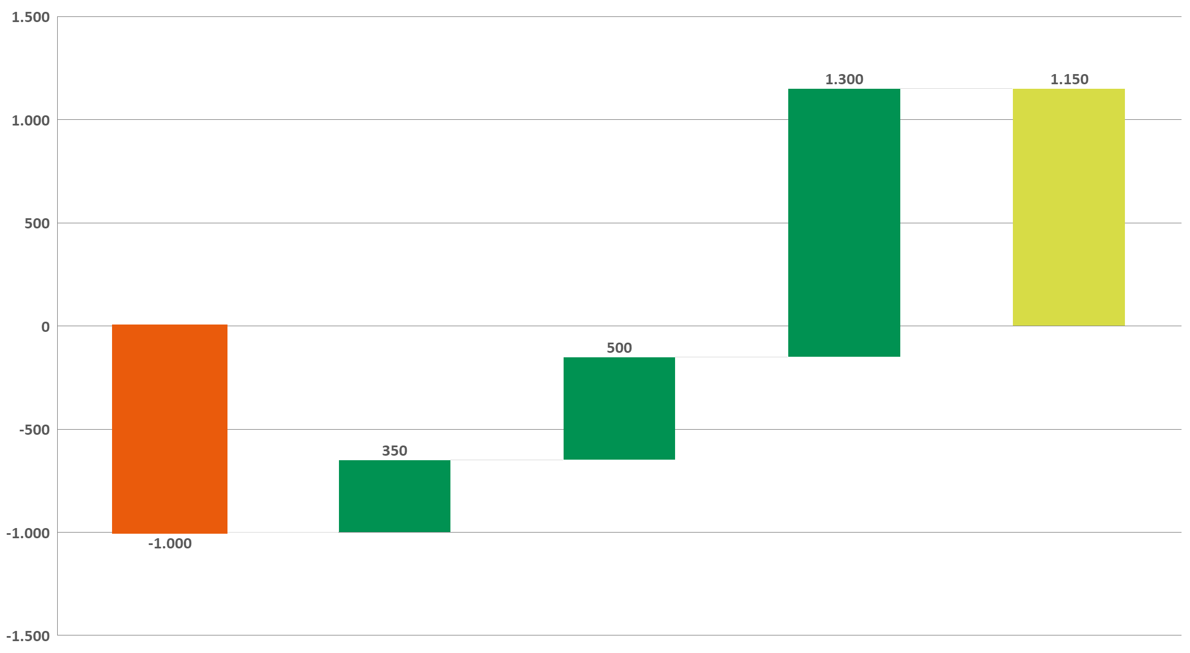

Budget versus actual result, 2025
<T€>
Market/Licensed amount significantly below budget
Less infrastructure costs due to less investments in collection bins because of higher efficiency
Reduction of collection cost due to optimization measures
Reduction of transport- and loading costs due to optimization measures
-19,2%
Despite a sharp decline in revenue, we were able to significantly improve the financial result while maintaining high performance!
-5,1 %
-3,5 %
-3,1 %
1
2
3
4
Result 2025

Slide 26
2026 ANNUAL EVENT
Advancing the Circular Economy for Glass Packaging
Nuno Vieira
Coordinator,
Plataforma Vidro+
PANEL 3 Focus on the national platforms of Close the Glass Loop
TownHall Europe
Sq. de Meeûs 5,
1000 Bruxelles, Belgium
4th JUNE 2026
8:30 AM > 16:00 PM (CET)

Slide 27

Platform for Glass Packaging Circularity in Portugal

Slide 28
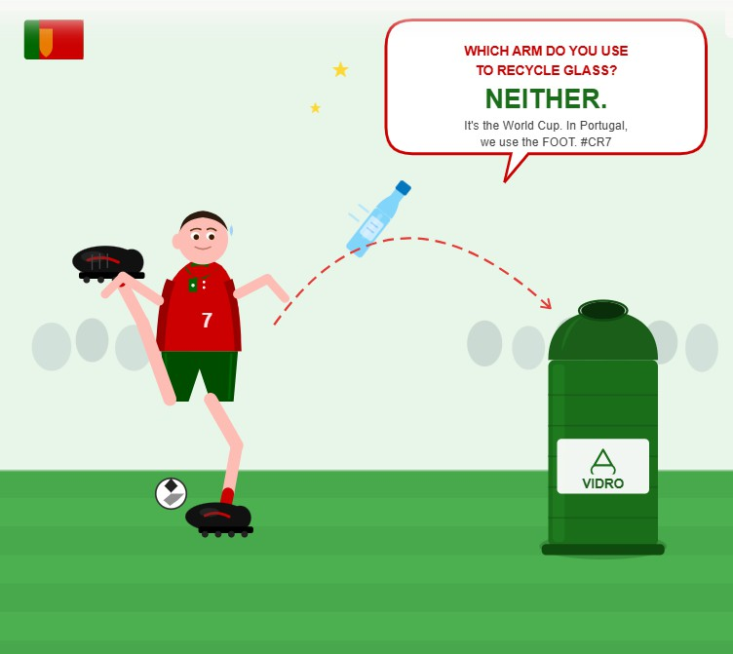


Slide 29


Vidro+ Platform is a collaborative initiative coordinated by ASWP, with the institutional support of FEVE (European Container Glass Federation), which was launched on 24 May 2022.
Vision
Convert Portugal into a reference country in the collection and recycling of glass packaging, as well as in the incorporation of recycled glass in the production of new glass packaging.
Goal
90% collection of glass packaging placed on the market for recycling by 2030.
Working groups
21 Effective Members
26 Institutional Members
Initially:
Currently:
Roadmap 2030
Metrics
Roadmap 2030
HORECA Channel
Institutional Support
Vidro+ figures
19 Pilot Projects
25 Collaborative meetings

Slide 30















































Effective Members
Institutional Members

Slide 31
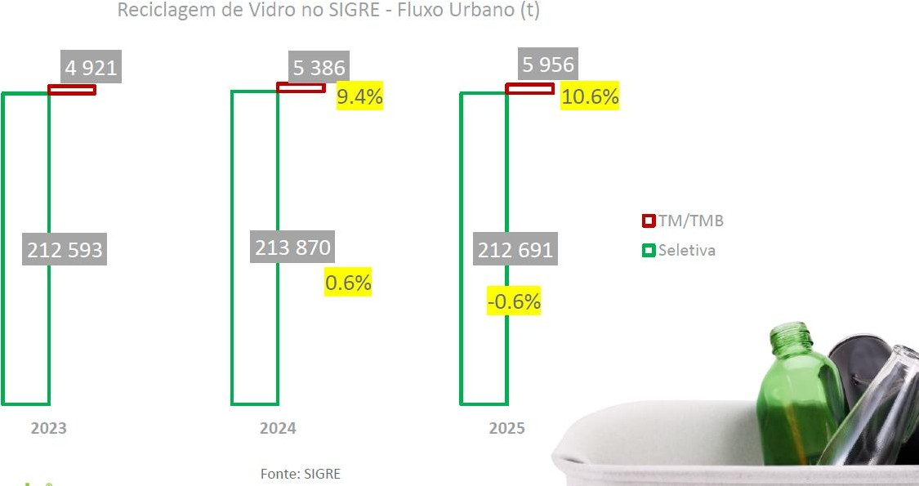
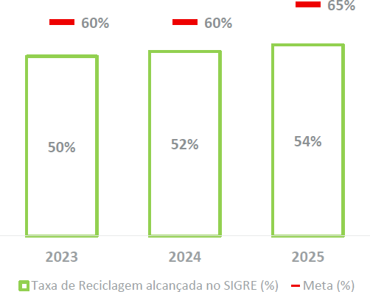
EPR Scheme Recycling rate of glass in Portugal
Preliminary 2025 results shows an increase to 54%
Recycling rate of glass in Portugal
Recycling of glass in Portugal (absolute)

Slide 32
EPR Scheme
Fees (paid by fillers)
~85 €
~25 €
€ per ton
2024
2025

Slide 33



What are we doing to move the needle?

Slide 34
Roadmap 2030
Projects Closed
Bottle Banks with lifting help at HORECA Channel
  Sociedade Ponto Verde, AIVE
HORECA Channel Door-to-Door Extension
  Porto Ambiente
Assessment of Bottle Bank Coverage Extension
  EGF
Accounting for Non-Urban Glass Packaging
  Trivalor
Urban Littering
  Electrão
Green Flags
  Electrão, AIVE
Awareness raising campaign
  AIVE, Disneyland Paris
A Tip for Nature
  AIVE, Editory Hotels, FEVE
Mass balance study of glass
  Vidro+ Platform
Marinha + Vidro
  AIVE, Valorlis (EGF), Municipality of Marinha Grande
Digital Bins Mafra
  Câmara Municipal de Mafra, Sociedade Ponto Verde, AIVE
Awareness raising campaign “Vidrões Temáticos”
  AIVE
Vidrados no Ambiente
  Maiambiente, Electrão
Com o Vidro no Coração
  Valorlis, Sociedade Ponto Verde, Liga Portuguesa contra o Cancro

Slide 35
Roadmap 2030
Projects Ongoing
Recovery of Glass from Mechanical and Biological Treatment (TMB)
  Electrão, BA Glass, Maltha Glass Recycling, AIVE
Figueira + Vidro
  AIVE, ERSUC (EGF), Municipality of Figueira da Foz
Mais Vidro, Mais Porto
  Porto Ambiente, Super Bock, Sogrape, Fujitsu
Glass collection improvement in municipalities
  LIPOR, Maiambiente, AIVE, BA Glass, Novo Verde
Vidrões com Volteador (Bottle banks with lifting support)
  VALORSUL, Mucicipalities of Caldas da Rainha, Nazaré and Peniche)

Slide 36

Assisted Transfer in Horeca for glass

Slide 37
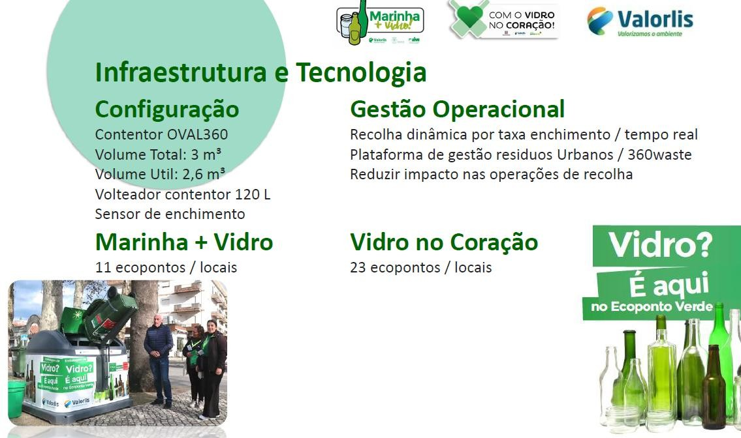
Installed 34 containers with assisted transfer

Slide 38
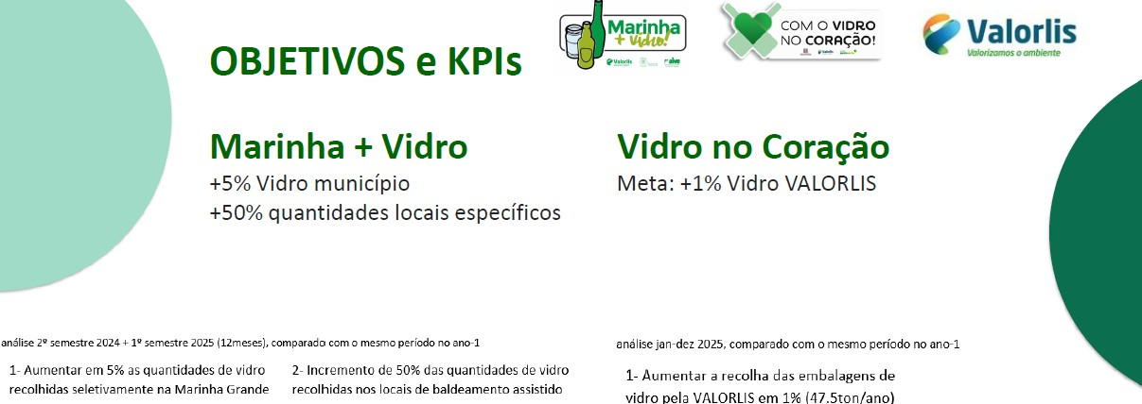


Assisted Transfer in Horeca
+4%
municipality
+71%
local recovery
+5%
municipality
+52%
local recovery
recovery (YoY)
(YoY)
recovery (YoY)
(YoY)

Slide 39




Mais Vidro Mais Porto

Slide 40

Background
Fujitsu NPO/NGO 2024 Program
A global initiative promoted by the Community Activities
Promotion Office in Japan.
It encourages Fujitsu employees to develop projects with a social and environmental impact, in partnership with local organisations.
Selected projects receive internal funding for implementation, reflecting Fujitsu’s commitment to social responsibility and sustainable innovation.
Funding: €24,700

Slide 41




Background
Coordinator
Partners

Slide 42
Project description
Implement a digital solution across 20 glass recycling bins
in the Boavista area;
Goals
Develop and implement an awareness campaign;
Increase the collection rate for glass packaging to 75 %
in the area under study;
Door to door residential
campaign – first round
Door to door residential campaign + commercial establishments – second round
Launch
19 November
2025
Until 13
February 2026
March 2026

Slide 43
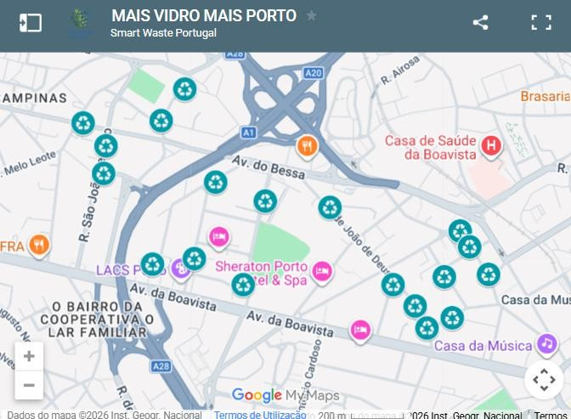
Project description
Target audience and pilot area
8,500 people in the Boavista area

Slide 44
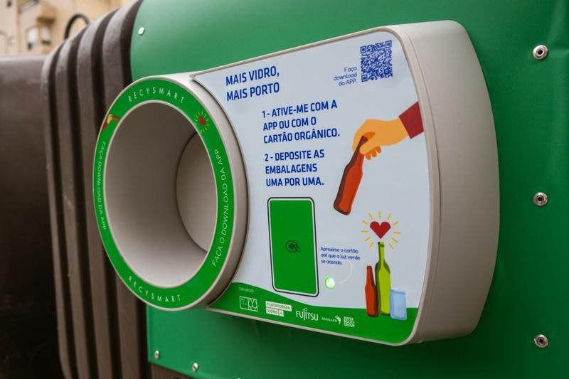
Project description
Find your nearest digital recycling bin using the Recysmart app or the project website.
Connect to the bin using the Recysmart app or your Orgânico card.
Introduce glass containers one by one.
Track the impact of your actions and the project via the Recysmart app, website or social media.
How it works

Slide 45
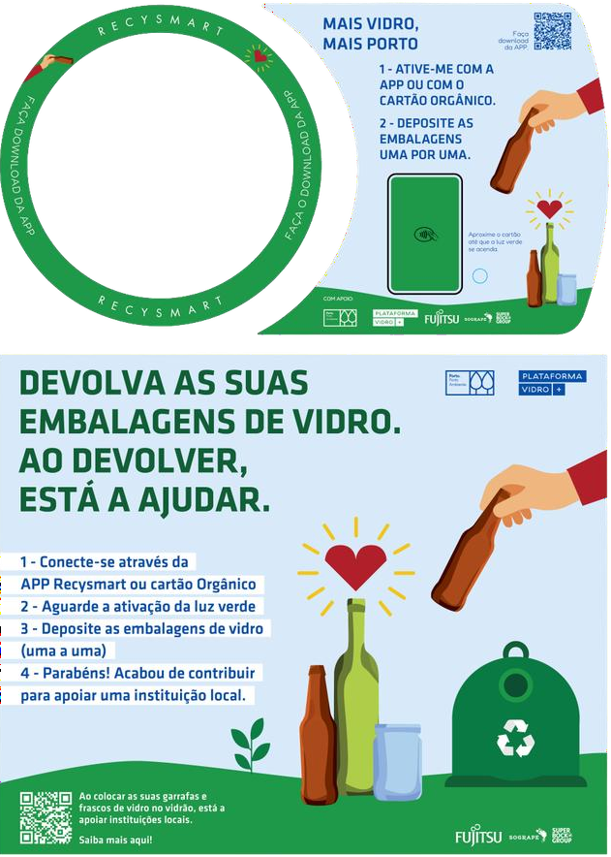
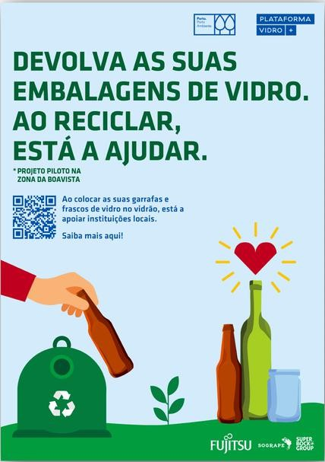
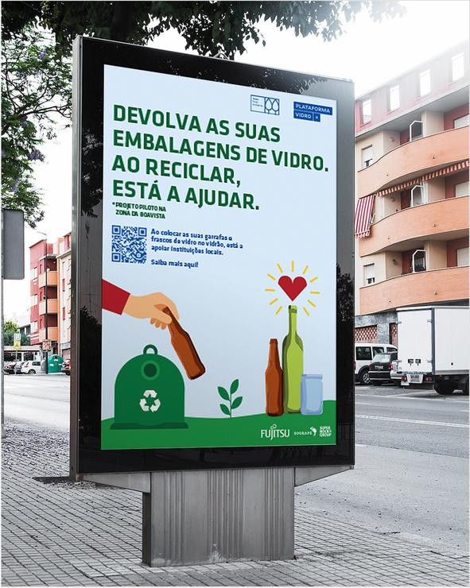
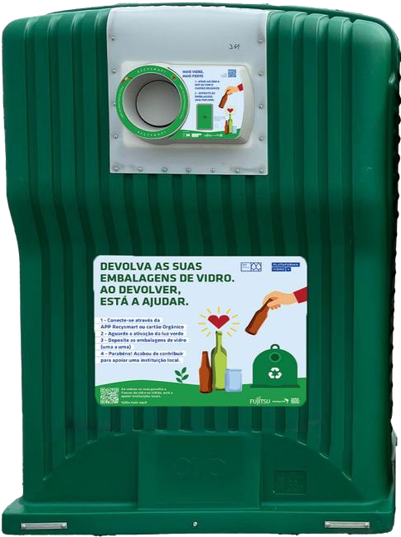
Communication

Slide 46
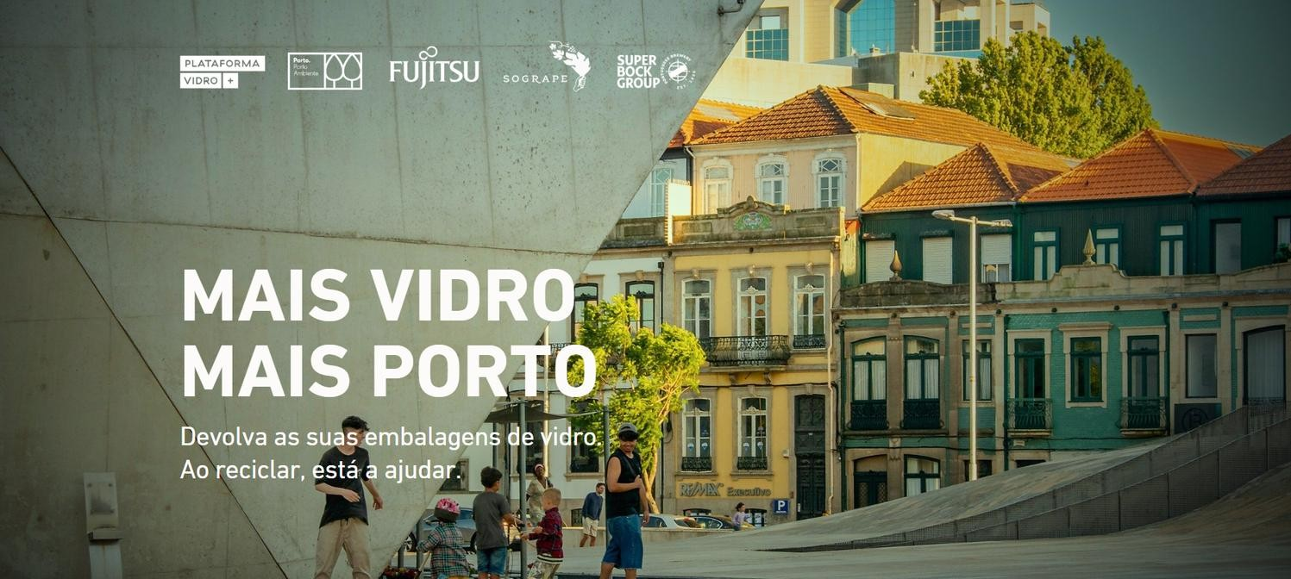
Communication
Website
https://maisvidromaisporto.vidromais.pt/

Slide 47
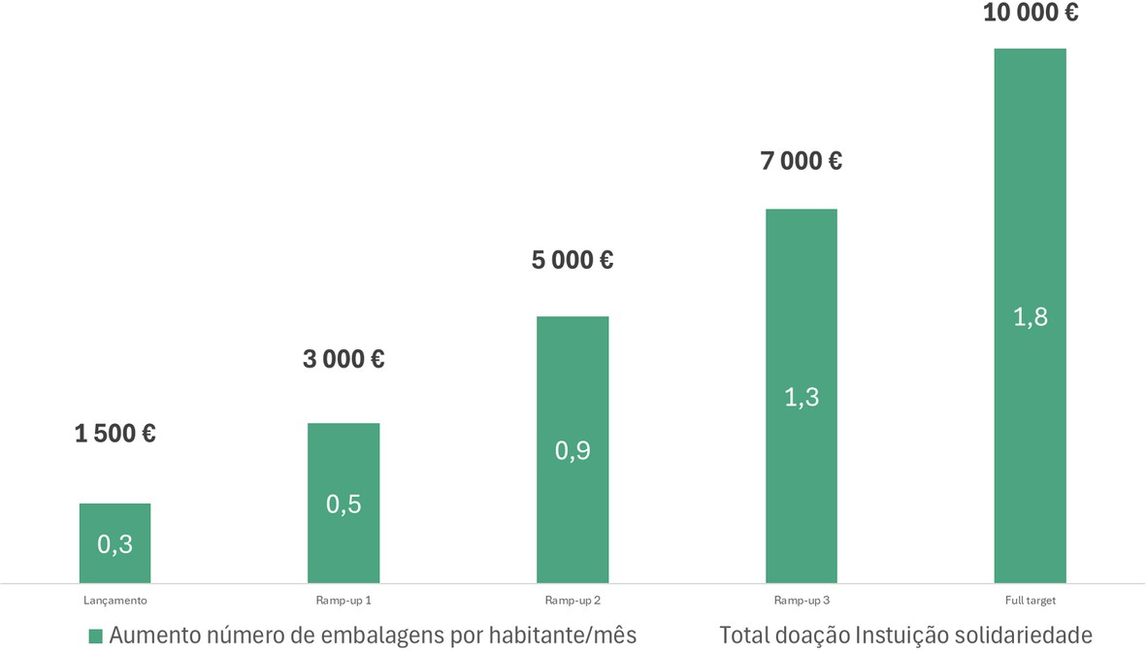
Social and Environmental Impact
The increase in the number of packaging items collected for recycling will be monitored on a quarterly basis, with this initiative providing support to local organisations.
Increase in the number of
Total donation to local organizations
packages per person per month

Slide 48
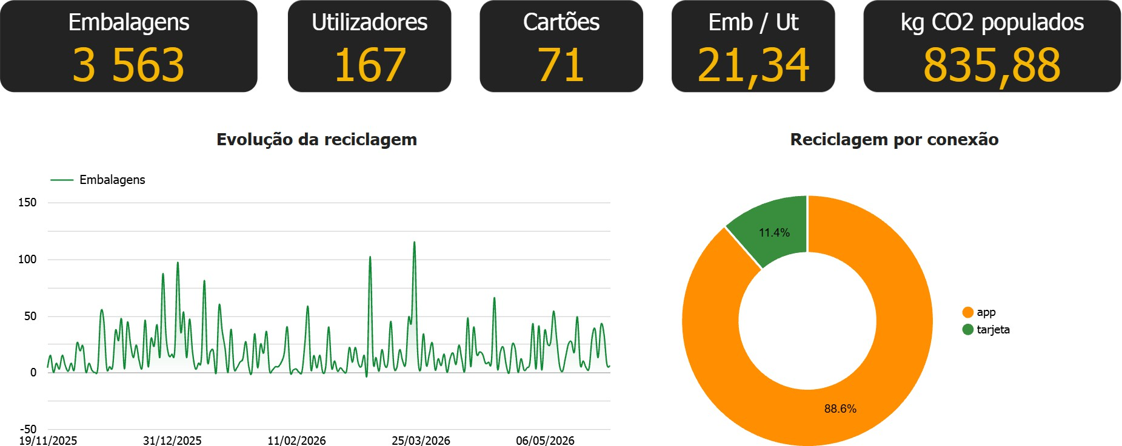
Results
Containers
App users
Card users
card

Slide 49
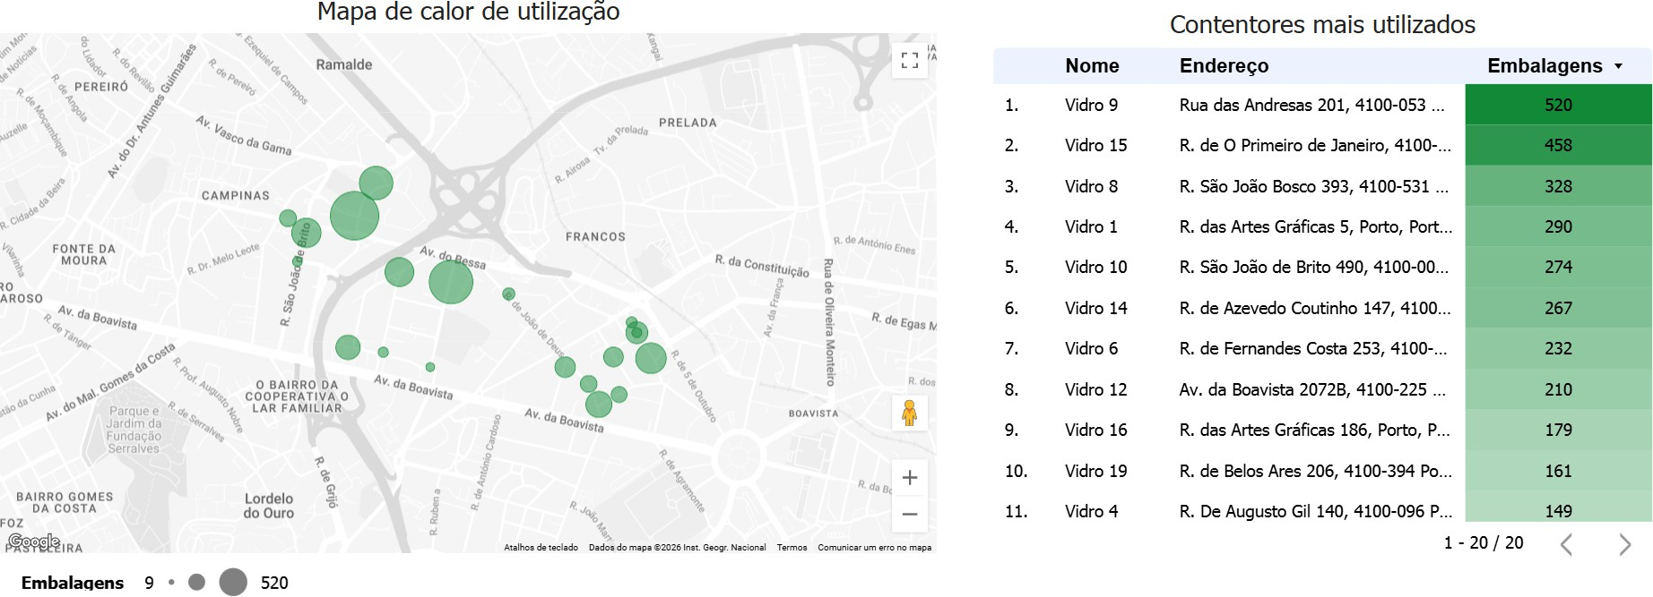
Results

Slide 50
Next Steps
Awareness-raising campaigns in a critical area
June 2026
Promotional support with local entities.
Street campaign featuring an awareness-raising game for families.
Schools

Slide 51
Challenges
High percentage of unsuccessful visits - Logistical challenge related to the difficulty
of finding residents at home).
Conversion of adhesion into actual participation - Habit vs. Adhesion: residents are aware of the project but have not yet incorporated the new behavior into their daily routine.
Monitoring of glass collection - Sensors were installed to assess the rate at which bins fill
up and any potential transfer of glass between recycling bins with and without RecySmart devices.

Slide 52


BECAUSE TOGETHER AND ORGANIZED WE CAN MAKE IT.
THANK YOU!
Visit our Website:
www.vidromais.pt
linkedin.com/showcase/plataforma-vidromais/
vidromais@smartwasteportugal.com

Slide 53
2026 ANNUAL EVENT
Advancing the Circular Economy for Glass Packaging
Sandra Anguiano
Public Affairs Director,
Ecovidrio
PANEL 3 Focus on the national platforms of Close the Glass Loop
TownHall Europe
Sq. de Meeûs 5,
1000 Bruxelles, Belgium
4th JUNE 2026
8:30 AM > 16:00 PM (CET)

Slide 54
Glass packaging management in Spain
Glass extraction initiative in MBT plants
Close the Glass Loop
Sandra Anguiano, Public Affairs manager
Thrusday 04/06/2026
Notes:
sería muy interesante un enfoque sobre los residuos urbanos y como tratan de sacar el vidrio, y cuales son las lecciones aprendidas del proceso. Al inicio, podrias presentar los ultimos datos / resultados de Ecovidrio en cuanto a la recogida y el reciclaje.

Slide 55
ECOVIDRIO. EPR SCHEME FOR GLASS PACKAGING IN SPAIN.
Glass extraction from MBT plants
Why?
Although the container remains central to our waste recovery strategy, we are also applying innovation to recovery through other sources.
Selective collection through 26 MBT plants
It represents only 6% of global tonnage of glass packaging.

Slide 56
ECOVIDRIO. EPR SCHEME FOR GLASS PACKAGING IN SPAIN.
Our value proposition
We are the only EPR scheme in Spain specializing in glass that offers:
  a unique solution for the sustainability of all their packaging for companies;
  a management model of trust and excellence for administrations ;
  to guarantee that society is moving towards a responsible future for the next generations.

Slide 57
ECOVIDRIO. EPR SCHEME FOR GLASS PACKAGING IN SPAIN.
Key factors for growth
Trusted management model of excellence
We are the only EPR scheme specialising in glass management with more than 30 years of experience.
We are experts in the HORECA channel; we develop specific plans for this sector, which generates 50% of glass waste.
Monomaterial collection and high-quality recycling (only 2% of impurities in refuse containers).
We improve the effectiveness and efficiency of our plans through innovation, data analysis and the use of AI.
We carry out the direct "on-site" management of glass collection in 60% of municipalities.
Spirit of collaboration and transparency with the administration; 95% of administration professionals rate Ecovidrio as efficient and professional.
A versatile model, we adapt to the needs and characteristics of the municipality.

Slide 58
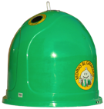
ECOVIDRIO. EPR SCHEME FOR GLASS PACKAGING IN SPAIN.
Our results 2025
Targets achieved
72.3%
70%
Over 90%
Estimated recycling rate 2025
Estimated separate collection rate 2025
Last official rate published by the Ministry for the Ecological Transition and the Demographic Challenge: 70.1% in 2023*
of recovered glass comes from separation at source
*excluding SIGRE
We have reached the target two years ahead of schedule (2023). Regulation target (70% in 2025 and 75% in 2030).
We have reached the target established in the national regulation (70% in 2025 and 80% in 2030).
Definition of recycling rate: percentage of tonnes collected and recycled, measured upon exiting the recycling plant (excluding losses and impurities), in relation to consumption.
Definition of separate collection rate: percentage of tonnes collected in refuse containers and door to door (without impurities) in relation to consumption.

Slide 59
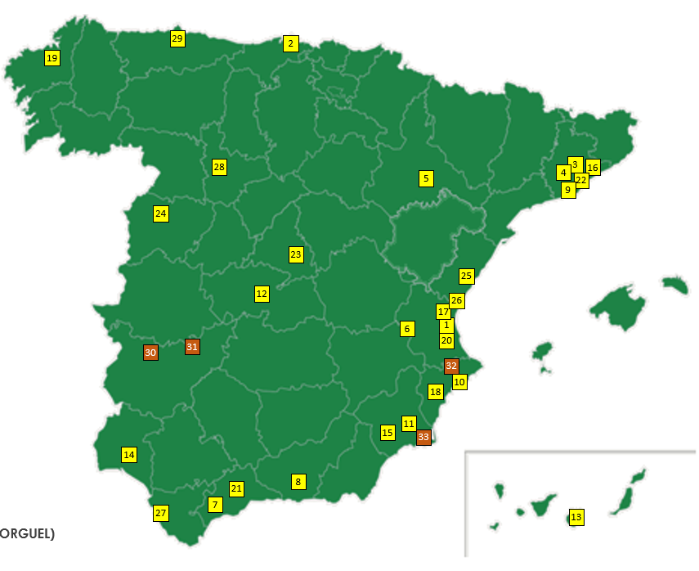
ECOVIDRIO. EPR SCHEME FOR GLASS PACKAGING IN SPAIN.
Glass extraction from MBT plants
Why?
Although the container remains central to our waste recovery strategy, we are also applying innovation to recovery through other sources.
Selective collection through 26 MBT plants
It represents only 6% of global tonnage of glass packaging.
MBT plants with glass recovery module

Slide 60
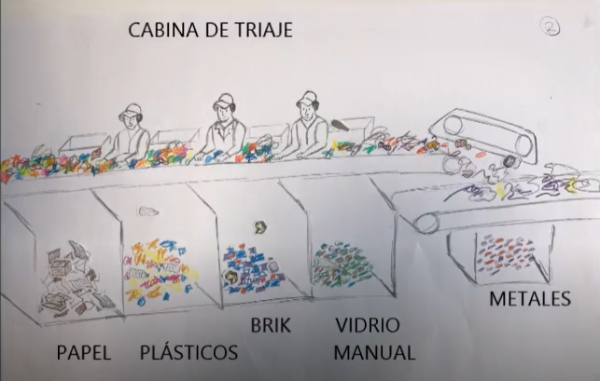
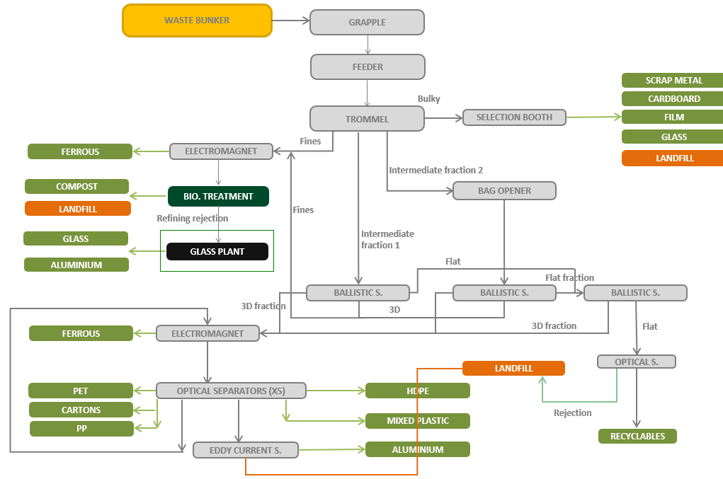
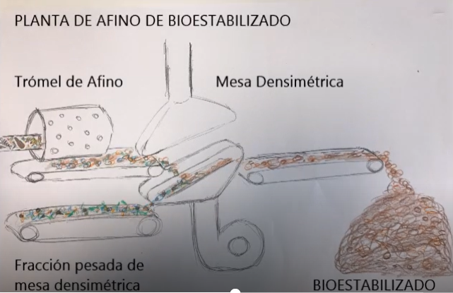
ECOVIDRIO. EPR SCHEME FOR GLASS PACKAGING IN SPAIN.
Glass extraction from MBT plants
How?
MBT plant
Notes:
Urban waste enters the plant and is unloaded into a pit or reception area. One large bulky items (like mattresses or bicycles) are removed.
The process starts with a large rotating screen called a trommel. As the waste moves through it, it is separated into different groups:
Fine fraction: This usually contains glass, along with organic waste, stones, metals, and small plastics.
Intermediate fraction 1: Mostly light packaging materials and some larger organic waste.
Intermediate fraction 2: Mainly closed bags. These are sent to a bag opener, which breaks them open and releases their contents.
Trommel overflow: This goes to a manual sorting area, where workers remove bulky items and separate recyclable materials such as glass, cardboard, plastic film, and scrap metal. The remaining waste is sent to landfill.
2. Biological Treatment
This stage involves composting with oxygen. The goal is to clean and stabilize the material to produce organic compost.
The result is compost, which still needs to be refined to remove non-organic materials.
3. Compost Refining
In this stage, inorganic materials are removed using screening and separation techniques.
Some materials can be recycled, such as aluminium or glass.
Others are discarded and sent to landfill.
The process begins with a magnetic separator to remove metals like iron and steel. The material is then screened again using a trommel:
The fine material (mostly organic) goes to a density separation table, where lighter material becomes final compost and heavier non-organic material is rejected.
The coarser material goes to another type of screen called a “flip-flop” screen.

Slide 61
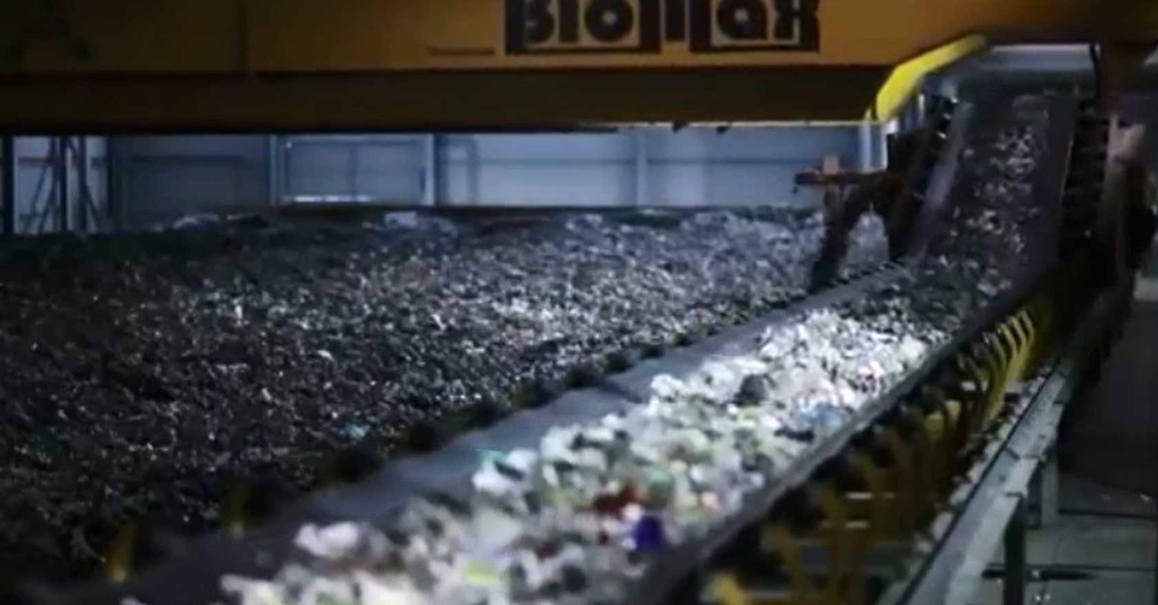
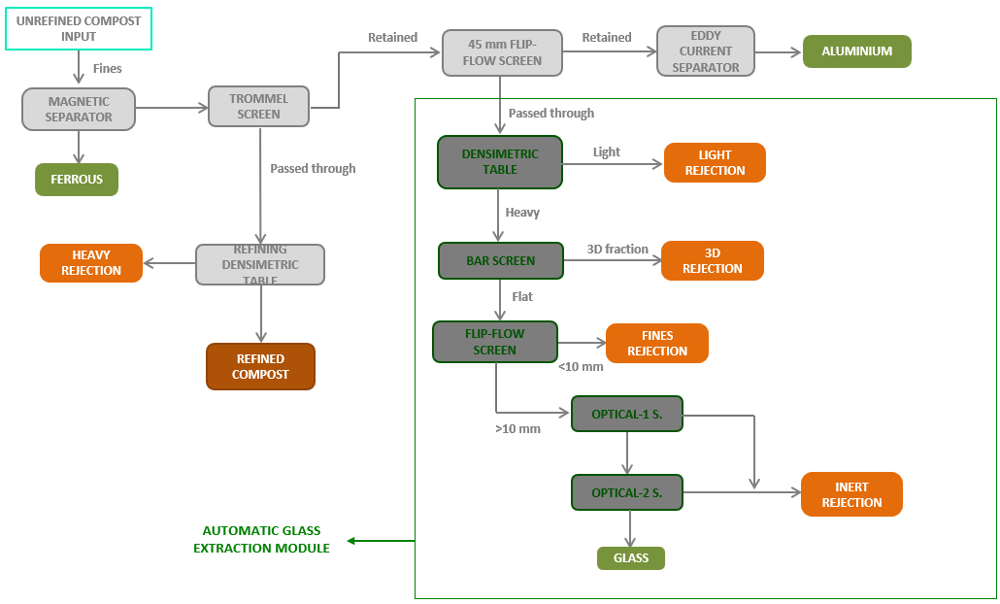
ECOVIDRIO. EPR SCHEME FOR GLASS PACKAGING IN SPAIN.
Glass extraction from MBT plants
How?
VIDEO Min 2.33 (until 4,58) biological treatment module + glass module
Glass extraction module

Slide 62
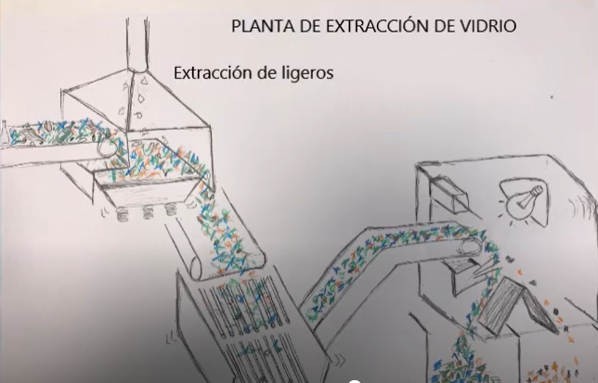
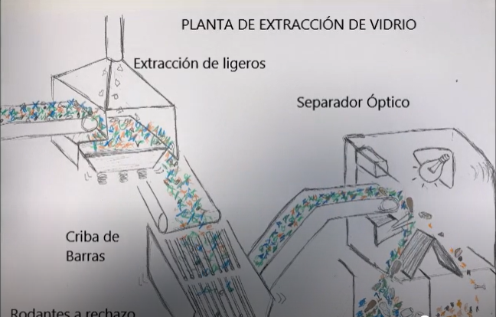
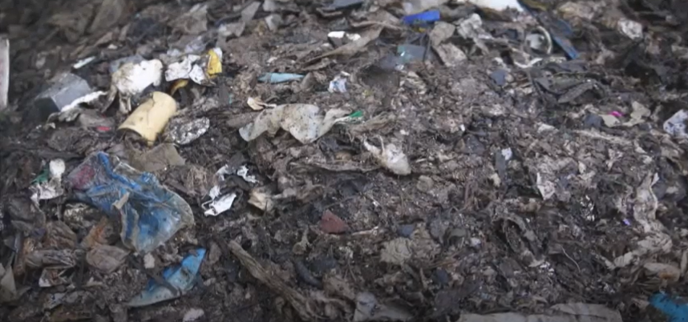
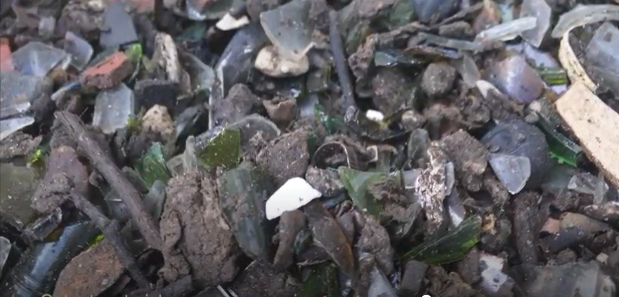
ECOVIDRIO. EPR SCHEME FOR GLASS PACKAGING IN SPAIN.
Glass extraction from MBT plants
How?
Requires goes through a treatmente recyling plant
Glass packaging after bar screen for the optical separator.
Light packaging
Notes:
4. Elastic Screen (Flip-Flop)
This vibrating screen separates the material into:
Coarse material: Goes through a separator that removes aluminium and sends the rest to waste.
Fine inert material: Sent to the automatic glass recovery system.
5. Density Separation
Fine material goes to a density table:
Light material (mostly organic) is rejected.
Heavy material (glass, stones, ceramics) continues in the process.
6. Bar Screen
The material passes through a bar screen:
Flat materials (glass, ceramics) pass through.
Rolling items (stones, caps) are removed as waste.
7. Fine Screening
The material goes through another screen, which removes particles smaller than 10 mm.
8. Optical Separation of Glass
The cleaned material enters optical sorting machines:
Cameras identify transparent materials like glass.
Air jets separate the glass from other materials.
Usually, two passes are made:
The first separates the glass.
The second removes unwanted materials such as ceramics, stones, or heavy organic waste.
9. Final Glass Collection
The recovered glass is stored in containers and later sent to a glass recycling plant.

Slide 63
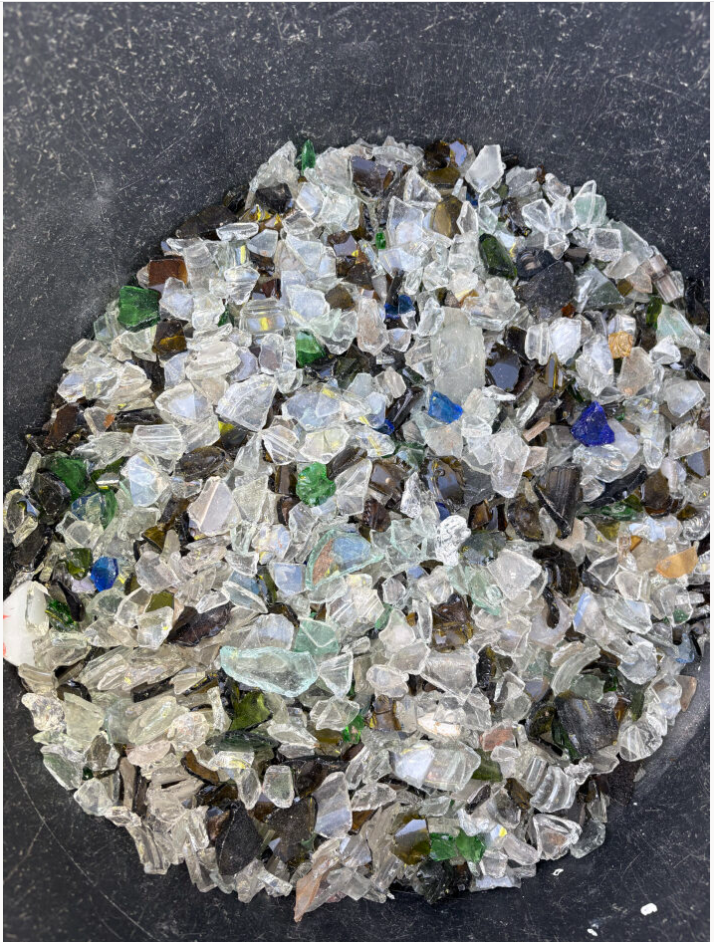
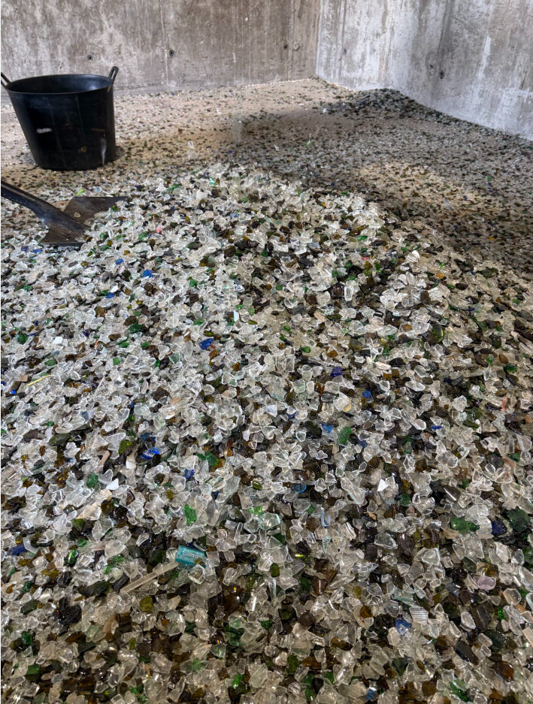
ECOVIDRIO. EPR SCHEME FOR GLASS PACKAGING IN SPAIN.
Glass extraction from MBT plants
How?
Glass material from MBT plant to treatment plant
Minimum Quality Requirements
  a)Contain no more than 5% by weight of particles smaller than 10 mm.
  b)Contain no more than 0.6% by weight of infusible materials, of which:- A maximum of 0.3% by weight of rolling infusibles (stones, gravel, etc.). This 0.6% is considered included within the 2.5% mentioned in point d).
  c)Contain no more than 1.5% by weight of organic matter. This 1.5% is considered included within the 2.5% mentioned in point d).
  d)Contain no more than 2.5% by weight of impurities.

Slide 64
ECOVIDRIO. EPR SCHEME FOR GLASS PACKAGING IN SPAIN.
Glass extraction from MBT plants
Learnings
The most efficient way to recover glass in an MBT (Mechanical Biological Treatment) plant is after the bio‑stabilisation process, when the material is dry.
Manual sorting is not effective or efficient.
Recovering glass in wet conditions does not work well either, because organic matter sticks to the glass and the system detects it as contamination.
The level of investment required means that a minimum amount of waste is needed for the installation to be profitable (around 100,000 tonnes).
After extraction, the glass must always be sent to a recycling plant for final cleaning.
With 12 years of experience in MBT plants in Spain, and thanks to collaboration between MBT plants, glass recycling plants, and packaging manufacturers, we have improved the quantity of the recovered glass and increased efficiency from 20% to 50%. This glass is suitable for making new containers.
Recovering glass from MBT plants reduces the amount of waste sent to landfill by around 1% to 2%.
The mixed waste stream contains about 3% to 4% glass, so we recover 1% to 2% that would otherwise end up in landfill.

Slide 65
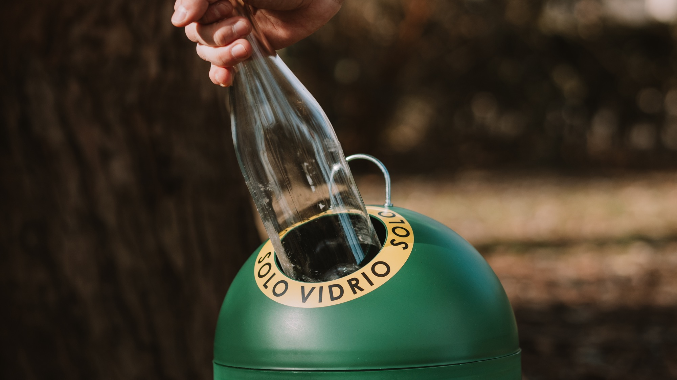
Sandra Anguiano
sandra.anguiano@ecovidrio.es
ecovidrio.es
@ecovidrio
Calle Estébanez Calderón, 3– 5
(4º planta), 28020, Madrid
914 118 344
900 555 700

Slide 66
2026 ANNUAL EVENT
Policy and implementation of the Packaging & Packaging Waste Regulation
4th JUNE 2026
8:30 AM > 16:00 PM (CET)
TownHall Europe
Sq. de Meeûs 5,
1000 Bruxelles, Belgium

Slide 67
Waste sorting pictograms

Slide 68
Context
PPWR: Commission to adopt implementing acts by 12 August 2026
  Label containing information on its material composition. The label shall be based on pictograms and be easily understandable.
  Harmonised labels that enable the separate collection of each material specific fraction of packaging waste that is intended to be discarded in separate receptacles to be affixed, printed or engraved on all waste receptacles
  The labelling for receptacles shall correspond to the labelling for packaging above
Introduction of the labels: From 12 August 2028 or 24 months from the entry into force of the relevant implementing act
The objective of these labels is to facilitate correct consumer disposal of packaging waste. It is expected that harmonised labels would improve sorting accuracy, leading to higher collection rates and better quality of collected material (reduced contamination).
In the case of glass, a previous JRC report concluded that the impact on glass packaging would be limited in terms of collection and quality in most countries.

Slide 69
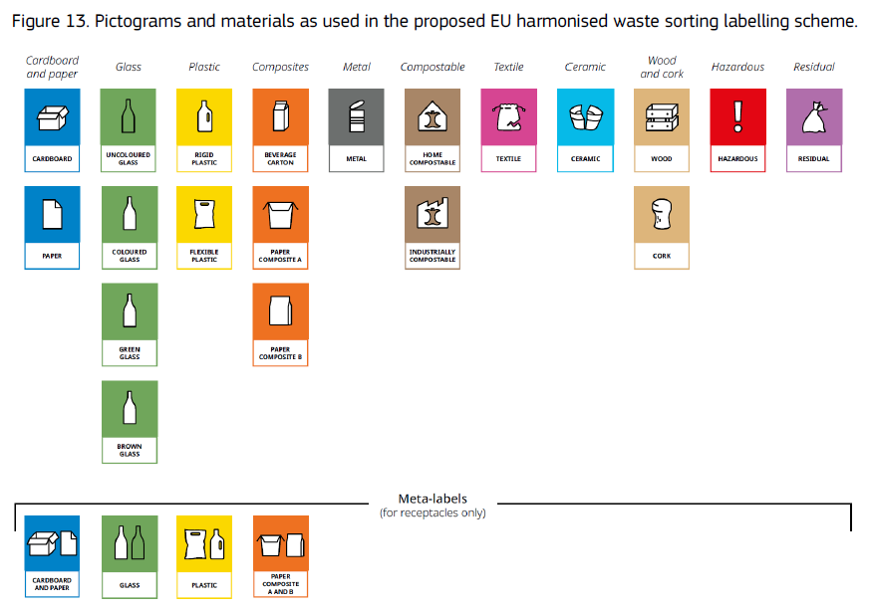
JRC final proposal
N.B. The system includes a pictogram for ceramic (packaging), which could be useful to help consumers understand that they should not mix up glass and ceramic.

Slide 70
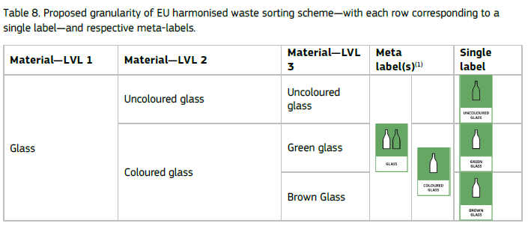


JRC final proposal
Meta labels for receptacles only
The pictograms for glass (as visual elements of the label) do not, on their own, allow users to distinguish between coloured glass, green glass and brown glass without accompanying text.

Slide 71
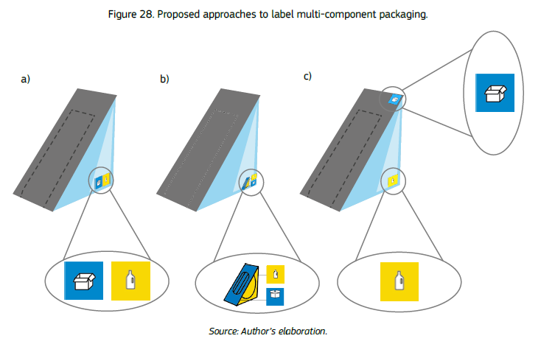
Multiple component packaging

Slide 72
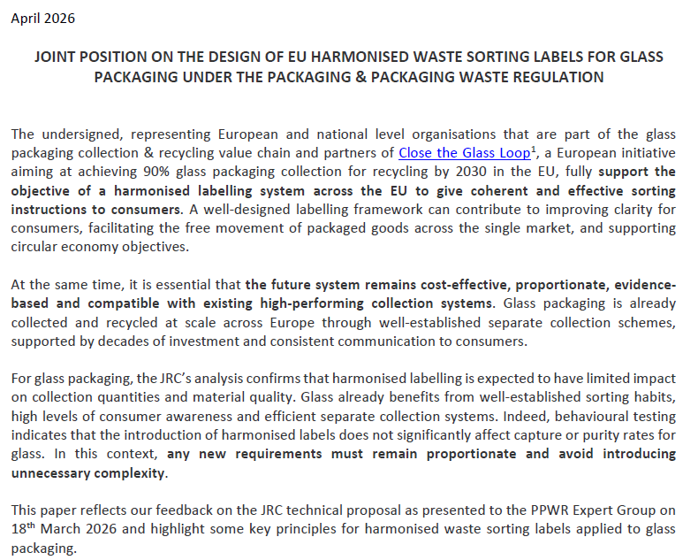
Glass packaging value chain contribution

Slide 73
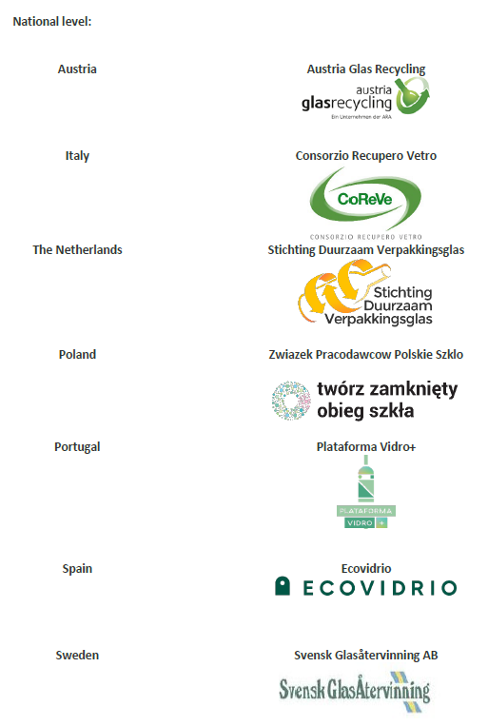
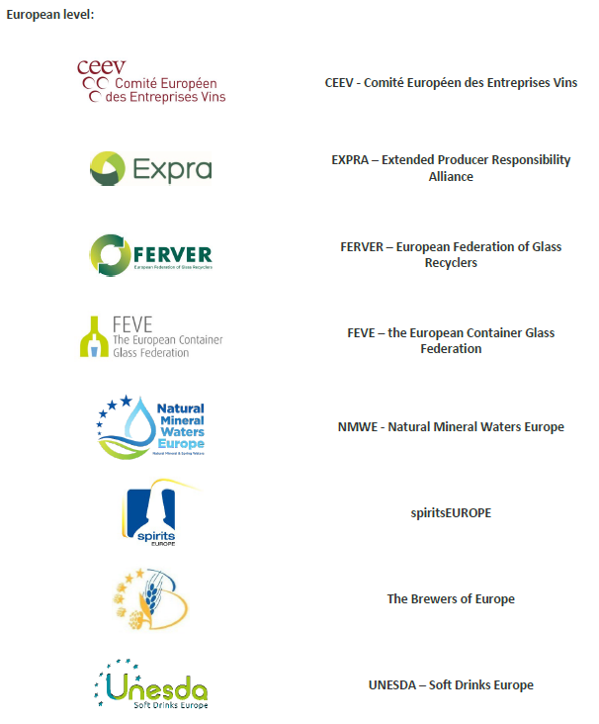
Glass packaging value chain contribution

Slide 74
Next steps
18 March 2026: PPWR Expert Group and discussion with Member States and stakeholders
By 12 August 2026: adoption of the Implementing Acts

Slide 75
Recyclability

Slide 76
Recyclability Requirements
Under the PPWR, all packaging on the market must be recyclable:
By 2030 all packaging have to be ‘designed for recycling’ (DfR)
By 2035, packaging also has to be recycled at scale, i.e. recycling rate that is equal or greater than 55%
To determine whether packaging can be placed on the market, the PPWR introduced the Recyclability performance grades (see table) that will take into account Design-for-Recycling criteria (2030) and ‘recycled at scale’ criteria (2035). These grades are the basis for the eco-modulation of Extended Producer Responsibility (EPR) fees – the adjustment of EPR fees based on the environmental impact of the packaging material used.
 | 2030 | 2035 | 2038
Grade A | DfR | DfR + at scale | DfR + at scale
Grade B | DfR | DfR + at scale | DfR + at scale
Grade C | DfR | DfR + at scale | DfR + at scale
Non-recyclable (no market access) | DfR | DfR + at scale | DfR + at scale

Slide 77







Design-for-Recycling criteria for glass – process
(And other national standardisation bodies)
Consulted
Involved
Support to
Develop delegated acts (DfR and performance grades)
Develop DfR criteria for glass packaging
Develop overarching technical specifications (all materials) and material-specific DfR criteria (incl. for glass)
Basis for

Slide 78
Design-for-Recycling criteria for glass – state of play
Documents delivered to the JRC on 16th January after intensive process
  Overarching document on definitions and principles for DfR for all packaging categories
  Overarching document on sorting for recycling of packaging – Outline definitions, principles, testing protocols for packaging categories other than plastics
  DfR tables using traffic lights approach for each packaging category – including for glass
  Testing protocol(s) for each packaging category – including for glass (opacity and labels)
Current process
Weekly meetings between CEN sub-group leaders and JRC
  JRC to provide feedback continuously in form of request for clarifications and/or eventual inclusions
  CEN to process the feedback from JRC and address the comments to improve the documents
  28 April: JRC to visit glass Cullet Treatment Plant in Sevilla

Slide 79
DfR table – Glass
 | GREEN Full compatibility |  | YELLOW Limited compatibility |  | RED Not compatible
 | Leads to recycled materials | Removed and not recycled | Leads to recycled materials | Removed and not recycled
Predominant packaging material
Surface treatment
Decoration/information/branding
Labels
Sleeves
Closing & opening systems
Tamper evident components
Others

Slide 80


Next: Recyclability Performance Grade Methodology

Slide 81
2026 ANNUAL EVENT
Building Close the Glass Loop projects
4th JUNE 2026
8:30 AM > 16:00 PM (CET)
TownHall Europe
Sq. de Meeûs 5,
1000 Bruxelles, Belgium

Slide 82





Advancing the Circular Economy for Glass Packaging
2026 ANNUAL EVENT
Building Close the Glass Loop projects - Collection
Collection systems overview
Case studies
Glass Collection Atlas
Study with ACR+
Collection Principles
  Workshops
  “Municipality Diagnostic tool” project
  Mapping of Digital Tools
And yet, no current Close the Glass Loop project on collection

Slide 83

Advancing the Circular Economy for Glass Packaging
2026 ANNUAL EVENT
Building Close the Glass Loop projects - Awareness raising
Close the Glass Loop HORECA Campaign -
Improving glass collection for recycling by addressing contamination by ceramics, stone, and porcelain (CSP) in the hospitality sector
Development of communications tools (2025)
  Specific underdeveloped topic (contamination by ceramics)
  Short engaging relevant material
  Professional service provider (call for tender)
  Customisable on national level
Campaign roll-out on national level (2026)
  Providing customised national versions
  Building national awareness raising campaigns
  Strengthening the collaborations with the hospitality sector

Slide 84




Official Launch 29.01
Press Release
90 Minutes to Close the Loop, episode 16 “Improving Glass Collection Quality in the Hospitality Sector – Focus on Ceramics”
Public Awareness Raising Event 29.01
The Sound of Glass video
YouTube – 1k views
LinkedIn Sponsored Content
LinkedIn targeted Sponsored publication - 177,000 + impressions
Close the Glass Loop
HORECA Campaign
Article “Bottoms up for glass recycling!”
Publication in Glass International;
ComPack News Italy
Collaboration with EVBB
Reaching out future hospitality professionals with the the European Association of Institutes for Vocational Training
National Level Roll-out
CGL National Platforms and partner members
8 videos customised

Slide 85




Advancing the Circular Economy for Glass Packaging
2026 ANNUAL EVENT
Building Close the Glass Loop projects - Awareness raising
Other Close the Glass Loop custom communication materials on specific issues?
Borosilicate glass
Cosmetics
Glass Tableware
Pharmaceutical

Slide 86

Advancing the Circular Economy for Glass Packaging
2026 ANNUAL EVENT
Building Close the Glass Loop projects - Awareness raising
Benefits of Glass Recycling
Mapping the communication practices and calculation methodologies for stronger citizen mobilisation
What environmental and economic benefits are communicated?
How the benefits are translated into relatable comparisons (local, sectoral, cultural, social)
How is the impact calculated?
Ensuring Credibility & legal compliance

Slide 87
2026 ANNUAL EVENT
Close the Glass Loop updates
4th JUNE 2026
8:30 AM > 16:00 PM (CET)
TownHall Europe
Sq. de Meeûs 5,
1000 Bruxelles, Belgium

Slide 88

Advancing the Circular Economy for Glass Packaging
2026 ANNUAL EVENT
Performance of Packaging Glass Recycling in Europe report – 2026
State-of-play
Data received by 03 June 2026 | 2026 | 2024 | 2023
Total number of responses received | 14 | 33 | 30
Number of countries covered | 11 | 20 | 17
Sample representativeness (provisional 2024 data) | 21% | 62% | 54%
Total number of surveyed Glass Cullet Recycling Facilities | 25 | 81 | 64
Countries covered so far
Bulgaria (new!) | Malta (new!)
Czechia | Portugal
Hungary | Slovakia
Ireland | Spain
Italy | Sweden
United Kingdom

Slide 89


Advancing the Circular Economy for Glass Packaging
2026 ANNUAL EVENT
New National Platforms
Close the Glass Loop Albania
17.06.2026
Close the Glass Loop Bulgaria
16.09.2026

Slide 90


Slide 91
Thank you for your time to Close The Glass Loop!

