Slide 1

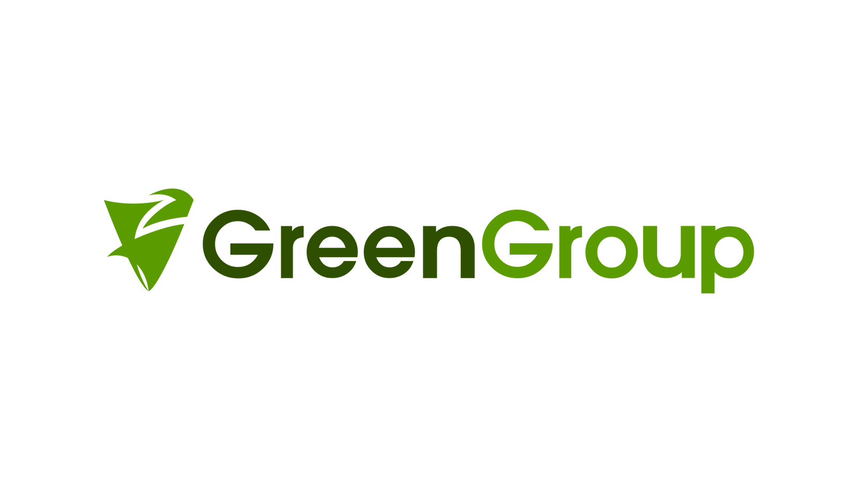

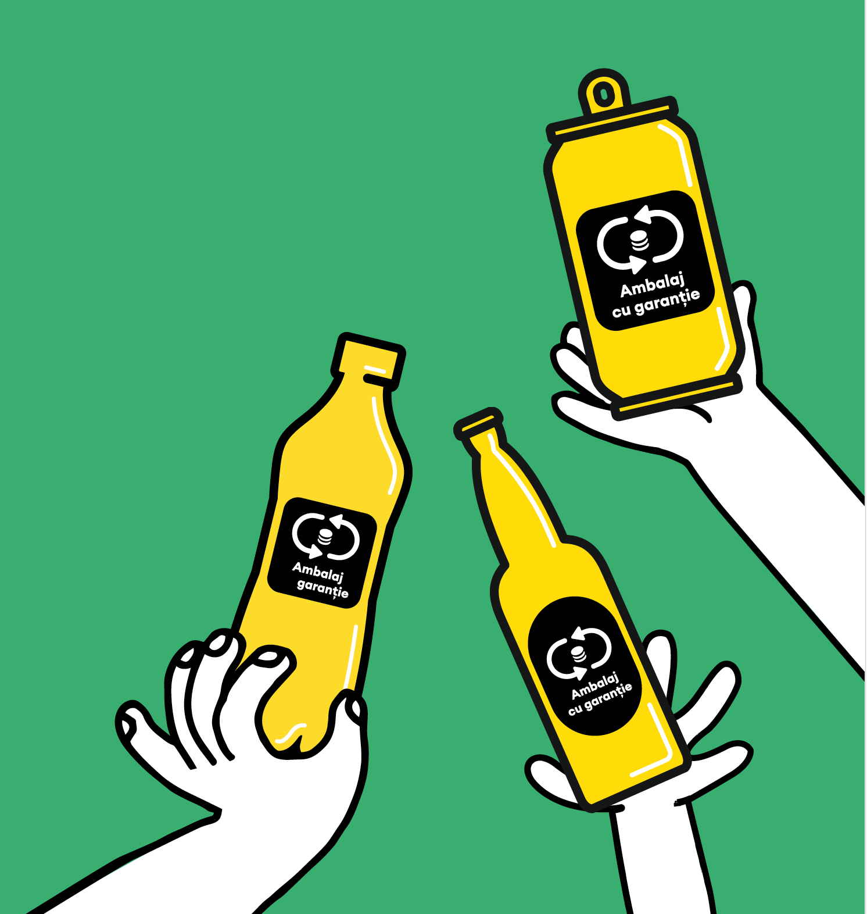

Albania towards a closed glass loop
&
Romania’s journey in glass recycling
Constantin Damov
GreenGlass Recycling (GreenGroup)
June 167 2026

Slide 2
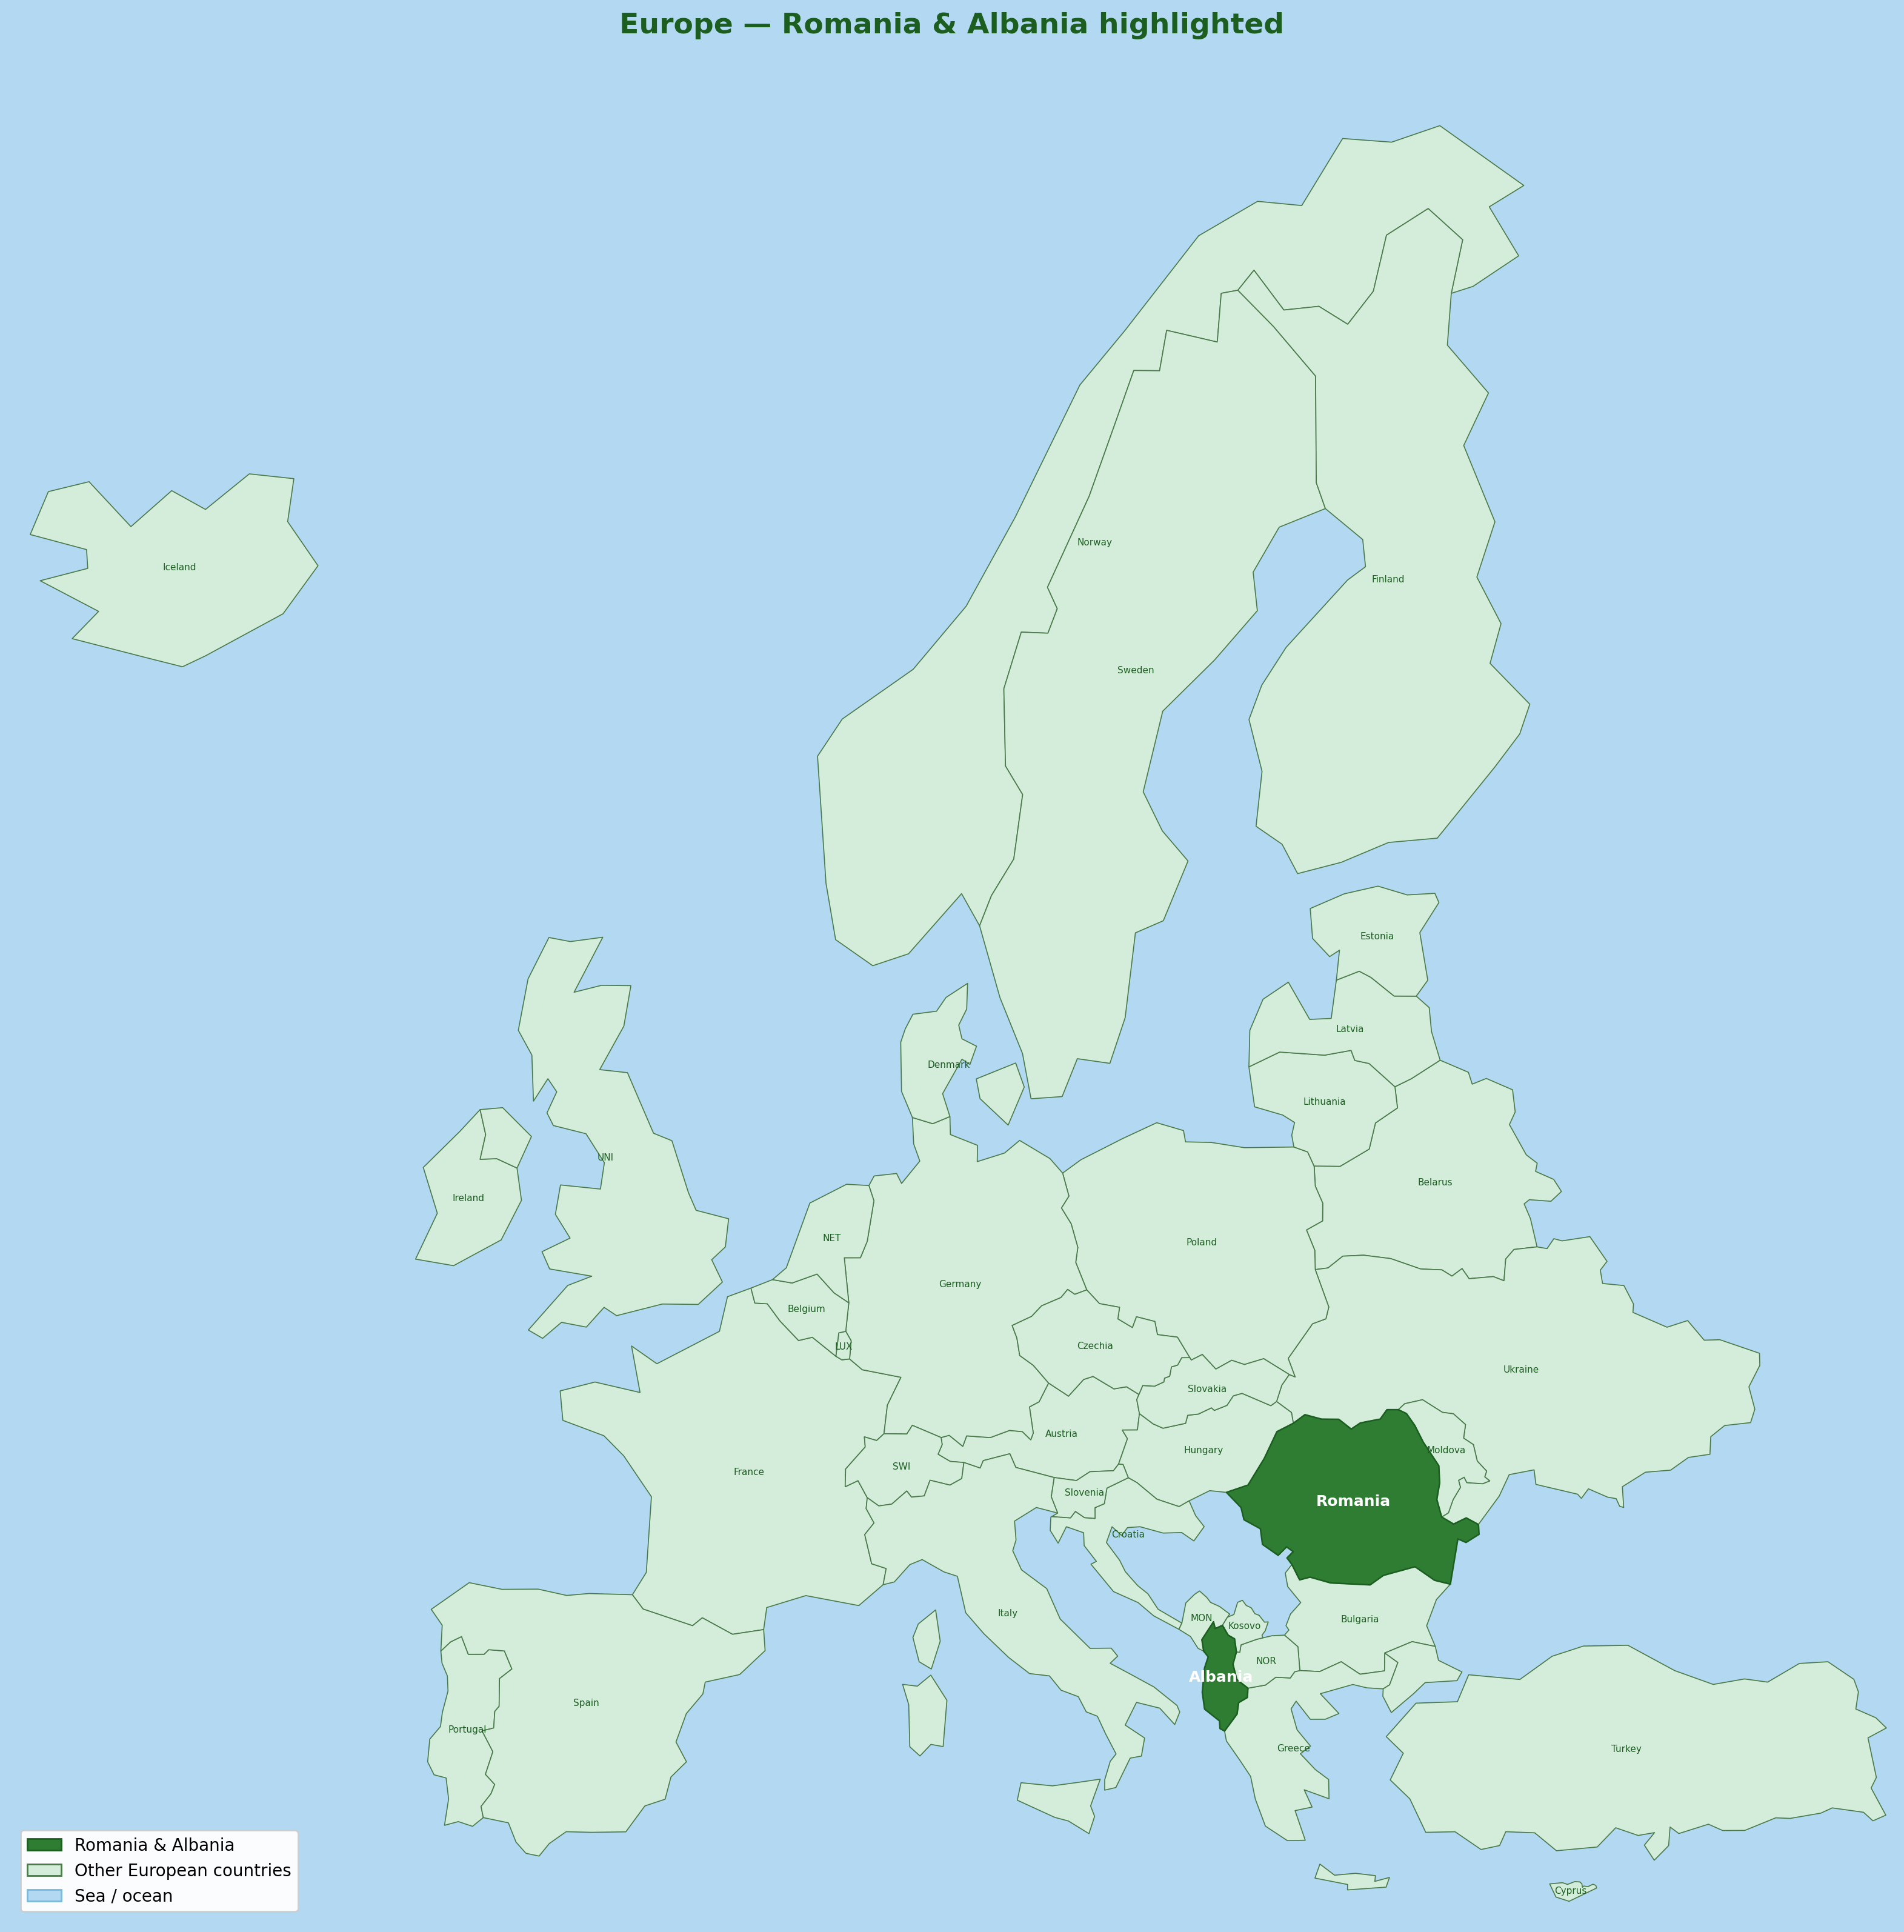
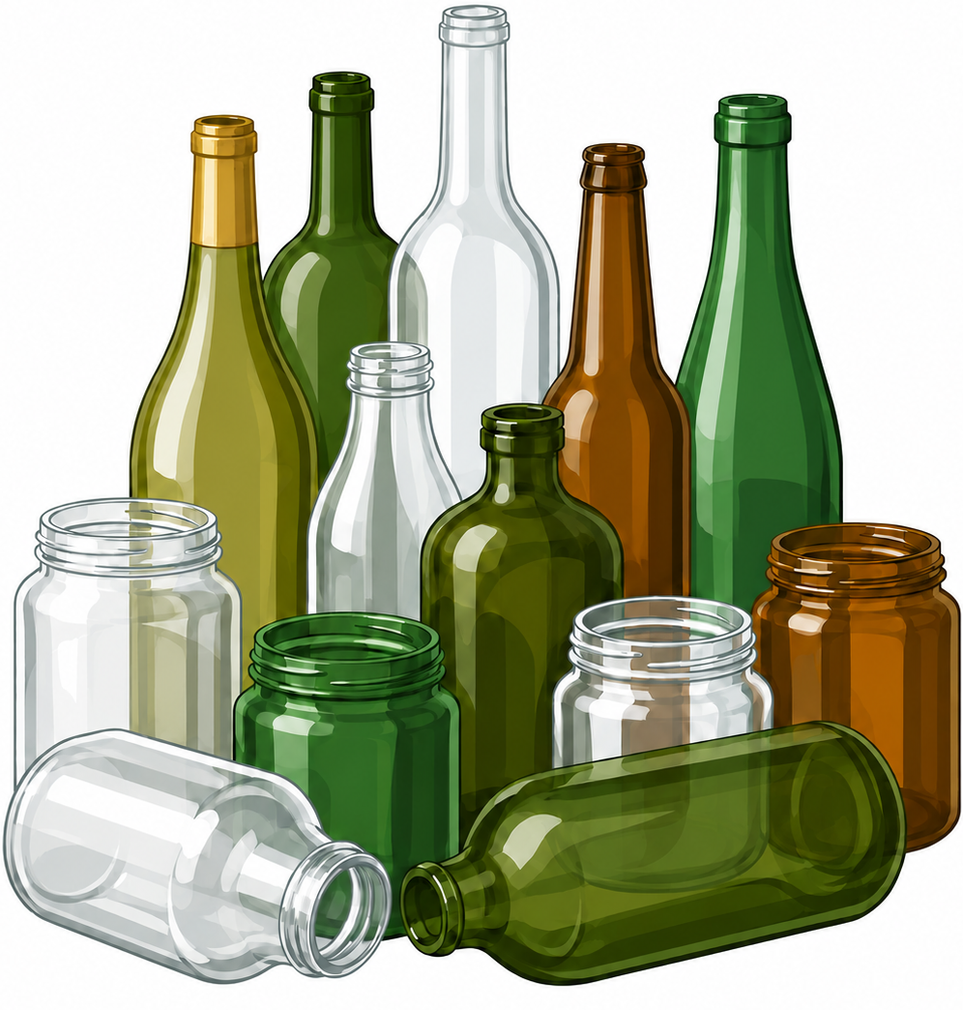
Albania Romania – Current status
Facts about Albania
Facts about Romania
Population: ~2.5 million
Surface: ~28,748 km²
Tourists in 2025: 12.5 million
EU Accession Negotiation to conclude by 2027;
Full EU membership to be achieved by 2030
Quantity of Packaging glass POM in 2025: No official data; No functional EPR system.
Population: ~19 million
Surface: ~238,397 km²
Romania 8.3 times larger than Albania
Tourists in 2025: 11 million
EU Member since 2007
Quantity of Packaging glass POM in 2025: 450,000 tons
Notes:
7

Slide 3
Romania’s Journey in Glass Recyling | 2003–2027
◀ Pre-DRS (OIREP/EPR)
DRS era (RetuRO SGR) ▶
100%
~90% est.
86%
85% tgt.
85%
75%
70%
66%
65%
60%
60%
~55%*
50%
45%
44%
43%
37%
41%
38%
28%
25%
0%
No reliable data
before 2007
2003
2007
2009
2011
2013
2014
2016
2018
2020
2021
2022
2023
2024
2025
2026
2027
New Eurostat methodology
Sharp drop due to Eurostat methodology change
Ecorom Ambalaje EPR
Green Glass Recycling
First producer responsibility
organisation in Romania
Romania joins the EU
First glass-specific
recycling plant in Romania
RetuRO DRS launched
EU Packaging Directive
becomes binding
Deposit Return System
starts Nov 2023
Glass recycling rate — all packaging (INS/OIREP/Eurostat)
SGR return rate — beverage glass (RetuRO, official)
2027 estimate based on trajectory
EU/RetuRO official targets
RetuRO 2026+ target: 85%
* 2024 SGR glass: ~55% annual avg. (rate climbed from ~35% early-year to 84%+ by Q4 — first full operational year). Post-2023 data covers SGR beverage glass only; not comparable to pre-DRS all-packaging series. Sources: INS, Eurostat env_waspac, AFM/OIREP via ECOTECA, RetuRO SGR (2024–2026), Interreg Europe (official SGR targets).
RetuRO 2025 target: 75%
EU 2025 target: 70%

Slide 4
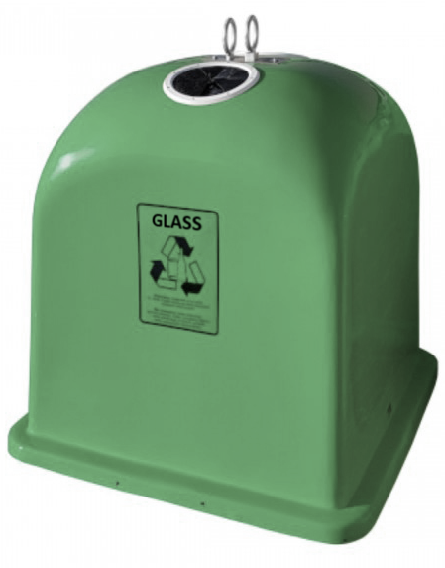
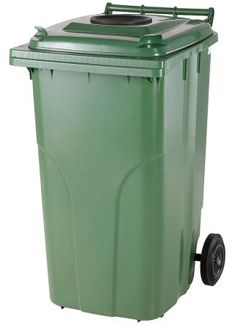
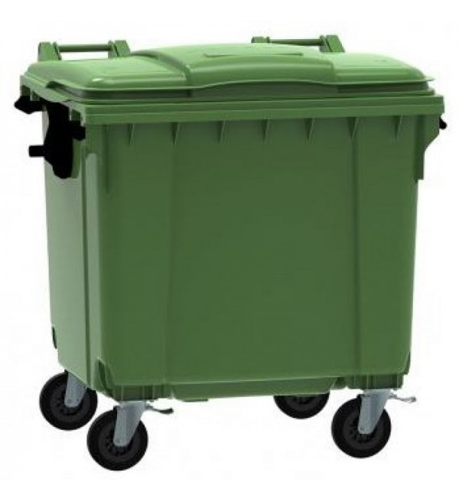
Pre Deposit Return System Collection
Glass POM: 450,000 tons
Recycling Rate: 38%

Slide 5
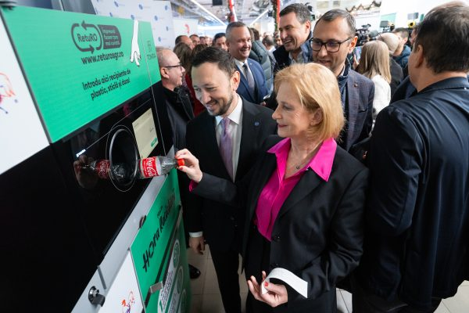


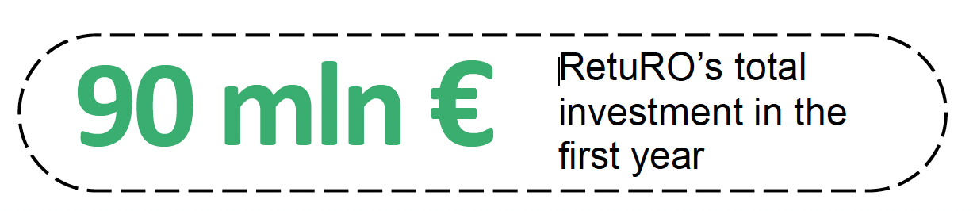


The Impact of Romanian Deposit Return System
Launched November 30, 2023
Extensive Coverage
Water, soft drinks, beer, wines, spirits
0.1L-3L volumes, PET, Aluminum, Glass

Slide 6
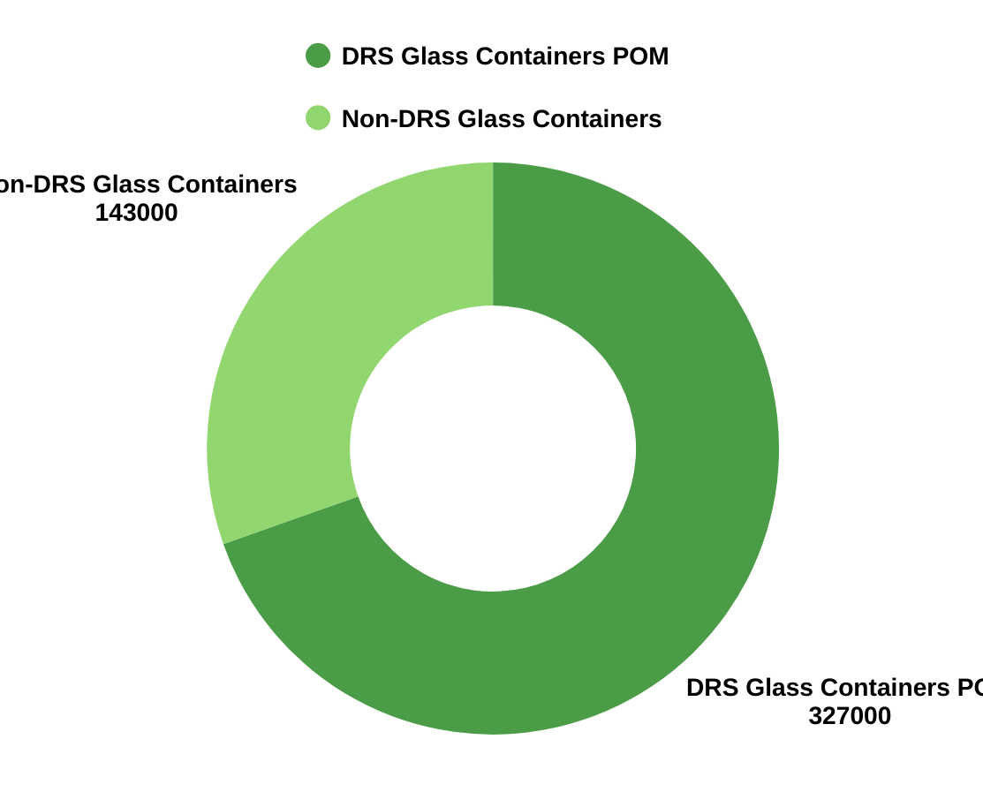

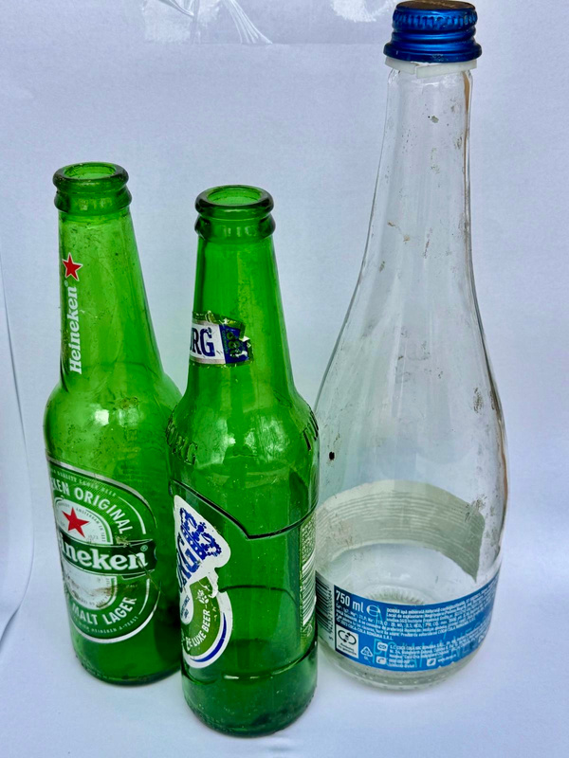

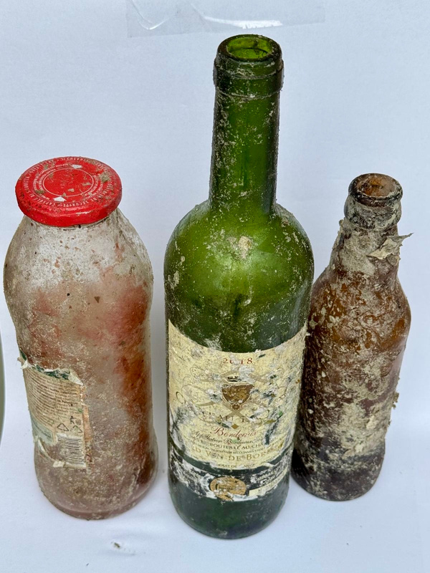

Glass Packaging Market - Romania 2025
Glass POM: 450,000 tons
Non-DRS Glass Containers POM
110,000 tons
DRS Glass Containers POM
340,000 tons
25%
DRS Collection
75%
Non-DRS Collection

Slide 7
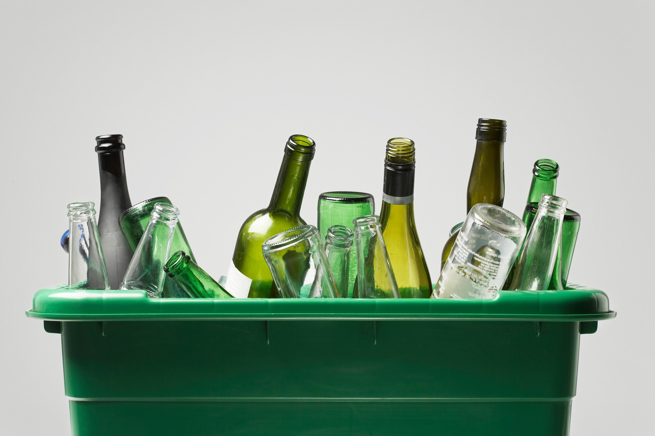


Glass Collection Rate in Romania 2025
Non-DRS Rate
DRS Rate
Total
2025
73%
86%
83%
Notes:
Glass collection Rate in Romania 2025 Non-DRS rate, DRS Rate.
CALCUL: (0.75 x 86%) + (0.25 x 73%) = 64.5% + 18.25% = 82.75%

Slide 8
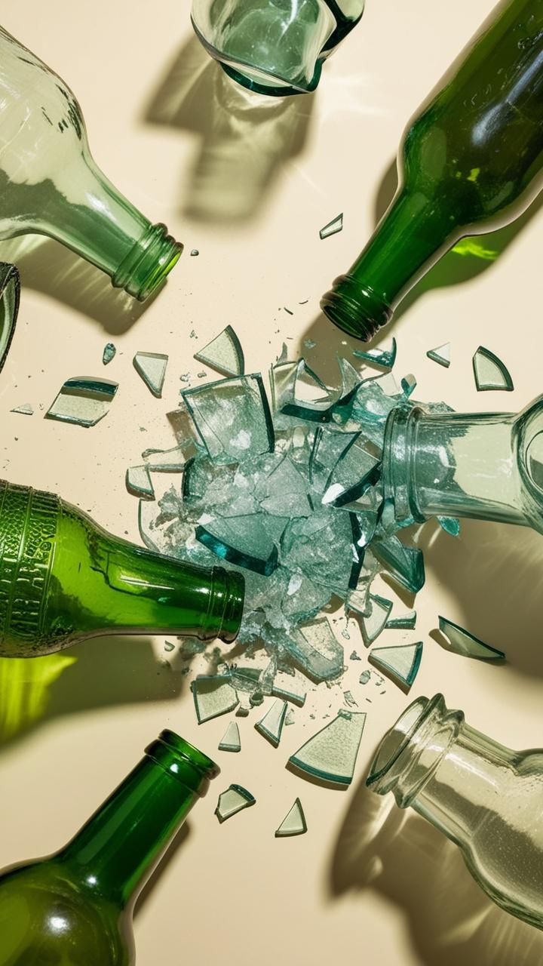

FALEMINDERIT !
Thank you!
Presented by: Constantin Damov
GreenGroup Chairman
constantin.damov@green-group.ro
+40 743 100 026
https://www.green-group-europe.com/en

