Slide 1

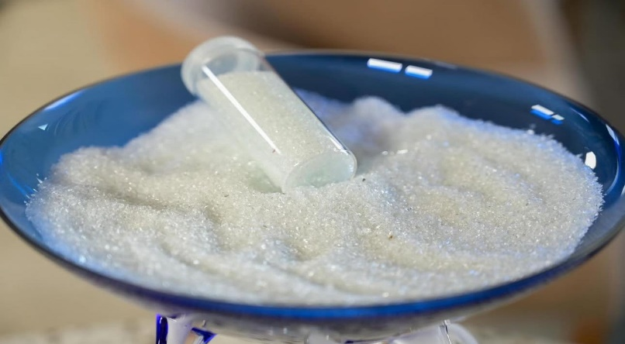
Recycled Glass Product Development
RecycAl – Recycling Albania SH.P.K.
June 2026

Slide 2
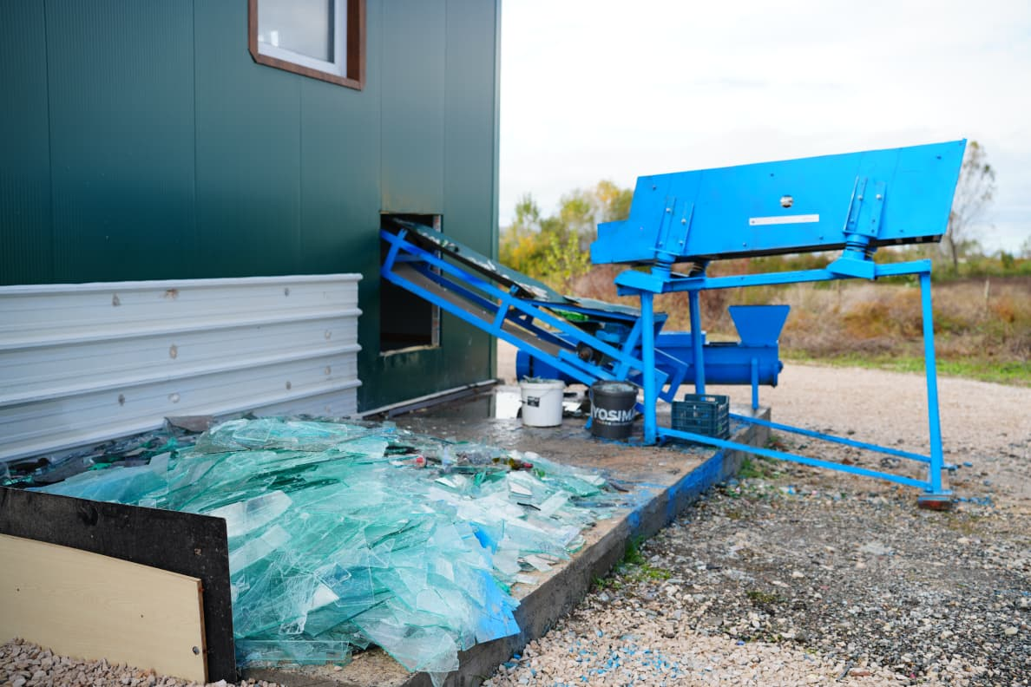
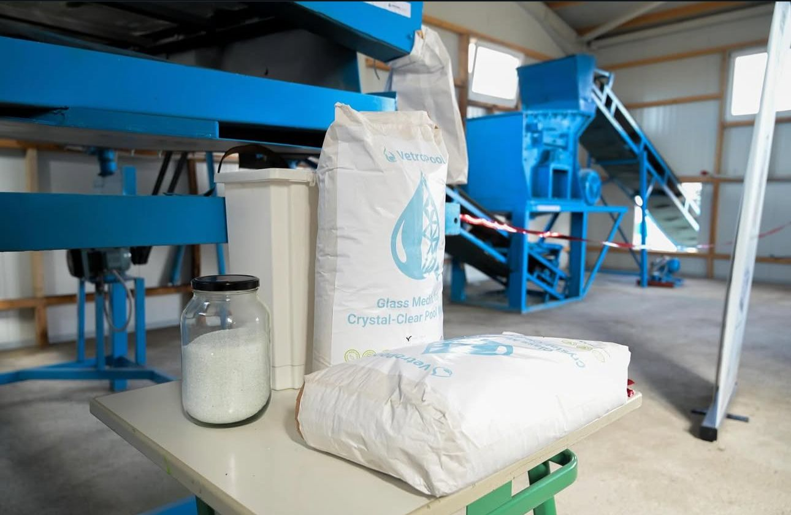
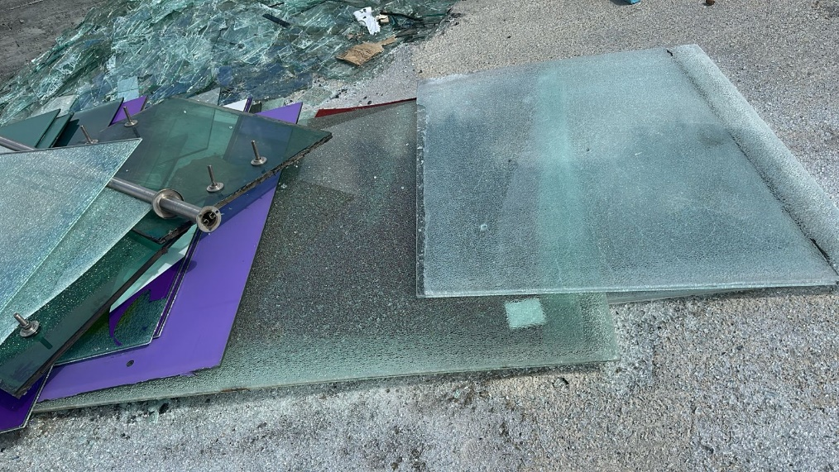
Overview & Glass Recycling Activities
RecycAl operates the first Circular Economy Park in Albania, including the collection and processing of glass waste, the production of recycled pool filtration media, as well as the development of terrazzo and blocks.
Current Glass Recycling Activities
✅ Waste glass collection & sorting – 60tons
✅ Recycled glass sand production – 20 tons
✅ Small-scale terrazzo testing
✅ Technical optimization of glass processing systems
✅ Development of circular glass-based products - blocks

Slide 3
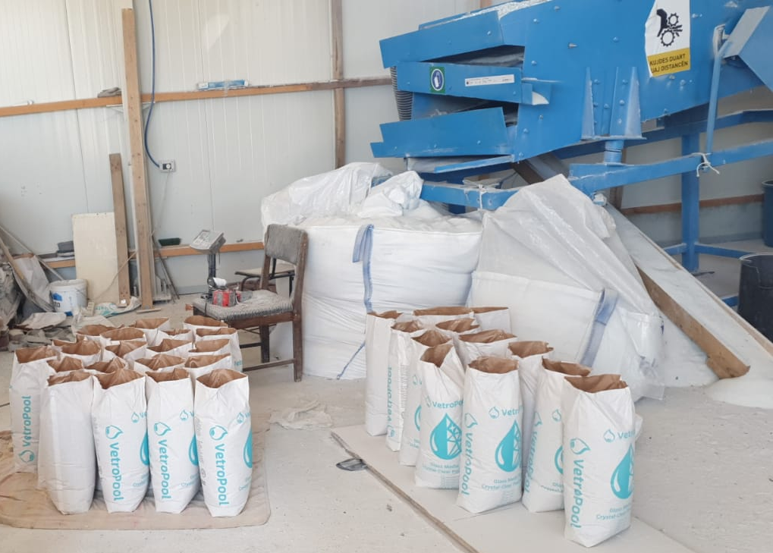
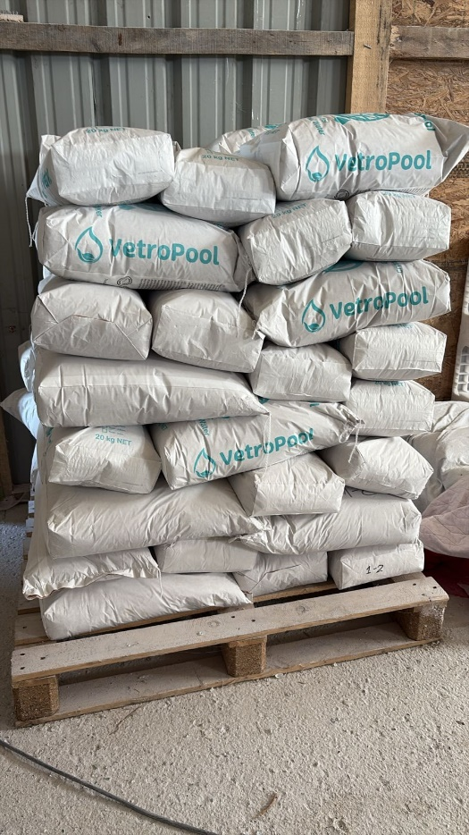
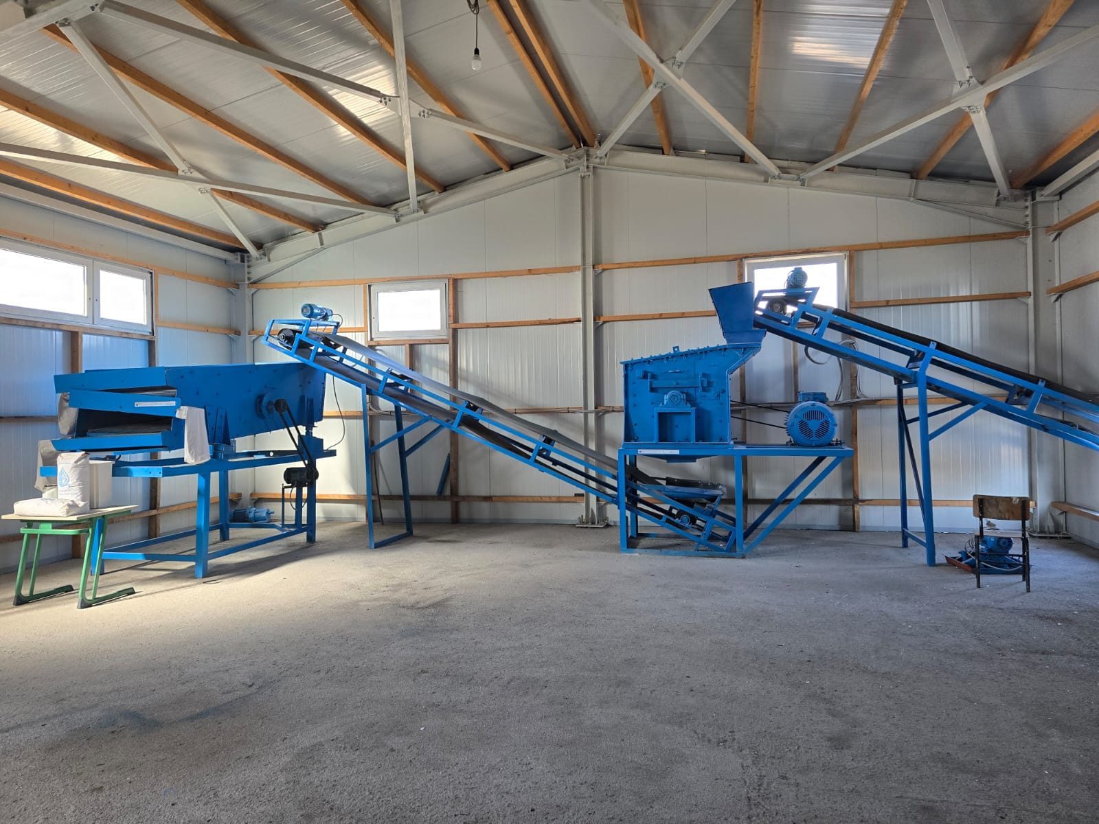
Objectives:
Optimize recycled glass processing equipment
Improve efficiency and consistency of glass sand production
Adapt existing systems to improve product quality
Test and refine terrazzo and other glass-based products
Strengthen practical technical know-how for production
Notes:
Replace photos with machine/equipment photo glass sand photo crushed glass photo terrazzo sample photo

Slide 4
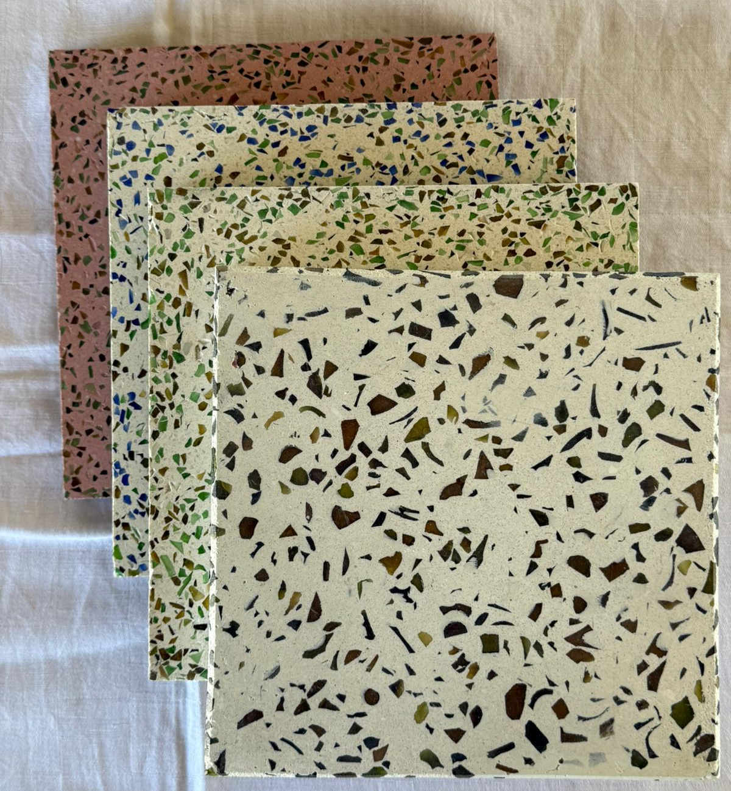
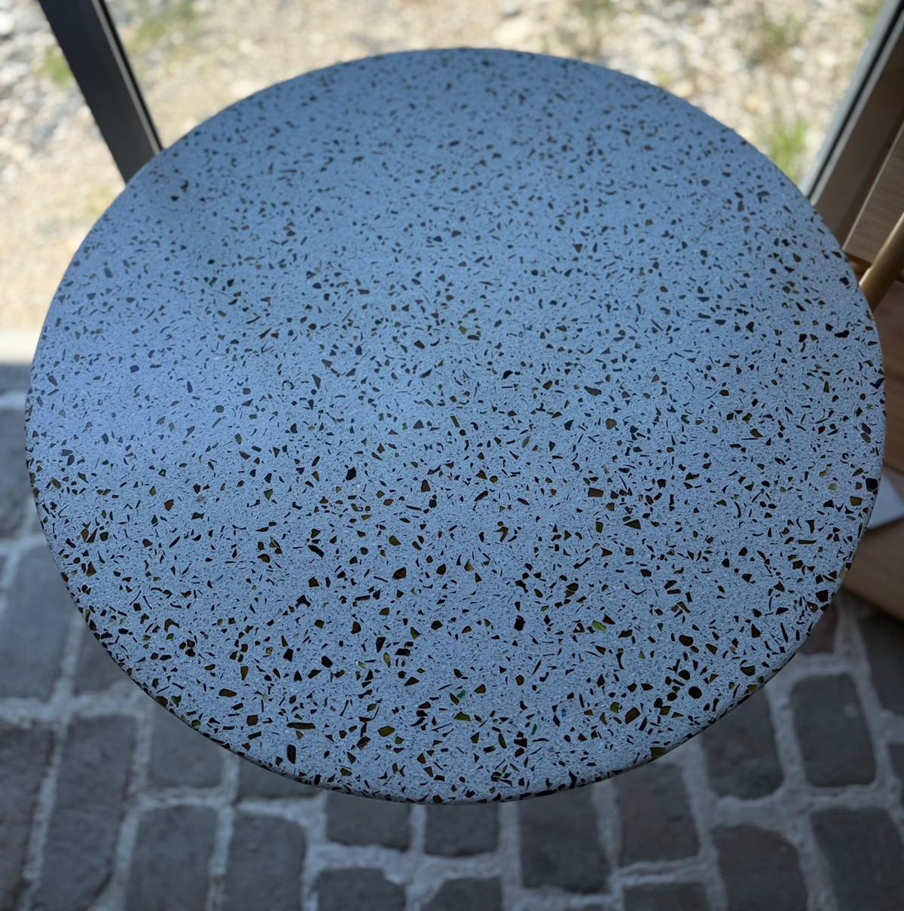
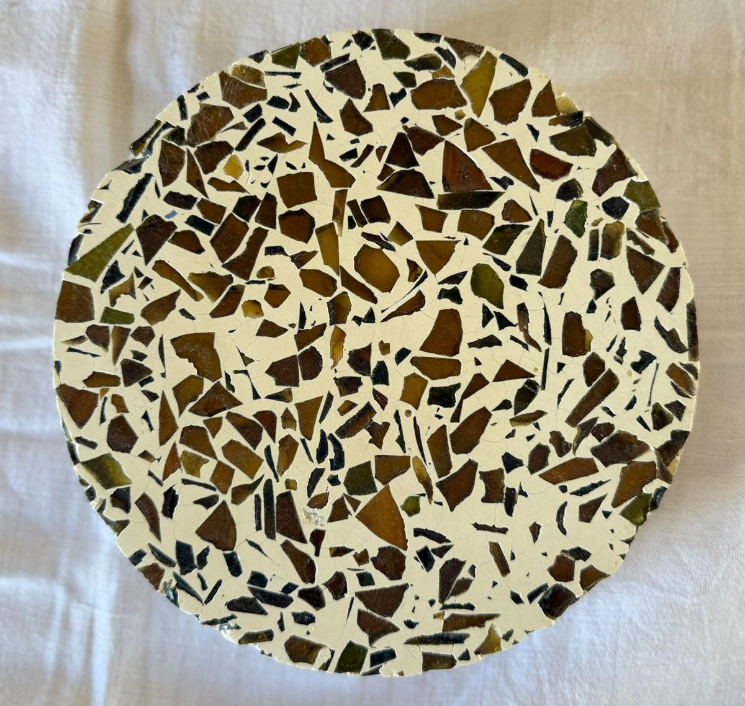
Terrazzo
Terrazo

Slide 5
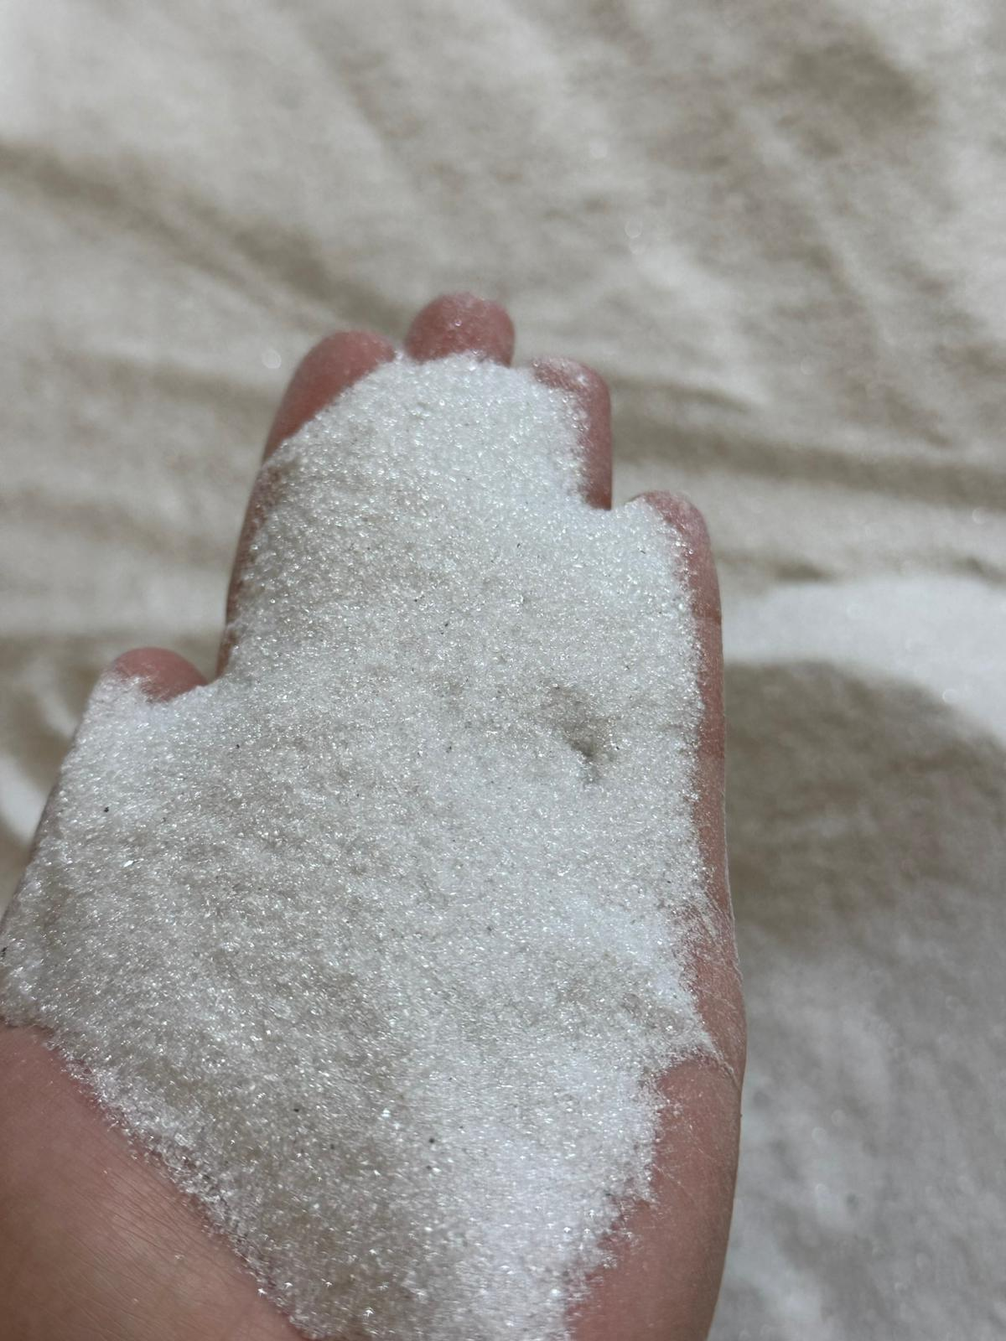
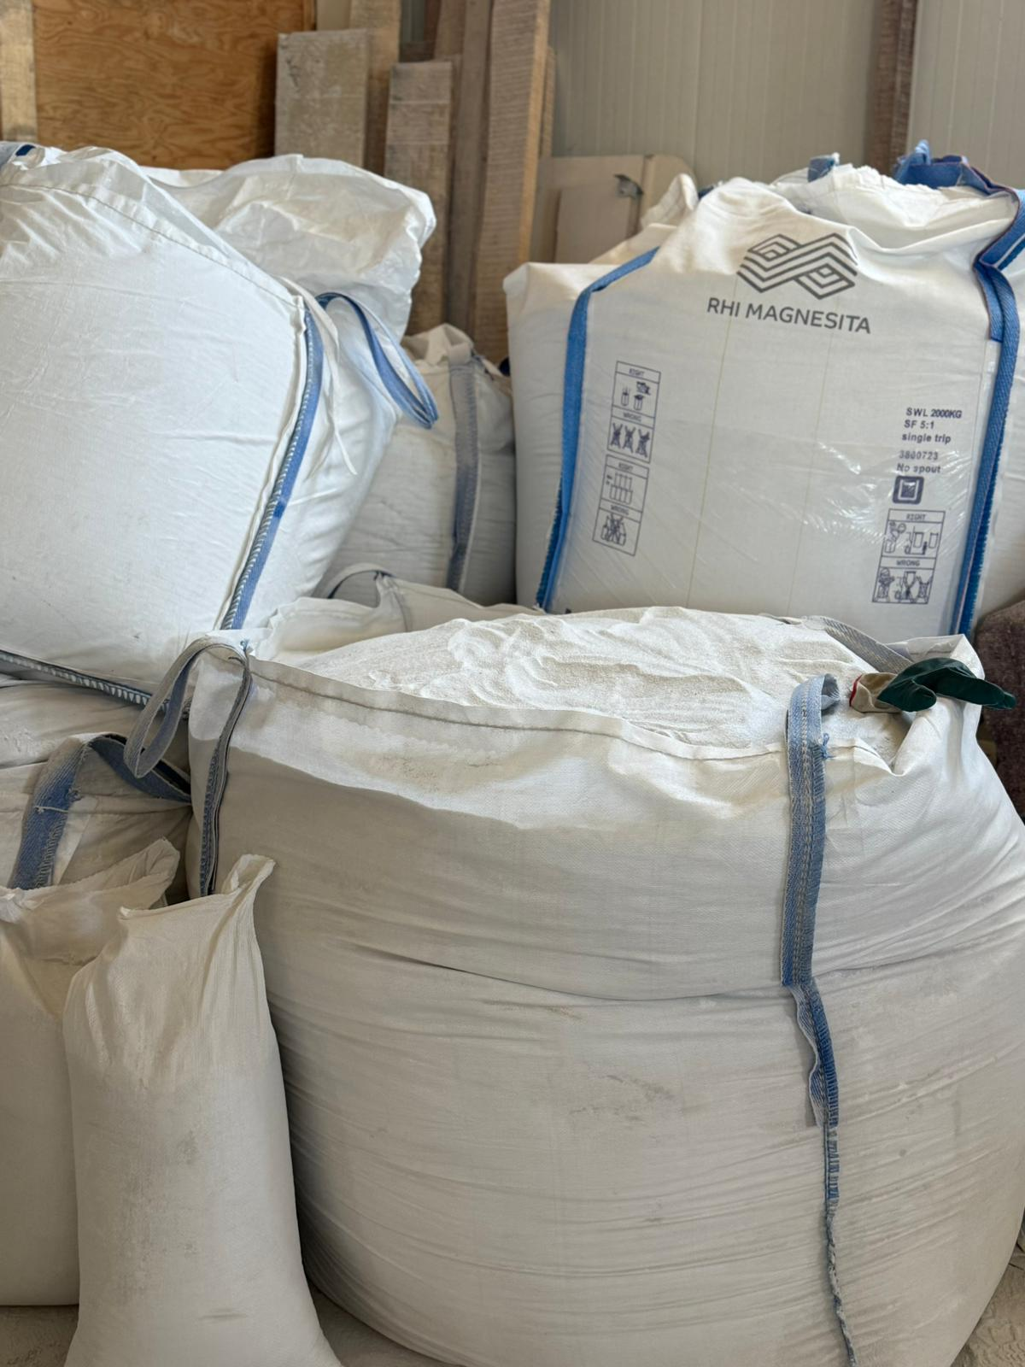
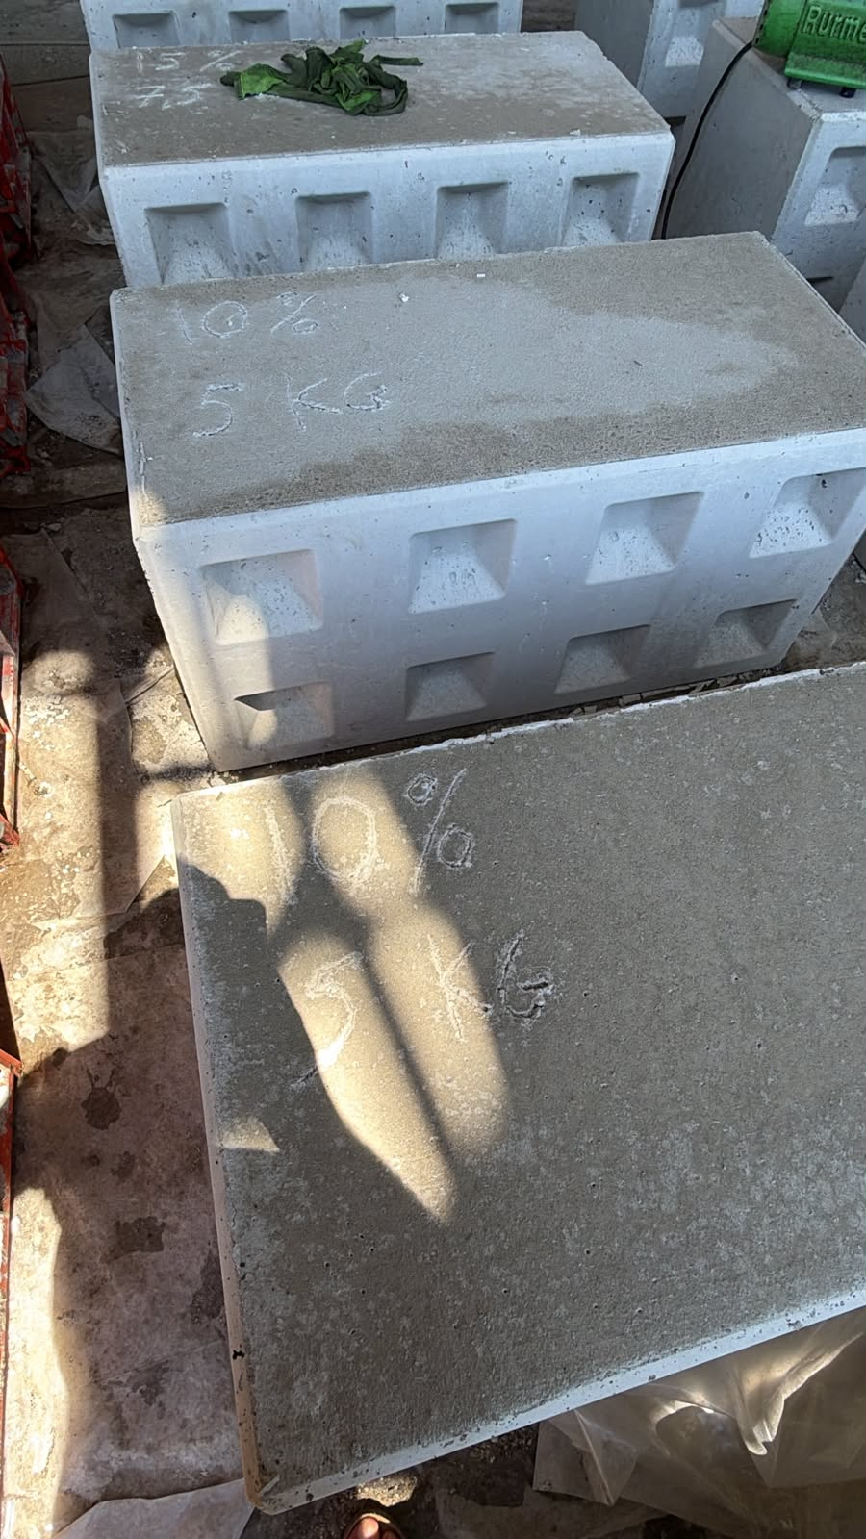
Glass powder <1mm

Slide 6
THANK YOU!
 | Lulzim Baumann Founder & CEO of RecycAl 📍 Address: Street Alb Sedia, Krujë, 1505 Albania 📧 Company Email: info@recyclingalbania.com 📞 Phone: +355 69 552 6728 🌐 Website: Recyclingalbania.com

