Slide 1


Towards a Close the Glass Loop Action Plan for Albania Workshop
Tirana, 17thJune 2026
Roberto Saettone
The Italian system for glass collection & recycling

Slide 2


CoReVe
It is the national, non-profit consortium responsible for the collection, recycling, and recovery of glass packaging waste in Italy
It was established in 1997 in compliance with Legislative Decree 22/97 which transposed EU Directive 94/62 (PPW Directive);
It operates as a “key branch” of CONAI* on the basis of the National Framework Programme Agreement, signed every four years by CONAI and ANCI**, which consists of a general section and the Technical Annexes for each packaging material
It has recently signed the 2026-2029 Technical Annex for the management of glass packaging waste
It grants to Municipalities/Service Providers Appointed by Municipalities a fee based on the quantity and quality of separately collected glass waste (5 quality tiers)
*the National Packaging Consortium; ** the National Association of Italian Municipalities

Slide 3





CoReVe’s members include
23
Glass producers
35
Commercial importers (wholesalers/distributors)
41
Industrial importers (fillers)
7
Cullet Treatment Companies
(from 2020 they can join CoReVe voluntarily)
CoReVe operates as a subsidiary system to the market

Slide 4
COLLECTION OF GLASS PACKAGING WASTE (2024)
In Italy, the collection of glass packaging waste slightly decreased (-0,7%), from 2.400.000 tons in 2023 to 2.383.000 tons in 2024

Slide 5
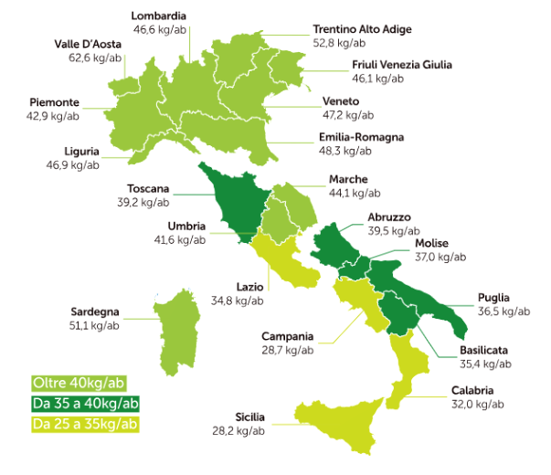
COLLECTION IN THE REGIONS (Kg/inhab, 2024)
NATIONAL AVERAGE
40,4 Kg/inhab
North | 46,7 kg/inhab
Centre | 37,8 kg/inhab
South | 33,2 kg/inhab

Slide 6
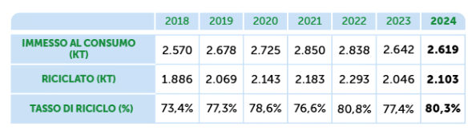
RECYCLING RATE (2024)
Put on the market (kt)
Recycled (kt)
Recycling rate (%)
Since 2019, we have exceeded the 75% target set by the EU for 2030

Slide 7



ENVIRONMENTAL BENEFITS (2024)
SAVINGS IN RAW MATERIALS:
about 3.8 million tons of traditional raw material extraction was saved
Approximately 2 times the volume of the Colosseum
ENERGY SAVINGS:
an amount of energy equal to approximately 394 million m³ of gas was recovered, equivalent to the average household consumption of a city of 1.4 million inhabitants
LOWER CO₂ EMISSIONS:
emissions were reduced by around 2.3 million tons of CO₂
equivalent to the emissions of approximately 1.5 million Euro 5 small cars on the road for one year with an average mileage of 15,000 km
Data referring to Total Recycling, including internal recycling

Slide 8
ECONOMIC BENEFITS FOR MUNICIPALITIES (2024)
 | 2023 | 2024
MUNICIPALITY REVENUES (Source: CoReVe) | 92 ml € | 113 ml €
SAVED LANDFILL COSTS (Source: ISPRA) | 410 ml € | 407 ml €

Slide 9
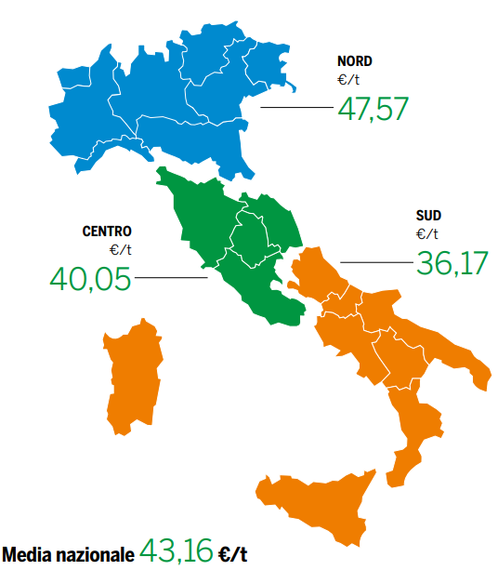

AVERAGE FEE IN THE DIFFERENT GEOGRAPHICAL AREAS
(€/t, 2024)
73,02
The average remuneration paid by CoReVe to Municipalities raised from 68,31 €/t in 2023 to 71,06 €/t in 2024.
69,10
68,77
National average
71,06 €/t

Slide 10
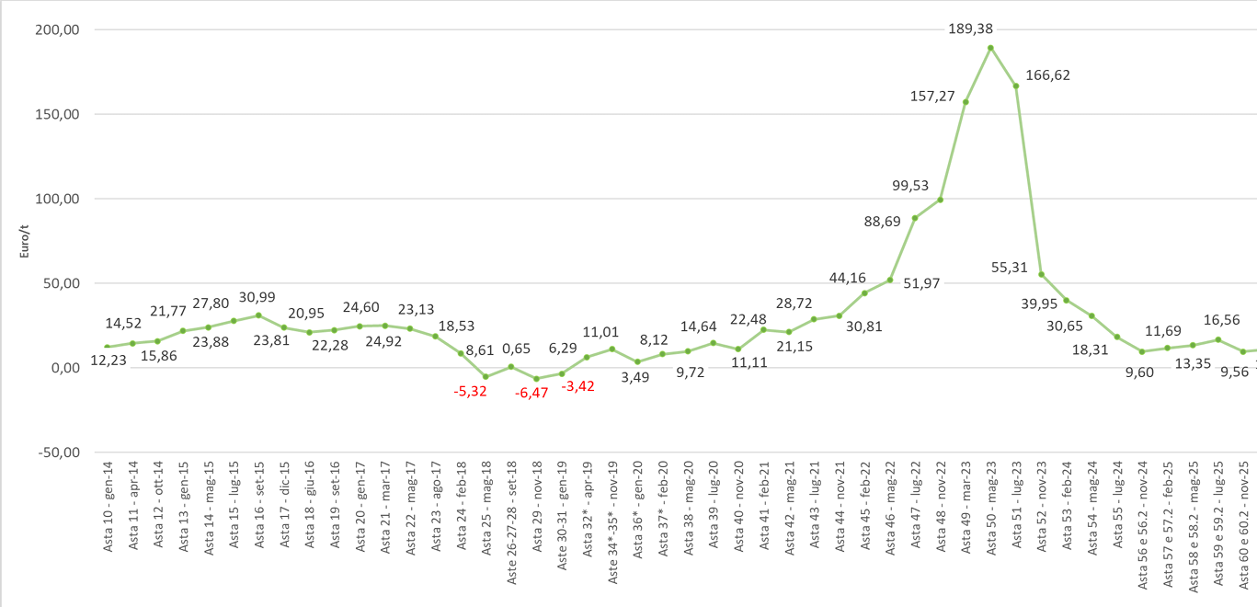
COREVE’S AUCTIONS - PRICE TRENDS

Slide 11



CoReVe'S COMMITMENT TO MUNICIPALITIES (ANCI-CoReVe Technical Annex 2026-2029)
Resources are allocated to finance:
  Purchase equipment (bottle banks and/or door-to-door containers)
Communication Campaigns: To raise awareness on correct glass sorting and disposal practices
Objective: To improve the quality of glass packaging waste collection

Slide 12

THANK YOU

