Slide 1


EPR in Practice: Core Principles for Successful Implementation
What makes EPR systems work in practice
Valeria Branca
Director of Programme Management and Members Relations, EXPRA-Extended Producer Responsibility Alliance
Towards a Close the Glass Loop Action Plan in Albania - 17 June 2026
Albania - 17 June 2026

Slide 2







EXPRA’s Mission and Beliefs
EXPRA
Built on our 10 Golden Rules for Extended Producer Responsibility
Knowledge partner
Efficient, green waste management
A trusted knowledge partner for the EU institutions on EPR and circularity.
Driving efficient and environmentally friendly waste management across markets.
Circularity & low-carbon
Best-practice platform
Driving circularity and low-carbon life cycles for packaging through optimised EPR.
A platform to exchange best practice and raise awareness among stakeholders.

Slide 3
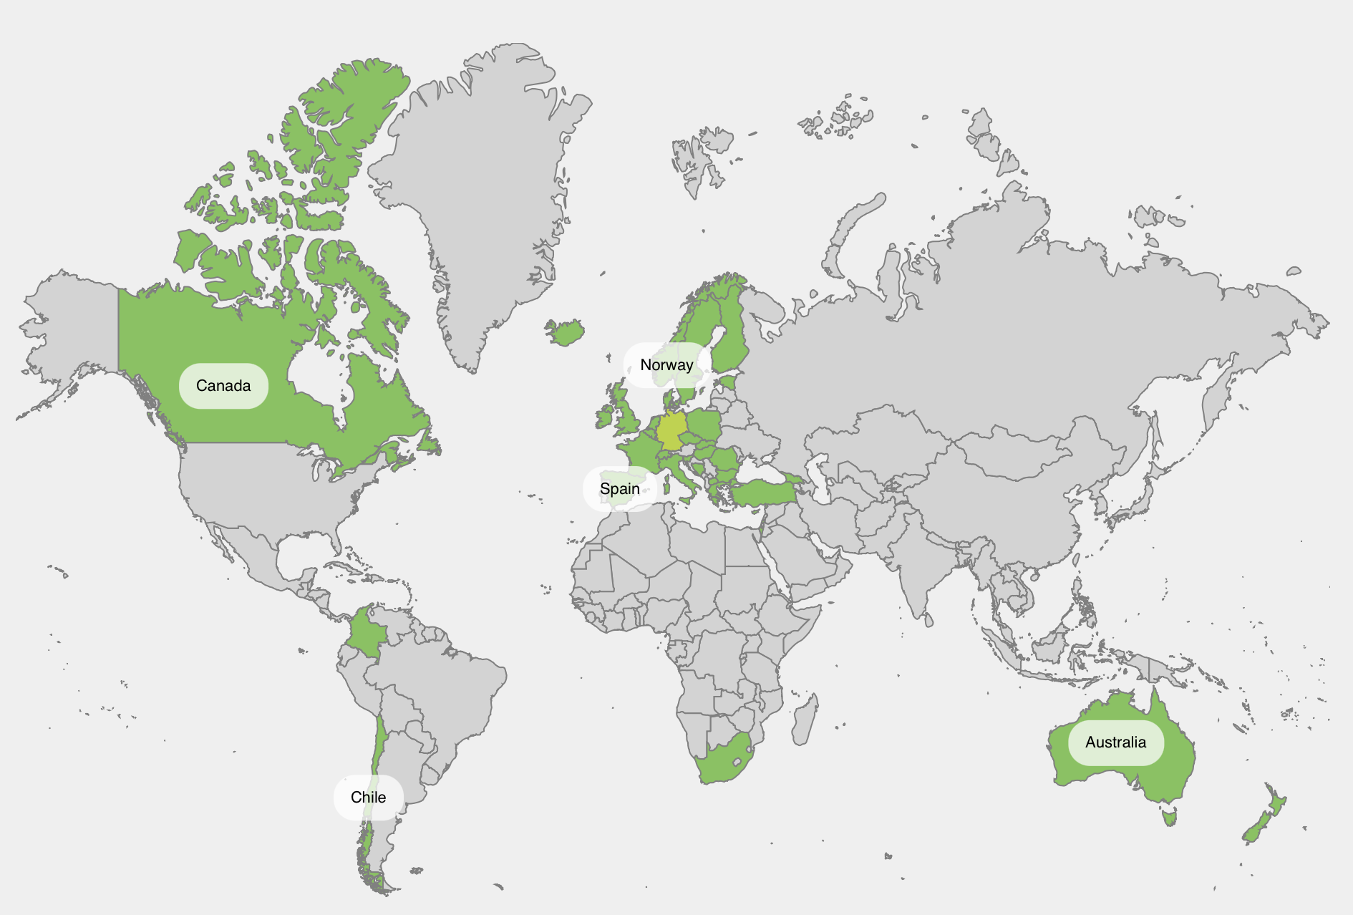
Our members
38 members and non-profit partners across the globe
PPWR scope – colour shows who applies the EU Packaging & Packaging Waste Regulation:
EU member – PPWR applies
EEA / EFTA – PPWR applies
EU candidate – alignment expected
Other – PPWR does not apply
EUROPEAN UNION
EEA / EFTA
REST OF THE WORLD
PPWR applies directly – from 12 Aug 2026
PPWR applies (via EEA Agreement)
PPWR does not apply
Fost Plus
BE
VALIPAC
BE
CITEO
FR
CONAI
IT
Ecoembes
ES
Grønt Punkt
NO
IRF
IS
North America
Australasia
ÉEQ Québec
CA
Circular Materials
CA
SPSA
AU
Packaging Forum
NZ
Ecovidrio
ES
Verpact
NL
Repak
IE
Green Dot
CY
EKO-KOM
CZ
EU CANDIDATE COUNTRIES
Expected to align with PPWR on accession
ETO
EE
RINKI
FI
Herrco
GR
Öko-Pannon
HU
Valorlux
LU
Ecopak
BA
PAKOMAK
MK
CEVKO
TR
South America
Africa
Resimple
CL
Visión Circular
CO
PRO Alliance
ZA
GreenPak
MT
ECO-ROM
RO
ENVI-PAK
SK
Slopak
SI
NPA
SE
OTHER
PPWR does not apply
Swiss Recycle
CH
PRO UK
UK
TAMIR
IL
Rekopol
PL
VANA
DK
EcoPack
BG

Slide 4

EPR as a solution : the Golden Rules
Key principles a producer's EPR should follow:
a
Ownership limited to obligated companies and the packaging value chain — no conflict of interest
g
Non-profit entity; a Service of General Economic Interest
b
Measurable waste-management targets
h
Information & reporting obligations for all actors in the life cycle
c
Fair treatment for producers of products
i
Consumer information & education for informed choices
d
High transparency in money and material flows
j
Full cost coverage reflecting end-of-life costs
e
Cost-effectiveness; clearly defined scope, bidding where possible
k
Fee modulation reflecting net cost and recyclability
f
Supervision & enforcement, incl. online sales and marketplaces
l
Structured stakeholder dialogue and input
Most of these are already in Art. 8a WFD (minimum requirements for EPR) — but have not really been implemented.

Slide 5


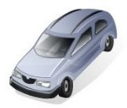














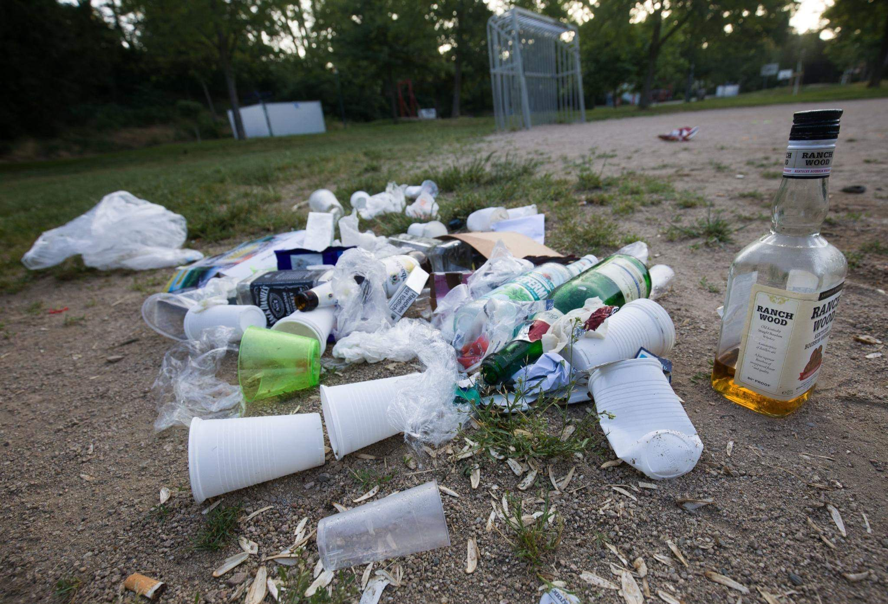


Optimal EPR Design
Clear rules and responsibilities
Monitoring
Application
D4R
Packaging
Manufacturer
New Products
Filler/bottling machine
Material for new products
EPR Producer Responsibility Organization
Compact
Product
Operational and Financial Accountability
Recycling/Recovery
Informal Sector
Sorting
Local authority waste management company
Collection and sorting
Retail
Contractual agreements
Strong cooperation and
Mutual understanding
Consumer
Funded by
Fees

Slide 6
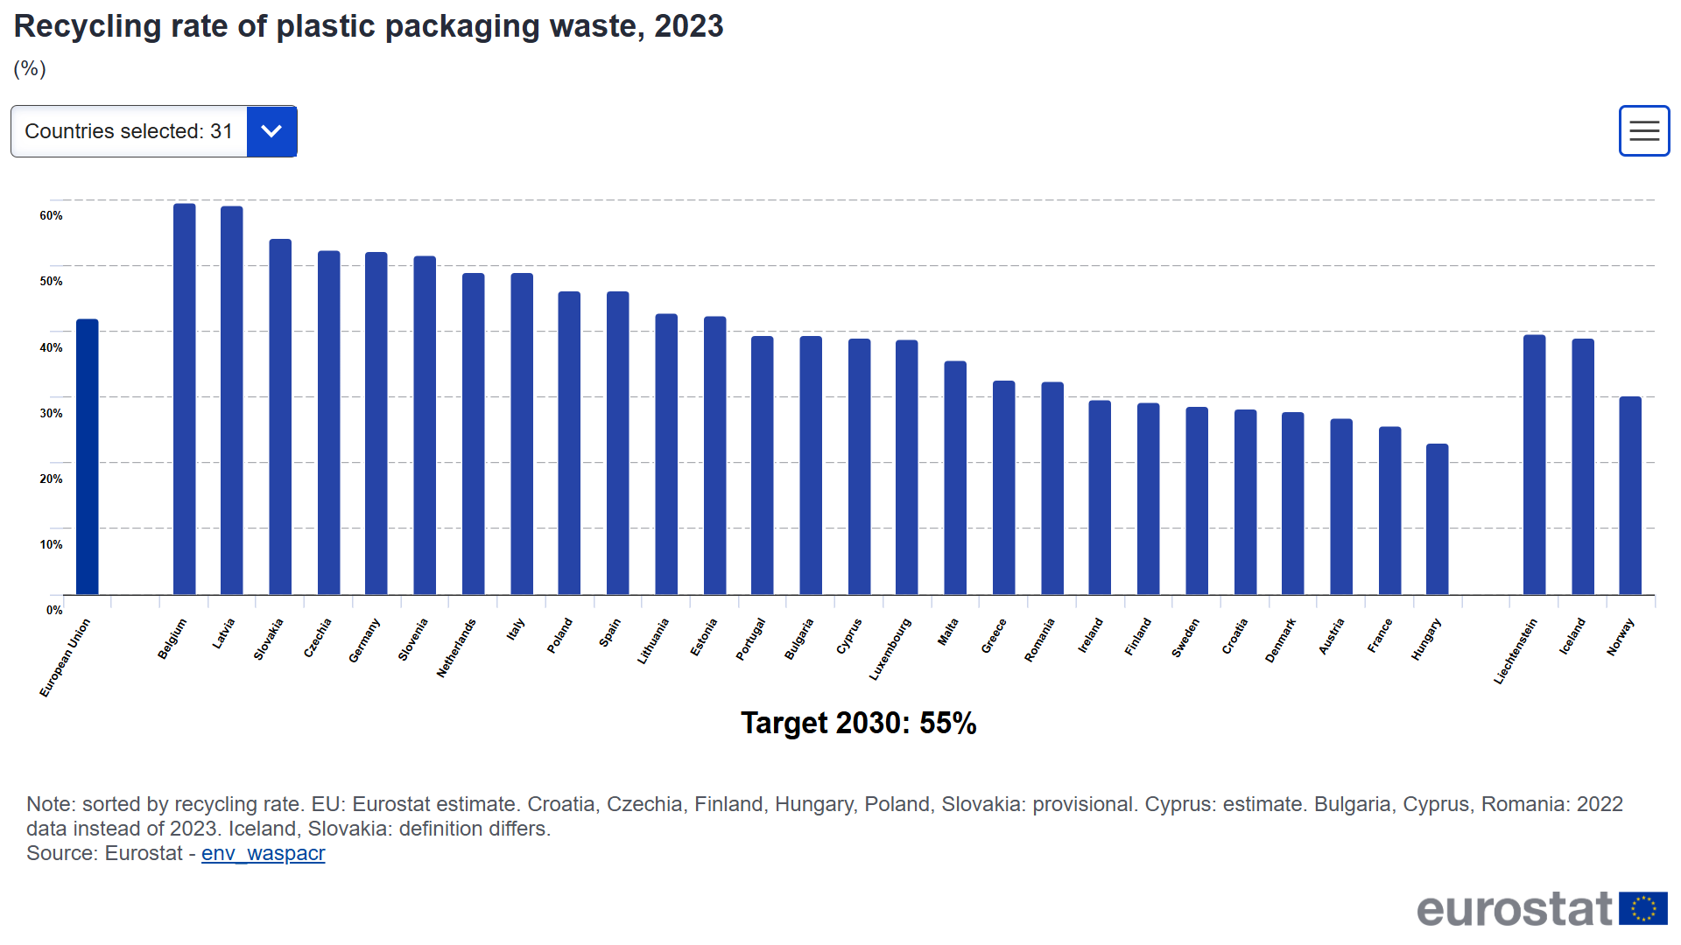

Slide 7

Short analysis of the leading systems
Belgium
Operational influence
The pattern
Latvia
Operational influence
Germany
Operational influence
Most leading countries run EPR where the PRO has real operational influence — either organising the complete operations (e.g. Germany) or at least sorting and marketing (e.g. Belgium).
Italy
Operational influence
Netherlands
Some operational influence
Slovakia
Operational influence
Czechia
Some operational influence
Slovenia
Operational influence
Spain
Operational influence

Slide 8

Short analysis of the systems lagging behind
Hungary
Taxation system (2023)
The pattern
France
Limited/no operational influence
All three taxation-based systems show up among the laggards. Member States with no EPR , or with financial-only systems , generally perform worse than EPR systems with operational influence.
Denmark
Taxation system (2023)
Croatia
Taxation system
Malta
Competing PROs
Greece
Competing PROs
Finland
Competing PROs
Austria
Competing PROs

Slide 9
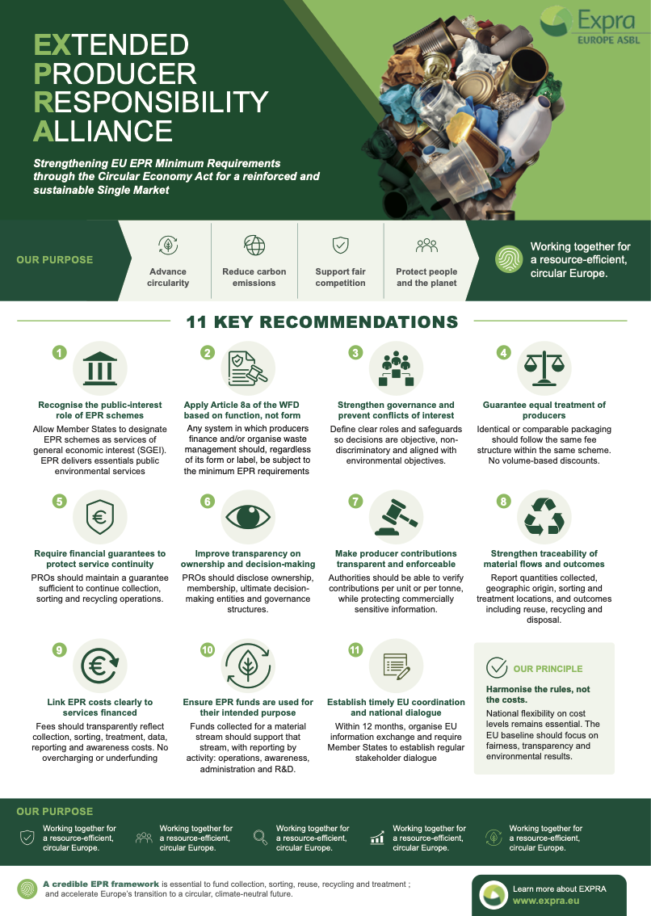
11 key recommendations on
Minimum Requirements of EPR
EXPRA
EXPRA's input to the upcoming Circular Economy Act
01
02
03
Keep EPR industry-led & independent from taxation
Explore transition to an SGEI framework
Make online marketplaces fully accountable
04
05
06
Align with the Digital Services Act
Strengthen consumer & citizen engagement
Benchmark waste policy on CO₂ performance
07
08
09
Fair treatment for SMEs & micro-enterprises
Comparable fees by material & weight
Publish public EPR fee tables
10
11
Ensure material & technology neutrality
Harmonise EU end-of-waste criteria

Slide 10
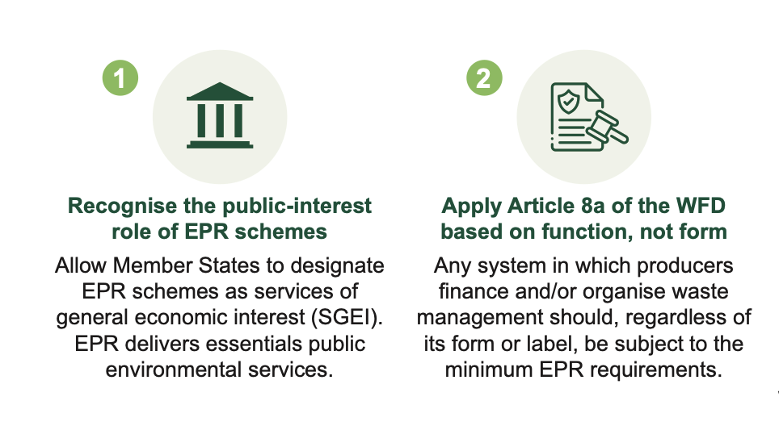
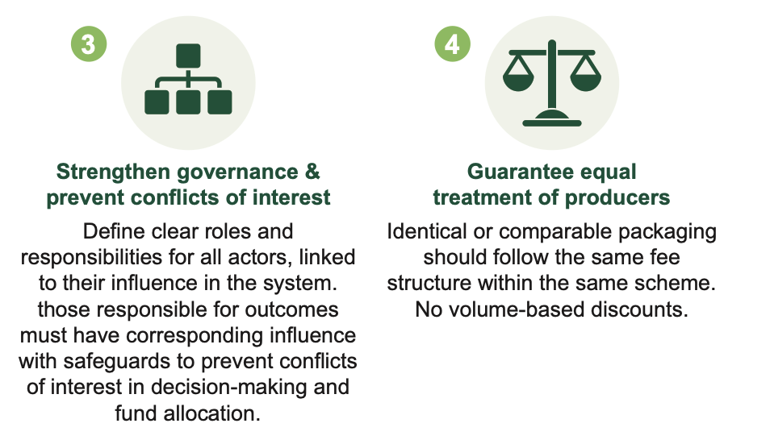
11 key recommendations on
Minimum Requirements of EPR
EXPRA
EXPRA's input to the upcoming Circular Economy Act

Slide 11
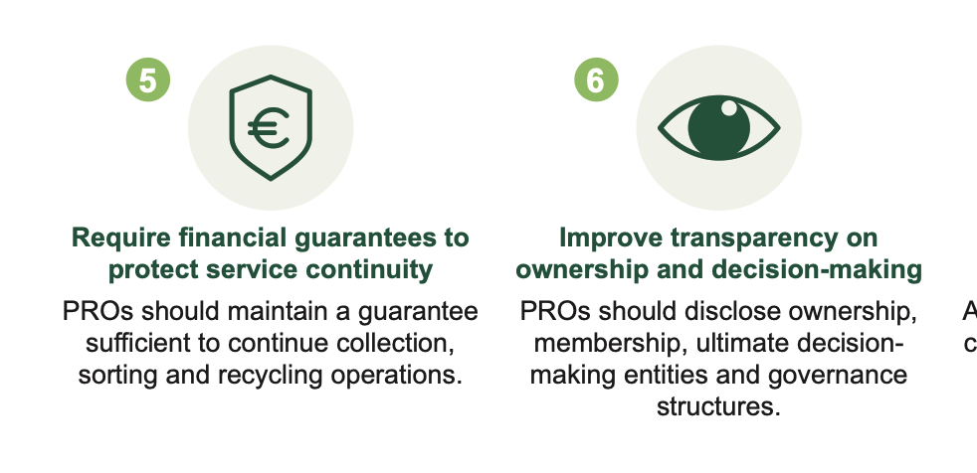
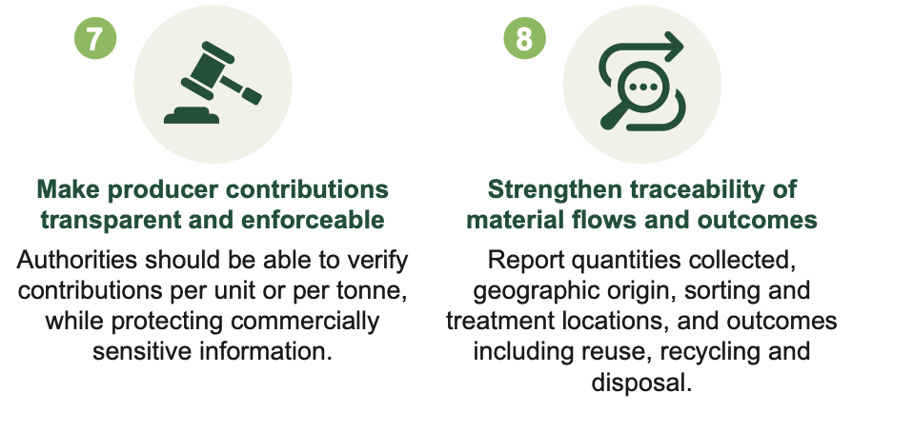
11 key recommendations on
Minimum Requirements of EPR
EXPRA
EXPRA's input to the upcoming Circular Economy Act

Slide 12
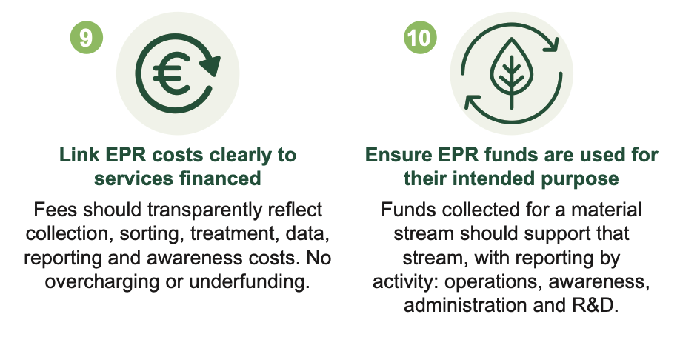
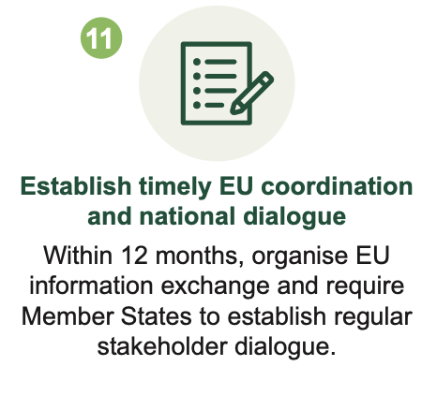
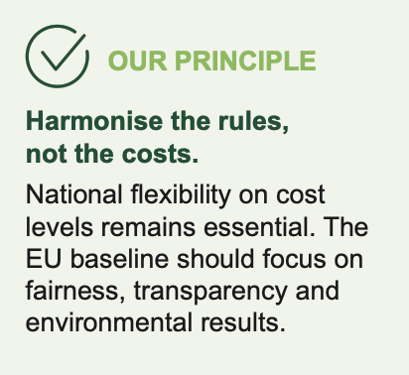
11 key recommendations on
Minimum Requirements of EPR
EXPRA
EXPRA's input to the upcoming Circular Economy Act

Slide 13
How to start with EPR
1. Start with the right structure
2. Set fees that fund real services
Define roles from day one : producer, municipality, PRO. Designate EPR as a public interest service. Build conflict-of-interest safeguards into the governance framework before they are needed.
EPR contributions must cover the full cost chain: collection, sorting, recycling and reporting. Avoid symbolic fees that leave infrastructure gaps , and equally prevent overcharging.
3. Build in transparency from day one
4. Plan for coordination
Require public reporting on material flows and PRO governance. What is collected, where it goes and how funds are spent should be visible to all authorities and stakeholders.
Establish structured dialogue between the national authority, municipalities and producers. Use EU minimum requirements as a reference model — harmonise the rules, not the costs.

Slide 14

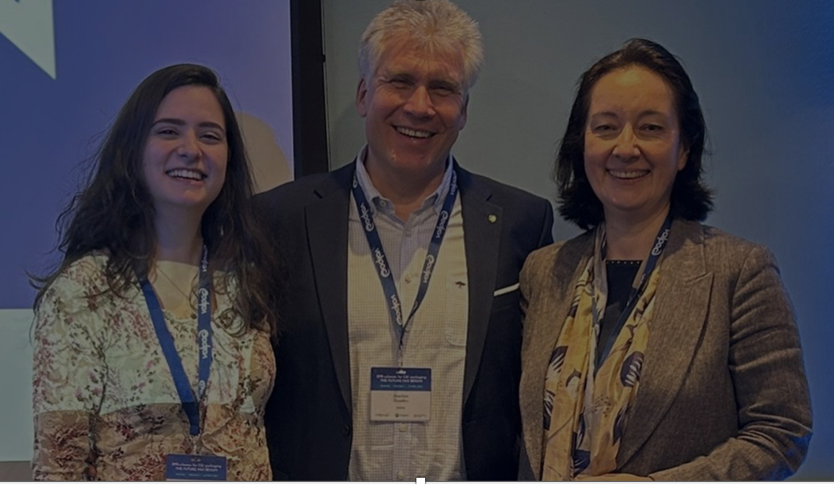
THANK YOU
Contact Us: info@expra.eu
EXPRA aisbl
Address: 2 Avenue des Olympiades, 1140 Brussels – Evere, Belgium
Website: www.expra.eu
LinkedIn: EXPRA on LinkedIn

