Slide 1
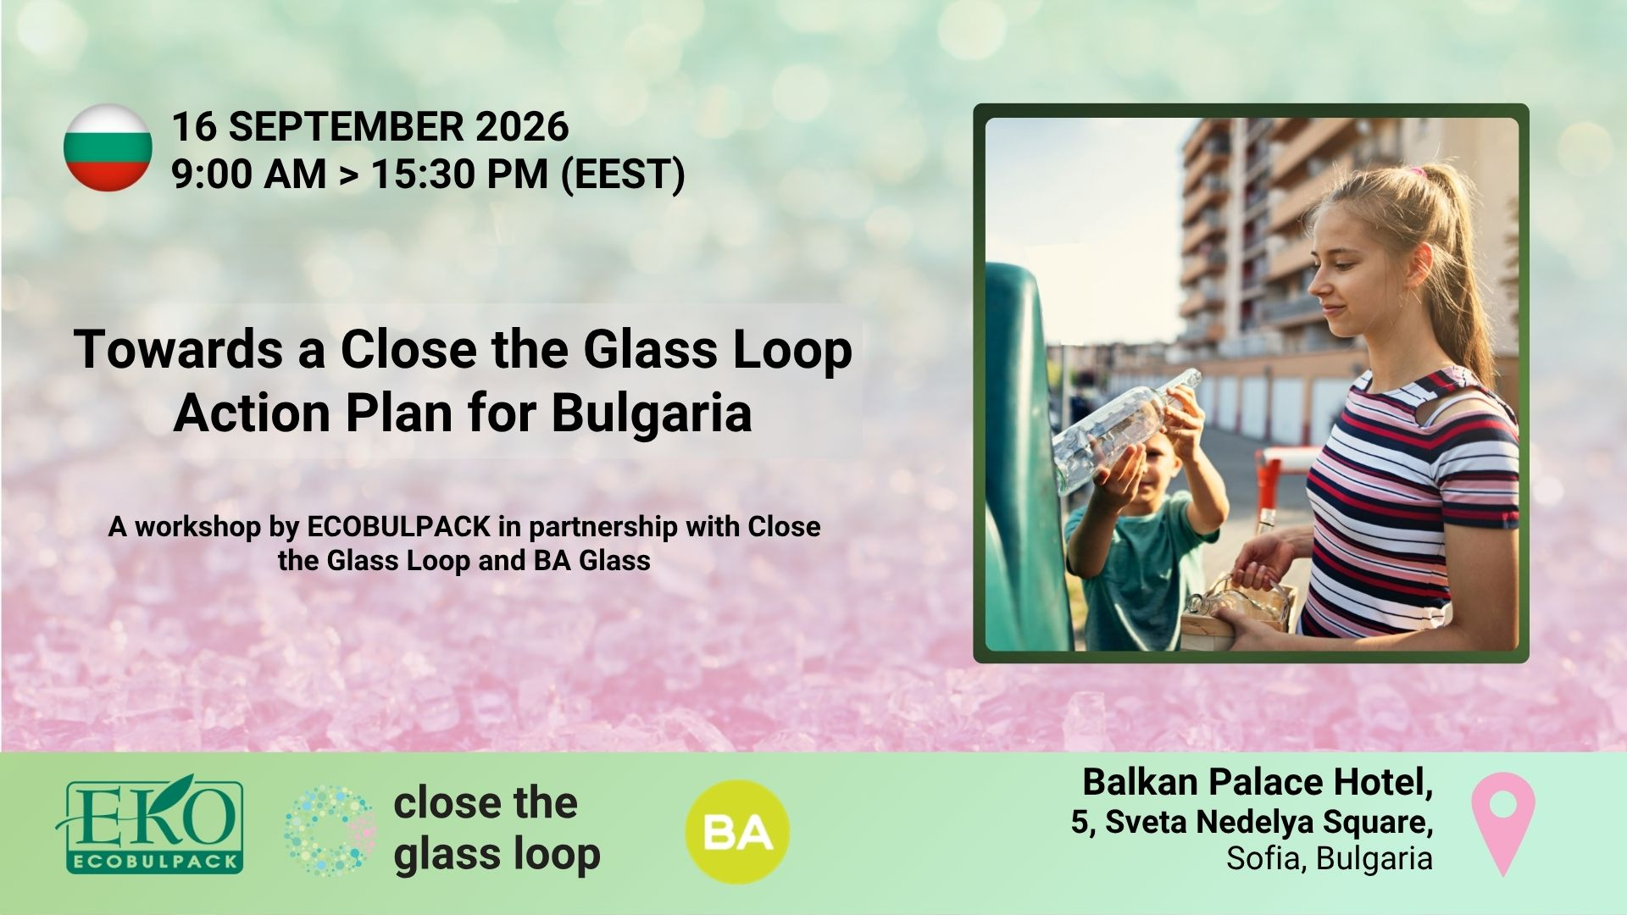

Slide 2


16 SEPTEMBER 2026
9:00 AM > 15:30 PM (EEST)
AGENDA
Opening session & keynote statements
Panel discussion and Q&A “Impact of the new European and national legislation on packaging and packaging waste on glass containers”
European Container Glass Federation FEVE
Extended Producer Responsibility Alliance EXPRA
European Committee of Wine Companies CEEV
Association of Soft Drink Producers in Bulgaria
Coffee break, 30’
European case studies on “Effective post-consumer waste management to improve and increase glass collection for recycling in Europe”
FERVER - European Federation of Glass Recyclers
Plataforma Vidro+, Portugal
Ecovidrio, Spain
Austria Glas Recycling, Austria
Lunch break, 60’
Increasing and improving glass collection and recycling in Bulgaria - Close the Glass Loop Action Plan
Stakeholders' perspectives
Open discussion on a joint action plan

Slide 3
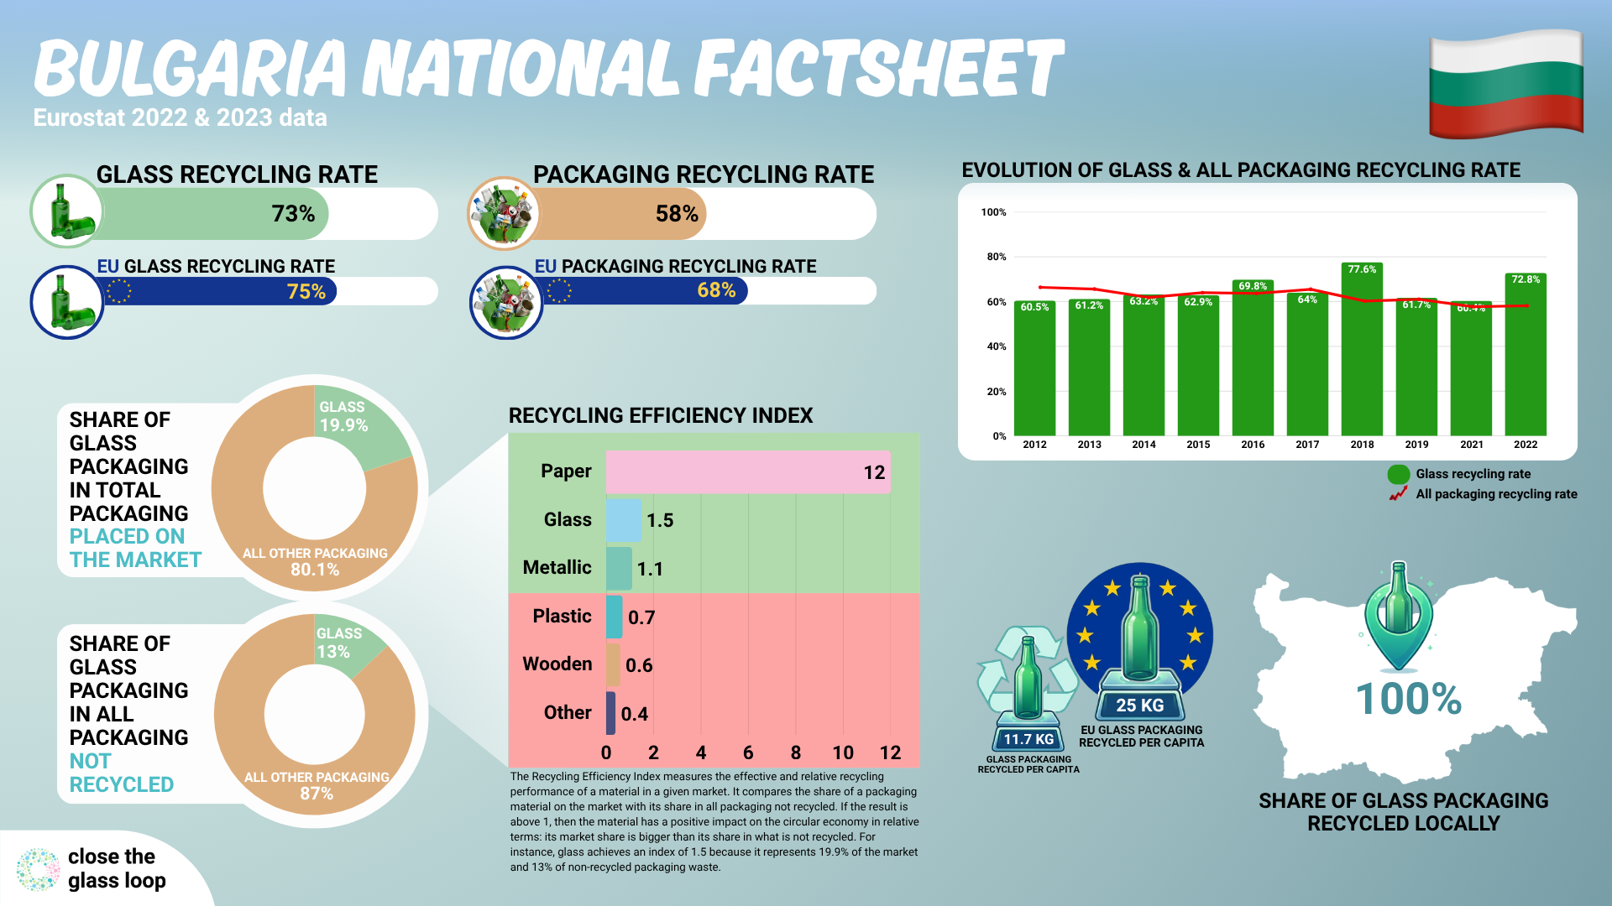

Slide 4
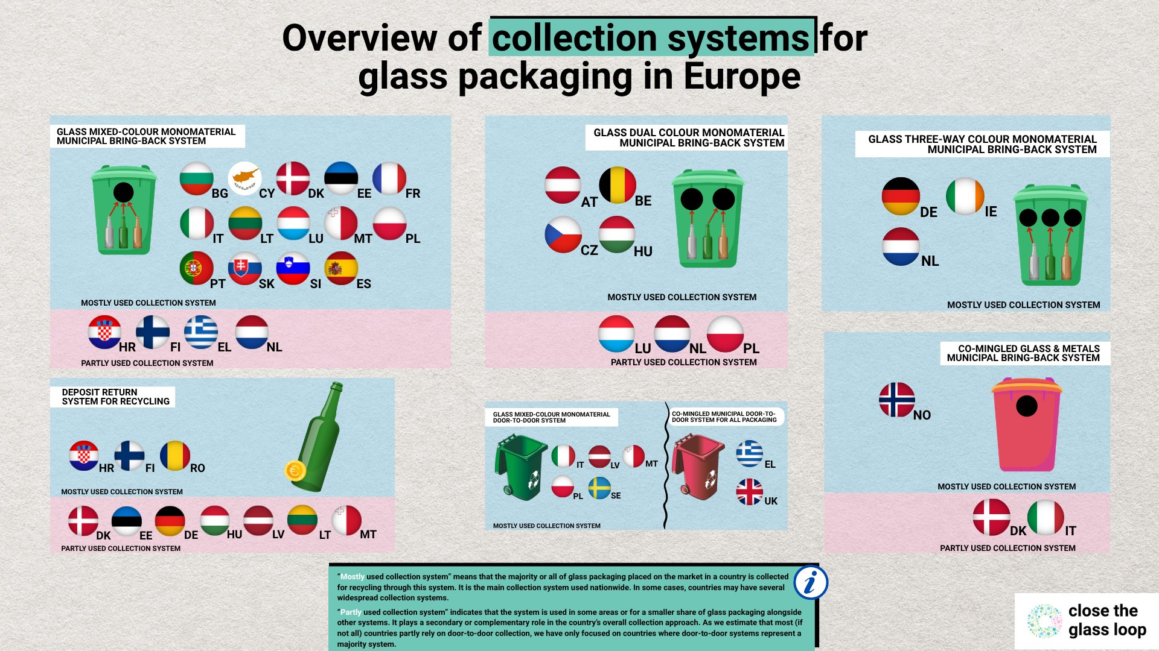

Slide 5
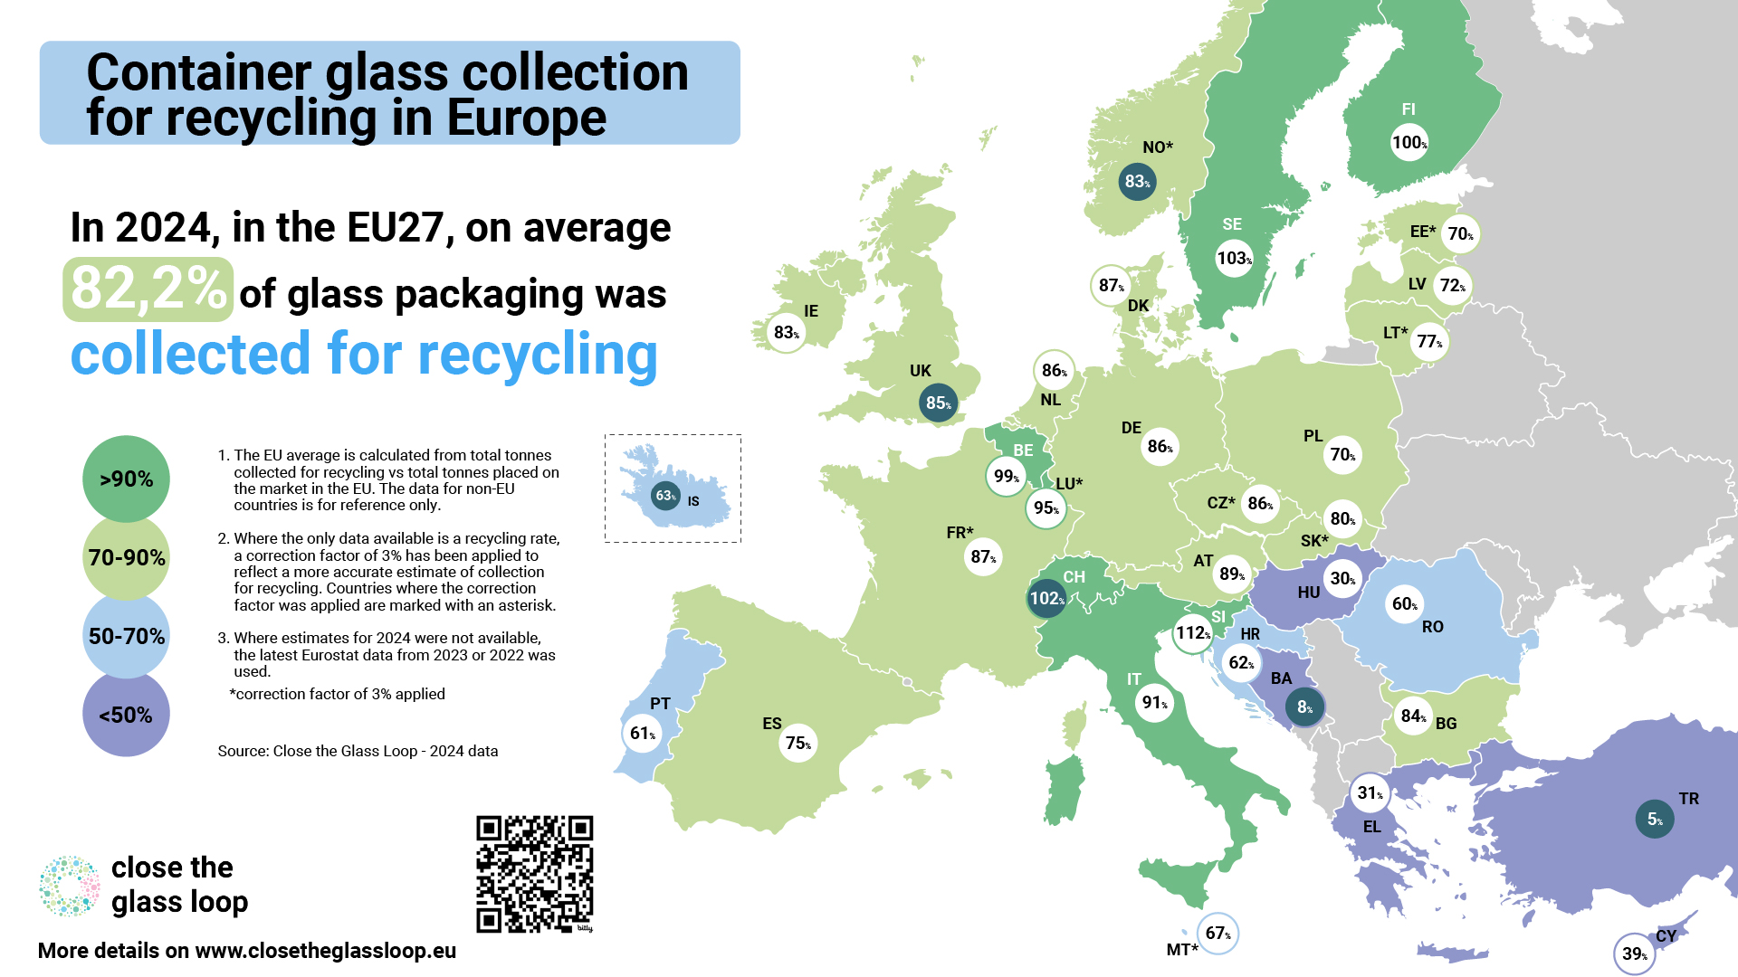

Slide 6

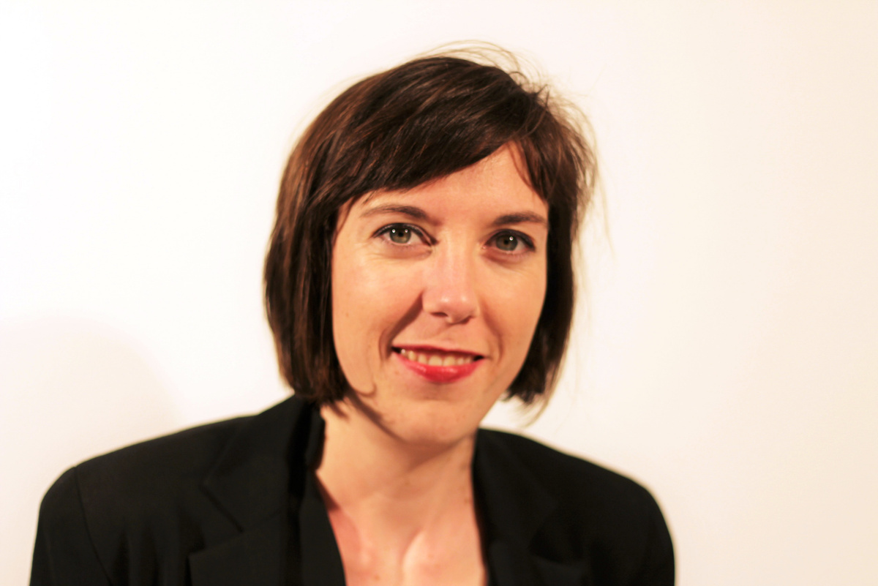
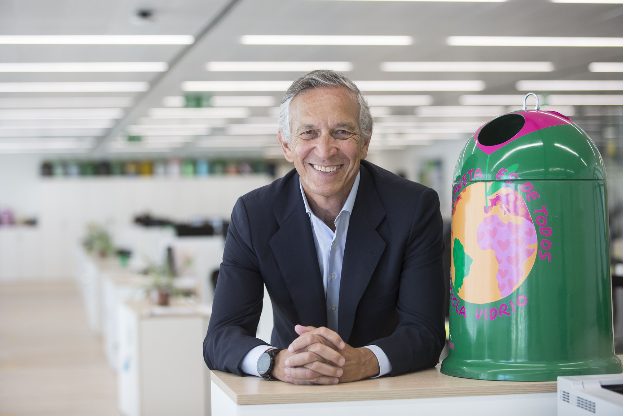
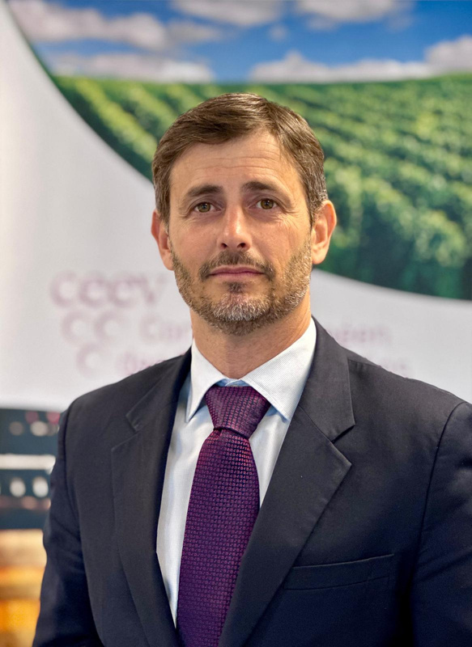


16 SEPTEMBER 2026
9:00 AM > 15:30 PM (EEST)
Towards a Close the Glass Loop Action Plan for Bulgaria
Impact of the new European and national legislation on packaging and packaging waste on glass containers
Vanessa Chesnot
FEVE – European Container Glass Federation
José Manuel Núñez-Lagos Bau
EXPRA – Extended Producer Responsibility Alliance
Ignacio Sanchez Recarte
CEEV – European Committee of Wine Companies
Balkan Palace Hotel,
5, Sveta Nedelya Square,
Sofia, Bulgaria

Slide 7
16 SEPTEMBER 2026
9:00 AM > 15:30 PM (EEST)
Towards a Close the Glass Loop Action Plan for Bulgaria
COFFEE BREAK
11:15 – 11:45
Balkan Palace Hotel,
5, Sveta Nedelya Square,
Sofia, Bulgaria

Slide 8
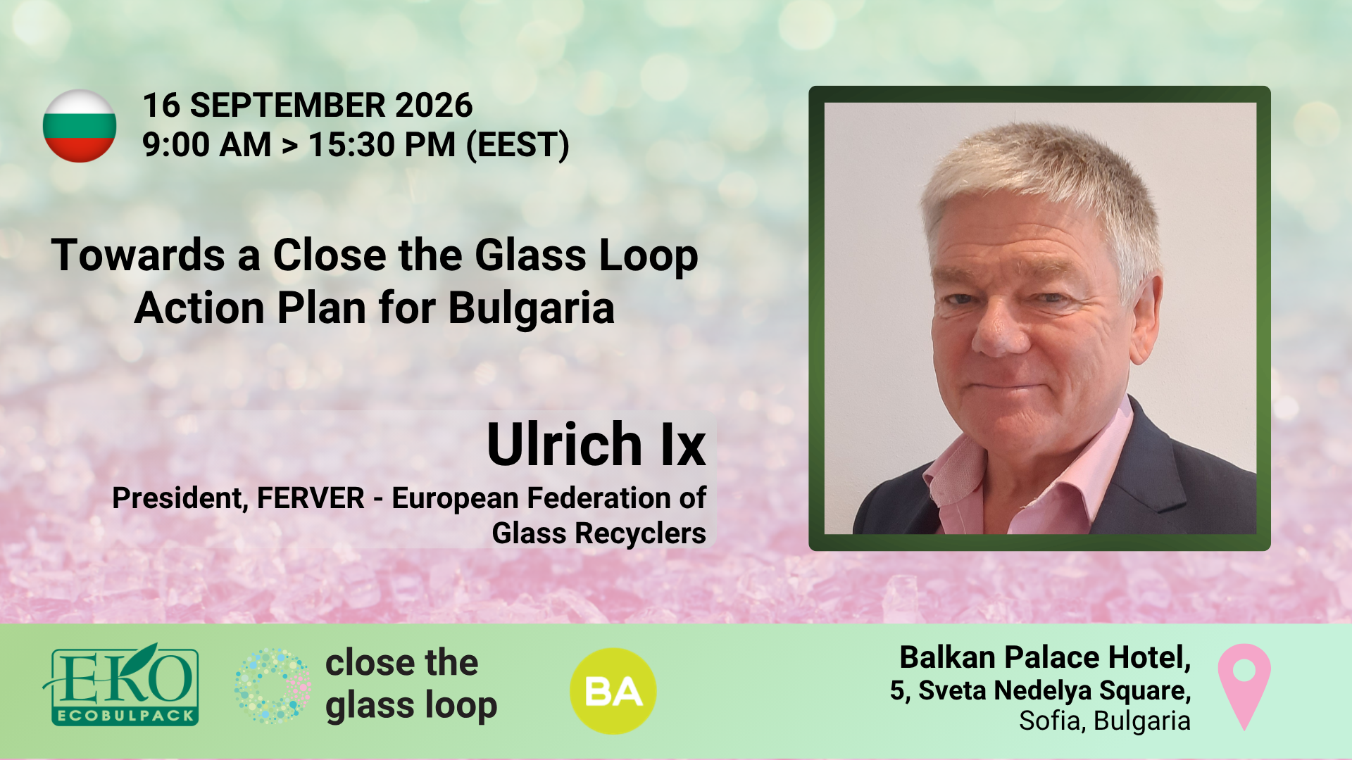

Slide 9
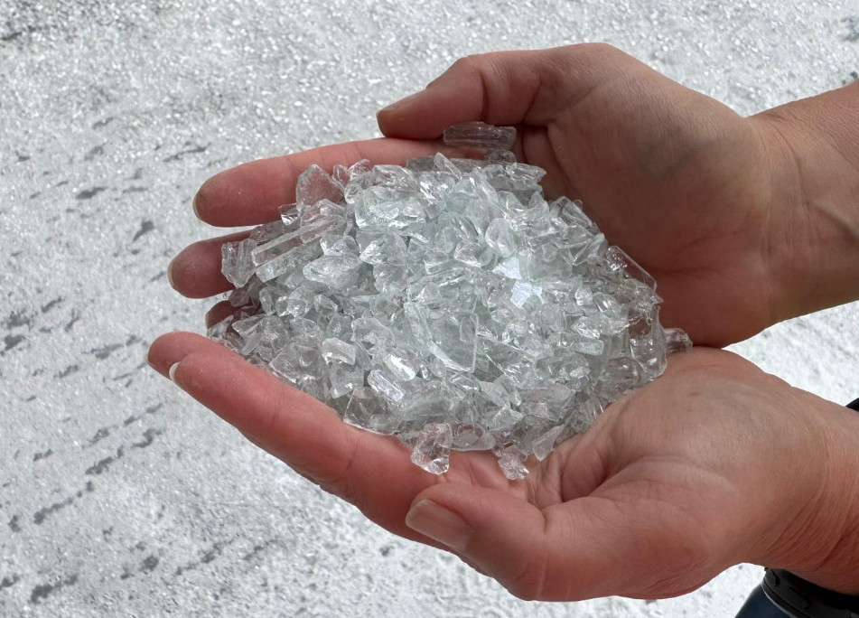

Slide 10

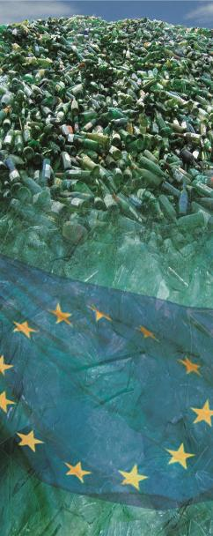
FERVER
Fédération Européenne des Recycleurs de Verre
European Federation of Glass Recyclers
founded in 2004 in Brussels
CGL Sofia September 2026 Ulrich Ix
www.ferver.eu

Slide 11

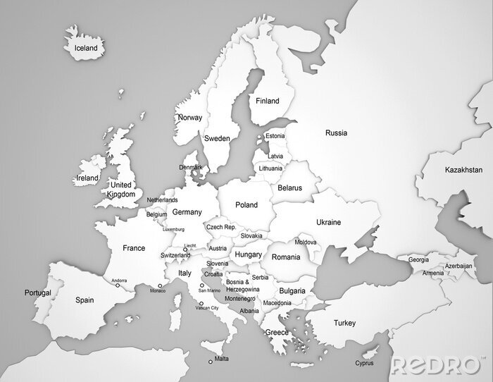
Countries with FERVER Members
Sept 2026
2026:
43 Members
24 Countries
91 Plants
FERVER members recycle 70% of the glass waste in Europe

Slide 12






FERVER Members recycle/produce
Fédération Européenne des Recycleurs de Verre
European Federation of Glass Recyclers
Packaging glass
Flat glass
Automotive glass
PV glass
. . .
www.ferver.eu
Glass sand
Foam glass
. . .

Slide 13
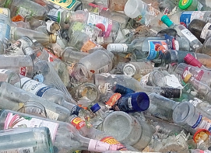
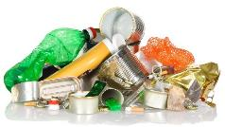
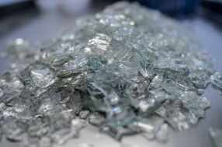
Glass Recycler’s Main Task
Fédération Européenne des Recycleurs de Verre
European Federation of Glass Recyclers
Remove anything that isn’t glass
+ colour sorting
Input
Output/Product
www.ferver.eu
Furnace Ready Cullet (FRC)

Slide 14
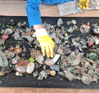
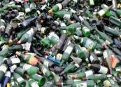
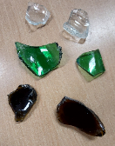

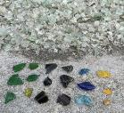





Fédération Européenne des Recycleurs de Verre
European Federation of Glass Recyclers
Glass Recycling Plant
Input
Recycling Process
Product FRC*
* Furnace Ready Cullet
Technology
Handpickers
Waste plastic bags plastic bottles other impurities
CSP ceramics stones porcelain
Labels paper plastic
Ferro closures nails paper-clips …
non-Ferro closures alu labels …
Off-Colour
www.ferver.eu
back to the process

Slide 15






Fédération Européenne des Recycleurs de Verre
European Federation of Glass Recyclers
Detection of Impurities + Colour Sorting
Opto-electronical impurity (CSP etc.) detection
product
light barrier
reject

Slide 16
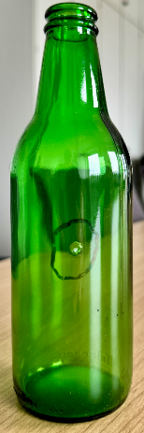
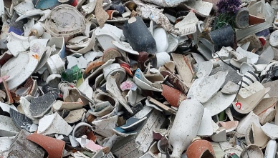
Fédération Européenne des Recycleurs de Verre
European Federation of Glass Recyclers
Possible Quality Issues with the Glass Product
CSP
Ceramics / Stones / Porcelain
Inclusion in new glass containers
CSP
Melting Points:
Glass $\sim$ 1400°C
CSP$>$2000°C

Slide 17
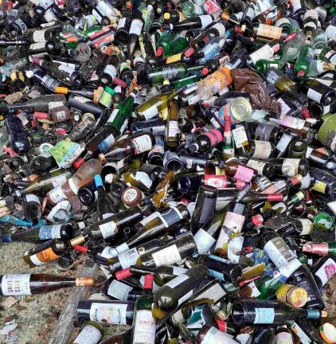
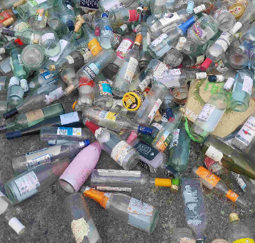
Challenges in Glass Collection
Fédération Européenne des Recycleurs de Verre
European Federation of Glass Recyclers
Collected Glass
as it should be
www.ferver.eu

Slide 18
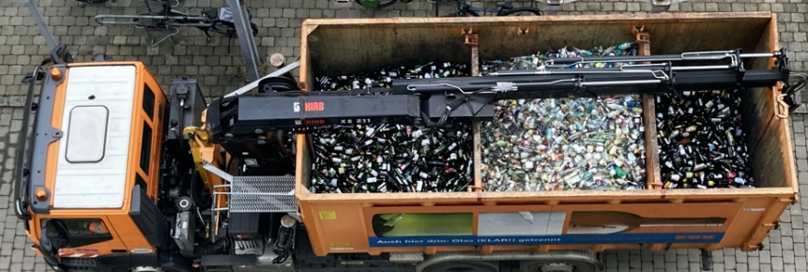
Challenges in Glass Collection
Fédération Européenne des Recycleurs de Verre
European Federation of Glass Recyclers
Collection
as it should be
For separated collection by colour the collection trucks are fitted with separate compartments.
Demonstrate it to the consumer on the side walls of the truck!
www.ferver.eu

Slide 19
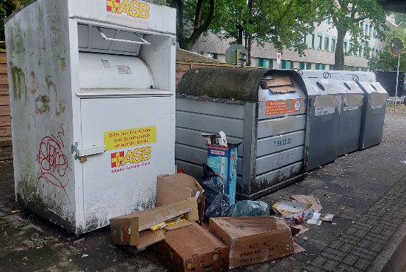
Challenges in Glass Collection
Fédération Européenne des Recycleurs de Verre
European Federation of Glass Recyclers
Collection
as it should not be
One collection point for different materials is often littered
If possible place glass bottle banks separately!
www.ferver.eu

Slide 20
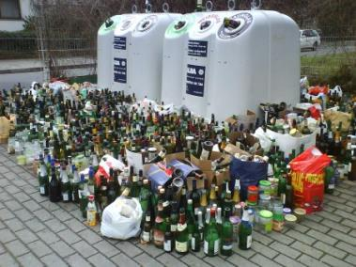
Challenges in Glass Collection
Fédération Européenne des Recycleurs de Verre
European Federation of Glass Recyclers
Collection
as it should not be
Better organisation in logistics
i.e. at
New Year’s Eve
Christmas
Carnival
Special events
www.ferver.eu

Slide 21
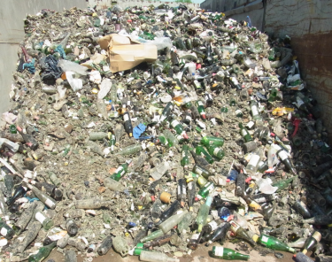
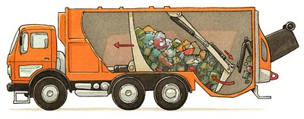
Challenges in Glass Collection
Fédération Européenne des Recycleurs de Verre
European Federation of Glass Recyclers
Collection
how it should not be
Collected and crushed by compaction trucks
www.ferver.eu
Broken glass < 10 mm can only be sorted to a limited extent!
(too small, too many pieces)

Slide 22
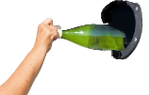
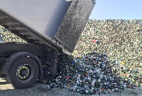

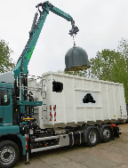
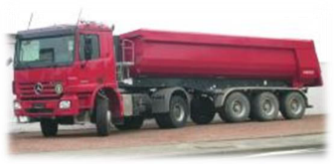

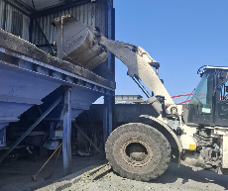

Challenges in Glass Collection
Fédération Européenne des Recycleurs de Verre
European Federation of Glass Recyclers
appr. 400 kg/m³
500 kg/m³
600 kg/m³
700 kg/m³
Each tip over adds appr. + 100 kg/m³
800 kg/m³
900 – 1.000 kg/m³
www.ferver.eu

Slide 23
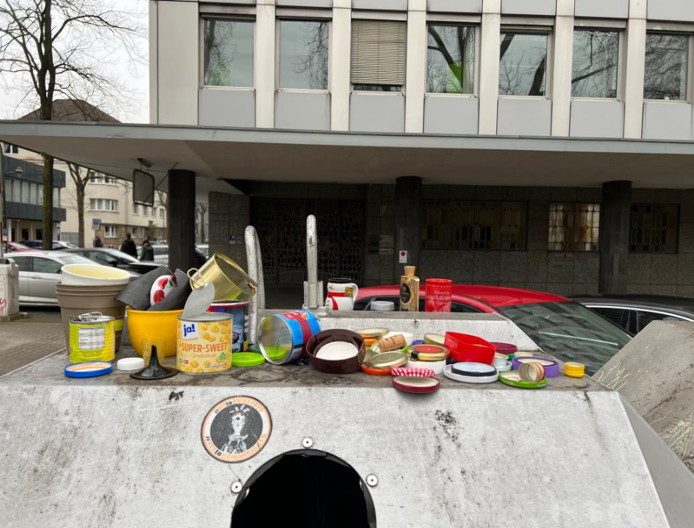
Public Relations
Fédération Européenne des Recycleurs de Verre
European Federation of Glass Recyclers
The consumer meant well but …
Closures of bottles and jars can remain on the glass packaging
« You can leave your cap on! »
in memory of Joe Cocker
www.ferver.eu

Slide 24
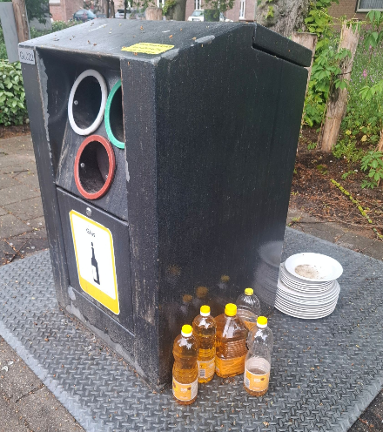
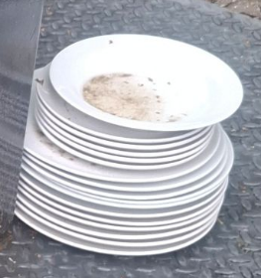
Public Relations
Fédération Européenne des Recycleurs de Verre
European Federation of Glass Recyclers
The consumer meant well but …
www.ferver.eu
17 plates (appr. 10 kg!)

Slide 25

Public Relations
Fédération Européenne des Recycleurs de Verre
European Federation of Glass Recyclers
Use pictograms!
www.ferver.eu

Slide 26
Collection Truck Drivers
Fédération Européenne des Recycleurs de Verre
European Federation of Glass Recyclers
They know their villages and urban areas best! Involve the drivers into the organisation and planning of glass collection.
Introduce (tour) the glass recycling plant and its process, problems and challenges live to the drivers!
When they know about the challenges of glass recycling they will support the quality of the system!
www.ferver.eu

Slide 27

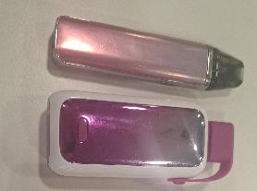
Fédération Européenne des Recycleurs de Verre
European Federation of Glass Recyclers
Modern Challenges: E-cigarettes / vapes
More and more e-cigarettes are found in glass collection mainly in combined collections like glass & metals, round & flat, MRF …)
Batteries / button cells problematic as impurity and fire hazard!
www.ferver.eu
… belongs into electronic waste!

Slide 28
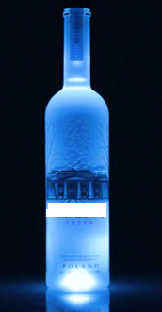
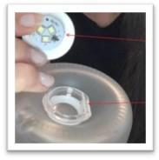

Fédération Européenne des Recycleurs de Verre
European Federation of Glass Recyclers
Modern Challenges: „Illuminators“
Stuck to the bottom of a bottle.
LED module incl. batterie(s) problematic as impurity and
Fire hazard!
Button cells!
www.ferver.eu
… belongs into electronic waste!

Slide 29
Conclusion
Fédération Européenne des Recycleurs de Verre
European Federation of Glass Recyclers
Colour separated collection (fl/gr/am or flint/gramber)
Collection tours planning tailored to the needs
Separate locations just for glass bottle banks
Place bottle banks close to busy or heavily used roads or places (parking …) easy to be reached by car/bicycle …
Don’t choose dark and hiden places for bottle banks!
Clear instructions on bottle banks – easy to understand (use less words, more pictograms)
Public relations (schools …) permanently required
www.ferver.eu

Slide 30
Fédération Européenne des Recycleurs de Verre
European Federation of Glass Recyclers
Everyone has a Responsibility in the Loop!
Packaging Material Designer
Glass Producer
Glass Filler
Retailer
Glass Consumer
Municipality
Legislator
EU + national
EPR Schemes
EU
www.ferver.eu
Glass Collector
Glass Recycler
SUSTAINABILITY means RECYCLABILITY

Slide 31

Fédération Européenne des Recycleurs de Verre
European Federation of Glass Recyclers
www.ferver.eu
www.closetheglassloop.eu

Slide 32
Fédération Européenne des Recycleurs de Verre
European Federation of Glass Recyclers
Many thanks for your attention!
Ulrich Ix
FERVER aisbl
Rue de la Science 23
B-1040 BRUSSELS
Email: info@ferver.eu
www.ferver.eu

Slide 33
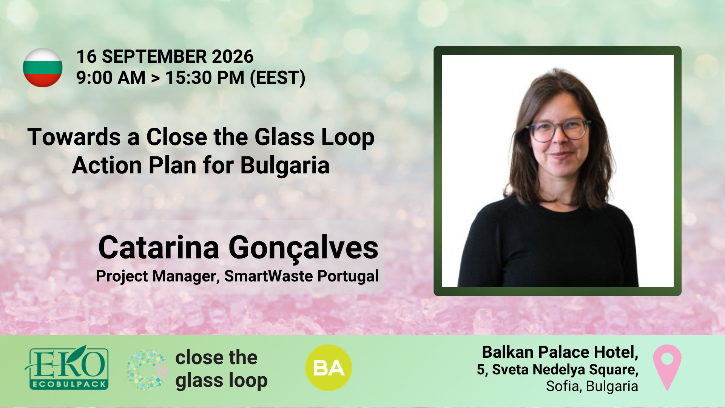

Slide 34

PLATFORM FOR GLASS PACKAGING CIRCULARITY IN PORTUGAL

Slide 35

46
Vidro+ Platform is a collaborative initiative coordinated by Smart Waste Portugal, with the institutional support of FEVE (European Container Glass Federation), launched on 24 May 2022.
Members
Goal
20
90% collection of glass packaging placed on the market for recycling by 2030.
Corporate Members
Institutional Support
26
Institutional Members

Slide 36













































Corporate Members ​
Institutional Members

Slide 37
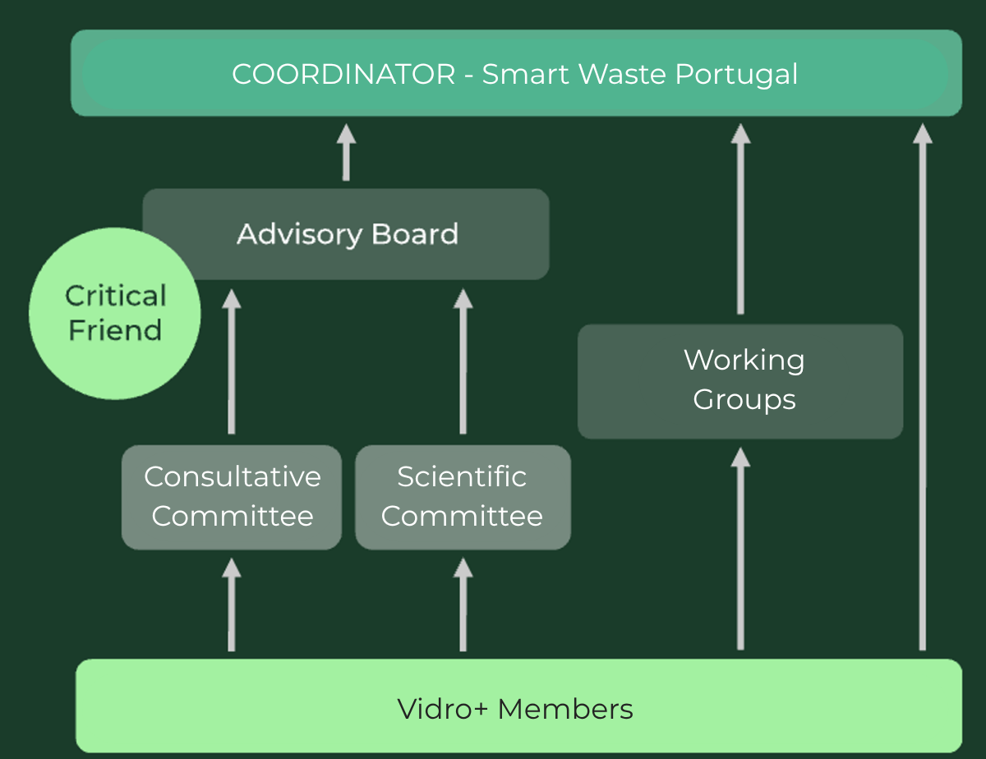
Governance
Advisory Board
Body responsible for overseeing the initiative’s progress
Scientific Committee
Body responsible for ensuring the scientific quality of the deliverables submitted
Consultative Committee
Body comprising sectoral associations that monitor the Platform’s results.
Critical Friend
NGO whose role is to ensure impartiality by providing a perspective independent of economic interests. Member of the Advisory Board
Working Groups
Established with the aim of achieving the initiative’s objectives.

Slide 38
Challenges
1
Prevent or reduce the impact of glass packaging and its waste on the environment.
2
Ensure the functioning of the internal market, with an economic and environmental balance.
3
Give special focus on the glass collections of the HORECA channel
4
Capture the potential of Glass packaging still existing in Municipal Waste Management Systems, associated with households
5
Place a strong emphasis on improving EPR system performance, through a combination of specific measures, financially supported by the stakeholders responsible for the process, as well as by the commitment of Municipal Waste Management Systems and the entire value chain.
6
Promote awareness-raising and education activities, both at the level of the HORECA channel and retailers, as well as consumers, to increase the recycling quality of this packaging material
7
Maximize the use of recycled glass in the production of new glass packaging

Slide 39
GLASS PACKAGING COLLECTION RATE FOR RECYCLING

Slide 40
WHAT ARE WE DOING
TO MOVE THE NEEDLE?

Slide 41

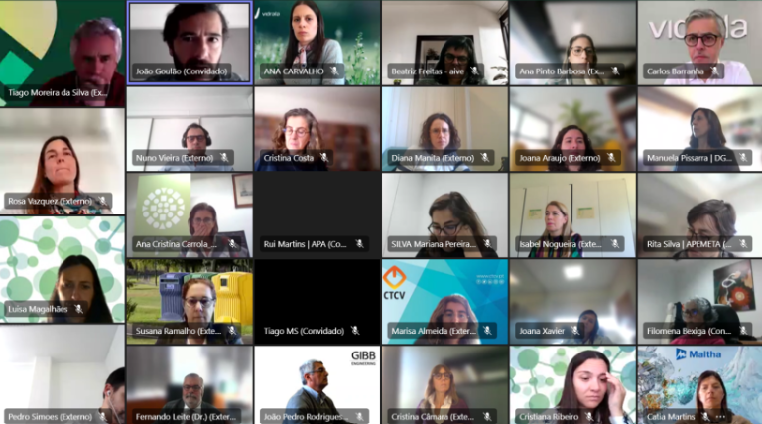
Activities
Media presence
Visits to Members
Annual Event
Newsletters
Meetings
Advisory Board
Consultative and Scientific Committee
Plenary Meetings

Slide 42

ROADMAP 2030
Projects
Finished
  Bottle Banks with lifting help at HORECA Channel
    Sociedade Ponto Verde, AIVE
  HORECA Channel Door-to-Door Extension
    Porto Ambiente
  Assessment of Bottle Bank Coverage Extension
    EGF
  Accounting for Non-Urban Glass Packaging
    Trivalor
  Urban Littering
    Electrão
  Green Flags
    Electrão, AIVE
  Awareness raising campaign
    AIVE, Disneyland Paris
  A Tip for Nature
    AIVE, Editory Hotels, FEVE
  9. Mass balance study of glass
    Vidro+ Platform
  10. Marinha + Vidro
    AIVE, Valorlis (EGF), Municipality of Marinha Grande
  11. Digital Bins Mafra
    Câmara Municipal de Mafra, Sociedade Ponto Verde, AIVE
  12. Awareness raising campaign “Vidrões Temáticos”
    AIVE
  13. Vidrados no Ambiente
    Maiambiente, Electrão
  14. Com o Vidro no Coração
    Valorlis, Sociedade Ponto Verde, Liga Portuguesa contra o Cancro

Slide 43

ROADMAP 2030
Projects
Ongoing
  Recovery of Glass from Mechanical and Biological Treatment (TMB)
    Electrão, BA Glass, Maltha Glass Recycling, AIVE
  Figueira + Vidro
    AIVE, ERSUC (EGF), Municipality of Figueira da Foz
  Mais Vidro, Mais Porto
    Porto Ambiente, Plataforma Vidro+, Super Bock, Sogrape, Fujitsu
  Glass collection improvement in municipalities
    LIPOR, Maiambiente, AIVE, BA Glass, Novo Verde
  Vidrões com Volteador (Bottle banks with lifting support)
    VALORSUL, Mucicipalities of Caldas da Rainha, Nazaré and Peniche)
  6. Vidro a Vidro fazemos o impossível
    ALGAR and Plataforma Vidro+

Slide 44
SOME EXAMPLES

Slide 45
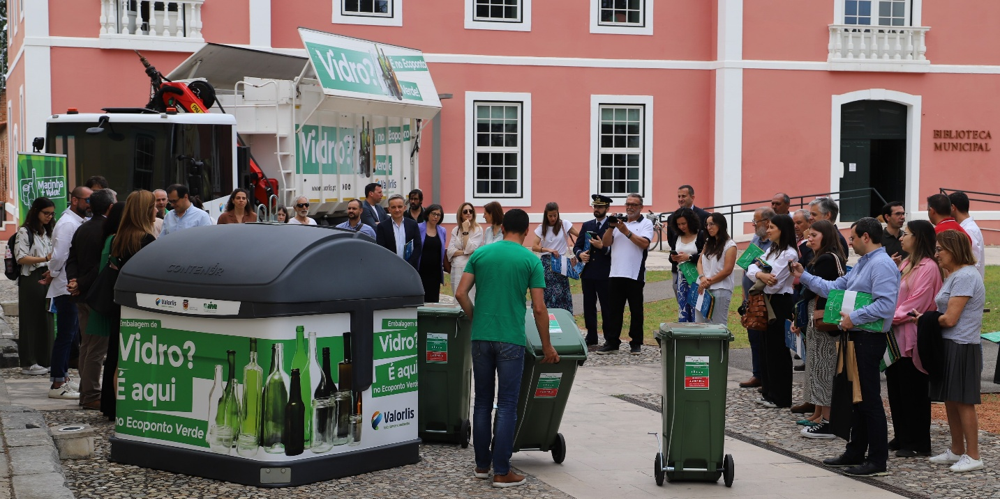



ASSISTED TRANSFER IN HORECA FOR GLASS
Marinha+ Vidro
Implementation: July 2024 – July 2025
Local: 1 municipality (Marinha Grande)
Com o Vidro no Coração
Implementation: Jan 2025 – Jun 2026
Local: 5 municipalities

Slide 46
ASSISTED TRANSFER IN HORECA FOR GLASS
Installed 34 containers with assisted transfer
Marinha+ Vidro
+4% Municipality Recovery (YoY)
+71% Local Recovery (YoY)
11 containers installed
Com o Vidro no Coração
+5% Municipality Recovery (YoY)
+52% Local Recovery (YoY)
23 containers installed

Slide 47
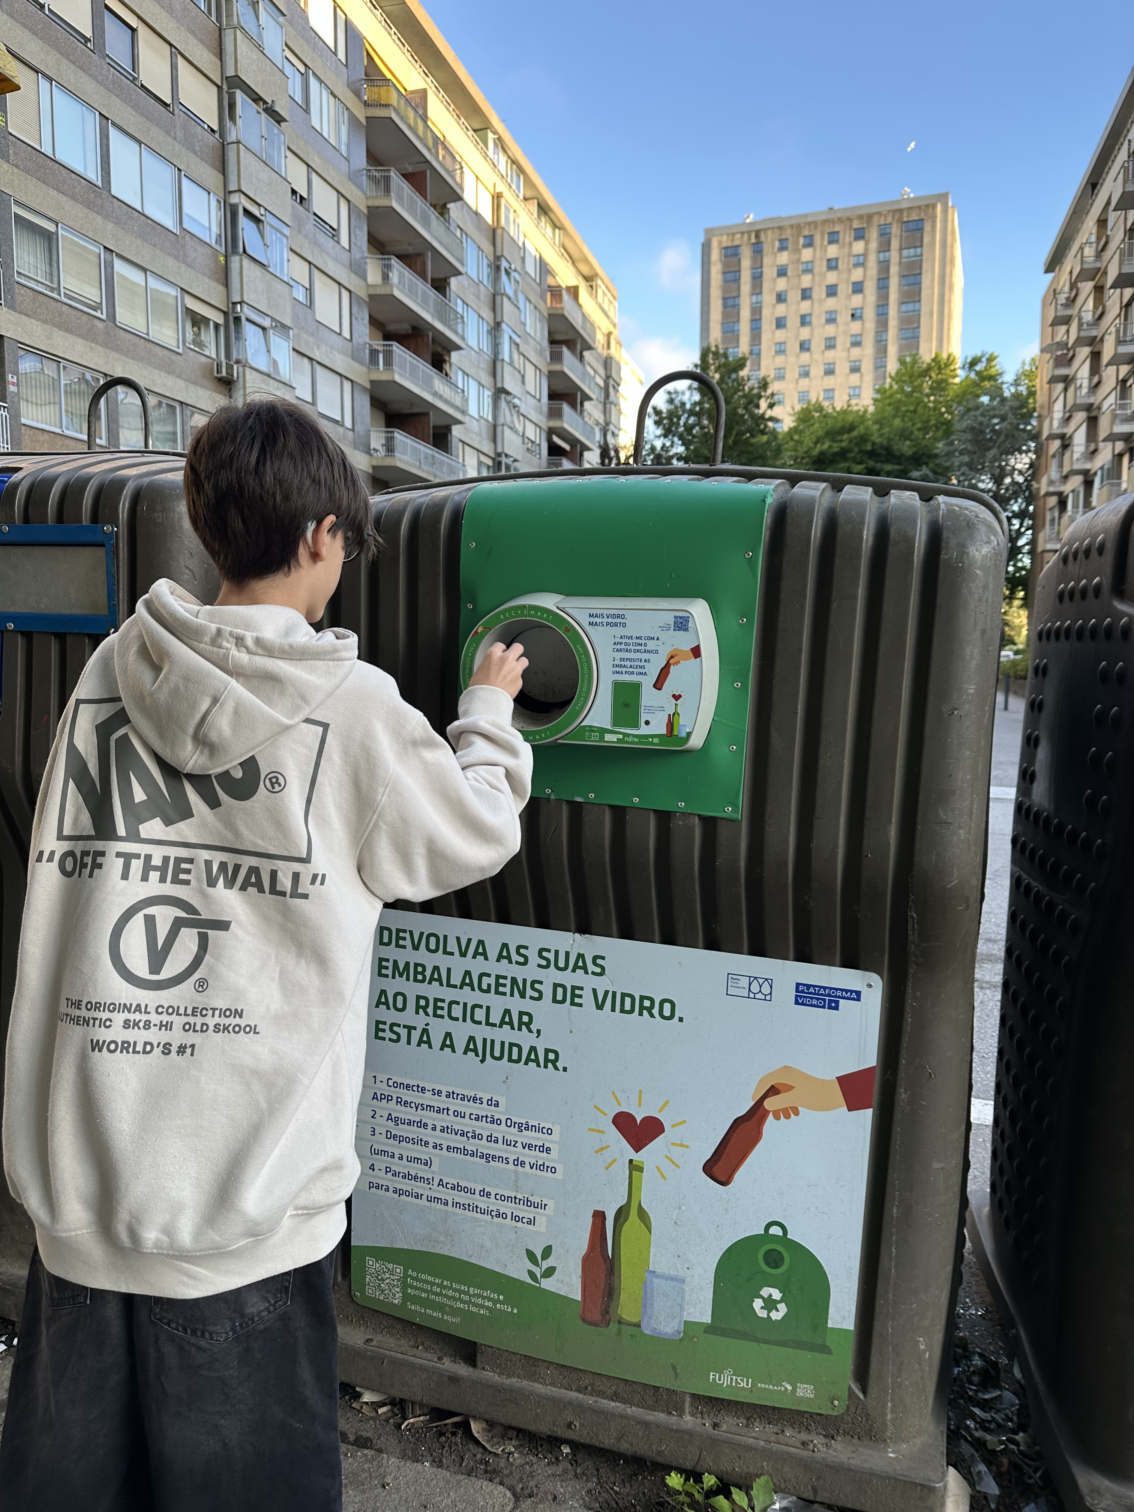
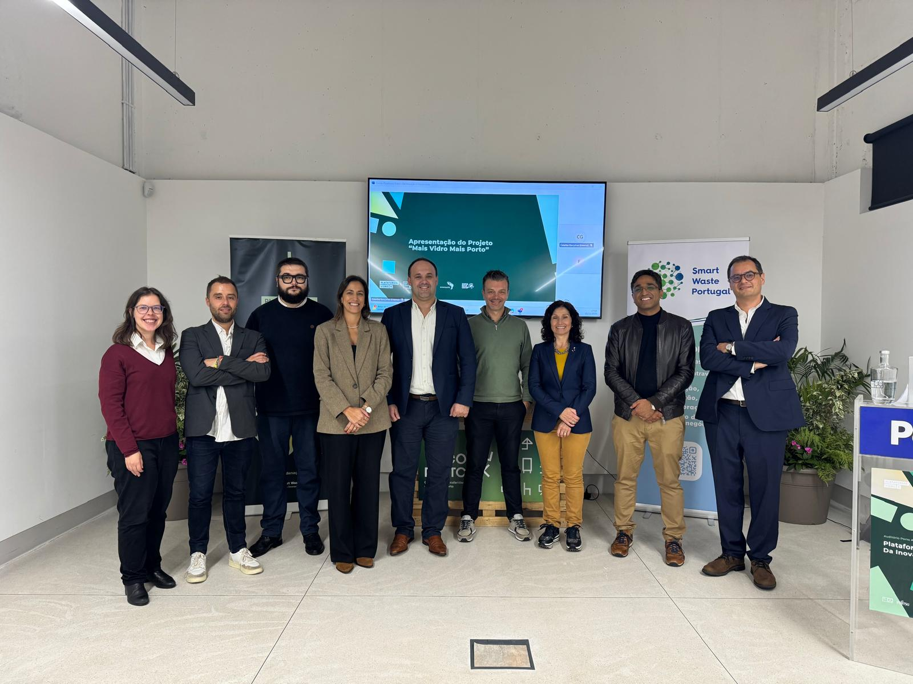
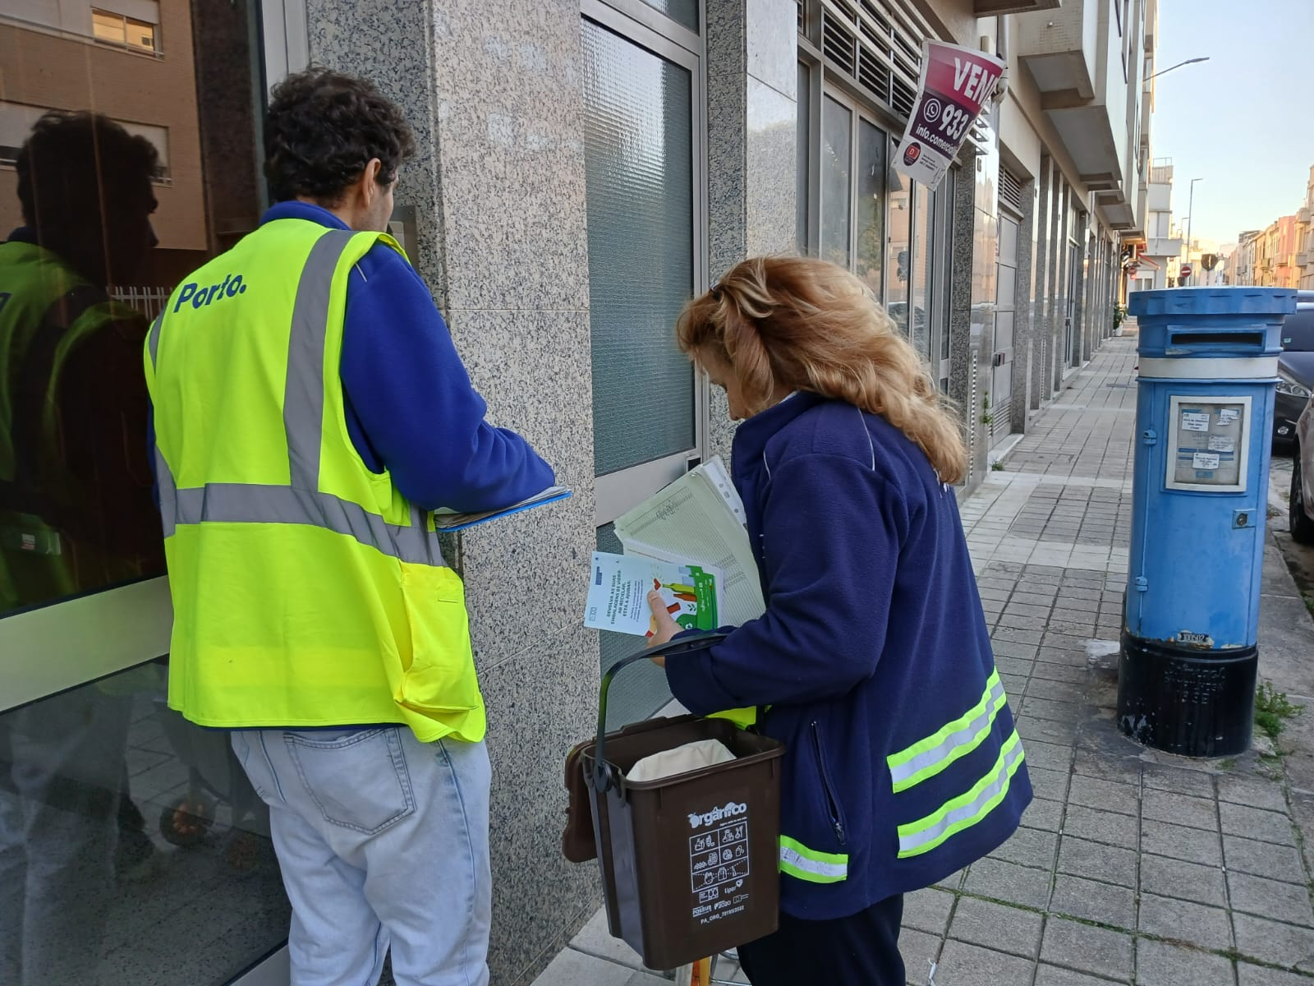

MAIS VIDRO, MAIS PORTO
Goals
  Implement a digital solution across 20 glass
  recycling bins in the Boavista area
  Increase the collection rate for glass packaging
  to 75% in the area under study
Launch
Nov 2025
Door-to-door Campaign
Nov – Mar 2027
Awareness raising campaign
Jun 2027

Slide 48
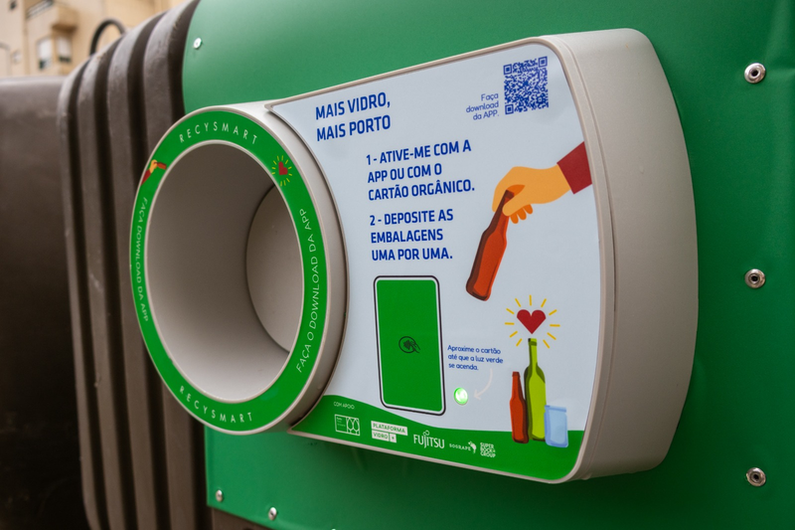

MAIS VIDRO, MAIS PORTO
Results
Next Steps
  190 users
  4 960 glass containers collected
  +6,4t glass containers collected in the circuit (YOY)
Inter-school competition
Oct – Jan 2027

Slide 49
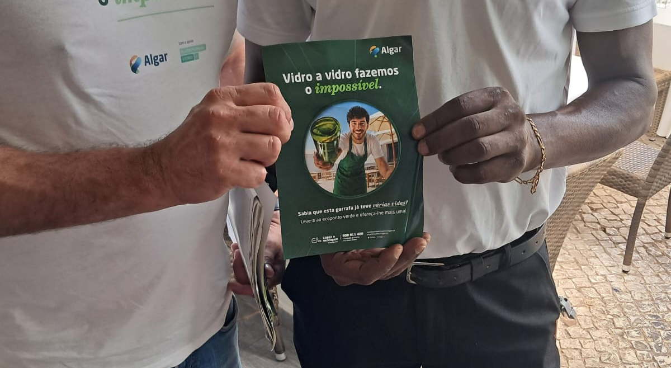

VIDRO A VIDRO FAZEMOS O IMPOSSÍVEL
Partners ALGAR, Vidro+ Platform
Implementation August and September 2026
Local 5 municipalities
Goals
Recruit new participants to ALGAR’s door-to-door
collection service for the HORECA sector;
Recruit new participants to the assisted transfer bins;
Carry out follow-up visits to existing users to raise awareness of the correct separation of recyclable packaging.

Slide 50


BECAUSE TOGETHER AND ORGANIZED WE CAN MAKE IT.
THANK YOU!
vidromais.pt
plataforma-vidromais
vidromais@smartwasteportugal.com

Slide 51


Slide 52






Inspiring case studies
Accelerating growth in
glass collection
September 2026, 16^{th.} Sofia, Bulgaria.

Slide 53
Inspiring case studies: accelerating growth in glass collection
Agenda
02
Digitalisation & IA: Opportunities to increase glass collection
03
Ecobarrios: cases studies
01
Our Goal
04
Marketing mobilisation

Slide 54
Inspiring case studies: accelerating growth in glass collection
01. Our Goal
Ecovidrio is focused on increasing Spain´s recycling rate and importantly separate collection.
Separate Collection target
Our results by 2025
(estimation)
70% by 2025
70% in separate collection
72,3% in recycling
80% by 2030
Separate collection is container collection excluding impurities (2%)
Recycling target
70% by 2025
75% by 2030

Slide 55
02. Digitalisation & AI – Opportunities to increase glass collection
Ecovidrio´s use cases
CGL NPC MEETING #9 - DIGITALISATION & AI / ECOVIDRIO´S USE CASES
Arán
Glass collection predictor
Virtual Avatar: Our digital environmental ambassador designed through artificial intelligence
Leveraging Data and AI to predict municipalities and areas with more potential glass collection growth
Filling forecasting
Collection optimizer
Container filling forecasting
AI model
Glass container collection optimization AI model
4

Slide 56
02. Digitalisation & AI – Opportunities to increase
CGL NPC MEETING #9 - DIGITALISATION & AI / ECOVIDRIO´S USE CASES
glass collection
Aràn
Innovative virtual avatar designed through artificial intelligence to act as an environmental ambassador and promote sustainable practices.
01
02
Ecólatras Platform ambassador
Catalyst for ecological action, encouraging people to participate in projects that seek to improve our
environment in a meaningful way.
Glass recycling divulgation
To show, in an interactive way, the end to end glass recycling process, from collection to transformation into
new glass packaging.
4

Slide 57
02. Digitalisation & AI – Opportunities to increase glass
CGL NPC MEETING #9 - DIGITALISATION & AI / ECOVIDRIO´S USE CASES
collection
Glass collection predictive model
Data
Our ingredients
AI aplication
AI application for
Data modeling
Mathematics algorithm to
Geolocated container
Daily collection per container
predict
+
Demographic
Socioeconomic.
Single use glass packaging put in market
Outcome
Glass collection predictive model
(by census area)
4

Slide 58


02. Digitalisation & AI – Opportunities to increase glass collection
CGL NPC MEETING #9 - DIGITALISATION & AI / ECOVIDRIO´S USE CASES
Container filling forecasting
Container filling forecasting solution based on daily collection data & AI model instead of using volumetric sensors in the containers, which provide:
Municipalities:
Ecovidrio´s
collection service transparency
Ecovidrio:
Input needed for the
collection optimizer
(efficiency)
7

Slide 59

02. Digitalisation & AI – Opportunities to increase glass
CGL NPC MEETING #9 - DIGITALISATION & AI / ECOVIDRIO´S USE CASES
collection
Glass container collection optimizer
Glass container clustering
based on:
Ecovidrio´s strategic plan 25-30 efficiency
COLLECTION GROWTH
(+TN)
+10-15%
Time efficiency
(truck and driver availability)
𝑮𝒍𝒂𝒔𝒔
𝒔𝒕𝒐𝒓𝒂𝒈𝒆
CONTAINERS
PLACEMENT (+ #UNITS)
Similar container filling pace (filling forecasting model)
Fill the collection body truck up to x % of truck´s capacity (i.e.: 20 Tn)
More efficient collection routes to truck´s fillment

Slide 60
Inspiring case studies: accelerating growth in glass collection
03. Ecobarrios. Case studies.
At Ecovidrio we are constantly seeking for new
opportunities
with potential
to increase separate
collection rate
in Spain
01
02
03
Innovative Citizens mobilization
Case study 1 – Vitoria (País Vasco)
Historical and touristic old-city centres
Case study 2 – Elche (Comunidad Valenciana)
Residential areas with individual houses
Case study 3 – Boadilla del Monte (Comunidad de Madrid)
9

Slide 61
03. Ecobarrios. Case study 1: Vitoria (País Vasco)
Inspiring case studies: accelerating growth in glass collection
Innovative Citizens mobilization
THE PROBLEM
Low glass collection compared with similar cities: Our data and tech solutions can identify areas with high potential to increase glass collection by comparing them to similar areas in Spain.
Necessity for more glass bins: There is “blank” spaces on the streets to place more glass bins and ease the
recycling process to the citizen.
Residential areas: Where majority of single-use glass waste is generated by the citizenship in the area
Mobilization channels: House door to door, information points and Digital ultrasegmentation (smart Tv, mobile and DOOH – Digital Out Of Home)
39.000 +700 Tn
CITIZENS IMPACTED
POTENTIAL INCREASE
ANNUAL GLASS COLLECTION
10

Slide 62
03. Ecobarrios. Case study 1: Vitoria (País Vasco)
Inspiring case studies: accelerating growth in glass collection
Residential areas with high potential to increase glass collection
THE SOLUTION
House door-to-door visit
Placement of new glass bins
Information points
Inform about local laws, explaining the importance and need to recycle correctly and reminding where the nearest glass bins
18 new glass bins in order to reduce the distance to recycle.
Installation in central locations with a high number of neighbours where environmental educators provide information and means to facilitate domestic recycling.
11

Slide 63
03. Ecobarrios. Case study 1: Vitoria (País Vasco)
Inspiring case studies: accelerating growth in glass collection
Residential areas with high potential to increase glass collection
THE SOLUTION
Digital Ultra Segmentation
Connected TV advertisement
Digital campaigns for mobile
Street Digital Billboards
(DOOH)
Pre roll advertisement before watching the content
phones
Across all the streets
Only to the people living in the area
12

Slide 64
Inspiring case studies: accelerating growth in glass collection
03. Ecobarrios. Case study 1: Vitoria (País Vasco)
Residential areas with high potential to increase glass collection
THE OUTCOME
Connected TV
Digital Campaigns
House Door-to-Door visit
300.000
270.000
12.000
Impressions
Impressions
Houses were visited
IMPACT OF ALL INITIATIVES
+11,4%
Increase of glass collection
INCREASE
+579 Tn/Year
Achievement 83%
of estimated potential (700 Tn)
Collection per capita
28,25 kg per capita
Previous: 14,86 kg per capita
VARIATION
↑90%

Slide 65
03. Ecobarrios. Case study 2: Elche (Comunidad Valenciana)
Inspiring case studies: accelerating growth in glass collection
Historical and touristic old city centers
THE PROBLEM
Difficulty to place standard glass bins: The collection trucks can´t drive nicely through the narrow, historical and pedestrian streets.
Huge distance to glass bins: The standard bins are in the surroundings of the historic areas, far from both
businesses (Horeca) and residents.
High glass waste generation: Area with a large number of tourists, bars, and restaurants with high
consumption of single-use glass packaching
Visual impact: Historic area rich in monuments, where the aim is to minimize visual impact
130 7.000 200 Tn
BARS AND RESTAURANTS
CITIZENS IMPACTED
POTENTIAL INCREASE
ANNUAL GLASS COLLECTION

Slide 66
03. Ecobarrios. Case study 2: Elche (Comunidad Valenciana)
Inspiring case studies: accelerating growth in glass collection
Historical and touristic old city centers
THE SOLUTION
FOR RESIDENTS (Locals & Tourists)
FOR BARS AND RESTAURANTS
Cover Glass bins
Horeca Door-to-Door glass collection
Alternative to standard bins. Small, aesthetic and functional.
These bins can be collected with small trucks or vans and can easily be placed in the streets
Each business has his own small bin, which is collected at the door of the business several times per week.
The same trucks collect both the cover glass bins and the Horeca´s.

Slide 67
Inspiring case studies: accelerating growth in glass collection
03. Ecobarrios. Case study 2: Elche (Comunidad Valenciana)
Historical and touristic old city centers
THE OUTCOME
Cover Glass bins
Horeca Door-to-Door glass collection
48 Tn
240 Tn
Glass collected per year*
Glass collected per year*
+6,8%
Increase of glass collection
INCREASE
+220 Tn/Year*
Achievement of +110 %
of estimated potential
NEW RATE
55,90 kg per capita and year*
Previous: 24,32 kg per capita
VARIATION
+130%
* Results measured an d estimated after the fir st 6 mon ths of the initiative in the area of action

Slide 68
03. Ecobarrios. Case study 3: Boadilla del Monte
Inspiring case studies: accelerating growth in glass collection
Residential areas with individual houses
THE PROBLEM
Low density population areas: The glass bins are located far away from the homes which does not ease the recycling process.
Different collection per type of waste: Existence of more convenient door-to-door collection systems for other type of waste (organic, paper and non-glass waste packaging) but not for the glass. This situation encourages people to deposit the glass in the incorrect bin.
High glass waste generation: Population living in these areas tend to have higher incomes and to consume more glass packaging products
Private residential areas: Inability to place standard bins, thus collect with usual trucks
11.000 125 Tn
CITIZENS IMPACTED
POTENTIAL INCREASE
ANNUAL GLASS COLLECTION
17

Slide 69
03. Ecobarrios. Case study 3: Boadilla del Monte
Inspiring case studies: accelerating growth in glass collection
Residential areas with individual houses
THE SOLUTION
Cover Glass bins
Drive Through bins
Door-to-Door collection
Alternative to standard bins. Small, aesthetic and functional.
Small bins adapted to cars height so glass can be deposit directly from the driver seat.
Each home has a glass bin which is collected every week.
LOCATED IN PLACES WHERE ALL THE WASTE IS COLLECTED THROUGH SMALL BINS
LOCATED IN THE EXIT BARRIERS OF PRIVATE AREAS
LOCATED IN AREAS WHERE NO OTHER COLLECTION SYSTEM IS POSSIBLE
18

Slide 70
Inspiring case studies: accelerating growth in glass collection
03. Ecobarrios. Case study 3: Boadilla del Monte
Residential areas with individual houses
THE OUTCOME
Cover Glass bins
Drive Through bins
Door-to-Door glass collection
+68%
+18%
+113%
Increase of glass collection*
Increase of glass collection *
Increase of glass collection*
+12,5%
Increase of glass collection
INCREASE
+120 Tn/Year*
Achievement of 96%
of estimated potential
NEW RATE
23,70 kg per capita
Previous: 12,85 kg per capita
VARIATION
↑85%
* Results measured an d estimated after the fir st 6 mon ths of the initiative in the area of action
19

Slide 71
Inspiring case studies: accelerating growth in glass collection
04. Marketing mobilisation
FORMER APPROACH
NEW APPROACH
TARGET AUDIENCE General
population
47 million people
TARGET AUDIENCE
Disengaged
11.6 million people in Spain
Predominantly young people aged 18–34
Middle class
+ 300
campaigns per year
SCOOPE: 4 PRIORITY REGIONS
SCOOPE: NATIONAL
STRATEGY
Brand awarness and overall positioning of the importance of glass recycling
STRATEGY
Disclousure and transparency
Seasonal media campaigns (summer and christmas)
Presence in large consumer events
Providing recycling tools and infrastructure
Social Media
(less) Brand awarness
20

Slide 72
04. Marketing mobilisation
Inspiring case studies: accelerating growth in glass collection
VIDEO
https://youtu.be/6goz81IFMa0?is=PPsUdCc0KP1gXbZ5
21

Slide 73
Inspiring case studies:
accelerating growth in glass collection
ecovidrio.es | Calle Estébanez Calderón, 3– 5 | (+34) 914 118 344
@ecovidrio | (4º planta), 28020, Madrid | (+34) 900 555 700

Slide 75
The Austrian glass collection and recycling system -
Challenges and optimization measures
Eva Koller
Close the Glass Loop
Sofia, 16th September 2026

Slide 76



the value chain in austria
38 %
43 %
5 %
14 %
collection infrastructure
collection
transfer
transportation
(optional)
storage
(optional)
transportation
recycling
Shared use
Collected material
to co-using household systems
Bin collection from
public collection
points
Regional
transfer center
%
Mechanical
Recycling
Household packaging
Bin collection
from small
businesses
Recycling
yards (MRF)

Slide 77
Challenges

Slide 78
Current Challenges
Quantities put into the market are decreasing significantly
Collection quantities are more or less stagnant
Operational partners are demanding higher prices mainly due to increasing labor costs and fuel price
Recycling of coloured glass
unstable
Public interest on separate
collection is declining
Notes:
^^

Slide 79
our measures to cope with this situation

Slide 80
Cost efficiency Measures through the entire value chain
collection infrastructure
collection
transfer
transportation
(optional)
storage
(optional)
transportation
recycling
Shared use
Collected material
to co-using household systems
Bin collection from
public collection
points
Regional
transfer center
%
Mechanical
Recycling
Household packaging
Bin collection
from small
businesses
Recycling
yards (MRF)

Slide 81
Cost efficiency Measures through the entire value chain
collection infrastructure
collection
transfer
transportation
(optional)
storage
(optional)
transportation
recycling
INFRASTRUCTURE
Optimization of the filling level
Low-utilized Containers are being removed and repaired
Containers are moved to other highly frequented and easily accessible locations or used as replacements for old containers
Less investment but the same quality
Shared use
Collected material
to co-using household systems
Bin collection from
public collection
points
Regional
transfer center
%
Mechanical
Recycling
Household packaging
Bin collection
from small
businesses
Recycling
yards (MRF)

Slide 82
Cost efficiency Measures through the entire value chain
collection infrastructure
collection
transfer
transportation
(optional)
storage
(optional)
transportation
recycling
Shared use
Collected material
to co-using household systems
Bin collection from
public collection
points
Regional
transfer center
%
Mechanical
Recycling
Household packaging
Bin collection
from small
businesses
Recycling
yards (MRF)

Slide 83
Cost efficiency Measures through the entire value chain
collection infrastructure
collection
transfer
transportation
(optional)
storage
(optional)
transportation
Collection
Optimization of the collection from small businesses
Cost cutting in operational field
New Tender 2028 with the aim of clear performance indicators
Projects involving digitalisation and tour optimization
  Sensor based measuring of the filling level of bins
  Projects that use long term data concerning the actual collection
Currently no benefits in this case visible, therefore projects on hold
recycling
Shared use
Collected material
to co-using household systems
Bin collection from
public collection
points
Regional
transfer center
%
Mechanical
Recycling
Household packaging
Bin collection
from small
businesses
Recycling
yards (MRF)

Slide 84
Cost efficiency Measures through the entire value chain
collection infrastructure
collection
transfer
transportation
(optional)
storage
(optional)
transportation
recycling
Shared use
Collected material
to co-using household systems
Bin collection from
public collection
points
Regional
transfer center
%
Mechanical
Recycling
Household packaging
Bin collection
from small
businesses
Recycling
yards (MRF)

Slide 85
Cost efficiency Measures through the entire value chain
TRANSPORT AND STORAGE
Optimization of truck transport routes to the recyclers
16% less transport kilometers in 2025 versus 2024
2024: 170 kilometers per delivery
2025: 143 kilometers per delivery
Optimization of rail transports:
  Optimization routes
  Reduction of direct loading from the collection truck to the railway carriage
collection infrastructure
collection
transfer
transportation
(optional)
storage
(optional)
transportation
recycling
Shared use
20 %
Reduction of CO₂ Emissions *)
Collected material
to co-using household systems
Bin collection from
public collection
points
Regional
transfer center
%
Mechanical
Recycling
Household packaging
Bin collection
from small
businesses
Recycling
yards (MRF)
*) including the impacts resulting from the use of a more environmental friendly fuel

Slide 86
Cost efficiency Measures through the entire value chain
collection infrastructure
collection
transfer
transportation
(optional)
storage
(optional)
transportation
recycling
Shared use
Collected material
to co-using household systems
Bin collection from
public collection
points
Regional
transfer center
%
Mechanical
Recycling
Household packaging
Bin collection
from small
businesses
Recycling
yards (MRF)
High costs:
low load weight
carriage not on time

Slide 87
Cost efficiency Measures through the entire value chain
TRANSPORT AND STORAGE
Optimization of truck transport routes to the recyclers
16% less transport kilometers in 2025 versus 2024
2024: 170 kilometers per delivery
2025: 143 kilometers per delivery
Optimization of rail transports:
  Optimization routes
  Reduction of direct loading from the collection truck to the railway carriage
Cost cutting of service costs
Warehouse Management and Delivery „just in time“: Saving storage and loading costs
collection infrastructure
collection
transfer
transportation
(optional)
storage
(optional)
transportation
recycling
Shared use
20 %
Reduction of CO₂ Emissions *)
Collected material
to co-using household systems
Bin collection from
public collection
points
Regional
transfer center
%
Mechanical
Recycling
Household packaging
Bin collection
from small
businesses
Recycling
yards (MRF)

Slide 88
Cost efficiency Measures through the entire value chain
DATA MANAGEMENT SYSTEMS
collection infrastructure
collection
transfer
transportation
(optional)
storage
(optional)
transportation
recycling
Shared use
Collected material
to co-using household systems
Bin collection from
public collection
points
Regional
transfer center
%
Mechanical
Recycling
Household packaging
Bin collection
from small
businesses
Recycling
yards (MRF)

Slide 89
Cost efficiency Measures through the entire value chain
DATA MANAGEMENT SYSTEMS
Digitalization in the field of reporting:
Introduction of automatic interfaces
Introduction of KPIs to enable comparison of service providers and to show them where they can improve their services
APP “Glassfuture”: Overview of the exact container locations and their condition
collection infrastructure
collection
transfer
transportation
(optional)
storage
(optional)
transportation
recycling
Shared use
Collected material
to co-using household systems
Bin collection from
public collection
points
Regional
transfer center
%
Mechanical
Recycling
Household packaging
Bin collection
from small
businesses
Recycling
yards (MRF)

Slide 90
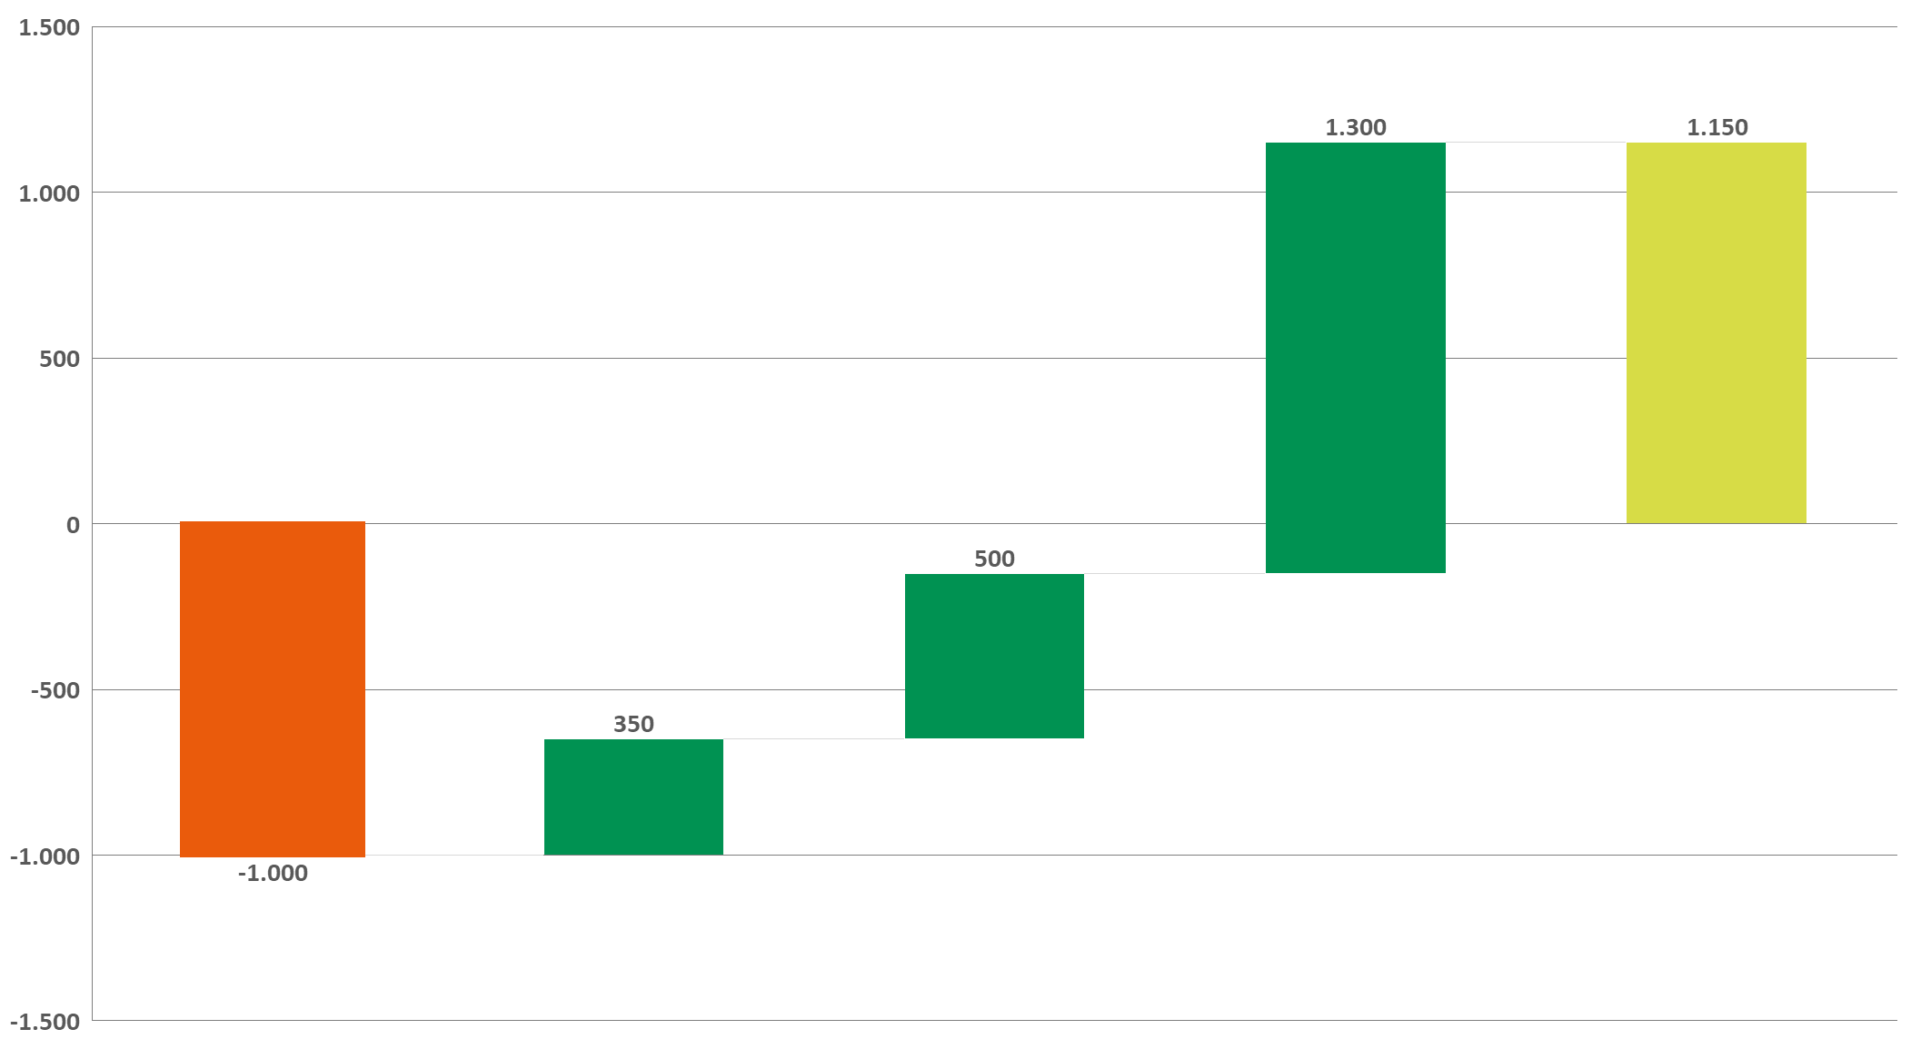

Success is already evident
<T€>
Market/Licensed amount significantly below budget
Less infrastructure costs due to less investments in collection bins because of higher efficiency
Reduction of collection cost due to optimization measures
Reduction of transport- and loading costs due to optimization measures
-19,2%
Despite a sharp decline in revenue, we were able to significantly improve the financial result while maintaining high performance!
-5,1 %
-3,5 %
-3,1 %
1
2
3
4
Result 2025
Budget versus actual result, 2025

Slide 91
Current Challenges
Quantities put into the market are decreasing significantly
Collection quantities are more or less stagnant
Operational partners are demanding higher prices mainly due to increasing labor costs and fuel price
Recycling of coloured glass
unstable
Public interest on separate
collection is declining
Notes:
^^

Slide 92
Engaging every audience through targeted, practical touchpoints
Public interest on separate
collection is declining
  Children and teenagers
    Bobby Bottle
    Experimental lectures
  Adults
    New containers labels and label designs
    Social Media and Print communication
  Via Waste advisors:
    Annual face to face training
    Online Updates
    Extensive information on agr.at
Notes:
^^

Slide 93
Key Success factors for an efficient epr scheme
Strong cooperation with local Authorities:
Close cooperation with municipalities and government stakeholders
Alignment on common objectives
Public Participation:
Citizens must actively participate
Clear and easy-to-use collection system
Efficient
EPR Scheme
Robust Network of Collection and Recycling Partners:
Sufficient number of qualified operators
Reliable and efficient collection infrastructure
Balance between Cost and Convenience:
Cost efficient operations
High convenience for consumers and small businesses

Slide 95
16 SEPTEMBER 2026
9:00 AM > 15:30 PM (EEST)
Towards a Close the Glass Loop Action Plan for Bulgaria
LUNCH BREAK
13:00 – 14:00
Balkan Palace Hotel,
5, Sveta Nedelya Square,
Sofia, Bulgaria

Slide 96
16 SEPTEMBER 2026
9:00 AM > 15:30 PM (EEST)
Towards a Close the Glass Loop Action Plan for Bulgaria
Increasing and Improving Glass Collection and Recycling in Bulgaria – A Close the Glass Loop Action Plan
STAKEHOLDERS PERSPECTIVES
Close the Glass Loop Bulgaria – National context from the EPR schemes
Georgi Slavchev,
Ecobulpack
Glass Packaging Manufacturers
Marco Marques
BA Glass
Municipal Ecology
Nikolay Sidzimov,
Association of Municipal Ecologists in Bulgaria
What is Close the Glass Loop Platform
Balkan Palace Hotel,
5, Sveta Nedelya Square,
Sofia, Bulgaria

Slide 97

Какво е CLOSE THE GLASS LOOP?
Close the Glass Loop е европейската платформа, която обединява участниците по цялата верига на стойността на стъклените опаковки с цел повишаване на количеството и качеството на разделно събиране и рециклиране на стъкло и постигане на 90% разделно събиране с цел рециклиране на стъклени опаковки в ЕС до 2030.
15
Партньори
14
Национални платформи
Close the Glass Loop е активна на европейско и национално ниво, обединявайки 15 европейски асоциации и 14 национални платформи.

Slide 98



ОСНОВНИ ДЕЙНОСТИ
Close the Glass Loop предоставя форум за обмен на добри практики между оператори и експерти, подпомага съвместни проекти и сътрудничество за адресиране на общи предизвикателства в области като комуникации, разделно събиране в общини и Хорека, рециклиране на стъкло в затворен цикъл и тн. Разработва и предоставя професионална информация, анализи, статистика за състоянието на разделното събиране, рециклиране и износ на отпадъци от стъклени опаковки в Европа.
Повишаване на осведомеността
Изследвания и Анализ на данни
Подкрепа за Национални платформи
Пътна карта за оптимизиране на рециклирането на стъкло в затворен цикъл
Принципи за ефективно събиране на стъклени опаковки
90 Minutes to Close the Loop серия от уебинари
    Фонд за национални платформи
Директна подкрепа за национални/ местни инициативи, кампании, събития
Journey Through Sectors секторни видеа
Доклад за резултатите от рециклирането на стъклени опаковки в Европа
Материали за директна употреба
Хорека видео The Sound of Glass
Комуникации и подкрепа за публични комуникации
Статистика за събирането на стъкло за рециклиране в Европа
Проучване на Евростат
Карти и статистика

Slide 99



Какво е Национална платформа?
(Не)формално стружение от национали организации, ангажирани с разделното събиране и рециклиране на стъкло.
Препоръчва се обединяване на цялата верига на стойността
Няма формална процедура по присъединяване
Подкрепа за целта постигане на 90% събираемост на стъклени опаковки за рециклиране в ЕС до 2030 г.
Привлечане на основните организации и оператори, отговорни за разработването на програми и политики за събиране и рециклиране на стъклени опаковки.
Поемане на ангажимент за разработване на национален план за действие
Всяка национална платформа получава напълно безплатен достъп до всички дейности и ресурси; възможност да участва в работни групи, тематични семинари, инициативи; излъчва представител/и в Съвета на националните платформи

Slide 100
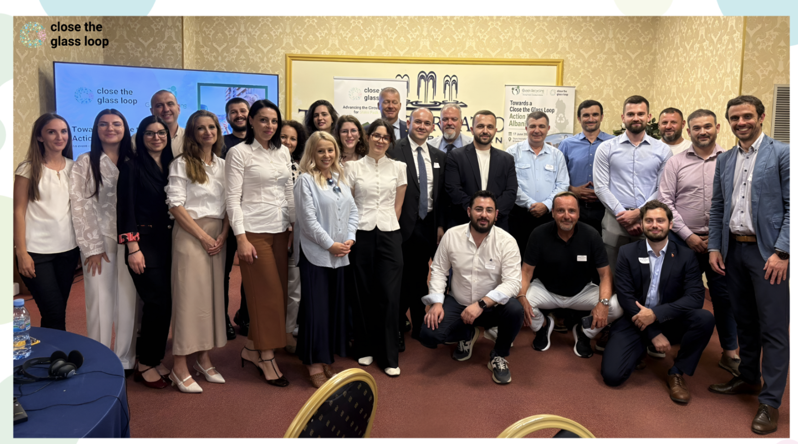
Национални събития
Конференция “Towards a Close the Glass Loop Action Plan for Albania”, юни 2026
Конференция “Towards A Close the Glass Loop Action Plan in Romania”, март 2024
Close the Class Loop подкрепя и организира съвместно с национални партньори национални конференции и семинари за въвличане на всички заинтересовани страни и институции.

Slide 101
  TOWARDS А CLOSE THE GLASS LOOP
  BULGARIA
РАЗДЕЛНО СЪБИРАНЕ и ПРЕДВАРИТЕЛНО ТРЕТИРАНЕ НА ОТПАДЪЦИ ОТ ОПАКОВКИ ОТ СТЪКЛО

Slide 102
ОРГАНИЗАЦИИ ПО ОПОЛЗОТВОРЯВАНЕ
НА ОТПАДЪЦИ ОТ ОПАКОВКИ
В България работят 4 организации по оползотворяване на отпадъци от опаковки
Притежават разрешение от министъра на околната среда и водите да извършват дейност като организации по оползотворяване на отпадъци от опаковки на територията на България
Прилагат модел за разделно събиране с 2 и с 3 контейнера. Опаковките от стъкло се събират в ЗЕЛЕН КОНТЕЙНЕР
Осигуряват събирането на стъклени опаковки като изграждат системи за разделно събиране на отпадъци от опаковки в общините
Имат сключени договори с над 200 общини в България
Обхванати са 6 303 896 жители от цялата страна
Имат сключени договори със събиращи и рециклиращи предприятия
Да запазим България чиста!

Slide 103
ОРГАНИЗАЦИИ ПО ОПОЛЗОТВОРЯВАНЕ
НА ОТПАДЪЦИ ОТ ОПАКОВКИ
РЕЗУЛТАТИ
Да запазим България чиста!

Slide 104
КЛЮЧОВИ НОРМАТИВНИ ИЗИСКВАНИЯ
Броят на контейнерите се определя от Наредбата за опаковките и отпадъците от опаковки
Зависи от броя на регистрираните жители по настоящ адрес
Изчислява се обемът на съдове, които са необходими за обхващане на съответното население в населено място
Местата се определят от кмета на общината, като ООООп преценяват възможността за достъп на обслужващата техника до мястото, както и за процеса на самото обслужване
Контейнерите се обслужват по ГРАФИК
Имат разположени и осигуряват обслужването на повече от 12 000 контейнера за стъклени опаковки в България
Да запазим България чиста!

Slide 105
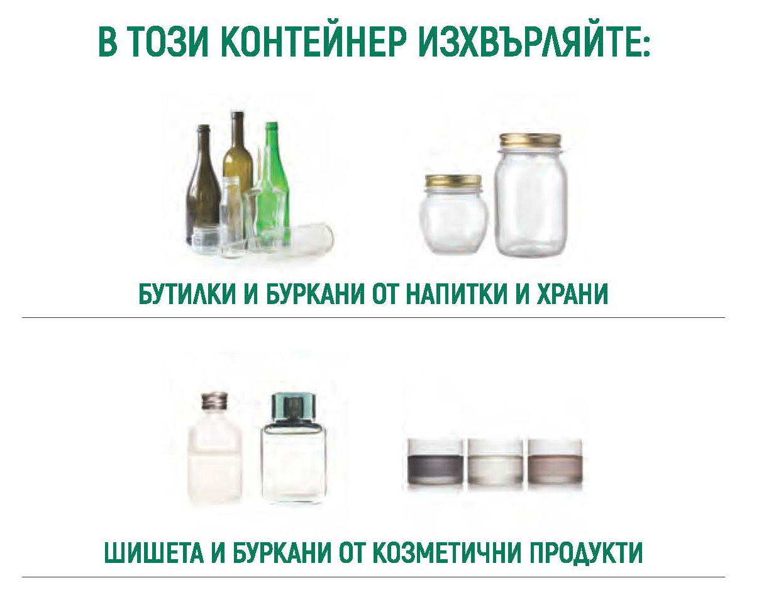

ИЗИСКВАНИЯ ПРИ СЪБИРАНЕ НА
ОПАКОВКИ ОТ СТЪКЛО
САМО
ОПАКОВКИ ОТ СТЪКЛО
Да запазим България чиста!

Slide 106

НАЙ-ЧЕСТО СРЕЩАНИТЕ ЗАМЪРСИТЕЛИ
Стъкло от прозорци или части от такива
Огледала
Керамика и порцелан
Съдове от огнеупорно стъкло
Електрически крушки
Строителни материали
ПРОСТИ ПРАВИЛА:
Стъклените опаковки трябва да бъдат празни /без течности и остатъци от храна/
Ако бутилки и бурканите са силно замърсени или омазнени, може да се изплакнат с вода
Не е необходимо да се отстраняват метални пръстени от гърлата на бутилките, както и етикети
Да запазим България чиста!

Slide 107
СОРТИРАНЕ
НА ОПАКОВКИ ОТ СТЪКЛО
ООООп изпълняват задълженията си по Закона за управление на отпадъците като осигуряват сепариране на стъклените опаковки
Към момента в България има 3 инсталации за сортиране на стъклени опаковки
Автоматично се отделят замърсявания: порцелан, керамика, органика, метал, пластмаса. Автоматично се отделят няколко цвята стъклена трошка
Общините имат задължения да изградят площадки за безвъзмездно предаване на едрогабаритни и други отпадъци
Въвеждането на принципа „замърсителят плаща“ при изчисляването на таксата за битови отпадъци ще допринесе значително за увеличаване на дела на разделно събраните отпадъци, тъй като ще създаде финансов стимул за гражданите да намаляват количеството генерирани отпадъци и да ги разделят за рециклиране
Да запазим България чиста!

Slide 108
БЛАГОДАРЯ ЗА ВНИМАНИЕТО!
Да запазим България чиста!

Slide 109


Slide 110


Slide 111
Thank you for your time to Close The Glass Loop!
info@closetheglassloop.eu

